Slide 1
Integrated Sensing & Database Architecture for White Space Networking
Sumit Roy
Dept. of Electrical Eng.
U. Washington, Seattle
roy@ee.washington.edu
www.ee.washington.edu/research/funlab

Slide 2
uw SPECTRUm OBSERVATORY
INSIGHTS FROM BUILDING AN OPEN SOURCE Spectrum DATABASE FOR TV WHITE SPACE
http://specobs.ee.washington.edu

Slide 3
Main Take-aways
Databases are based on (predictive) propagation models
- these are imperfect at best, and at worst – significantly
inaccurate (urban canyons and indoors, in particular)
  For TVWS, the FCC mandated the use of F-curves for primary
  protection, already we can do better (use Longley-Rice) !
Current Databases leave a lot to be desired in terms of
lack of useful supporting analytics; secondary interference
modeling is missing (FCC rules only focused on primary
protection!)
Hence purely using Databases (as per present FCC) to
estimate availability of White Spaces is inadvisable
→ need to involve local spectrum measurements to
complement Databases!

Slide 4
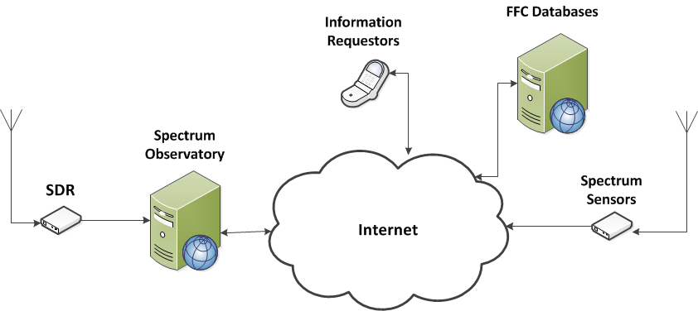
UW Spectrum Observatory Database
- Concept Overview
http://specobs.ee.washington.edu/

Slide 5
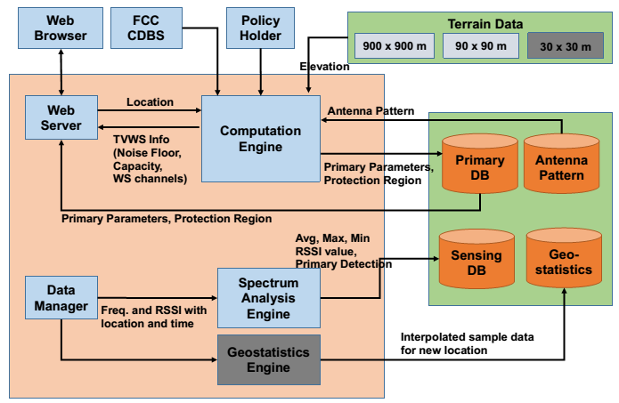
UW SpecObs Architecture

Slide 6
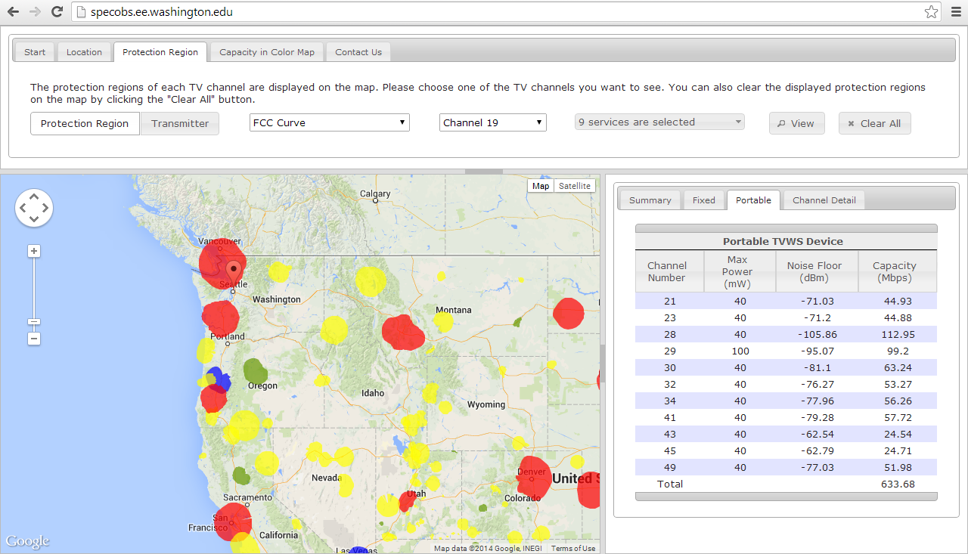
SpecObs Web GUI (Google Maps API)

Slide 7
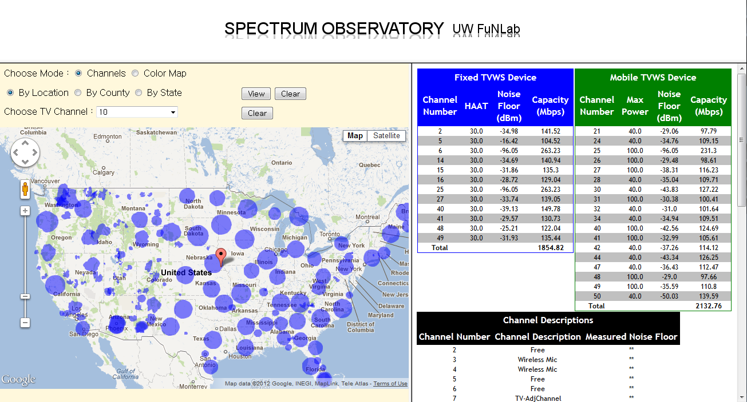
Show TV White Space Data
(Example Data for
latitude : 40.3832, longitude : -96.0511)
Query data by various options
Coverage region of each TV tower for channel 10

Slide 8
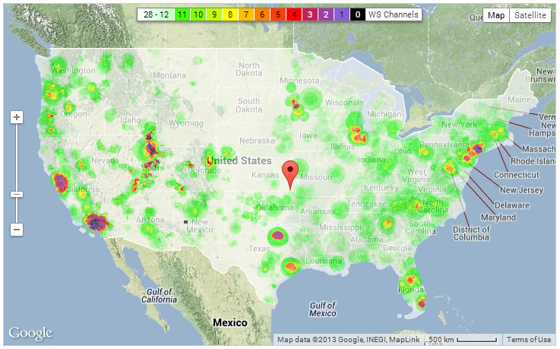
TV White Space Analytics (US)
# of available TVWS channels in the U.S. acc. to location

Slide 9
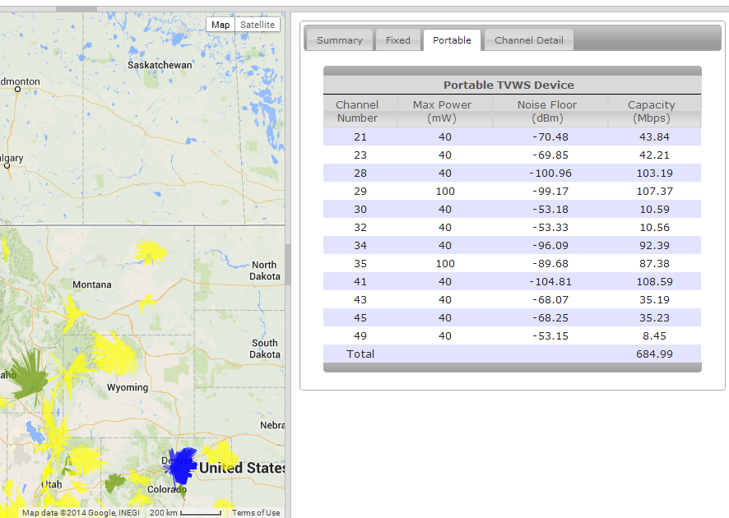
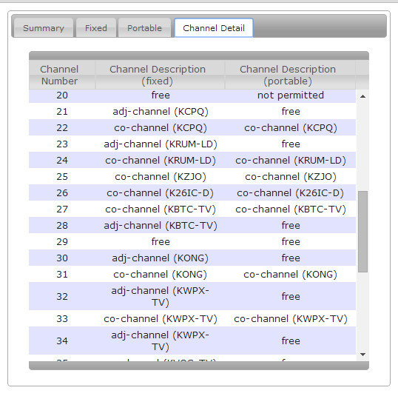
SpecObs Database Functions
Calculates noise floor and capacity based on Longley-Rice P2P mode, for each predicted WS channel
Shows details of each occupied channel

Slide 10

FCC - OET Bulletin 69
  Developed in 1990s for the transition from
  analog to digital
  Determining coverage area
  and interference using two propagation models
  - FCC F-Curves and Longley-Rice model
  Coverage area
    Calculates TV service contours by using F-Curves
  Evaluation of TV service
    Predicts field strength at the receiver location with Longley-Rice model
    Analyzes interference based on predicted field strength
  “Longley-Rice Methodology for Evaluating TV Coverage and Interference”

Slide 11
FCC Method: F-Curve
  F-Curve Functions
    Provide two functions for different outputs - field strength and distance
Input Parameters
Distance (TX and RX)
Channel
Propagation Curve
ERP
TX HAAT
CalcFieldStrength()
Output Parameters
Field Strength (dBuV/m)
Input Parameters
Desired Field Strength
Channel
Propagation Curve
ERP
TX HAAT
CalcDistance()
Output Parameters
Distance (km)

Slide 12
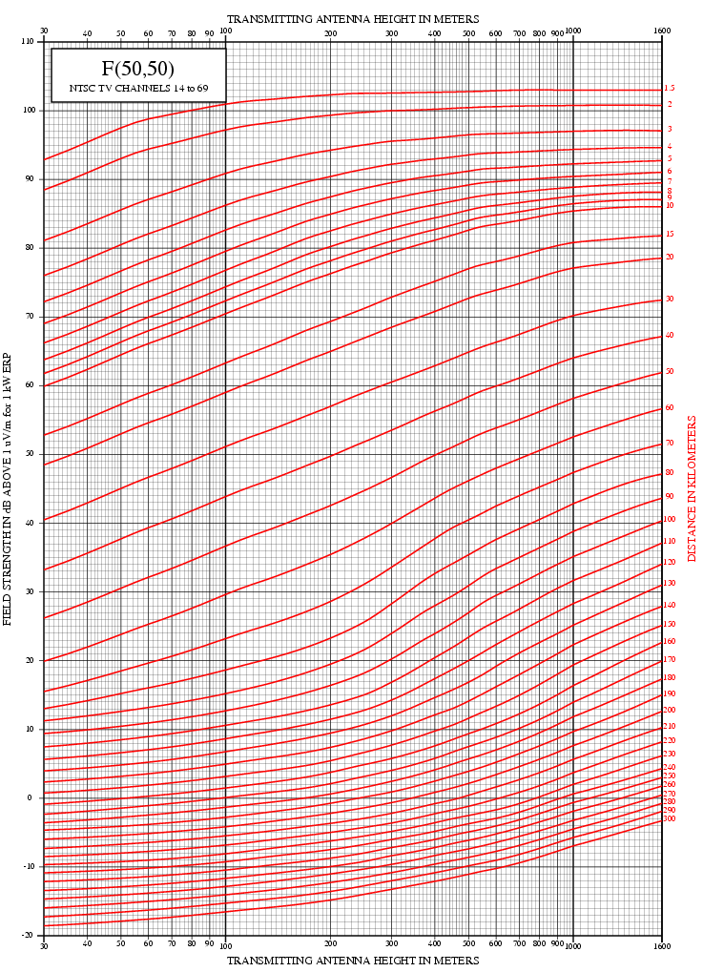
What are F-Curves?
Frequency bands
  Low VHF (channel 2-6)
  High VHF (channel 7-13)
  UHF (channel 14-51)
Time and Location
  F(50, 50)
    50% of Location and 50 % of Time
    Used for Analog TV
  F(50, 90)
    50% of Location and 90 % of Time
    Used for Digital TV

Slide 13
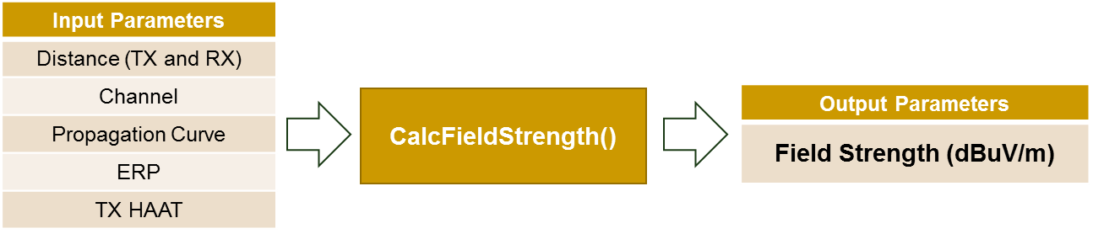
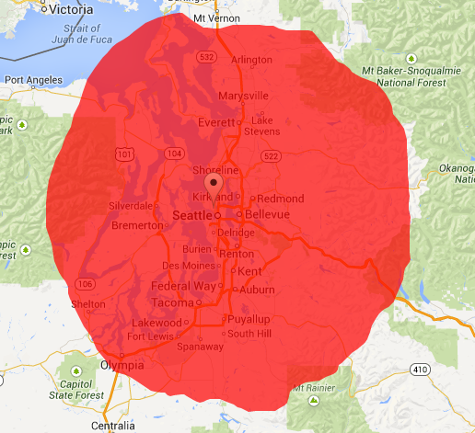
FCC Defined Coverage Area
  TV station’s noise-limited contour
→ Defined with F-Curve and Field Strength Threshold
Coverage Area computed by F-Curve (KIRO-TV in Seattle)
TV Type | Channel 2- 6 | Channel 7 – 13 | Channel 14 - 51
Analog | 47 | 56 | 64
Digital | 28 | 36 | 41
Table 1. Field Strength (dBuV/m) Threshold to define TV coverage

Slide 14


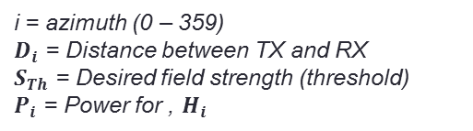
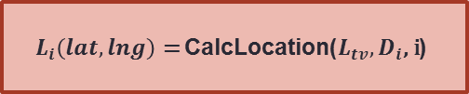


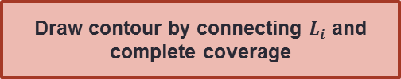

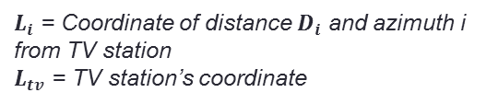






FCC Method: Coverage Area (F-Curve)
$D_{i}$ = CalcDistance($S_{Th}$, $P_{i}$, $H_{i}$, Channel, Curve) for i = [0:359]
$$L_{i}\left(lat,lng\right)\text{ = }\text{Calc}\text{Location}\text{(}L_{tv},D_{i}\text{, }\text{i}\text{)}$$
i = azimuth (0 – 359)
$D_{i}$ = Distance between TX and RX
$S_{Th}$ = Desired field strength (threshold)
$P_{i}$ = Power for , $H_{i}$
$L_{i}$ = Coordinate of distance $D_{i}$ and azimuth i from TV station
$L_{tv}$ = TV station’s coordinate
Draw contour by connecting $L_{i}$ and complete coverage
$$L_{1}$$
$$L_{3}$$
$$L_{1}$$
$$L_{3}$$
$$L_{0}$$
$$L_{0}$$
$$D_{1}$$
$$D_{2}$$
$$D_{1}$$
$$D_{2}$$
$$D_{0}$$
$$D_{0}$$
TV Station
θi
Di
TV Station
TV Station

Slide 15


FCC Method: Issues with F-Curve
Incomplete use of terrain data
  Calculate average terrain elevations (every 100 m) between 3.2 and 16.1 km from the transmitter
  Transmitter HAAT = Antenna Height (AMSL) – Avg. Elevation
  Problem: Only considers nearby elevation (up to 16.1km)
    How about a terrain obstacle at distance > 16.1 km?
    Does not take account into diffraction due to LoS obstruction
TV Transmitter
TV Receiver
3.2 km
16.1 km

Slide 16
Longley-Rice model for Path LOSS PREDICTION
IRREGULAR TERRAIN MODEL
Statistical/semi-empirical model
- includes terrain specific inputs
- Empirically weights loss components from knife
edge diffraction with those from multipath propagation
Adopted as a standard by the NTIA
  Wide range of applicability: 20 MHz- 40 GHz;
upto 2000 Km
low & high altitude scenarios
Many software implementations available commercially
Includes most relevant propagation modes
  multiple knife & rounded edge diffraction (irregular terrain),
  atmospheric attenuation, tropospheric propagation

Slide 17
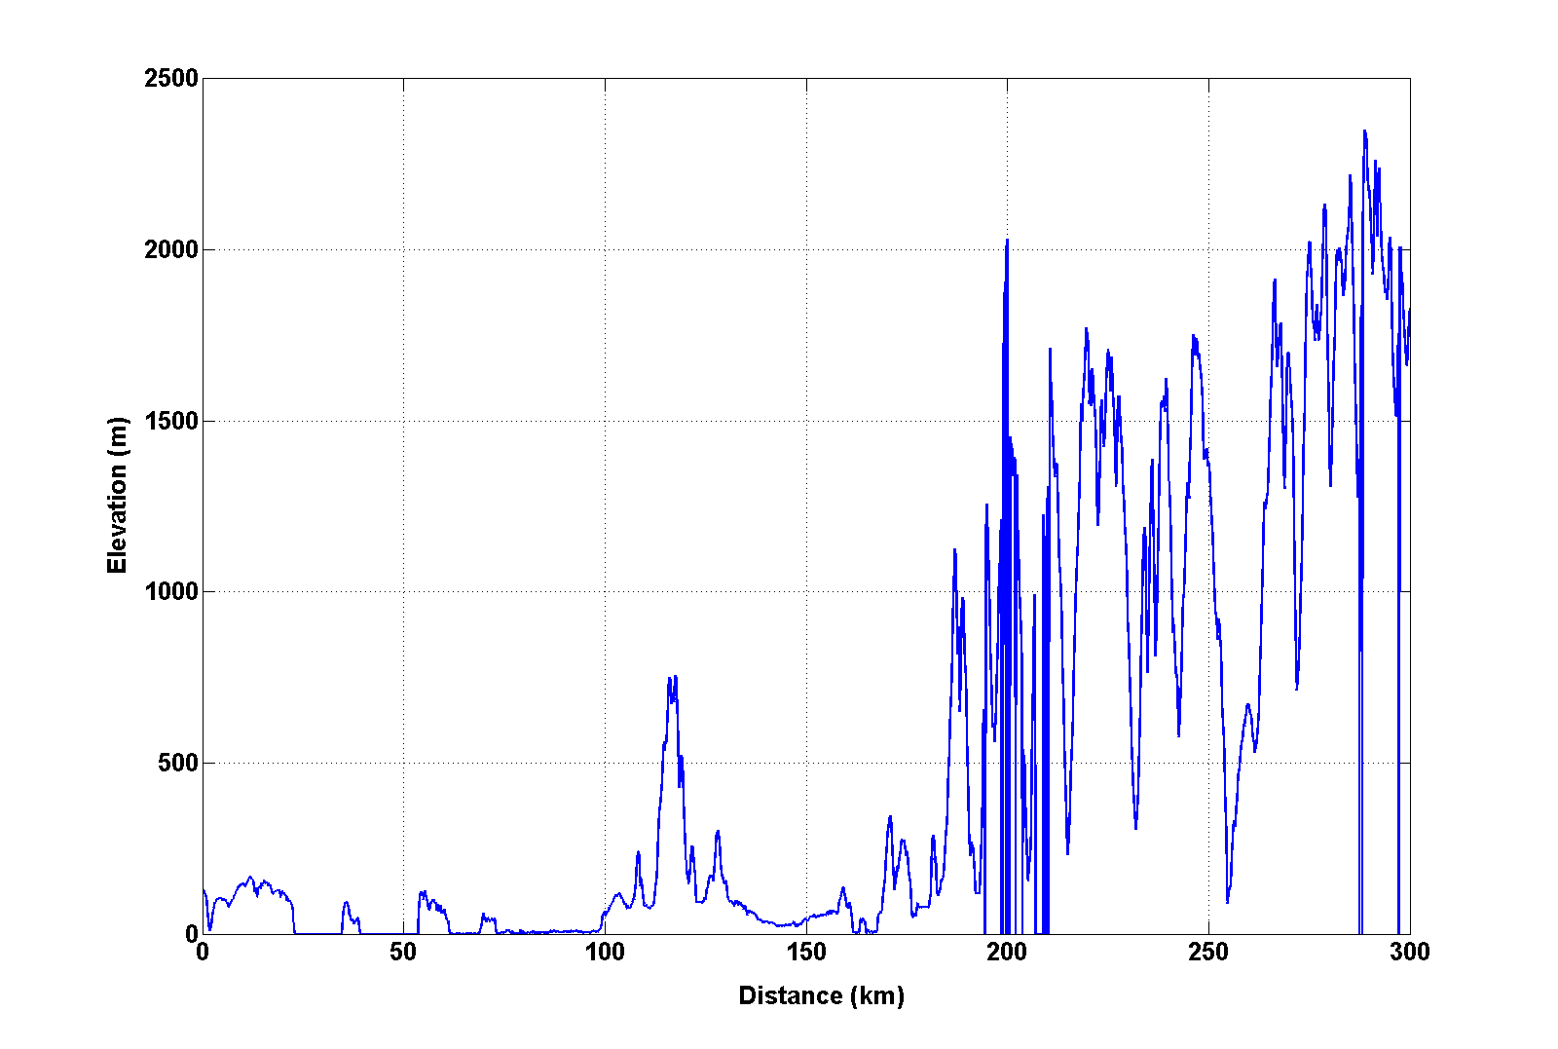
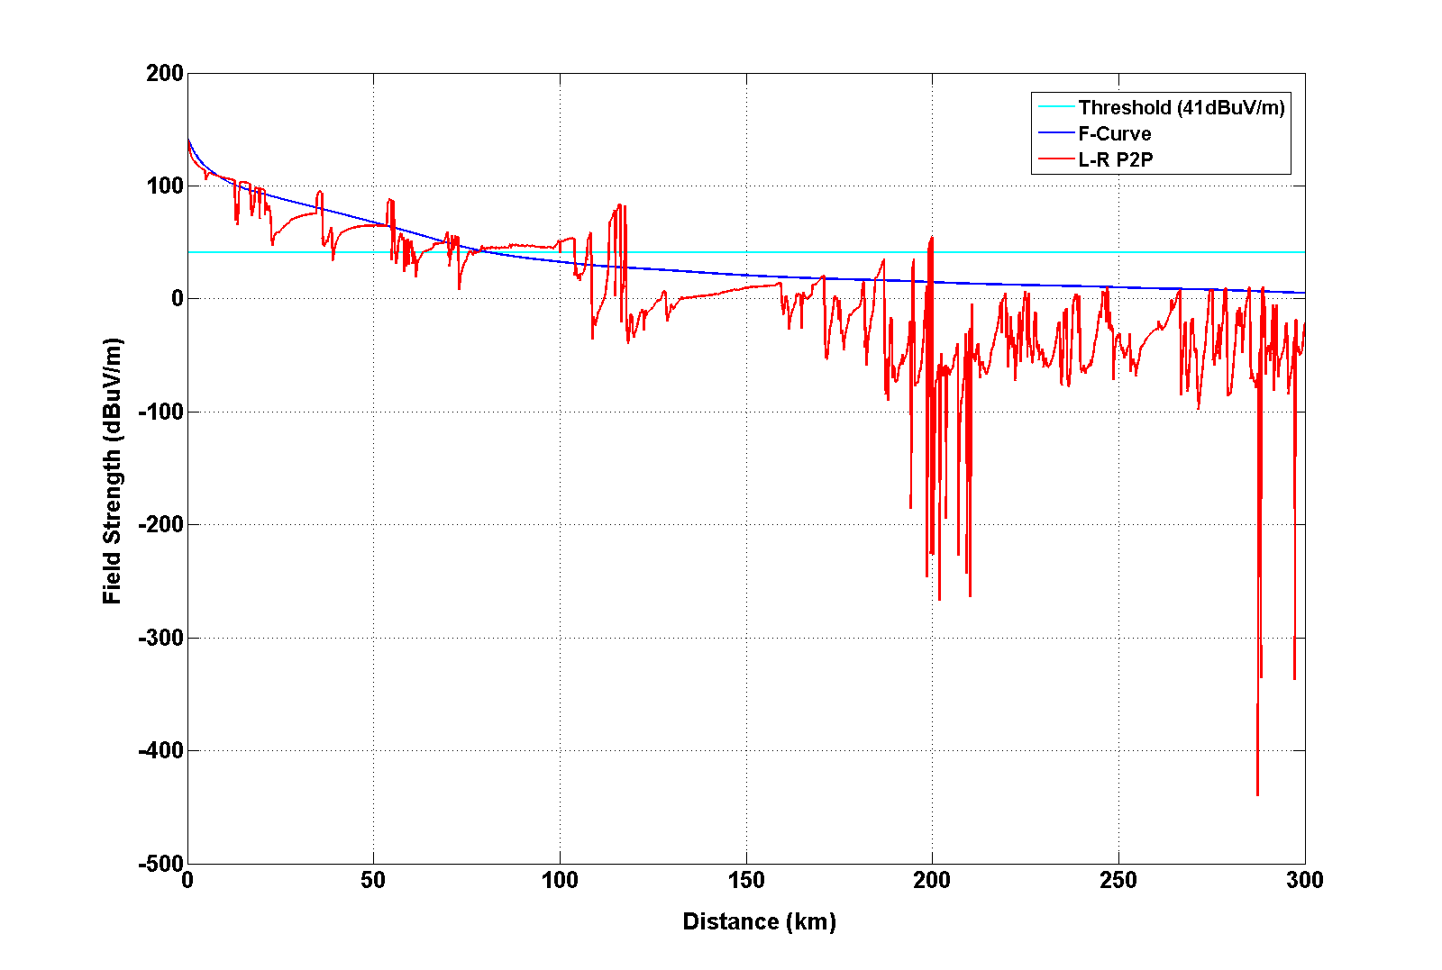
Longley-Rice Model
L-R P2P mode
  Input – Elevation values every 100 m between TX and RX used
  Output – Field Strength (dBuV/m)
  Accounts for LOS, diffraction, multipath effects from irregular terrain
  The figures show impact of terrain elevation
Elevation of azimuth 0 degree (KIRO-TV)
Field strength of azimuth 0 degree (KIRO-TV)

Slide 18
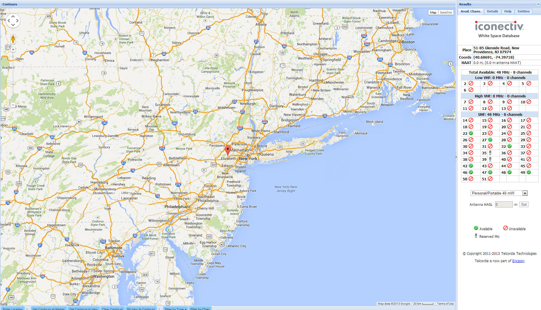
Iconectiv(Telcordia) prism.telcordia.com/tvws/main/index.shtml
The location (40.68691, -74.39718), Portable TVBDs (40 mW)
WS Channel Result [22,27,32,42,46,47,48,49]

Slide 19
Experimental Results (Bell Labs, NJ)
Sensed TV Spectrum during 15 hours (7:00 PM – 10:00 AM)
Scan every minute for 30 seconds
Location {Lat : 40.68691, Long : -74.39718} inside a lab
Portable Device Channel [21-51] except 37
Ranking with Average RSSI for the experiment time, Red : WS Channels from official DBAs
Rank | Channel | Avg RSSI (dBm) | Rank | Channel | Avg RSSI (dBm) | Rank | Channel | Avg RSSI (dBm)
1 | 22 | -118.9723 | 11 | 33 | -111.2699 | 21 | 39 | -108.1211
2 | 21 | -118.6064 | 12 | 36 | -111.2457 | 22 | 48 | -107.5307
3 | 23 | -115.1224 | 13 | 25 | -111.0240 | 23 | 30 | -107.3896
4 | 38 | -113.6022 | 14 | 27 | -110.4862 | 24 | 45 | -106.9321
5 | 26 | -112.3652 | 15 | 41 | -110.4683 | 25 | 47 | -106.8143
6 | 24 | -112.1441 | 16 | 32 | -110.4371 | 26 | 44 | -106.5032
7 | 34 | -112.0327 | 17 | 43 | -110.3331 | 27 | 46 | -106.2404
8 | 31 | -111.8473 | 18 | 40 | -110.2666 | 28 | 28 | -106.1710
9 | 49 | -111.5402 | 19 | 50 | -109.8531 | 29 | 29 | -99.6048
10 | 42 | -111.4835 | 20 | 35 | -109.2027 | 30 | 51 | -94.4028

Slide 20
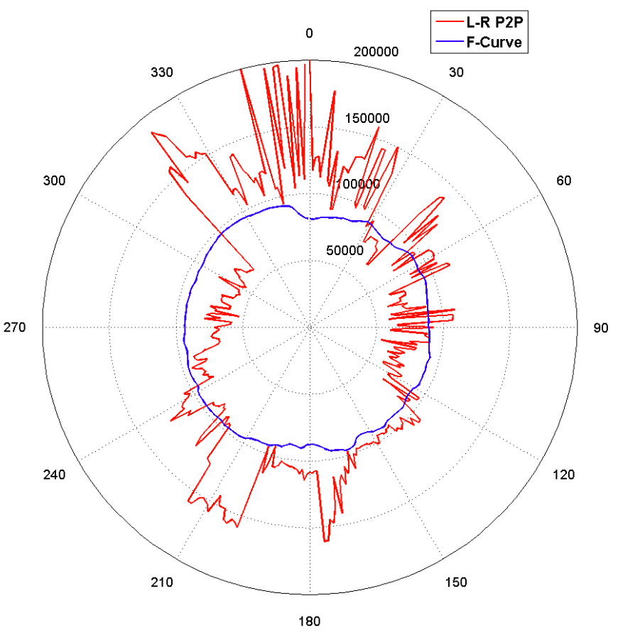
Coverage Area with Longley-Rice
  Method
    Calculate the maximum distance to threshold (i.e. field consistently < threshold thereafter) for each azimuth
    Connect max. points over azimuth to obtain coverage perimeter
  Note on result
    Typically very irregular coverage perimeter but also provides over-optimistic service area.
Example of L-R Coverage
(Digital Full Power TV,
Call Sign: KIRO-TV, Channel: 39)

Slide 21
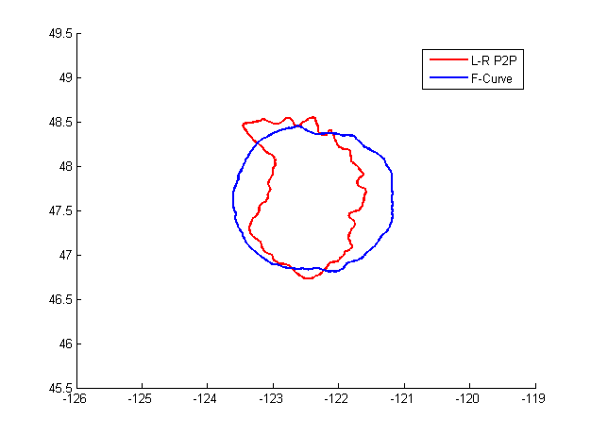
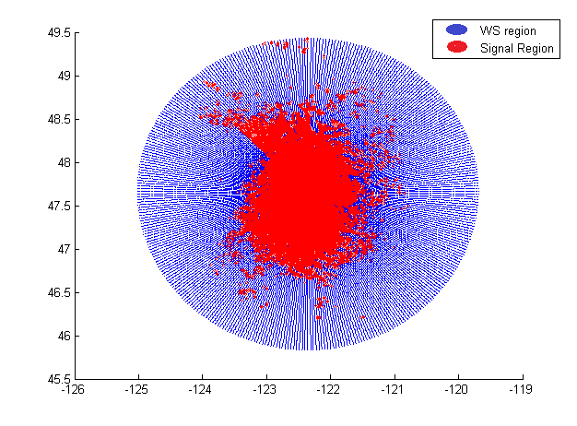
Coverage Area: L-R P2P + Classification
Incorporate classification algorithm
  Calculate field strength at dense points around transmitters with L-R P2P mode
  Use K-NN algorithm to classify points as WS or within service area
Estimation of L-R field strength
(KIRO-TV)
Comparison of coverage (KIRO-TV)
L-R P2P Vs F-Curve

Slide 22
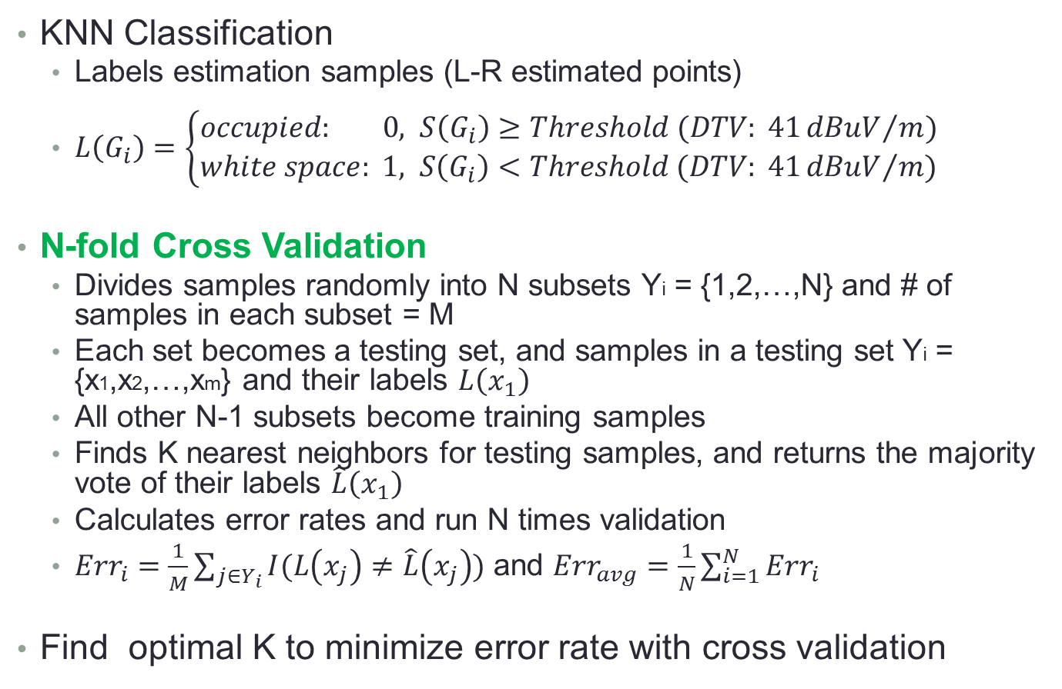
K-NN Classification and Validation
KNN Classification
  Labels estimation samples (L-R estimated points)
  $L\left(G_{i}\right)=\left\{\begin{aligned}occupied: 0, S\left(G_{i}\right)≥Threshold (DTV: 41{dBuV}/m) \\ white space: 1, S\left(G_{i}\right)<Threshold (DTV: 41{dBuV}/m)\end{aligned}\right.$
N-fold Cross Validation
  Divides samples randomly into N subsets Yi = {1,2,…,N} and # of samples in each subset = M
  Each set becomes a testing set, and samples in a testing set Yi = {x1,x2,…,xm} and their labels $L\left(x_{1}\right)$
  All other N-1 subsets become training samples
  Finds K nearest neighbors for testing samples, and returns the majority vote of their labels $\hat{L}\left(x_{1}\right)$
  Calculates error rates and run N times validation
  ${Err}_{i}=\frac{1}{M}\sum_{j∈Y_{i}}{I(L\left(x_{j}\right)≠\hat{L}\left(x_{j}\right))}$ and ${Err}_{avg}=\frac{1}{N}\sum_{i=1}^{N}{{Err}_{i}}$
Find optimal K to minimize error rate with cross validation

Slide 23
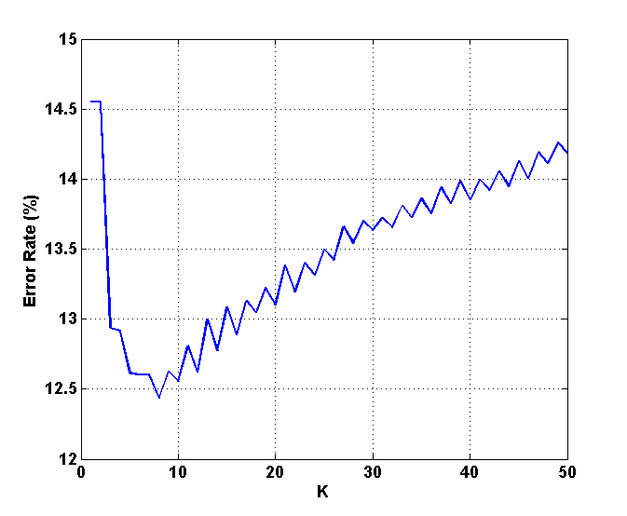
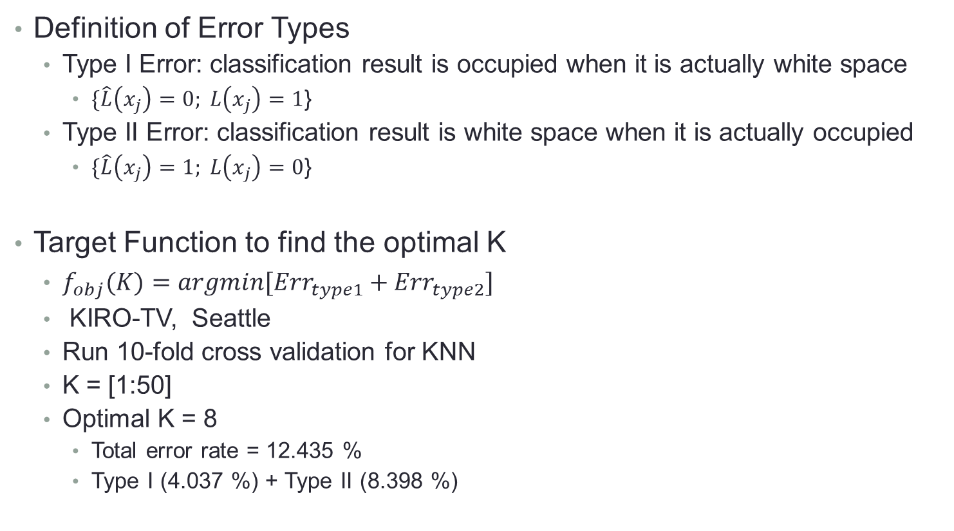
KNN Classification
Definition of Error Types
  Type I Error: classification result is occupied when it is actually white space
    $\{\hat{L}\left(x_{j}\right)=0; L\left(x_{j}\right)=1$}
  Type II Error: classification result is white space when it is actually occupied
    $\{\hat{L}\left(x_{j}\right)=1; L\left(x_{j}\right)=0$}
Target Function to find the optimal K
  $f_{obj}(K)=argmin[{Err}_{type1}+{Err}_{type2}]$
  KIRO-TV, Seattle
  Run 10-fold cross validation for KNN
  K = [1:50]
  Optimal K = 8
    Total error rate = 12.435 %
    Type I (4.037 %) + Type II (8.398 %)

Slide 24
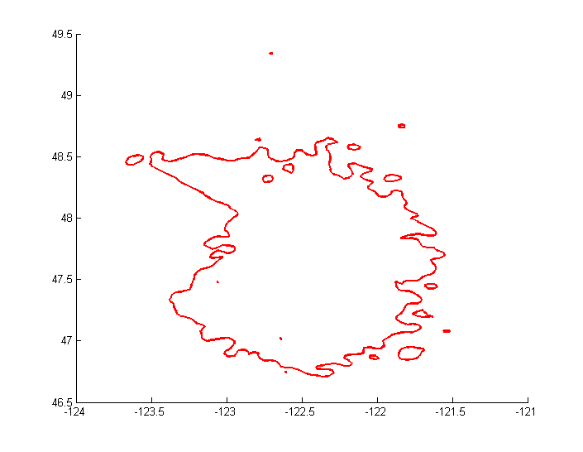
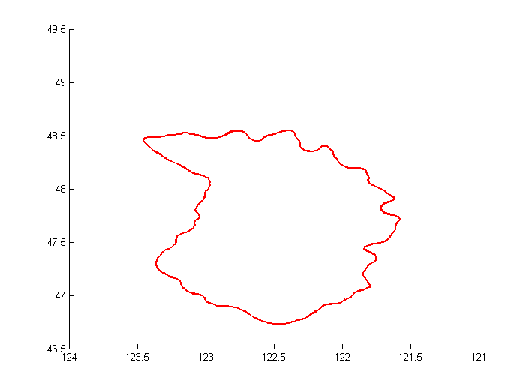
K-NN Classification: choice of K?
  Large K: Draw one coverage, but higher prob. of miss classification
  Optimal K (relatively small): Create many holes, but optimum for miss classification
L-R coverage (K = 8)
Optimal K
Total error rate = 12.435 %
Type 1 (4.037 %) + Type 2 (8.398 %)
L-R coverage (K = 113)
The smallest K to get one coverage
Total error rate = 15.086 %
Type 1 (4.573 %) + Type 2 (10.513 %)

Slide 25

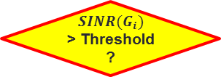





Coverage Area Prediction: SINR based
  Consider interference from other TV transmitters
  Determine service reception based on SINR threshold
  Use Longley-Rice P2P mode to calculate signal strength
Calculate $S_{D}(G_{i})$
for each Cell
Calculate $S_{U}\left(G_{i}\right)$
for each Cell
Calculate SINR($G_{i}$)
$SINR(G_{i})$
> Threshold ?
N = kTB = -106 dBm/6MHz
- Desired station (D)
- Undesired station (U)
Yes
No
Service Cell
No-service
Cell
$$Undesired Station U$$
$$Grid Cell{ G}_{i}$$
Run KNN classification
Determine Boundary
$$Desired Station D$$

Slide 26
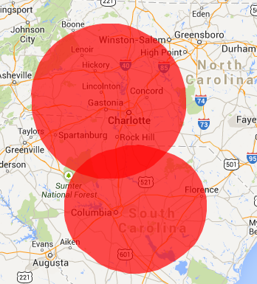
Example
Evaluation of the coverage computed with F-Curve
  Two nearby DTV stations operating in co-channel (channel 39)
  Their TV coverages are partially overlapped
  High possibility of co-channel interference
Coverage area for WMYT-TV and WKTC (F-Curve)
Desired Station
Channel: 39
Call sign: WMYT-TV
Service type: DT
ERP: 225.0 kW
HAAT: 571.0 m
Antenna Type: ND
Coordinate:
35.36222,-81.15528
Undesired Station
Channel: 39
Call sign: WKTC
Service type: DT
ERP: 500.0 kW
HAAT: 391.0 m
Antenna Type: DA
Coordinate:
34.11611,-80.76417

Slide 27
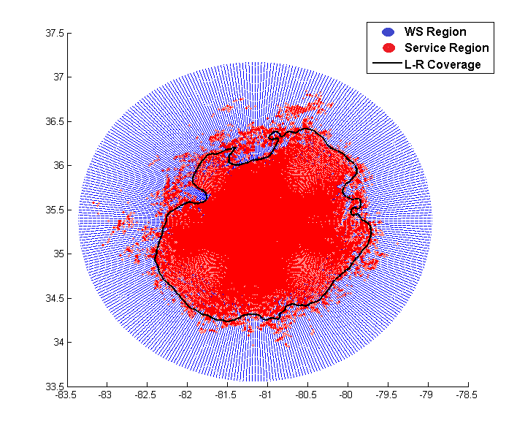
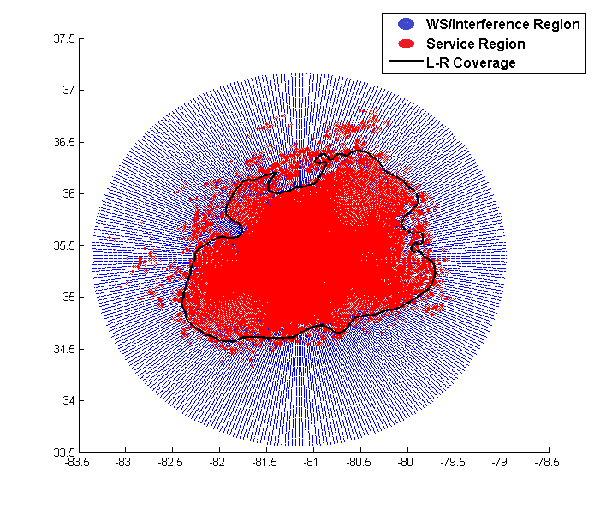
Results (Our Approach)
Result of TV Coverage (WMYT-TV)
  Calculates SNR-based coverage and SINR-based coverage
  Run KNN algorithm to compute a closed-loop coverage
  SINR-based coverage loses some service regions of WMYT-TV due to interference from WKTC
WMYT-TV service region and coverage based on SNR threshold (16 dB) and K = 250
Total error rate = 15.376 %
Type 1 (8.218 %) + Type 2 (7.158 %)
WMYT-TV service region and coverage based on SINR threshold (15.16 dB) and K = 250
Total error rate = 13.916 %
Type 1 (6.491 %) + Type 2 (7.425 %)

Slide 28
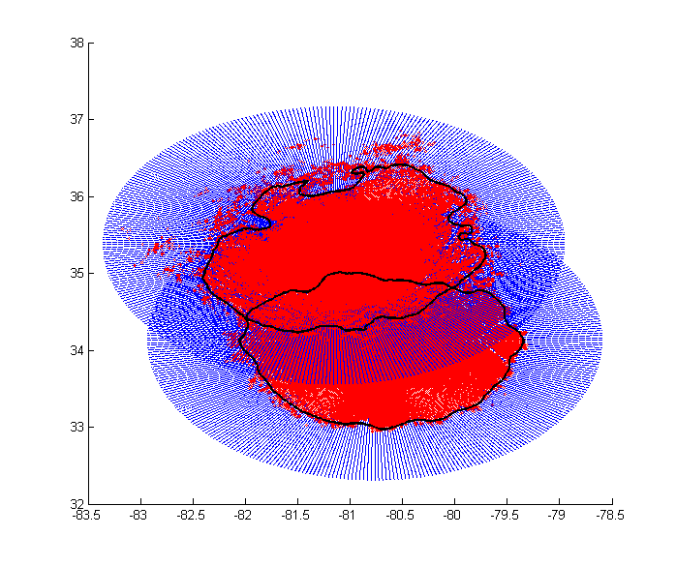
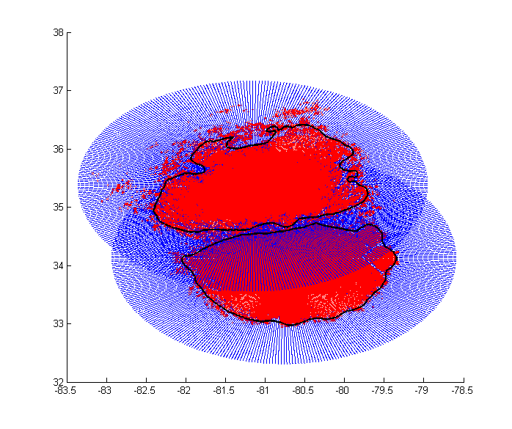
Results (Our Approach)
Comparison of TV Coverage
  SINR-based coverage of two stations are distinct
  Our approach shows better estimation of coverage
SNR-based Coverage comparison
for WMYT-TV and WKTC
SINR-based Coverage comparison
for WMYT-TV and WKTC

Slide 29
Towards Data-driven White Space Maps
State of Spectrum Measurements very spotty
- data not publicly available
- no continuous monitoring
- point data, almost no driving data (i.e. area coverage)
→ need robust vehicle-friendly platforms and commitment to
sustained open source data campaigns !

Slide 30

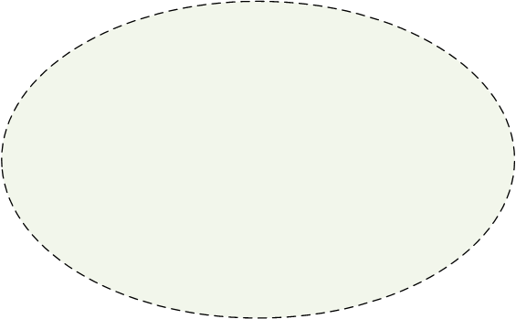

System Architecture
Dynamic Spectrum Database
- Compute and store sensing data
- Provide available WS channels
(Longley-Rice propagation model + spectrum sensing)
Management
Server
Spectrum
Database
IP Network
- Report sensing data
- Request channel
Sensor Nodes
Response WS list
(spectrum sensing)
Response WS list
(L-R model)
Client
Access Point
Secondary TVWS Networks (with sensing capability)
Secondary TVWS Networks (without sensing capability)

Slide 31
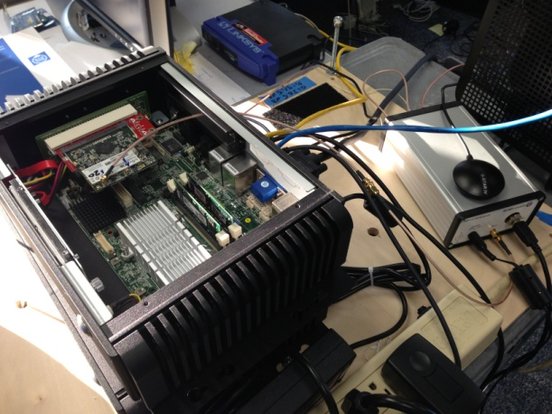
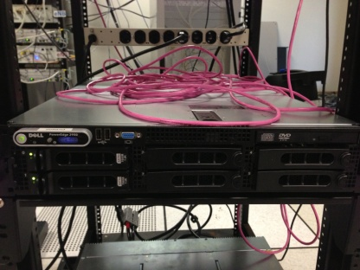
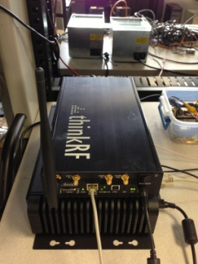
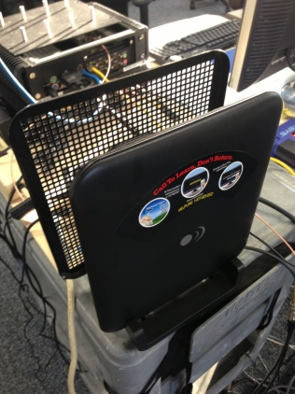
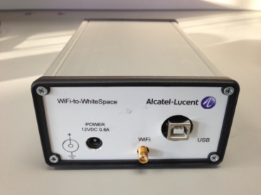
Mobile-sensor based Data Collection
Database
Server
GPS
Access Point
Daemon Module
(Python)
Dell PowerEdge 2950
PyRF Library
Wi-Fi Interface Card
Spectrum Sensor
Wi-Fi to WhiteSpace
Translator
ThinkRF WSA4000
UHF Antenna

Slide 32
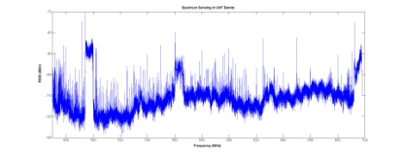
Spectrum Sensing
Daemon Module
  Run spectrum sensing and collect I/Q Samples in UHF bands
  Perform windowing (Hanning, Hamming, Blackman, Bartlett-Hann)
  FFT -> convert signal into frequency domain
  Report the result to the database server periodically
Sensing UHF TV bands
(470-698 MHz)
Daemon Module
Spectrum Sensor
I/Q Sample
Window Function
Calibration
Database
Server
<FREQ (Hz), RSSI (dBm)>
Tagged by time and location
FFT
(average N times scan)
Upload as CSV files

Slide 33
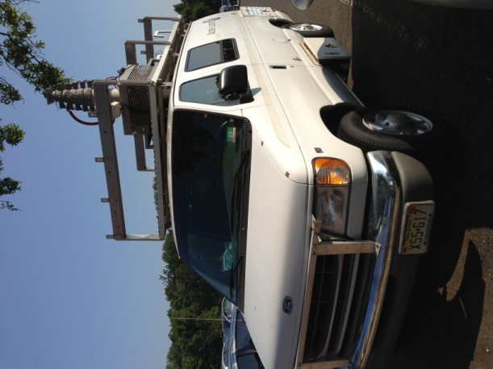
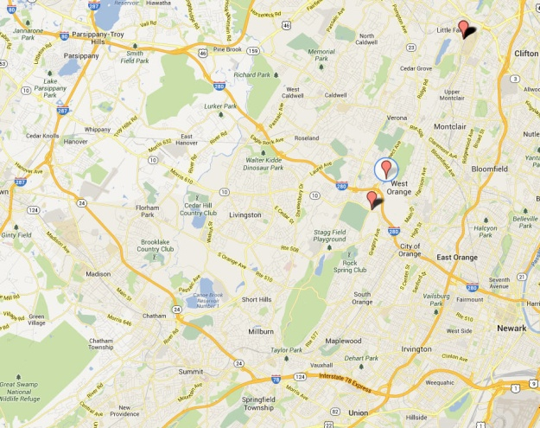
Mobile Data Collection (near Bell Labs, NJ)
Measured RSSI for TV spectrum tagged by location and time
Expect RSSI with new location

Slide 34
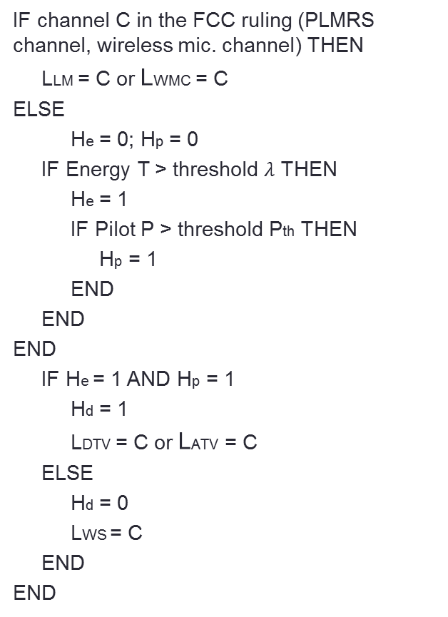
TVWS Detection Algorithm
IF channel C in the FCC ruling (PLMRS channel, wireless mic. channel) THEN
LLM = C or LWMC = C
ELSE
He = 0; Hp = 0
IF Energy T > threshold $λ$ THEN
He = 1
IF Pilot P > threshold Pth THEN
Hp = 1
END
END
END
IF He = 1 AND Hp = 1
Hd = 1
LDTV = C or LATV = C
ELSE
Hd = 0
LWS = C
END
END
DTV
Analog TV

Slide 35
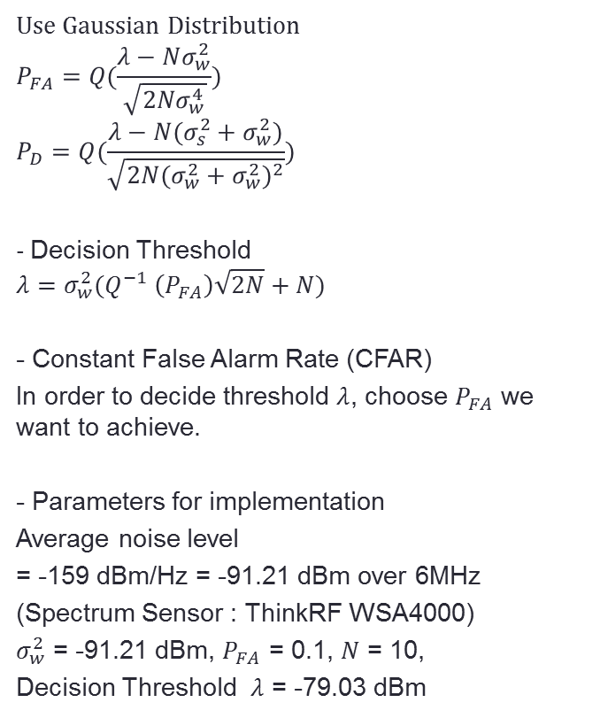
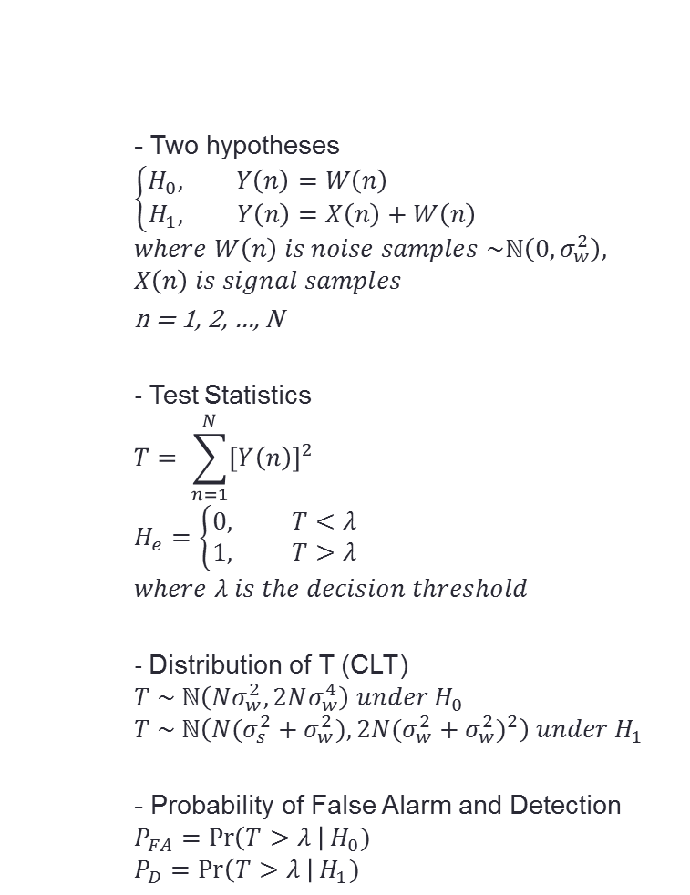
Energy Detector
- Two hypotheses
$$\left\{\begin{aligned}H_{0}, Y\left(n\right)=W\left(n\right) \\ &H_{1}, Y\left(n\right)=X\left(n\right)+W\left(n\right)\end{aligned}\right.$$
$$where W\left(n\right) is noise samples \sim ℕ\left(0,σ_{w}^{2}\right),$$
$$X\left(n\right) is signal samples$$
n = 1, 2, …, N
- Test Statistics
$$T= \sum_{n=1}^{N}{{\left[Y\left(n\right)\right]}^{2}}$$
$$H_{e}=\left\{\begin{aligned}0, T<λ \\ 1, T>λ\end{aligned}\right.$$
$$where λ is the decision threshold$$
- Distribution of T (CLT)
$$T \sim ℕ\left(Nσ_{w}^{2},2Nσ_{w}^{4}\right) under H_{0}$$
$$T \sim ℕ\left(N(σ_{s}^{2}+σ_{w}^{2}),2N{(σ_{w}^{2}+σ_{w}^{2})}^{2}\right) under{ H}_{1}$$
- Probability of False Alarm and Detection
$$P_{FA}=\operatorname{Pr}\left(T>λ \right|H_{0})$$
$$P_{D}=\operatorname{Pr}\left(T>λ \right|H_{1})$$
Use Gaussian Distribution
$$P_{FA}=Q(\frac{λ−Nσ_{w}^{2}}{\sqrt{2Nσ_{w}^{4}}})$$
$$P_{D}=Q(\frac{λ−N(σ_{s}^{2}+σ_{w}^{2})}{\sqrt{2N{(σ_{w}^{2}+σ_{w}^{2})}^{2}}})$$
- Decision Threshold
$$λ=σ_{w}^{2}(Q^{−1} \left(P_{FA}\right)\sqrt{2N}+N)$$
- Constant False Alarm Rate (CFAR)
In order to decide threshold $λ$, choose $P_{FA}$ we want to achieve.
- Parameters for implementation
Average noise level
= -159 dBm/Hz = -91.21 dBm over 6MHz
(Spectrum Sensor : ThinkRF WSA4000)
$σ_{w}^{2}$ = -91.21 dBm, $P_{FA}$ = 0.1, $N$ = 10,
Decision Threshold $λ$ = -79.03 dBm

Slide 36
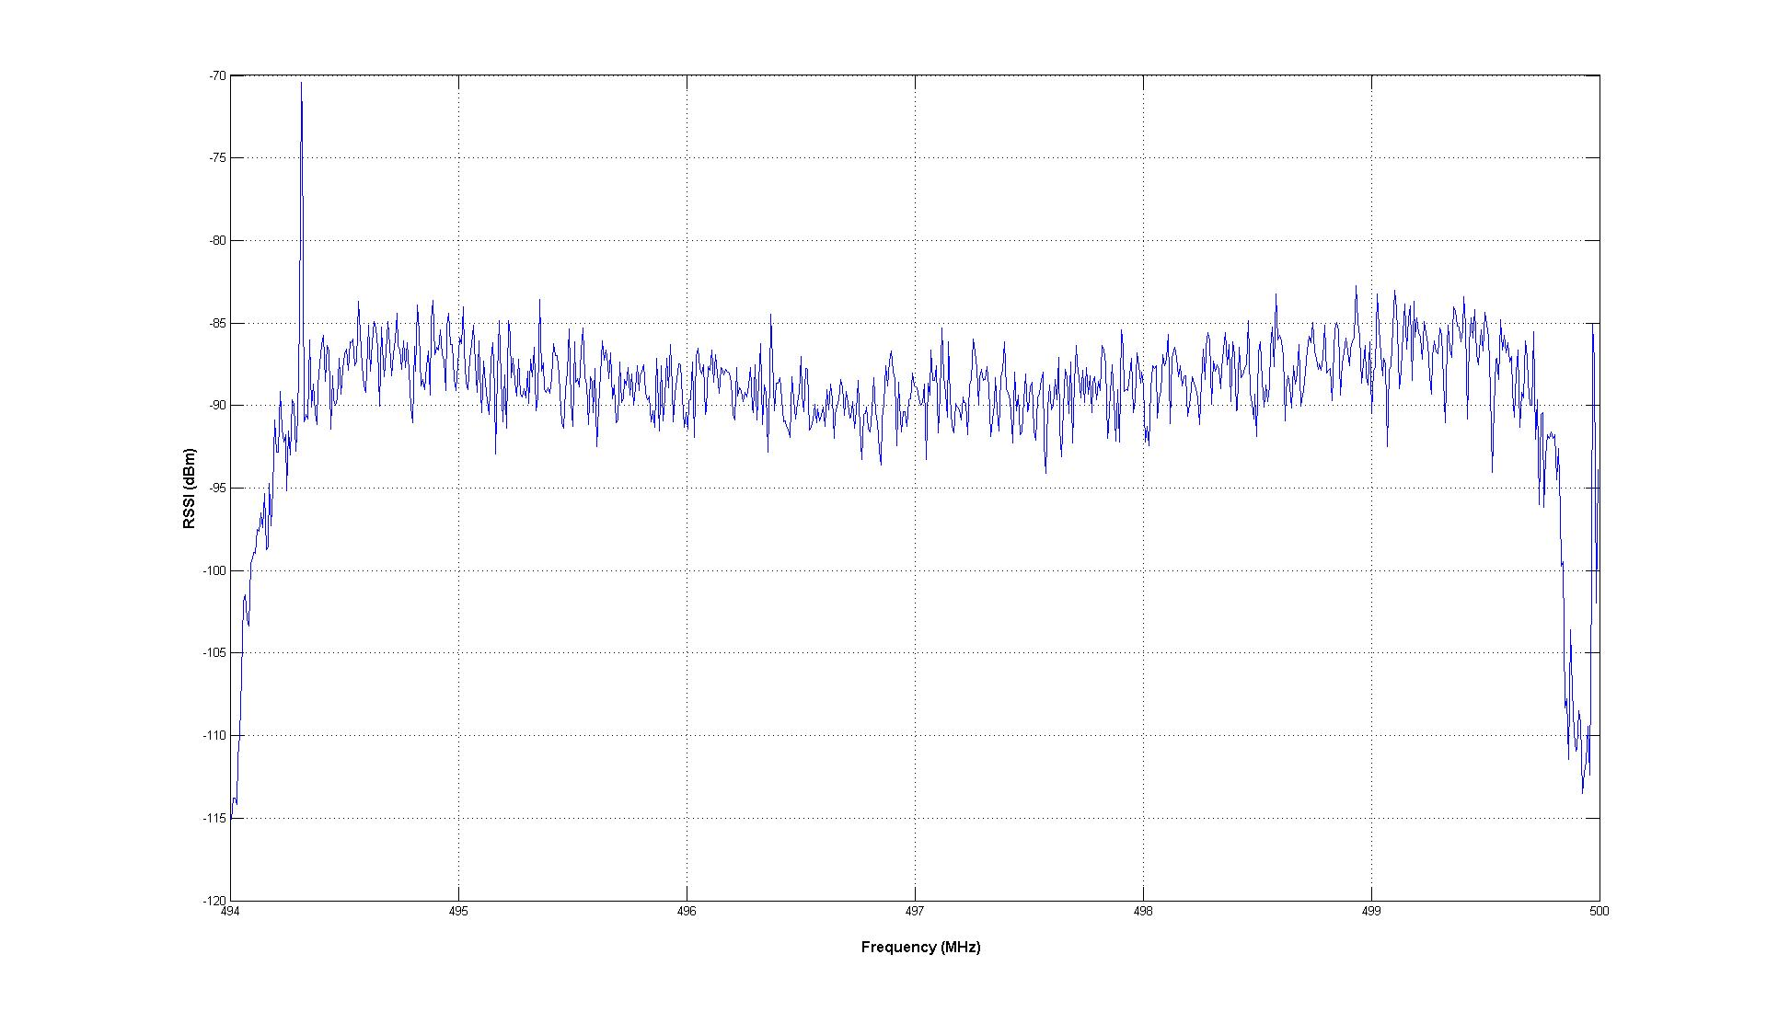
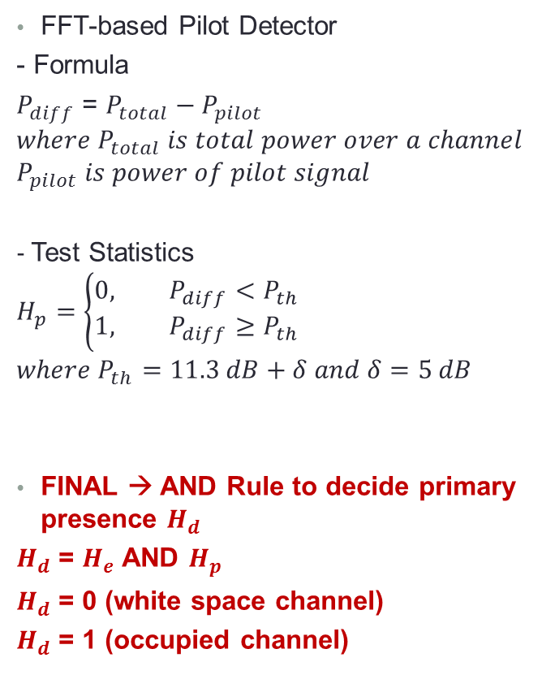
Pilot Detector
FFT-based Pilot Detector
- Formula
$P_{diff}$ = $P_{total}−P_{pilot}$
$$where{ P}_{total} is total power over a channel$$
$$P_{pilot} is power of pilot signal$$
- Test Statistics
$$H_{p}=\left\{\begin{aligned}0, P_{diff}<P_{th} \\ &1, P_{diff}≥P_{th}\end{aligned}\right.$$
$$where P_{th}=11.3 dB+δ and δ=5 dB$$
FINAL → AND Rule to decide primary presence $H_{d}$
$H_{d}$ = $H_{e}$ AND $H_{p}$
$H_{d}$ = 0 (white space channel)
$H_{d}$ = 1 (occupied channel)
DTV Pilot Signal

Slide 37
Primary Detection Algorithm
Loop [Channel List]
Energy & Pilot Detection
Pg = Logical AND
Pg = 0?
Mark as white space channel
FCC rules
Delete from white space channel
Last Channel?
Terminate

Slide 38
Experiment Result
Total observation time: 15 hours (7:00 PM – 10:00 AM)
  Sensing Duration = 30 seconds per every minute
  About 800 observation samples
Sensing Location: the Bell Labs (fifth floor) in NJ
  Latitude : 40.68691, Longitude : -74.39718
Run spectrum sensing for portable device: Channel [21-51]
AND Rule threshold = 90% (occupancy of channel during observation time)
WS channels from SpecObs: 25 channels
  Including all DBA WS channels
  [22,23,24,25,26,27,28,30,31,32,33,34,36,38,40,41,42,43,44,45,46,47,48,49,50]
WS channels from DBA: 8 channels
  [22,27,32,42,46,47,48,49]

Slide 39
Experiment Results
Channel | Avg RSSI (dBm) | Energy Detection (%) | Pilot Detection (%) | Category | Channel | Avg RSSI (dBm) | Energy Detection (%) | Pilot Detection (%) | Category
51 | -65.43 | 100 | 100 | DTV | 27 | -81.49 | 0.0 | 0.0 | WS
29 | -70.64 | 100 | 99.88 | DTV | 32 | -81.55 | 15.84 | 0.0 | WS
28 | -77.20 | 99.65 | 2.72 | WS | 25 | -82.15 | 0.72 | 0.0 | WS
46 | -77.22 | 100 | 0.0 | WS | 36 | -82.24 | 0.48 | 0.0 | WS
44 | -77.55 | 100 | 0.0 | WS | 33 | -82.31 | 0.35 | 0.24 | WS
47 | -77.74 | 100 | 0.0 | WS | 49 | -82.47 | 0.0 | 0.0 | WS
45 | -77.96 | 100 | 0.0 | WS | 42 | -82.53 | 0.0 | 0.0 | WS
30 | -78.39 | 79.08 | 41.25 | WS | 34 | -82.84 | 0.48 | 4.09 | WS
48 | -78.50 | 85.34 | 14.89 | WS | 31 | -83.07 | 0.0 | 0.0 | WS
39 | -79.10 | 17.26 | 0.0 | WMC | 24 | -83.25 | 0.0 | 7.33 | WS
35 | -80.25 | 4.49 | 0.0 | WMC | 26 | -83.45 | 0.35 | 0.0 | WS
50 | -80.89 | 0.0 | 0.0 | WS | 38 | -84.62 | 0.00 | 0.0 | WS
40 | -81.23 | 1.06 | 0.0 | WS | 23 | -86.15 | 0.0 | 3.9 | WS
43 | -81.41 | 0.12 | 0.0 | WS | 21 | -89.63 | 0.0 | 0.0 | LM
41 | -81.47 | 0.0 | 0.0 | WS | 22 | -90.05 | 0.0 | 0.0 | WS
Predictions (DB) are often conservative and
may NOT protect primaries &
may lead to missed spectrum usage opportunities
LM: Private Land Mobile Radio Service Channel WS: White Space Channel, WMC: Wireless Microphone Channel, DTV: DTV Channel

Slide 40
Role of Spatial Stochastic Modeling for Signal Mapping
Current approaches do not account for spatial
correlations in the received signal
Uniform spatial sampling is impossible !
Hence, given RSSI samples over some set:
→ use measurement data to estimate the
spatial statistics (variogram) and model fit
followed by spatial interpolation (Kriging) to points
where no measurement is available.
Then conduct classification as before.

Slide 41
General Approach
Sampling
Pre-processing
Empirical variogram estimation
(Semi) variogram estimation
Empirical variogram modeling
Interpolation
(Ordinary Kriging)
Model selection via cross-validation
Radio Environment Map/Protection Region

Slide 42
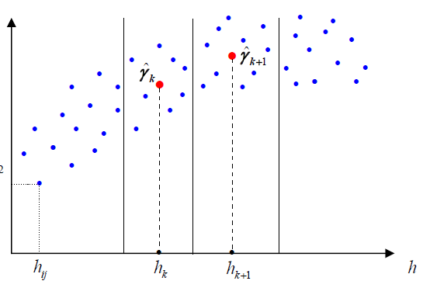
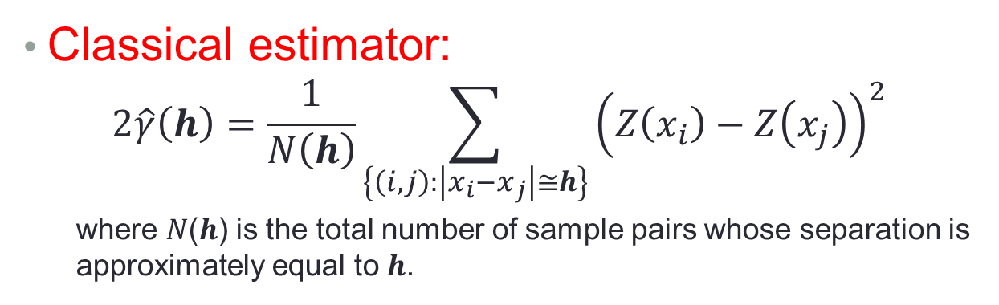
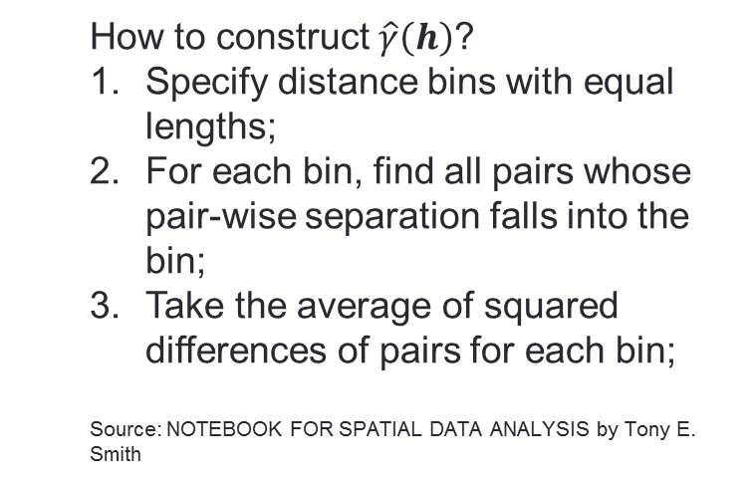
Empirical Semivariogram Estimation
Classical estimator:
$$2\hat{γ}\left(h\right)=\frac{1}{N\left(h\right)}\sum_{\left\{\left(i, j\right):\left|x_{i}−x_{j}\right|≅h\right\}}{{\left(Z\left(x_{i}\right)−Z\left(x_{j}\right)\right)}^{2}}$$
  where 𝑁(𝒉) is the total number of sample pairs whose separation is approximately equal to 𝒉.
  How to construct $\hat{γ}\left(h\right)$?
  Specify distance bins with equal lengths;
  For each bin, find all pairs whose pair-wise separation falls into the bin;
  Take the average of squared differences of pairs for each bin;
  Source: NOTEBOOK FOR SPATIAL DATA ANALYSIS by Tony E. Smith

Slide 43
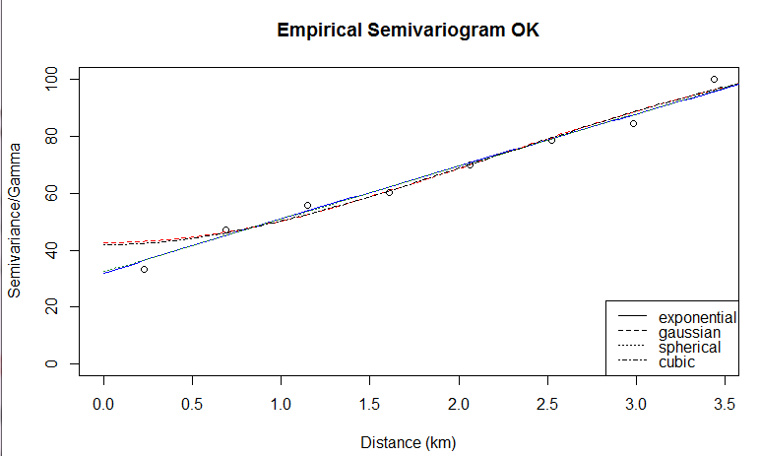
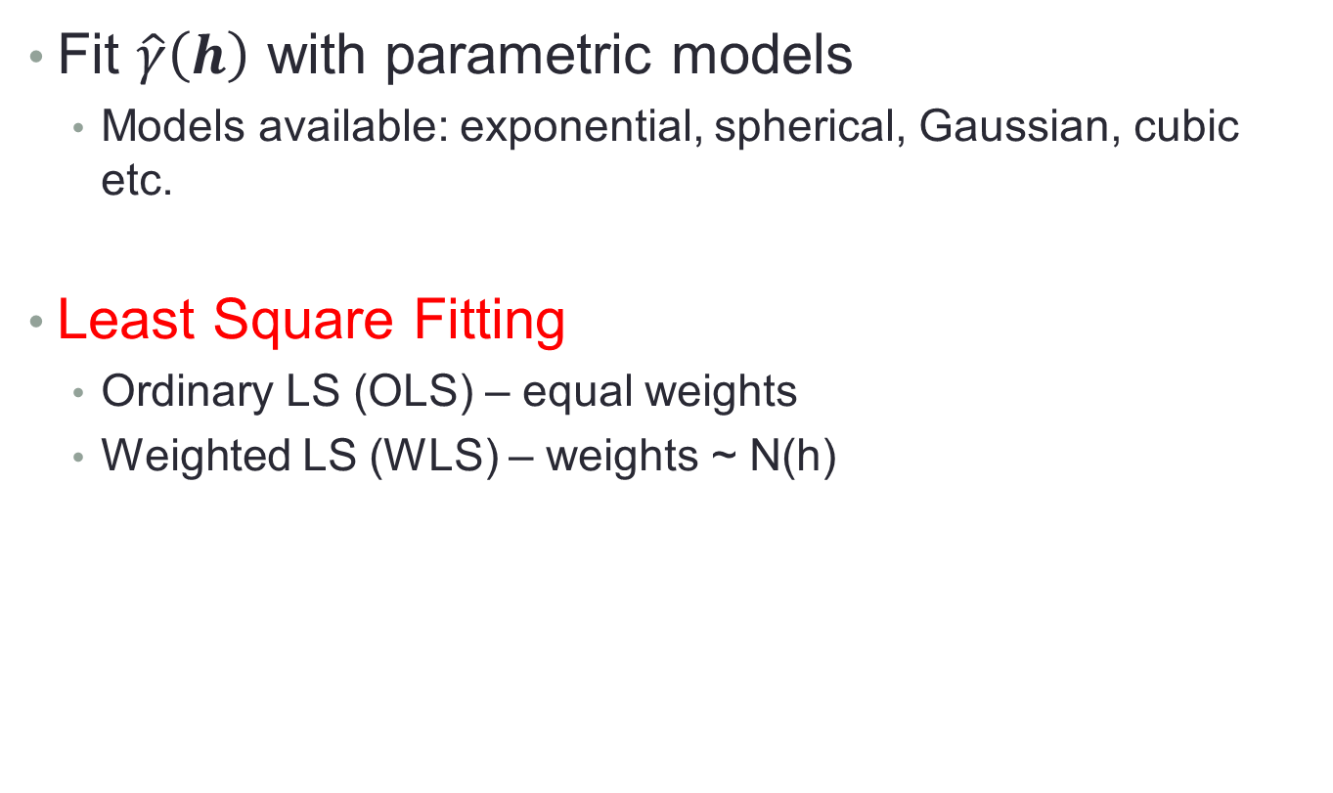
Empirical Semivariogram Modeling
Fit $\hat{γ}\left(h\right)$ with parametric models
  Models available: exponential, spherical, Gaussian, cubic etc.
Least Square Fitting
  Ordinary LS (OLS) – equal weights
  Weighted LS (WLS) – weights ~ N(h)

Slide 44

Seattle Drive Data (Jun 2014)
Location/Area: North Seattle
  Three days: June 6/11/12
  240+ locations
  4.6 km x 5 km
Setup
  USRP B210 (GNURadio) + a laptop
  Digital TV antenna (gain = 3 dBi) installed on top of a van
  I/Q samples of CH 21 – 51 are collected
  Energy detection is realized through post-processing
  Reported noise level = -82.16 dBm

Slide 45


Propagation models v.s. Kriging
Example: CH 38
Two models: Longley-Rice ITM and F-Curve
Ordinary Kriging is applied
Distance:
9 km

Slide 46
Evaluation
CH NO. | Metric | CH 25 | CH 38 | CH 50
Tower Dist. To Region | N/A | 10.6 km | 9 km | 35 km
L-R | Mean Error | 31.59 | 27.86 | 14.99
 | S. D. | 7.42 | 7.45 | 12.93
F-Curve | Mean Error | 27.27 | 24.93 | 8.95
 | S. D. | 6.80 | 8.97 | 9.10
Kriging | Mean Error | -0.02 | 0.01 | 0.01
 | S. D. | 5.48 | 6.26 | 5.96
Observations:
  L-R and F-Curve overestimates RSS up to 30 dB.
  Kriging is based on local sensing data, and hence more accurate than L-R and F-Curve models.

Slide 47



Kriging vs KNN – Boundary Estimation
Setup
  CH 35 exhibits weak signal strengths in Northern Seattle.
  Measurement results are assumed to be the ground truth.
  A Location x is a white space (labeled as 1) if $Z\left(x\right)<threshold$, otherwise, a non-white space (labeled as 0).
  Example of training/testing sets. Data are randomly divided into training/testing sets equally. Red dots denote training samples, and blue dots testing samples.
~120 km

Slide 48

Metrics
Type I Error: a channel is predicted to be occupied, when the primary is absent (ground truth).
$$Type I Error Rate (ε_{1})=\frac{No. of Type I Errors}{No. of White Spaces }$$
Type II Error: a channel is predicted to be available, when the primary is present (ground truth).
$$Type II Error Rate (ε_{2})=\frac{No. of Type II Errors}{No. of Non White Spaces }$$
Note that per FCC ruling, secondary devices should avoid any interference with primary users. Hence, the type II error rate is more important.

Slide 49



Evaluation
Thr. (dBm) | -82 | -81.9 | -81.8 | -81.7 | -81.6 | -81.5
Kriging ($ε_{1}/ε_{2}$) | 0.65 | 0.47 | 0.39 | 0.24 | 0.22 | 0.18
 | 0.07 | 0.09 | 0.24 | 0.09 | 0.23 | 0.13
KNN ($ε_{1}/ε_{2}$) | 0.19 | 0.25 | 0.20 | 0.14 | 0.19 | 0.06
 | 0.25 | 0.18 | 0.42 | 0.45 | 0.32 | 0.44
  Kriging and KNN boundaries when threshold = -81.8 dBm.
  Red/blue shadows are predicted coverage/ non-coverage regions.
  Red dots are testing samples that are not white spaces, and blues are testing white spaces.

Slide 50
Conclusions
Work in Progress → just the beginning in Large Scale Radio Mapping!

