Slide 1
GHz-Wide Realtime Spectrum Sensing Using MHz-Wide Radios
Lixin Shi (MIT)
Victor Bahl (Microsoft), Dina Katabi (MIT)

Slide 2
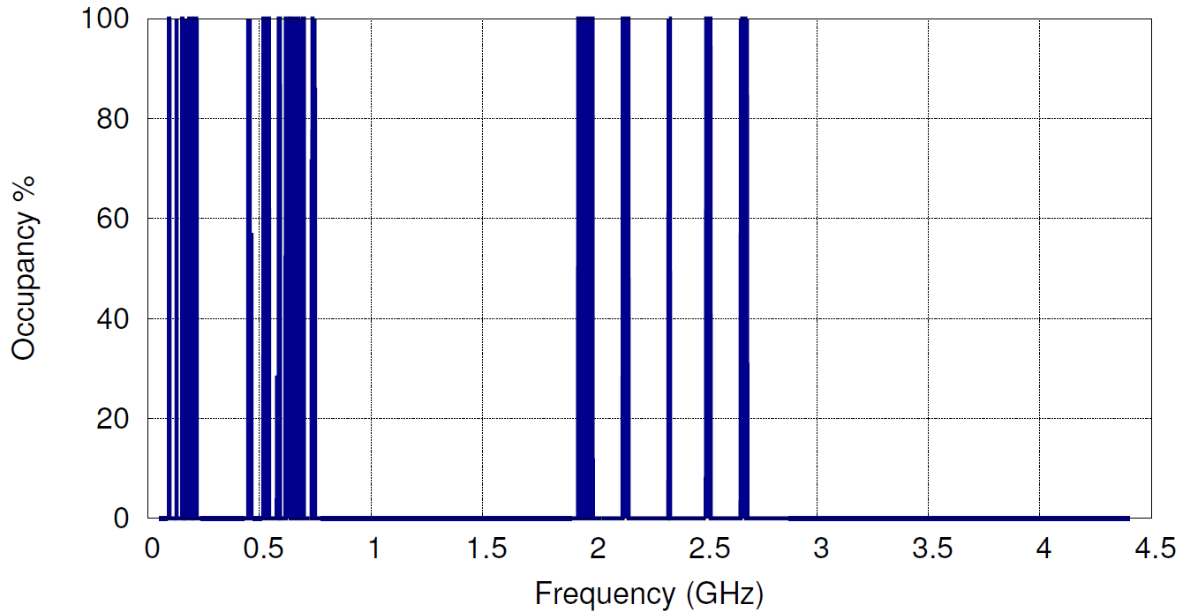
Today’s Spectrum Occupancy Report
Microsoft Spectrum Observatory (08/03/2013 – 08/08/2013)

Slide 3
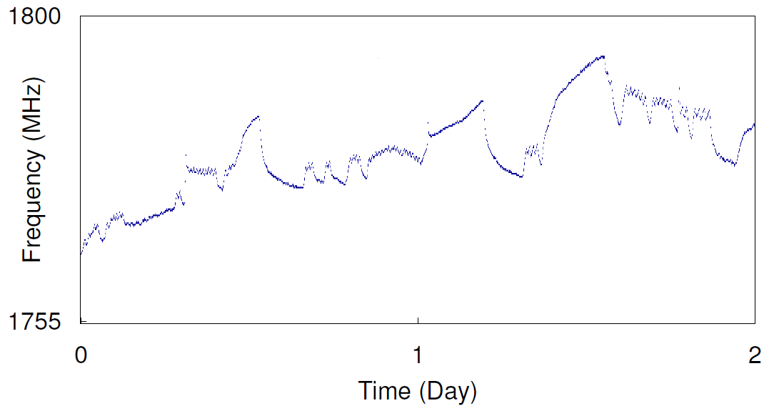
Today’s Spectrum Occupancy Report
Microsoft Spectrum Observatory (08/03/2013 – 08/08/2013)
1755MHz – 1800MHz
(Air Force)

Slide 4
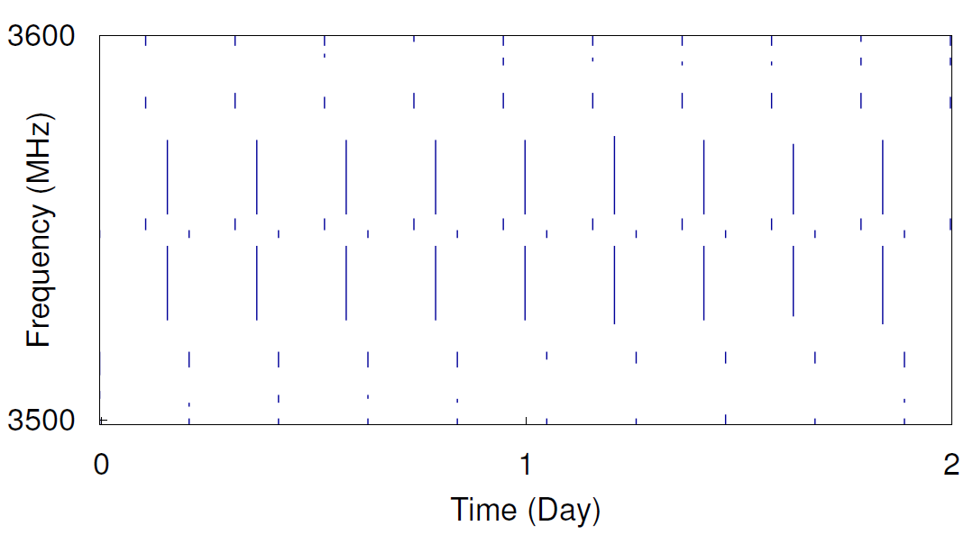
Today’s Spectrum Occupancy Report
Microsoft Spectrum Observatory (08/03/2013 – 08/08/2013)
Today’s spectrum occupancy reports miss important signals
Why?
3.5GHz-3.6GHz
(Radar Band)

Slide 5


Today:
Sequential sensing with MHz BW
Ideally:
Realtime sensing with GHz BW
Freq
Freq
Time
Time
Cheap, practical
Capture all signals
Miss important signals
Costly, and effectively impractical
Can we use MHz radios but capture all signals?

Slide 6
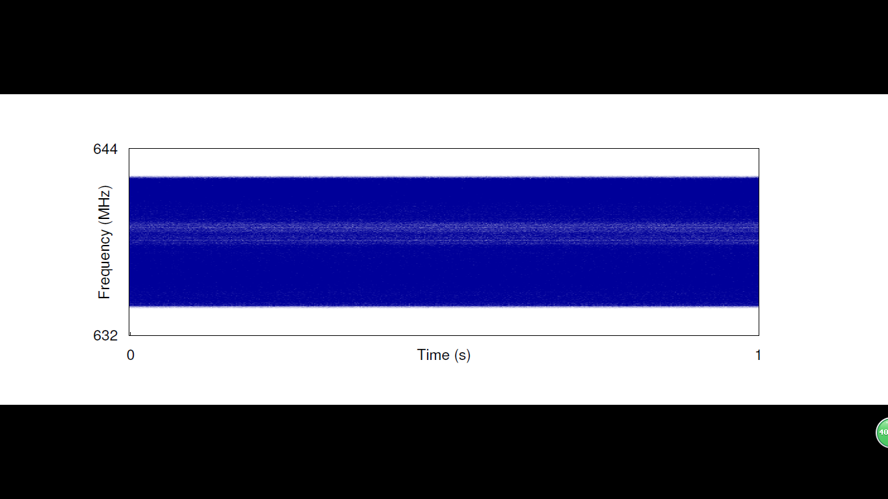
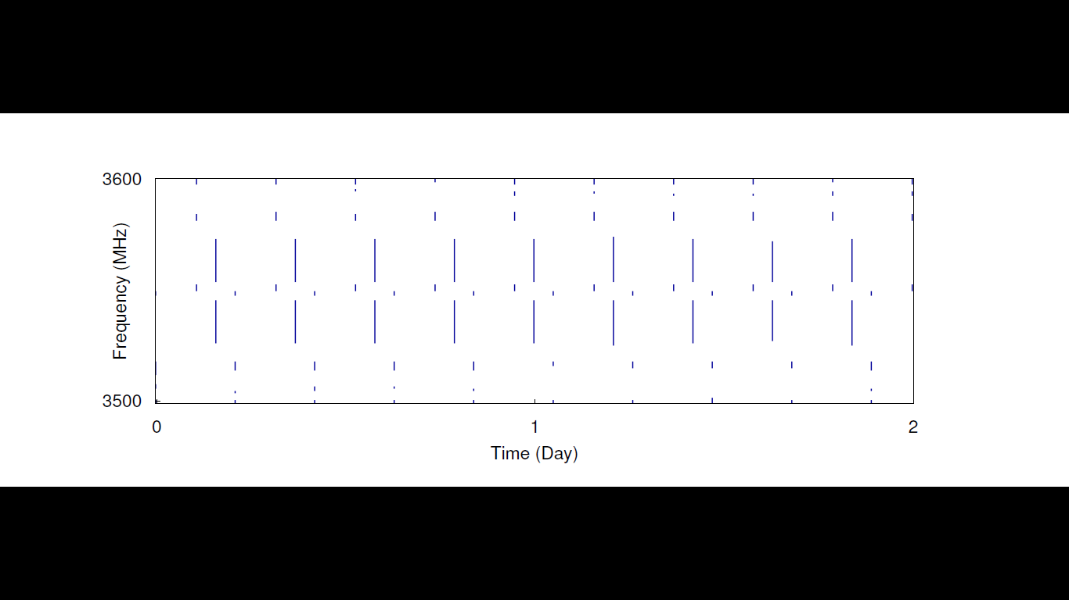
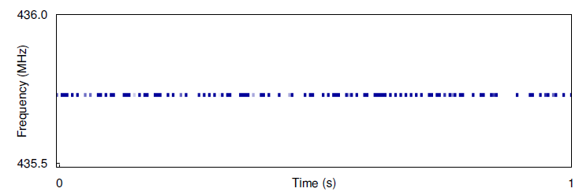
Intuition: Scan Bands to Maximize the Probability of Detecting Signals
638 MHz
632 MHz
3500
MHz
3600
MHz
436.0
MHz
435.5
MHz
Brief Check
Example 1:
Always-on
(TV signal)
Random Check
Brief Check
Example 2:
Periodic
(Radar Signal)
Use all of the saved time
Example 3:
Dynamic
(Amateur Radio)
Time (s)

Slide 7
SpecInsight
Uses tens-of-MHz radios to scan a multi-GHz spectrum
Evaluated in 6 US cities
Captures signals even if their occupancy is very small

Slide 8
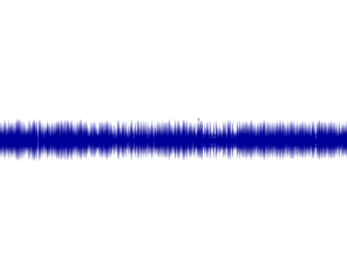
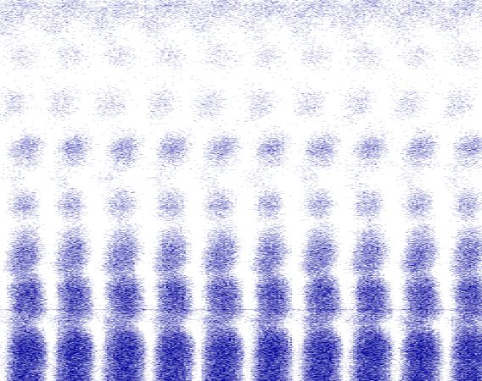




SpecInsight Architecture
Learning Spectrum Patterns
Scheduling Based on the Patterns
Pattern is a representative time-frequency chunk
$$f$$
$$f$$
$$t$$
$$t$$

Slide 9
SpecInsight Architecture
Learning Spectrum Patterns
Scheduling Based on the Patterns
Pattern is a representative time-frequency chunk
$$f$$
$$f$$
$$t$$
$$t$$

Slide 10
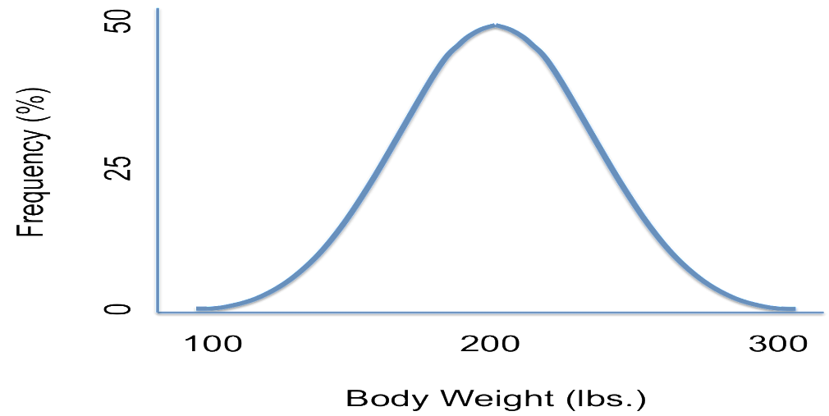







Learning Patterns
Extract the patterns
Detect the distribution of occurrence
FCC Band
$$f$$
CDF
$$t$$
$$σ$$
Pattern 1
$$μ$$
$$t$$
$$f$$
$$t$$
Pattern 2

Slide 11
Learning Patterns
Extract the patterns
Detect the distribution of occurrence
FCC Band
$$f$$
CDF
$$t$$
$$σ$$
Pattern 1
$$μ$$
$$t$$
$$f$$
$$t$$
Pattern 2

Slide 12
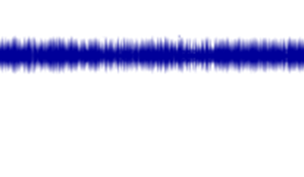






Extracting Patterns
f
f
f
t
t
t
Input samples
Dividing
Patterns
Cluster!

Slide 13
Identifying Patterns
f
f
f
t
t
t
Input samples
Dividing
Patterns
Clustering
Cluster 2
Cluster 1
Noise

Slide 14
Learning Patterns
Extract the patterns
Detect the distribution of occurrence
FCC Band
$$f$$
CDF
$$t$$
$$σ$$
Pattern 1
$$μ$$
$$t$$
$$f$$
$$t$$
Pattern 2

Slide 15
Learning Patterns
Extract the patterns
Detect the distribution of occurrence
FCC Band
$$f$$
CDF
$$t$$
$$σ$$
Pattern 1
$$μ$$
$$t$$
$$f$$
$$t$$
Pattern 2

Slide 16
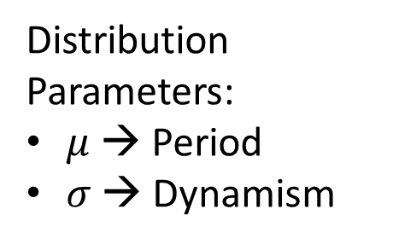






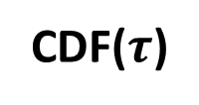
Pattern Occurrence Distribution
…
$$τ^{(0)}$$
$$τ^{(1)}$$
$$t$$
Distribution
Parameters:
$μ$ → Period
$σ$ → Dynamism
CDF($τ$)
$$μ$$
$$σ$$
$$t$$

Slide 17
SpecInsight Architecture
Learning Spectrum Patterns
Scheduling Based on the Patterns
Pattern is a representative time-frequency chunk
$$f$$
$$f$$
$$t$$
$$t$$

Slide 18



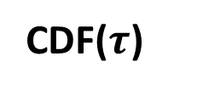



Scheduling Sensing Based on Patterns
Expected
occurrence
Sensing Schedule
$$t$$
$μ$
Proportional to $σ$
When to sense the next?
CDF($τ$)
$$μ$$
$$σ$$
$$t$$

Slide 19
Exploitation vs. Exploration
Exploration
Exploitation
Learning Spectrum Patterns
Scheduling Based on the Patterns
What is the optimal balance?

Slide 20
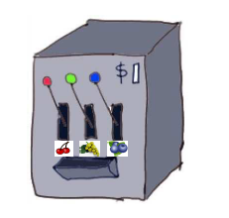
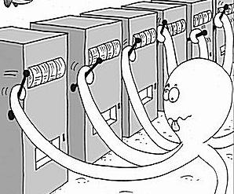

Solution: Multi-Armed Bandit
K bandit machines
Each machine will give some random rewards
The rewards follow some distribution
The distribution is not known a priori
Each time only one machine can be chosen
…
[1] J. Vermorel and M. Mohri. Multi-Armed Bandit Algorithms and Empirical Evaluation, In ECML, 2005.

Slide 21
Solution: Multi-Armed Bandit
K bandit machines
Each machine will give some random rewards
The rewards follow some distribution
The distribution is not known a priori
Each time only one machine can be chosen
How to maximize the rewards?
K frequency bands
Each band might have signals at any time
The signals follow some pattern
The pattern is not known a priori
Each time only one band can be sensed
How to maximize the signals captured?
…
SpecInsight optimizes the scheduling using the multi-armed band algorithm.
[1] J. Vermorel and M. Mohri. Multi-Armed Bandit Algorithms and Empirical Evaluation, In ECML, 2005.

Slide 22

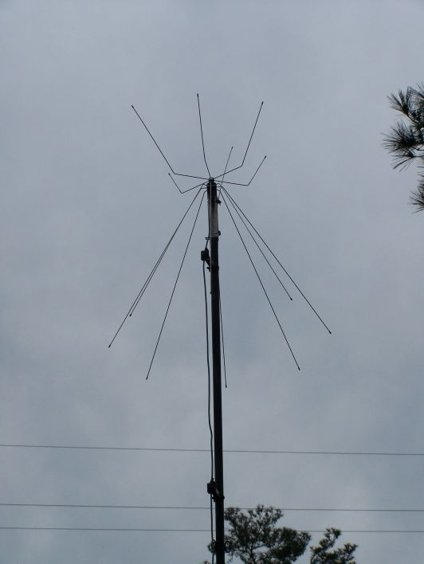
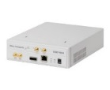
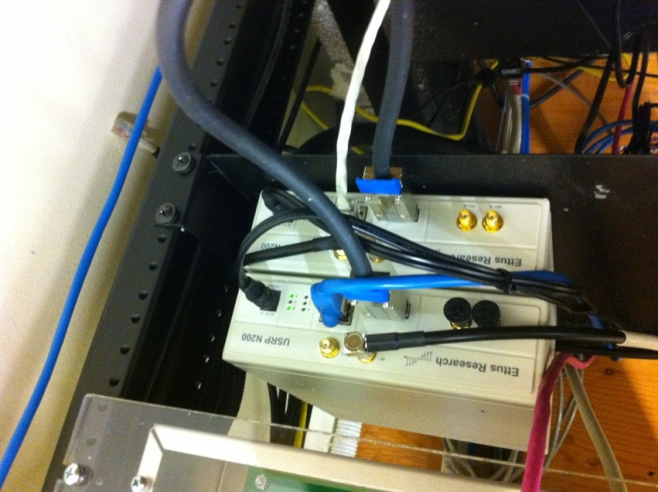
SpecInsight’s Implementation
Outdoor Antenna
Outdoor Antenna
USRP1(SBX)
400-4400MHz
USRP2(WBX)
50-2200MHz
Per USRP:
- Sampling Rate: 50 MS/s
- Instant BW: 40MHz
Indoor USRPs

Slide 23
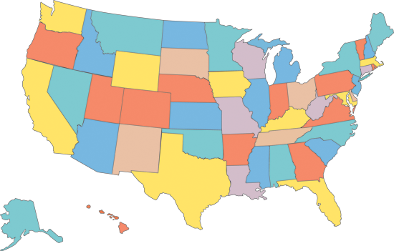
Evaluated in Six Locations
Redmond, WA
Upper Arlington, OH
Amherst, MA
Boston, MA
New York City, NY
San Francisco, CA
One week of data

Slide 24
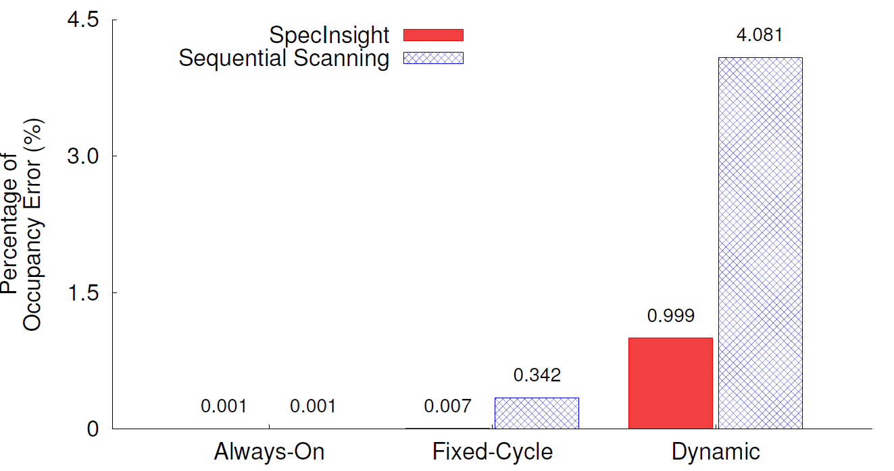
Accuracy
Comparing SpecInsight with today’s sequential scanning from 50MHz to 4.4GHz for exactly the same time / bandwidth resources
On average, our error is 10x smaller than today’s sequential scanning.

Slide 25
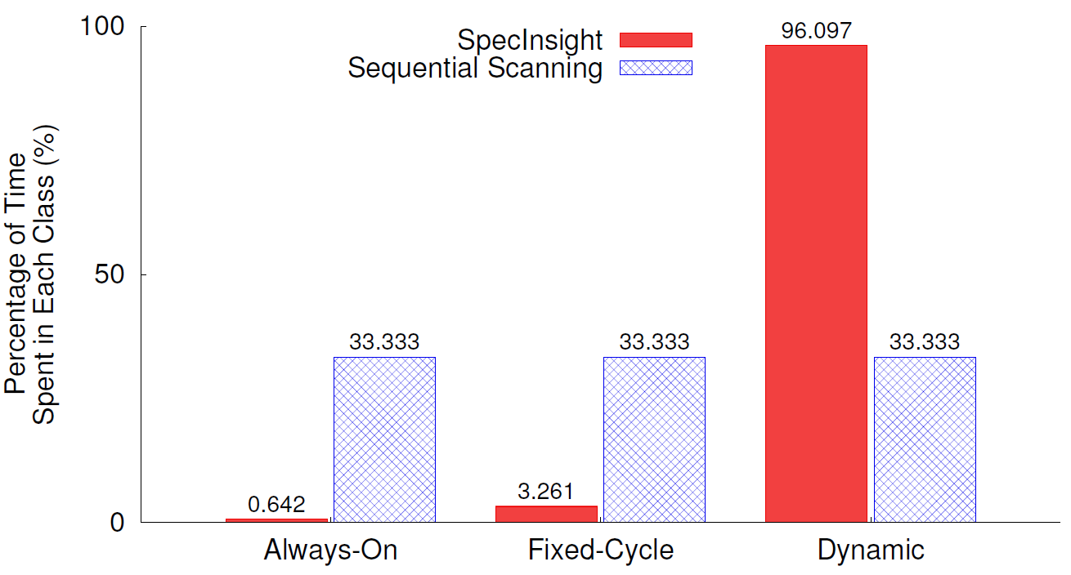
Understanding why SpecInsight is more accurate
SpecInsight saved more than 95% of the time to be spent on the dynamic classes

Slide 26
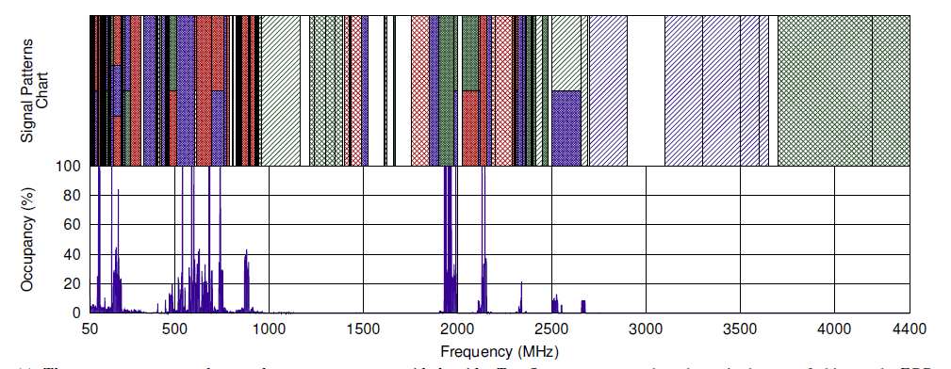
Spectrum Analytics Chart

Slide 27
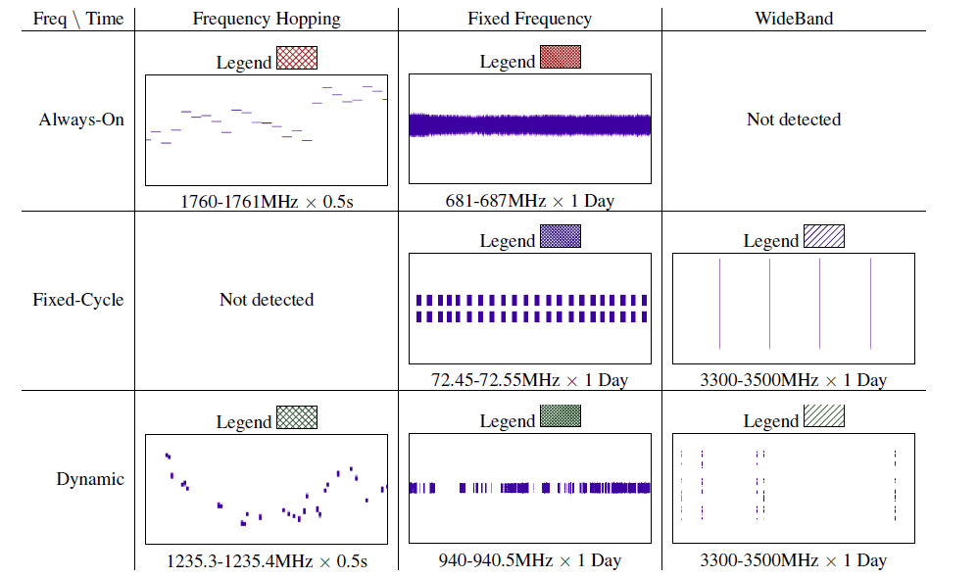

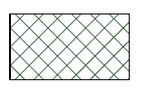
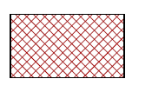

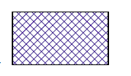


Spectrum Analytics Chart
Fixed Freq, Fixed Cycle
Freq Hopping, Dynamic
Wide-Band, Fixed Cycle
Frequency Hopping, Always On
Frequency Hopping, Dynamic
Fixed Frequency, Always On
Fixed Frequency, Dynamic
Fixed Frequency, Fixed Cycle
Wide-Band, Dynamic
Wide-Band, Fixed Cycle

Slide 28
Spectrum Analytics Chart
Frequency Hopping, Always On
Frequency Hopping, Dynamic
38% of spectrum looks completely empty while they are used
Fixed Frequency, Always On
Fixed Frequency, Dynamic
Fixed Frequency, Fixed Cycle
Wide-Band, Dynamic
Wide-Band, Fixed Cycle

Slide 29
Occurrence Distributions

Slide 30
Occurrence Distributions
65% of the bands have technologies that are either always-on or transmit periodically
65%

Slide 31
Occurrence Distributions
5%
65% of the bands have technologies that are either always-on or transmit periodically
Among the dynamic patterns, only 5% are highly dynamic

Slide 32
Conclusion
SpecInsight resolves the conflict of obtaining full spectrum details while using limited-bandwidth, cheap radios.
SpecInsight reveals new information about spectrum patterns providing deeper understanding of both occupancy and spectrum usage.

