Slide 1
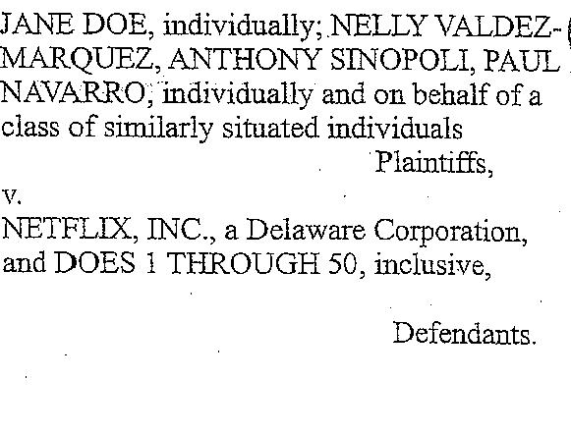
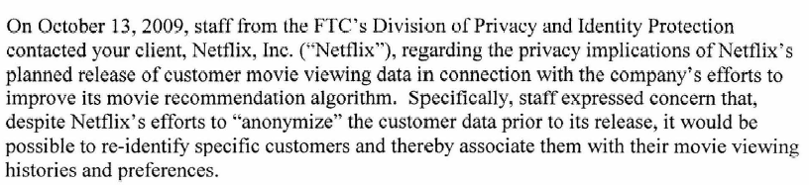
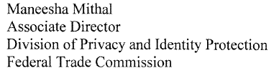





Adding Privacy to Netflix Recommendations
Frank McSherry, Ilya Mironov (MSR SVC)
Attacks on Recommender Systems
— No “blending in”, auxiliary information
— Differencing attacks/active attacks
— Potential threats:
  — re-identification, linking of profiles
  — business, legal liabilities
“Users like you”
  “Enjoyed by members who enjoyed”
A
C
A
B
C
?
A
B
C
D
E
?
F
:
D
E

Slide 2
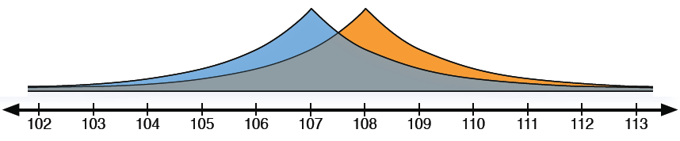

Differential Privacy
Strong formal privacy definition. Informally:
  “Any output of the computation is as likely with your data as without.”
Privacy for a Count: How Many Ratings?
  Any output is as likely with your data as without.
Current Architectures:
Private Architecture:
DP

Slide 3
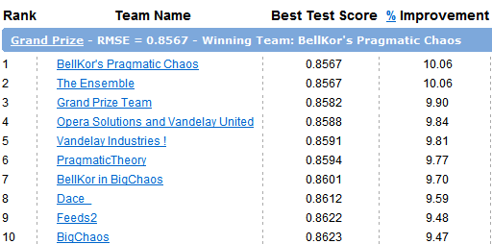
Netflix Prize Dataset
17K movies
480K people
100M ratings
3M unknowns
$1M for beating the benchmark by 10%
Differentially Private Recommendation
Global effects (movie/user averages)
Movie-movie covariance matrix
Leading “geometric” Netflix algorithms
DP
Accuracy-Privacy Tradeoff
Cost of Privacy over Time

