Slide 1


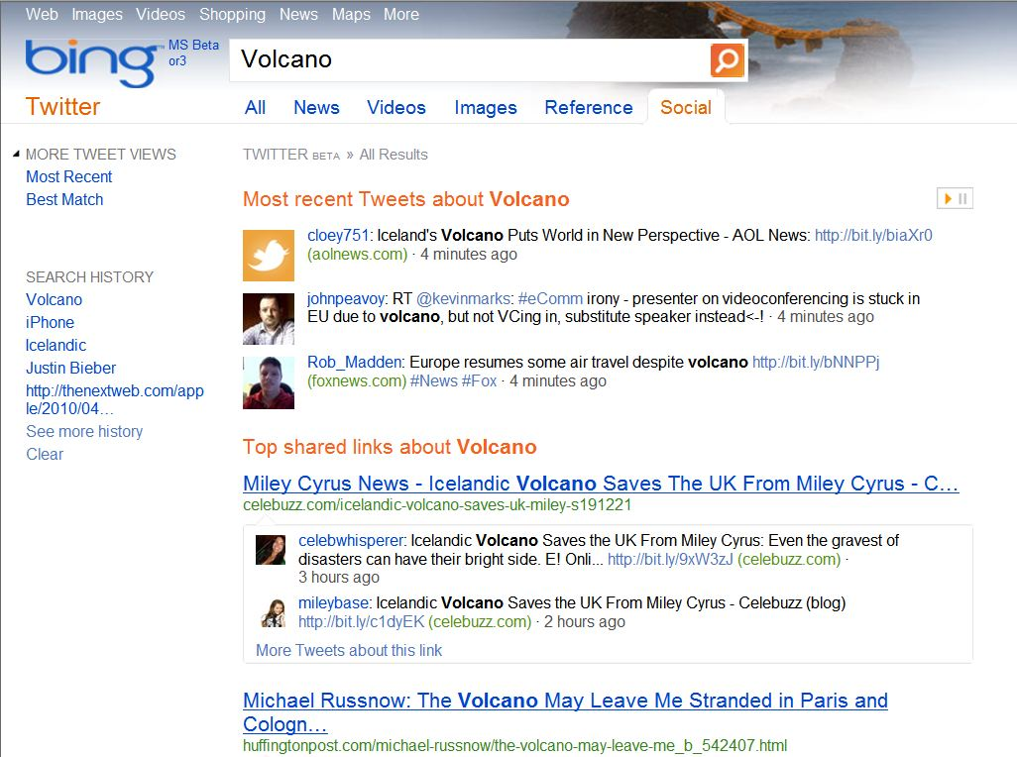
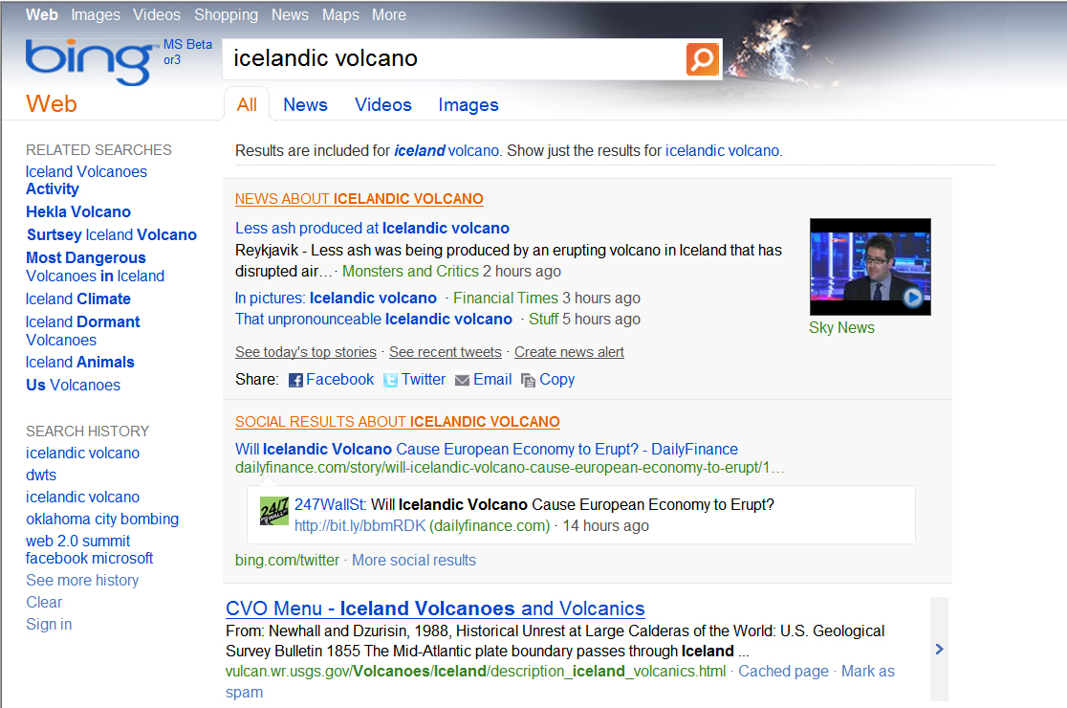
Bing.com/Twitter, Twitter Answer
Twitter is producing millions of tweets every minute on every subject imaginable - from important social and political issues to updates from your social circle. The power of those tweets as data that can be surfaced in search is enormous.
On Bing.com/twitter, you can now search for what people are saying all over the web about breaking news topics, your favorite celebrity, and anything else you use Twitter to stay on top of today.
On the main Bing.com SRP, Bing pulls in social content generated on Twitter to surface the most relevant updates within seconds of a breaking news event.
Top
Tweets
Social Answer
Top
Shared
Links

