Slide 1


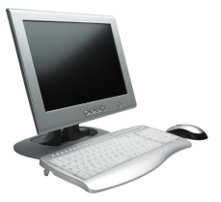

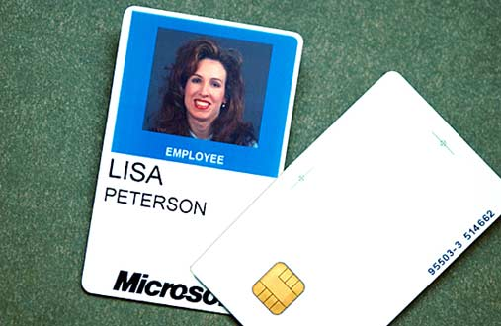
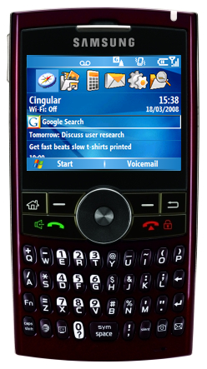
Green99: Saving Desktop Energy using SleepServer
Joshua Reich (Intern), Michel Goraczko, Aman Kansal, Jitu Padhye – MSR Redmond
Problem
Enable idle desktops to sleep, while minimizing disruption to users
Solution
1. Idle machine informs SleepServer before going to sleep
2. SleepServer takes over MAC/IP addr of sleeping machine by sending ARP Probe
3. Traffic meant for sleeping machine is redirected to sleep server
Subnet
Router
WAN
Subnet
Router
WAN
Subnet
Router
WAN
Notification
ARP
Probe
Sleep Server
Idle Desktop
Sleep Server
Sleeping Desktop
Sleep Server
Sleeping Desktop
4. SleepServer wakes up sleeping machine by sending WoL upon receiving “important” traffic or events
5. Subsequent traffic is sent to the now-awake machine
Subnet
Router
WAN
Subnet
Router
WAN
WoL
Sleep Server
Desktop
Sleep Server
Desktop
Advantages
Your desktop is “always available”
Lightweight, easy to deploy
“Last man standing” configuration eliminates need for a dedicated sleep server
Seamless support for most corporate applications/protocols: RDP, SMB, RPC
SleepServer can do complex, stateful packet parsing
Results
Challenges
Live deployment in MSR
Used by 50+ users over 4 months
(Including lab director)
Typical machine sleeps > 40% of time
IT causes most wakeups
Sleeping machine responds in 8-9 seconds
Existing connections break
Not a problem in typical
corporate environments.
Applications that depend on outgoing connections may be delayed (e.g. LiveMesh, LiveSync)
Most of the savings come from long sleeps (typically at night)

