Slide 1
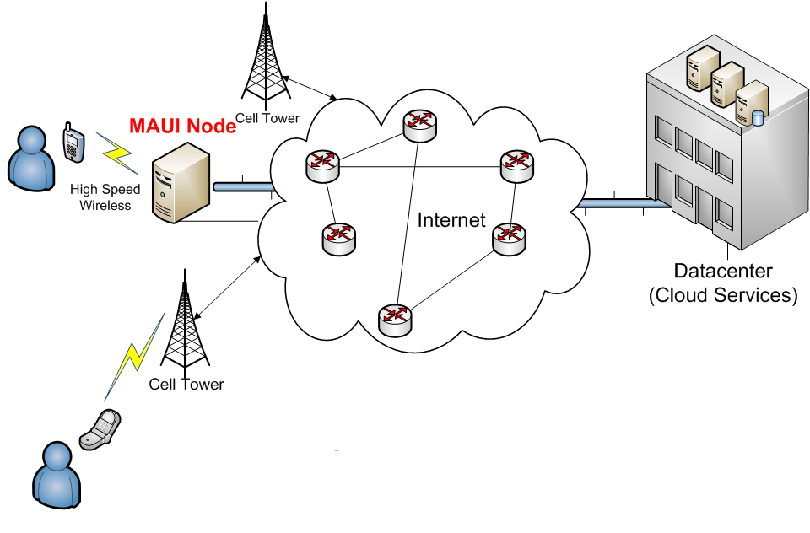
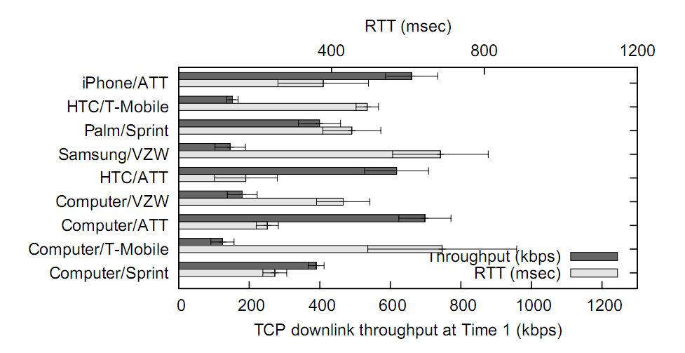
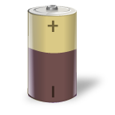
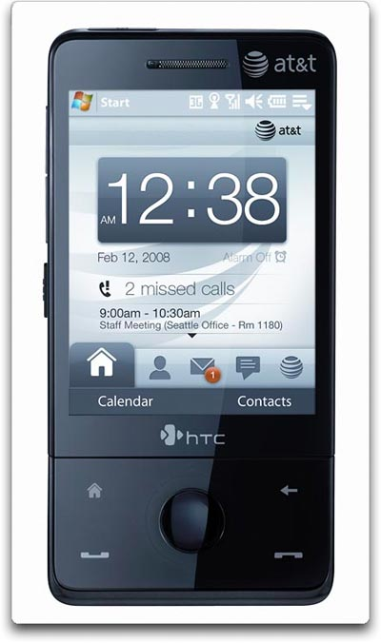
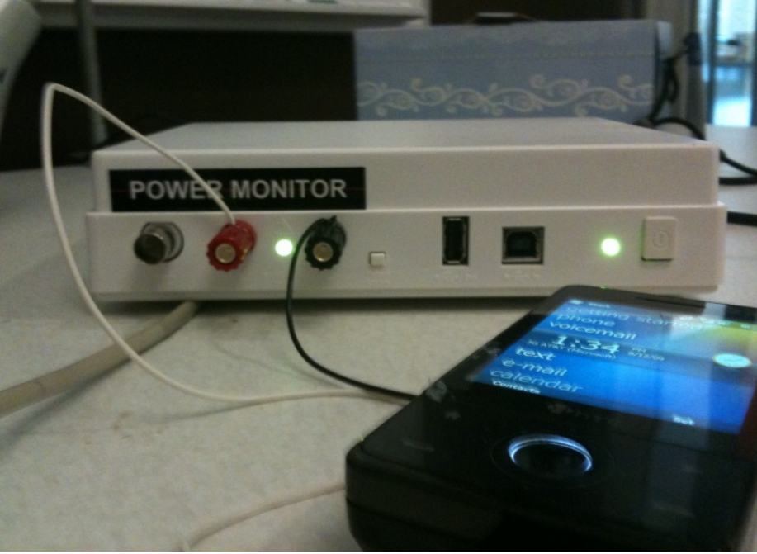
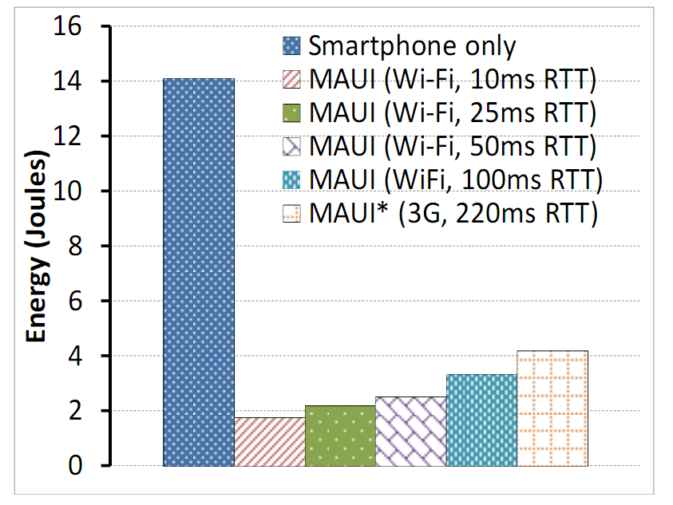
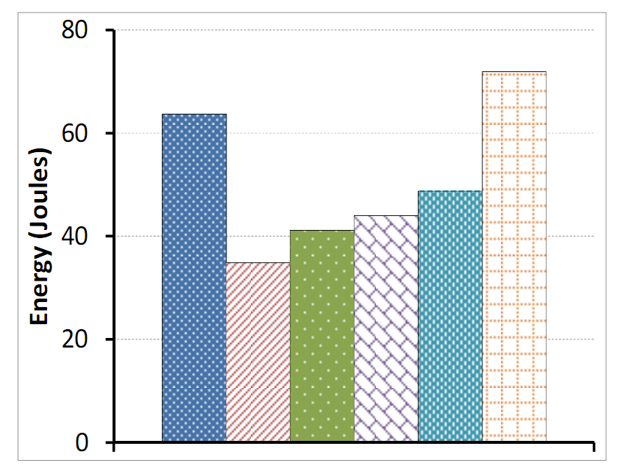
Mobile Assistance Using Infrastructure (MAUI)
Victor Bahl, Ranveer Chandra, Stefan Saroiu, Alec Wolman, Ming Zhang – Networking Research Group, MSR Redmond Kris Tolle – External Research University Partners: Duke, UCLA, CMU, Purdue
Problem:
Enable smartphone applications to overcome the severe resource limitations (Battery, CPU, Memory, 3G Wireless) of today’s handheld devices
Motivation
3G Network Issues
Solution
Handheld Device Trends
Device technology keeps improving
Faster CPU, larger screen, more RAM, faster WLAN, lots of useful sensors (e.g. camera, GPS, accelerometer, compass)
Battery technology is not keeping up
A resource-intensive application can drain a fully charged phone in 1 hr 20 mins
A major breakthrough is required – seems unlikely
Latency
Round trip time (in ms) for 3G & Wi-Fi
3G: 150 to 350 ms
Wi-Fi: 20 ms
Mobile Assistance Using Infrastructure (MAUI)
Enables Next Generation Apps: Resource-Intensive
Offload computation to nearby infrastructure
Interactive applications require fast response times
Lets push the cloud closer to mobile devices
Use WLAN as primary network, 3G as fallback
Bandwidth
3G networks are already congested in cities
Comparison of US carriers:
Enables new interactive resource intensive apps:
Augmented Reality
Corrective Human Behavior
Mobile 3D Gaming
1
2
Overview
Architecture
Applications
Cloudlets: collaboration w/CMU on VM-based offload
Proteus: Profiling and Offload for Legacy Apps
Energy-Aware Program Partitioning for .NET Applications
Security: Improving Guest Security in Virtualized Environments
MAUI Runtime
Guest Partition (VM)
Voice-based translator
Too resource-intensive to run on WinMo phones
Interactive Arcade Game
More than doubled the frame-rate by offloading the enemy strategy routines
Memory Assistant
Built a simple UI around XCG’s face-recognizer, ported to use the MAUI runtime
Obtained an order of magnitude improvement in energy consumed
Client Proxy
Server Proxy
Application
Application
RPC
Solver
Profiler
Hypervisor
Root Partition (VM)
Solver
MAUI
Controller
3
Smartphone
MAUI Server
4
5
Legacy Apps
MAUI for .NET Apps
Results
Finding Execution Zones For Offload
Classify each system call as local or non-local
Uses CeLog event tracking to record syscalls, CPU, Memory, interrupts, Disk, Network
Implement transparent offload with process suspend & resume (using Debug API)
Dynamic Energy-Aware Offload for .NET Apps
Partitioning .NET applications into:
Must run on the mobile (GUI, Sensors)
Must run on infrastructure node
Can run at either location
“Semi-Automatic” Partitioning
User classifies methods with .NET attributes
Granularity of partitioning at method level
MAUI runtime handles control and state transfer
Solver: Optimize battery usage subject to latency constraints
Analyzes annotated call graph to determine which portions of the application to offload
Attached hardware power meter to smartphone battery to collect energy measurements
State
Transfer
Offload
Energy Results:
Memory Assistant Arcade Game
Performance Results:
Response Time
Memory assistant: 17.3 sec -> 1.5 sec
Arcade game: 6 FPS -> 13 FPS
Time
Z₁
6
7
8

