Slide 1
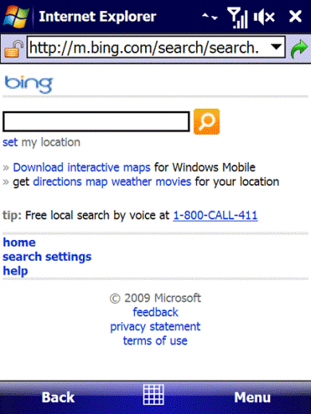
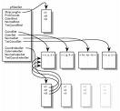
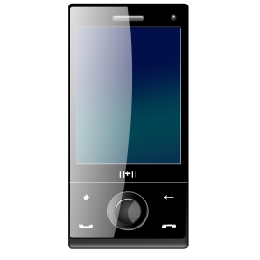
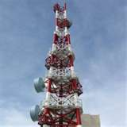
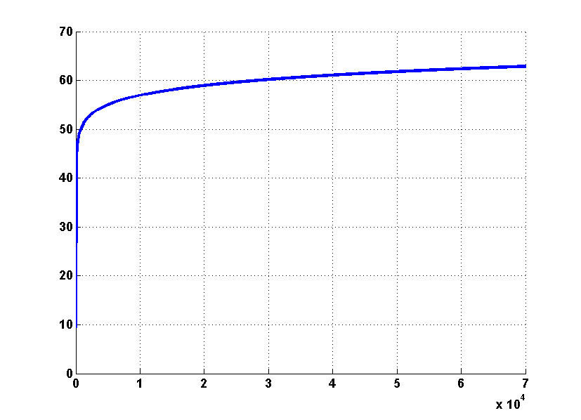
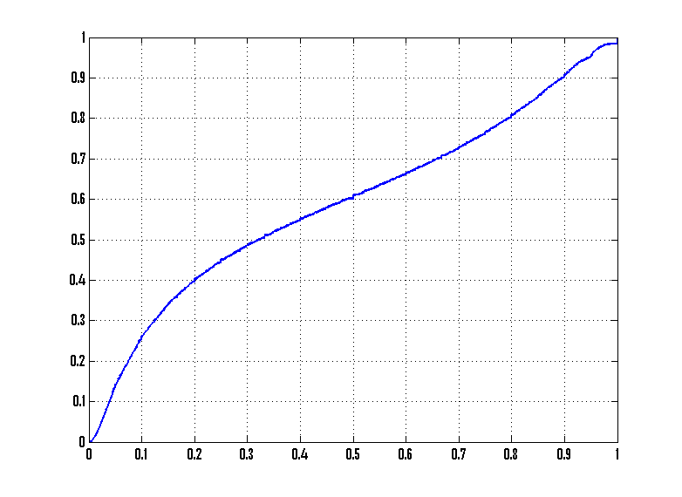

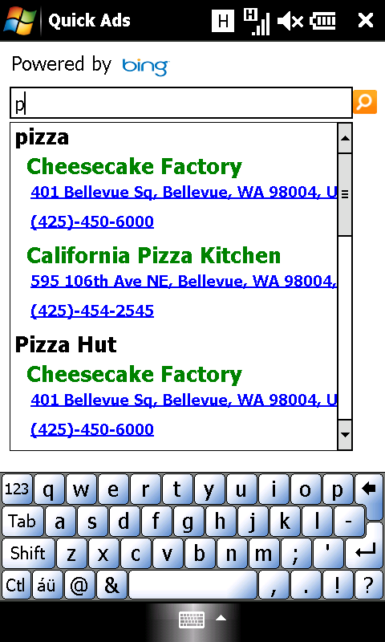
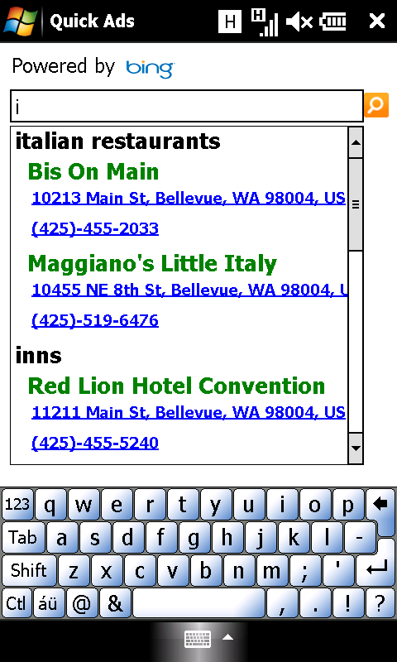
Mobile Search and Advertisement Cache Architecture
Dimitrios Lymberopoulos, Emmanouil Koukoumidis, Jie Liu, Doug Burger (MSR Redmond)
Varun Kansal, Chen Xia, Kenny Chien, Bin Wu, Fang Wang, Melissa Dunn (MAXPLAT)
Mobile Search Experience
Push Search/Ads to the Phone
Performance Bottleneck
m.bing.com
Sensing
Web
Data
Search/Ad Request
Data
Community+
Personal
…
3G
Data
Ads
Data
indexes
results
Subjective Cache
Context
+
Personalization
3G link is slow
Average end-to-end delay: 4-8 seconds
3G connection time: 10 - 30 seconds
Phone
Cloud
Leverage mobile trends
Increasing flash density at lower cost
Increasing processing power
Challenges
What information do we cache?
How do we cache it?
How do we manage it over time?
Goal: Faster Mobile Search Experience
SONGO (Search ON the GO): A Data-driven Architecture
Mobile Search Log Analysis - 100M Queries
results
Results Page Construction
Fetch links
SONGO cache
Ranking
…
…
user clicks
Rank links based on their quality
0.links
15.links
31.links
cache hit
results
Link Storage
(Flash ~ 1-2MB)
Aggregate Volume (%)
Percentage of Unique Users
query
Personalization
cache hit
Community
Query Hash | Link #1 | Link #2 | Flags
… | … | … | …
95431A49 | (08761A49, Q₁) | (98BA4311, Q₂) | 0xFFFFFFFF
… | … | … | …
1E51C65A | (18EE1A49, Q₃) | (08761A49, Q₄) | 0xFFFFFFFF
… | … | … | …
51BD34A3 | (08761A49, Q₅) | (98BA4311, Q₆) | 0xFFFFFFFF
… | … | … | …
Phone
SONGO cache
query
cache miss
periodic updates
m.bing.com
Hash Table
(RAM ~ 200KB)
Number of query-link pairs
Probability of a new query-link pair
Up-to-date Community Cache
Adjust Ranking Scores
60% of mobile query volume hits 6K queries and 4K links!
50% of the users repeat a query at least 70% of the time!
user clicks
Experimental Prototypes
On average 66% of the queries a user submits hit the cache
Beyond Web Search
Real-time:
search results
business lookups
ad delivery
Opportunities:
Faster user experience
Monetization of autosuggest
Fastest mobile ad delivery engine
Personalized ranking for search/ads
Privacy: profile on the phone
16x faster!
23x more energy efficient!

