Slide 1

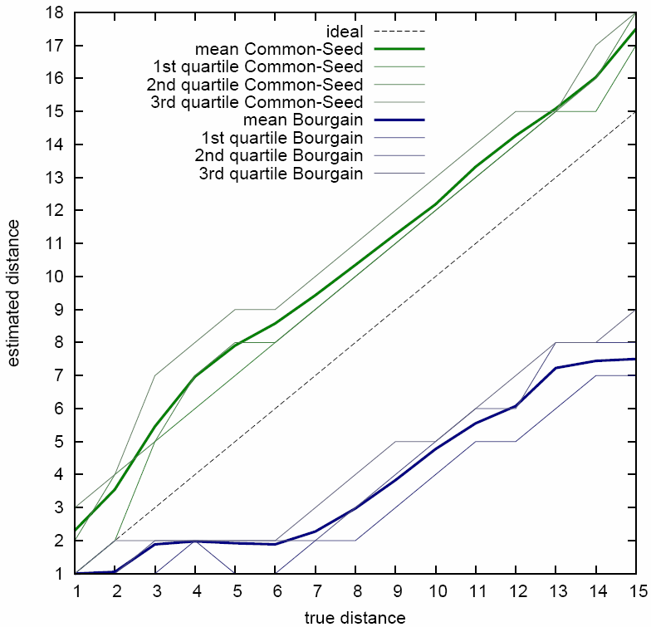
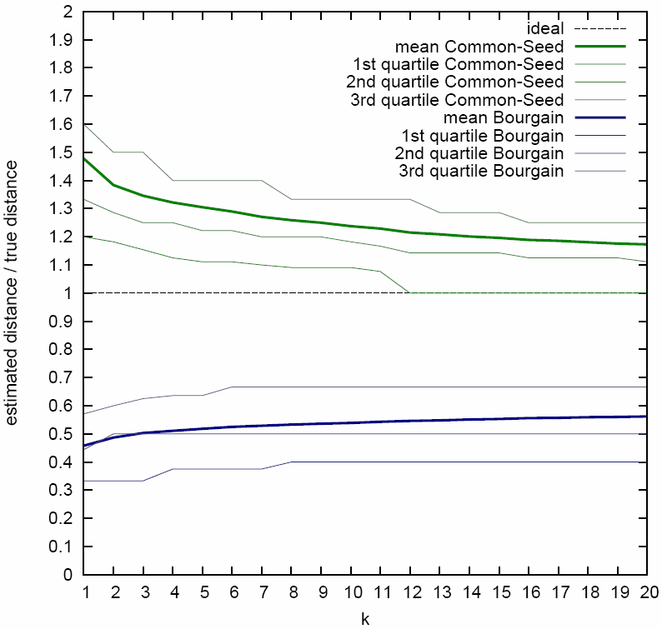
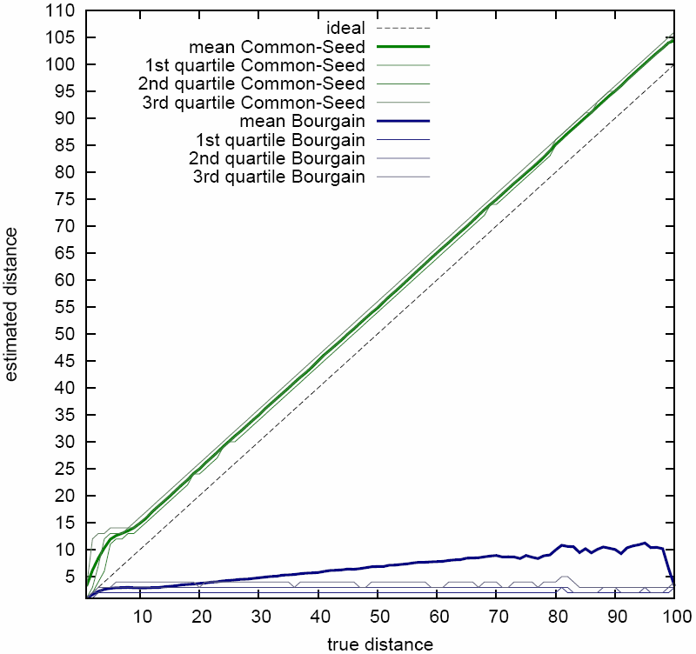
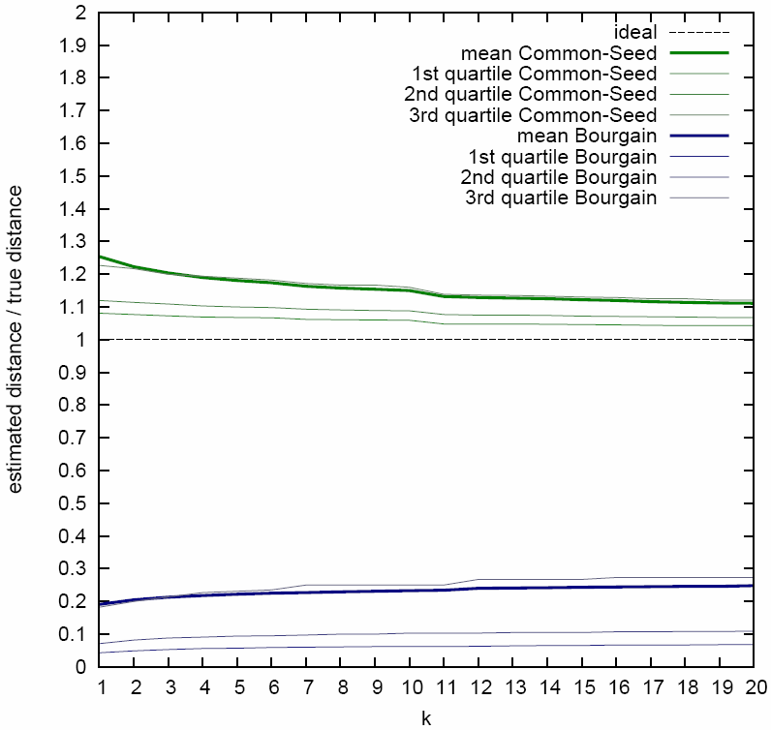
Sketch-Based Distance Estimates for Web Scale Graphs
Atish Das Sarma (Georgia Tech), Sreenivas Gollapudi, Marc Najork, and Rina Panigrahy (Microsoft)
Online Distance Computation on Massive Graphs
Distance/path computation on Social Networks
Distance between search and ad results
Building block for other online algorithms
Distance Computation Algorithm
pre-computation : all sketches
query time: nodes u and v
at runtime, retrieve
Road Networks
Already solved very efficiently – specific to 2D
Obama
Set
Sketch Based Distances
For all nodes x, precompute small information Sketch(x)
At query time, combine Sketch(u) and Sketch(v) to estimate distance.
Effectiveness of our Algorithm
You
Real Data
undirected
65M web pages, 420M URLs, 2.3B edges
C = 60M (directed), C = 128M (undirected)
Undirected distance [1,15]
Directed distance [1,100] (∞ otherwise)
Sketch size: (s+8)k |log C|bits
k = 3 number of copies of seed sets
s = 12 size of seed id. 8 to store distance
~200, 400 bytes for undirected, directed
Sketch computation
Repeatedly (k times), sample random set of nodes (S) of sizes 2⁰, 2¹, 2², …, 2^{│logC|} from candidate set C and store nearest node and distance to it from all nodes in the graph.
directed

