Slide 1
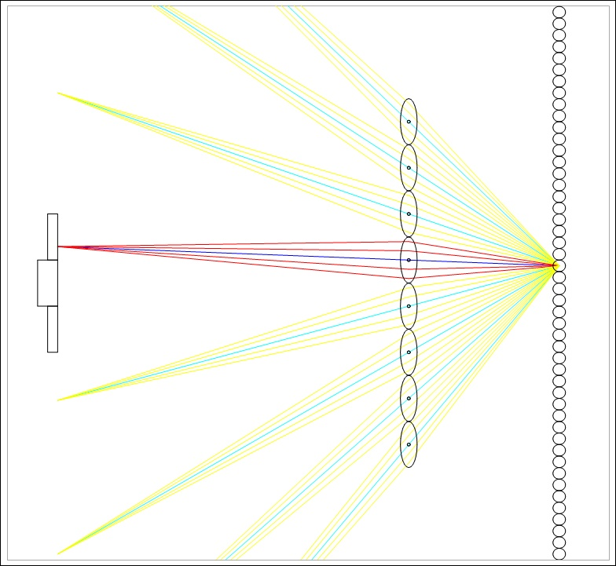
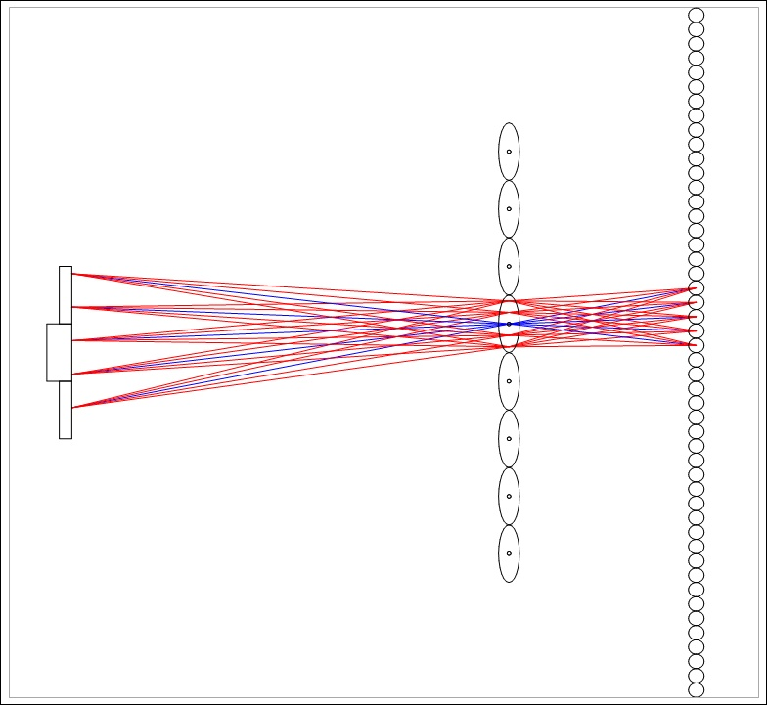
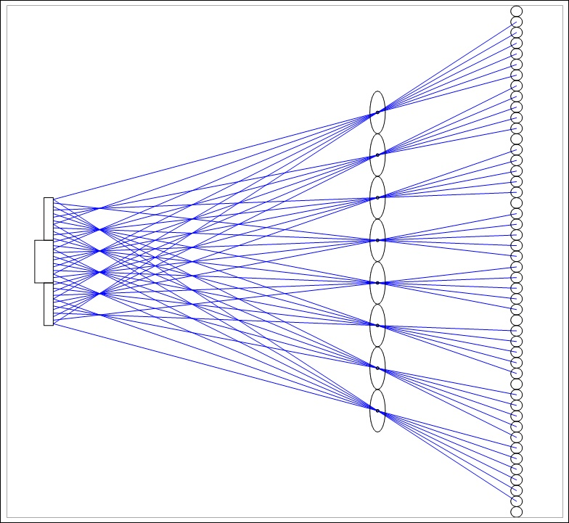
Stereo Display with Correct Focus Cues
LCD (8 pix/mm)
A new solution:
Create a high-resolution 4-D light field
Micro-lens array
(1 lens/mm)
Pupil in 10 mm aperture
Simulated object
Schematic model – not to scale
Challenge | Solution
Achieve adequate spatial resolution (30 cpd Nyquist) | Small micro-lenses (1 mm diameter) at a large viewing distance (3.5 m)
Achieve adequate angular resolution (~1 mm ray spacing at pupil) | Wide separation between the micro-lens array and the LCD panel (350 mm)
Simulate the effects of diffraction | PSF evaluation using QED path integration on a 1000-CPU DryadLINQ array
Determine LCD-pixel to aperture mapping | Calibration software using a sensitive, low-noise camera (Hamamatsu C4742-95)
Render stereo image pairs | Ray tracing with primary-ray casting directed by the calibration data
Screen with
directional pixels
Real world
Light-field display

