Slide 1
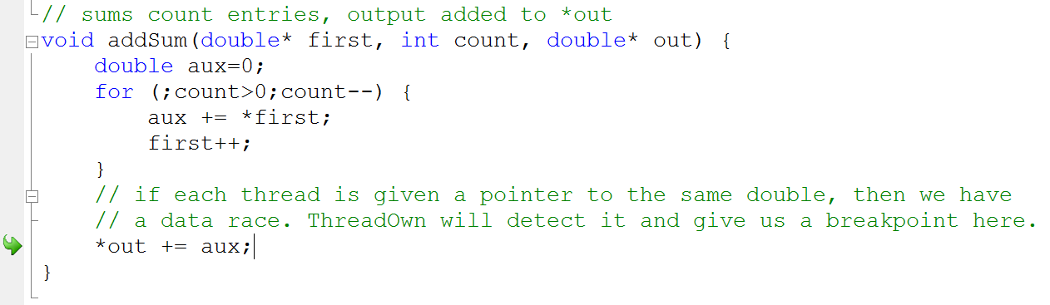
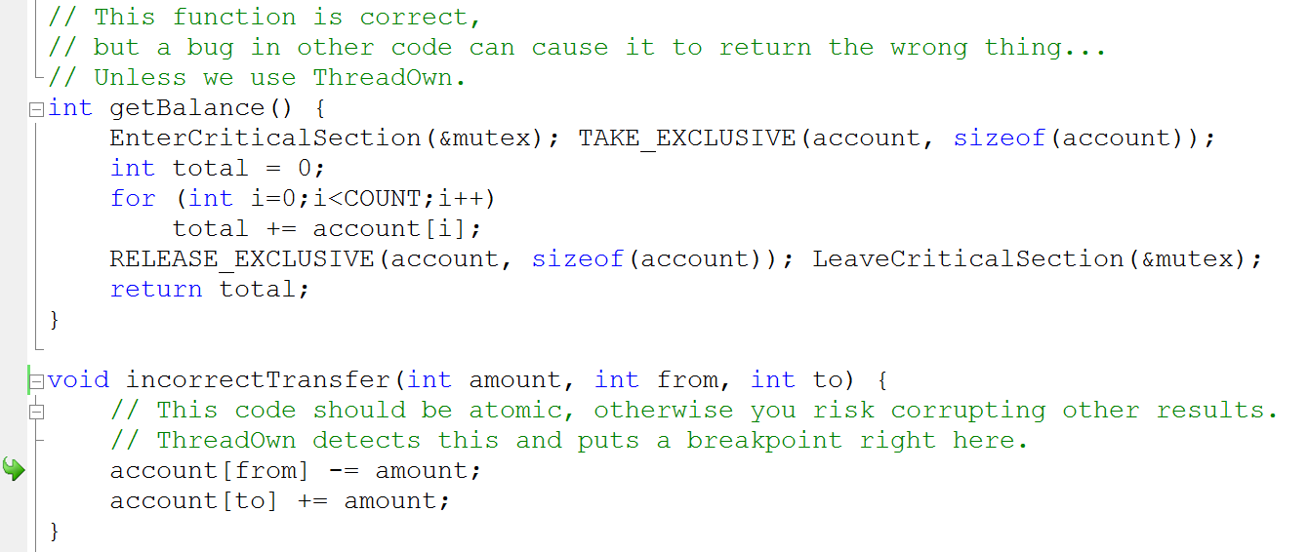
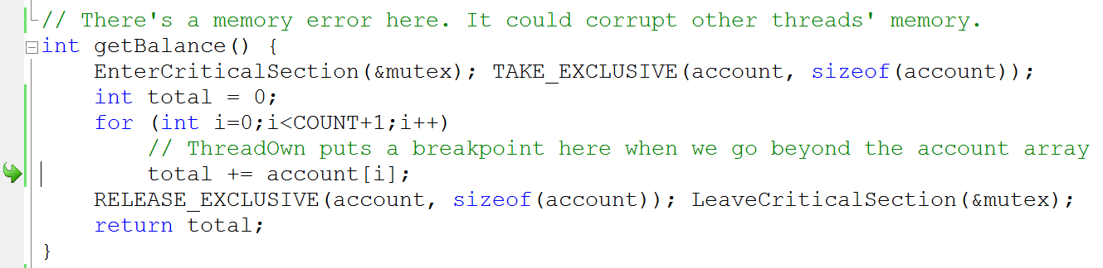






Thread Ownership of Memory
⇨ Finds sharing errors at runtime
Data races
Atomicity Violations
Memory Errors
⇨ Supports locks but also joins, events, condition variables, etc.
⇨ Cheap enough to keep in all debug builds
⇨ Ask me how!
by Jean-Philippe Martin, Michael Hicks, Manuel Costa, Periklis Akritidis, and Miguel Castro
(in collaboration between Microsoft Research and the University of Maryland, College Park)
contact: jpmartin@microsoft.com
or more details at: http://research.microsoft.com/apps/pubs/default.aspx?id=117864
Jean-Philippe Martin
Microsoft Research
Michael Hicks
University of Maryland, College Park
Manuel Costa
Microsoft Research
Periklis Akritidis
University of Cambridge
Miguel Castro
Microsoft Research

