Slide 1
Reconfigurable Network Topologies at Rack Scale
Sergey Legtchenko, Xiaohan Zhao, Daniel Cletheroe, Ant Rowstron
Microsoft Research Cambridge

Slide 2
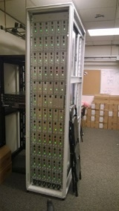
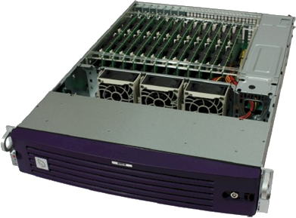

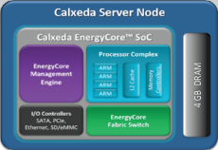
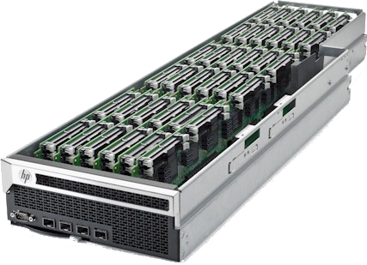

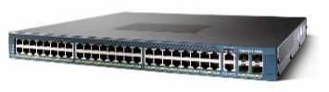
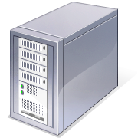

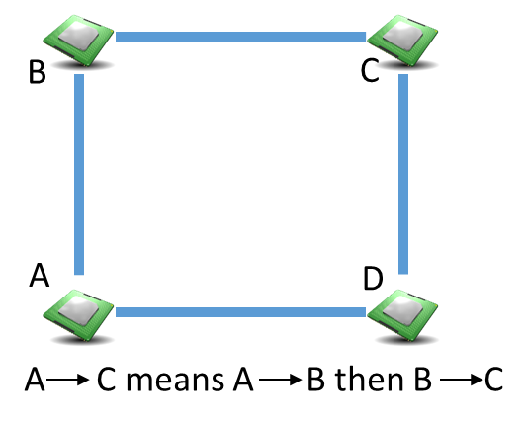
Networking for Rack-Scale Computers
Trend: density in the rack is increasing
  HP Moonshot: 360 cores in 4.3U
  Boston Viridis: 192 cores in 2U
  MSR Pelican: 9PB of storage/rack [OSDI 2014]
Systems-on-a-Chip
(SoC)
Challenge for in-rack networking
  Traditional racks: 40-80 servers + Top of Rack (ToR) switch
  Rack-scale computers: 100s/1,000s servers
  Hard to build 1,000-port ToRs
  Hard to add too many ToRs
Pelican rack
Distributed network fabrics
  SoCs with embedded packet switching
  no ToR: switching distributed across SoCs
  Direct uplinks to datacenter
  Cheap, low power, small physical space
Uplink to
datacenter

Slide 3
How to choose the topology?
125 SoCs, 6 links/SoC
Shortest path routing
Topology impacts performance
Topology must fit the workload
Workloads vary:
  Different traffic patterns
    Clustered, uniform…
  Different requirements
    Latency, bandwidth sensitive…
  Variability over time
    daily patterns, bursts…
Challenge:
No topology fits all workloads

Slide 4

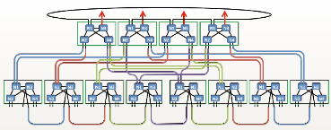

Looking for solutions…
Design the network for a workload?
  Lack of flexibility: one network fabric per workload
Overprovision the network?
  Higher cost
One static topology for all workloads?
  Less performant
HP Moonshot: 4 separate fabrics!
Servers to ToR switches (Radial)
Between servers (2D-Torus)
Servers to Storage (Custom)
Management (Radial)
Requirements:
  Flexibility: One network fabric for all workloads
  Performance: Topology must be adapted to the workload
  Low cost: No overprovisioning, hardware available today
Solution: reconfigurable topology

Slide 5



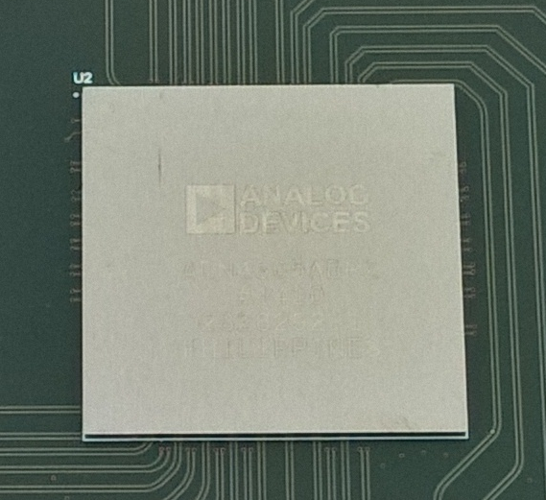

A Reconfigurable Topology
Principle: packet switching over circuit switching
Physical
Logical
Commodity crossbar switch ASICs
144x144 @ 10 Gbps
No queuing
Electrical signal forwarding
Cost : $3/port
Physical
circuit
PCB track
Crossbar
switch
Building blocks:
  SoCs with packet switches
  Crossbar switch
    N ports, each connected to a SoC
    physical circuits between SoCs
    Can be reconfigured at runtime
Physical
Physical
Physical
Logical
Logical
Logical
Crossbar switch
Crossbar switch
Crossbar switch
N
N
N

Slide 6

Circuit Switching Cost
Rack-scale fabric with N SoCs and d links/SoC
Do we need one crossbar with N x d ports?
We can do better: d crossbars of size N (typically d < 6)
  Possibility to connect each link of a SoC to any other SoC
  Any d-regular topology

Slide 7

XFabric Architecture Overview
Traffic monitoring
…
SoCs
1
2
3
n
L uplinks
Controller
Utility
function
Printed Circuit Board
Generate
topology
Nx(d+L)+L tracks
1
2
…
d
d + 1
…
d+L
Analyse
traffic
Configure
XSwitches
Crossbar Switches
Control plane
Instantiate
Instantiate
Uplink
map
Notes:
Speed to reconfigure

Slide 8
Controller: Challenges
Optimal topology for a given traffic?
  NP-Hard problem
  Time constraints (needs to run online)
Current approach: lightweight greedy algorithm
  Start with simple topology
  Add links that maximize utility
How to reconfigure at runtime without stopping traffic?
  Inconsistent forwarding state in the network
Current approach: controller-driven switch reconfiguration
  Manageable at rack-scale
  Lower inconsistency period: avoids distributed link state discovery

Slide 9
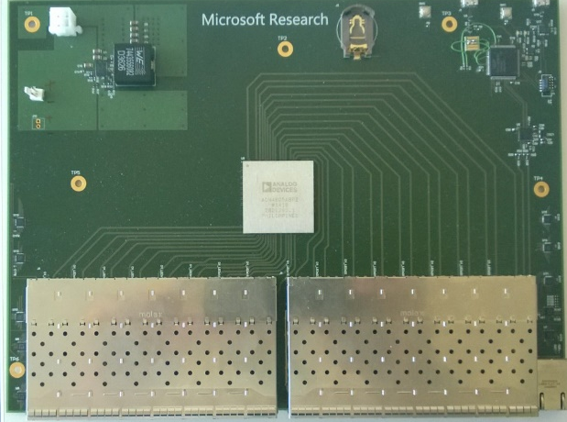
XFabric: Does It Work?
Building a rack-scale SoC emulator
  27 servers
  7 NICs/server, emulating SoC functionality
  Supports unmodified applications
Goals:
  Understand how to build SoCs
  How to build rack-scale systems
XSwitch hardware:
  Gen 1: 32x 1 Gbps
  Gen 2: 36x 40 Gbps (in progress)
Gen 1 XSwitch
microcontroller
32 Gigabit Ethernet ports
Non blocking 40x40 @ 1 Gbps/port

Slide 10
Performance of XFabric
Lower is
better
Flow-based simulation
  125 SoCs, 6 links/SoC
Utility function used:
  minimizing path length
Production workload trace
How stable are the workloads?
  Hourly reconfiguration
  2.7x path length reduction

Slide 11
Conclusion
Reconfigurable network topology
Packet switching over circuit switching
Benefits:
  Flexibility, performance, low cost
  Low cost: all components available today
Perspectives: exploring rack-scale design
  How to deliver performance without overprovisioning?
  Building proof-of-concept rack hardware [Pelican, OSDI 2014]
  Rethinking hardware and software at rack scale
    Flexible network stacks
    Tighter integration with storage, compute
10

