Slide 1
Secure Outsourced Aggregation via One-way Chains
Suman Nath, Microsoft Research
Haifeng Yu, National Univ. of Singapore
Haowen Chan, Carnegie Mellon University

Slide 2



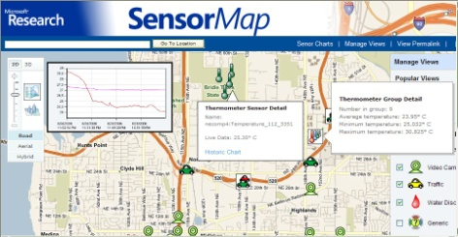
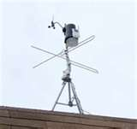
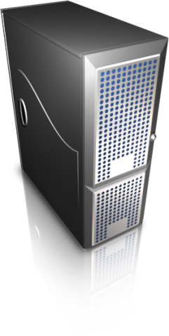


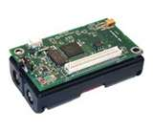
Wide-area Shared Sensing
SensorBase
Lets users query sensors through the Web
Internet
Sensors
Gateway
Aggregator
Portal

Slide 3
Unique Characteristics
Diverse queries
  Min/max, Count/sum/mean, Random Sample, Top-K, Quantiles, Frequent Readings, etc.
Push-based data collection
  Large number of sensors (e.g., >100K in SciScope)
  Query rate higher than data rate
Outsourced aggregation (e.g., SensorMap, SciScope)
  Scalability (network load at portal)
  Network proximity
  Privacy, economy
Unlike wireless sensor-nets

Slide 4
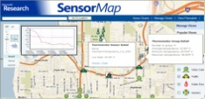

Malicious Aggregator
A malicious/compromised/lazy aggregator can report incorrect aggregation result
FloodWatch
Maximum water level: 3ft
(Flood warning if level >= 10ft)
3ft
Malicious aggregator
10ft
12ft
Aggregation service provider
Water level
9
10
8
10
11
12
Our goal: enable portal to verify whether and aggregate reported by aggregator is correct

Slide 5
Related Work
Outsourced database [Li’06, Narasimha’05, Pang’05]
  Does not consider aggregation queries
SIA [Chan’07]
  Only one central aggregator; multiple rounds
SHIA [Chan’06]
  Only Count; pull-based model
Proof-sketch [Garofalakis’07]
  Only Count; aggregators can safely cheat
Not suitable for wide-area sensing

Slide 6
Our Contribution
SECOA: a family of optimally secure aggregation protocols
  Supports a strict superset of aggregates supported by previous work (e.g., SIA, SHIA, Proof-sketch)
    Min/max, Count/Sum/Mean, Top-K Readings, Random Sample, Top-K Groups, Frequent Items, Popular Items, etc.
  Supports a push-based model
We use conceptually simple one-way chains
  We provide optimizations for up to 10⁵x speedup
Evaluation with prototype and real dataset

Slide 7
Outline
Problem Statement
System Model
Secure Algorithms
  Max
  Beyond Max
Evaluation

Slide 8

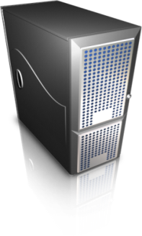

System Model
Internet
Aggregates +
Verification object
Sensors
Gateway
Aggregator
Portal
Portal knows the list of sensors
  Each sensor shares a symmetric key with portal
Sensors/portal loosely time synchronized
Sensors/Aggregators/Portal can do RSA
Sensor readings are integers

Slide 9
Attack Model
Byzantine aggregator
  Can fabricate, replay, duplicate, ignore readings
Malicious aggregators can collude
Sensors are trusted
  Fundamentally impossible to prevent
  Most aggregates we consider are robust against a small number of malicious sensors

Slide 10
Cryptographic Primitive
Message Authentication Code (MAC)
Key k
Key k
Integrity and
Authenticity of
message m
MAC Function
MAC M
MAC verifier
Message m
MAC M
One-way Chain
Uses one way function F,
e.g., MD5, SHA-1, RSA
0
1
2
3
F⁰ = s
F¹(s)=F(s)
F²(s)= F(F¹(s))
F³(s)= F(F²(s))
Given F and F^{k}, one can compute F^{i} (i>k), but not F^{i} (i<k)
SEAL (Self Authenticating Value) at position k: F^{k}
SEAL folding: Combine multiple SEALs into one
  Folded SEALs can be verified
  E.g., XOR of MD5 SEALs, Multiplication of RSA SEALs

Slide 11
Outline
Problem Statement
System Model
Secure Algorithms of SECOA
  Max
  Beyond Max
Evaluation

Slide 12

Secure Max (Sensor/Aggregator)
Water levels
Flood warning if max > 4
MAC
2
Aggregator output
Value = 2
Value = 5
0
1
2
3
4
5
One way chain
5
Inflation-free proof
MAC
4
Value = 4
0
1
2
3
4
5
One way chain
Deflation-free proof
(Folded SEAL)
MAC
5
Value = 5
0
1
2
3
4
5
One way chain
Malicious aggregator can inflate result and report 10
Malicious aggregator can deflate result and report 2

Slide 13
Secure Max (Portal)
Aggregator reports (5, MAC, folded SEAL)
Portal first checks if the MAC is valid
Portal then computes a reference SEAL
Checks if the reference SEAL = folded SEAL
0
1
2
3
4
5
0
1
2
3
4
5
Reference
folded SEAL
0
1
2
3
4
5
Theorem: the algorithm is optimally secure

Slide 14
Distributed Aggregator
Challenge: Roll folded SEALs forward ?
Portal
Fold at position 5??
Global max: 5
(Folded SEAL
At position 5)
Folded at position 3
Aggregator
Local max: 5
(Folded SEAL
at position 5)
Local max: 3
(Folded SEAL
at position 3)
Aggregator
Aggregator
Sensors
Sensors
Sensors

Slide 15
Homomorphic Function
Requirement
Necessary and sufficient condition:
  F(x . y) = F(x) . F(y) and F(x . y) = F(y . x)
    Homomorphic function
  Example: F = RSA encryption, = multiplication
  (More expensive than MD5, but can be made cheaper with clever optimizations)
0
1
2
3
0
1
2
3
0
1
2
3
0
1
Rolling → folding
Rolling → folding → rolling

Slide 16
Outline
Problem Statement
System Model
Secure Algorithms
  Max
  Beyond Max
Evaluation

Slide 17
Secure Count
Adapt Alon-Matias-Szegedy Algorithm
  Each sensor i picks a random value v_{i} (aka sketch), s.t. x chosen with probability 2^{-x}
  Max v = Max_{i}(v_{i})
  Est. Count = 2^{v} (increase accuracy with more sketches)
Other aggregates: Count Distinct, Sum, Mean
Problem: high overhead
  Example: 100K sensors, 300 sketches
    510 million rolling operations, 30 million folding operations
    A single query: 7 hours for RSA, 9 minutes for MD5

Slide 18
Reducing Rolling Cost
Folded Rolling: exploit homomorphism of RSA
  Aggressively fold
Fold
0
1
2
3
4
0
0
1
2
3
4
0
1
2
3
4
0
1
2
3
4
0
At the portal
0
1
2
3
4
0
1
2
3
4
0
1
2
3
4
0
1
2
0
1
2
3
4
0
1
2
3
4
At aggregators

Slide 19
Reducing Folding Cost
Portal still needs to fold many sensors per query
Tree (at portal): Index sensors as a tree
(e.g., B-Tree)
Sensor1
0
Sensor2
0
1
2
3
4
Sensor3
0
Logarithmic folding
Query

Slide 20
Other Aggregates
Top-K Readings
  Finds K sensors with maximum values
  One pass solution challenging
    An aggregator may not know the global top-K
    Locally produced proofs must be combined globally
Top-K Groups
  Group sensors (based on dynamic properties) and find k groups with maximum values
  Significantly more complicated than top-k readings
    Portal does not know grouping, so verification is hard
Details in paper

Slide 21
Other Aggregates
Uniformly random sample: Top-K
  Many other statistical aggregates from random sample
Most popular items: Top-K Groups
  Use item name as the group ID, AMS sketch as the group value
Items occurring above a threshold: Top-K Groups
  Use item name as the group ID, AMS sketch as group value, report groups above threshold

Slide 22
Outline
Problem Statement
System Model
Secure Algorithms
  Max
  Beyond Max
Evaluation

Slide 23
End-to-end Performance
Prototyped in SensorMap, using Crypto++ library
Dataset: 16,106 stream gauge sensors from USGS
2.5GHz Pentium desktops
Query | KB/query | Computation time (ms/query)
 | Portal | Sensor | Aggregator | Portal
Max | 0.5 | 0.84 | 11.97 | 1.05
Count | 3 | 35.97 | 158.9 | 1.11
Top-10 Readings | 1.5 | 1.09 | 10.9 | 1.12
Top-10 Groups | 1.6 | 0.78 | 8.2 | 80.9
320KB without
in-network aggregation

Slide 24
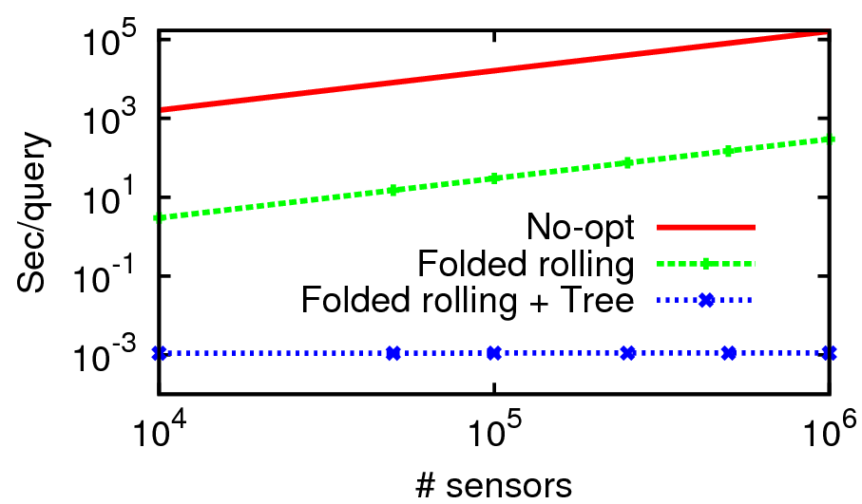
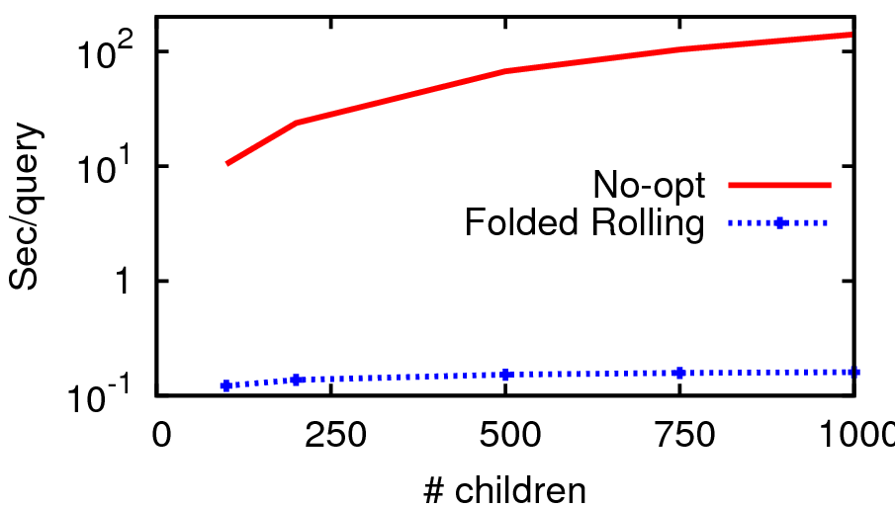
Effect of Optimizations
Computation costs (for Count)
At Portal
At Aggregator
Additional results in the paper

Slide 25
Conclusion
SECOA: a framework for outsourced aggregation
  Supports a large number of diverse queries
  Supports push-based model
  Optimally secure
  Supports hierarchical aggregators
  Has small computation/communication overhead
Future work: design a system without a centralized portal
Thank You

Slide 26
Backup slides

Slide 27
Distributed Aggregator
Challenge: Roll folded SEALs forward ?
Portal
Fold at position 5??
max: 5
Folded at position 3
Aggregator
max: 5
max: 3
5
Aggregator
Aggregator
2
3
Computed
by sensors
Sensors
Sensors
Sensors

Slide 28
One-pass Top-K
Solution: i’th top value has SEAL over all sensors excluding top i-1 values
80
80
61
F⁸⁰
75
12
F⁶¹
F¹²
61
10
F⁸⁰
26
F⁷⁵
20
75
F⁶¹
18
26
F⁷⁵
12
20
F²⁶
10
F²⁰
18
Optimally secure
Cost proportional to the top value and independent of k

Slide 29
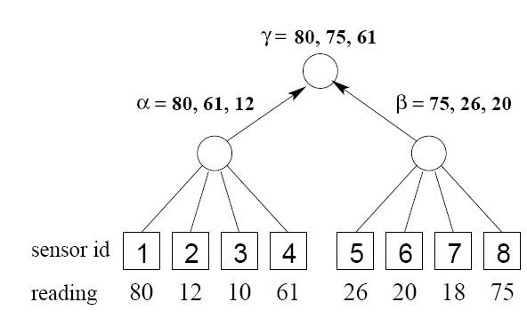
Top-K Readings
Challenge for a one-pass algorithm
  An aggregator may not know the globally top-k items
  Locally produced SEALs must be combined
  Solutions in the paper

Slide 30
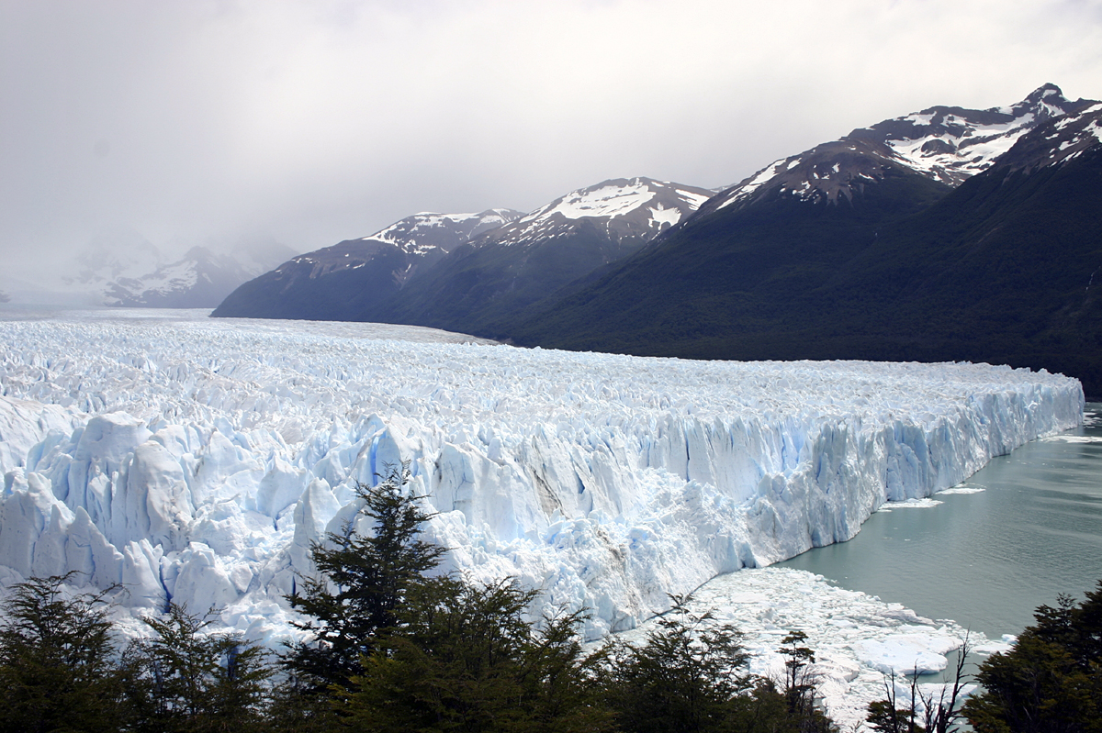
Top-K Groups
6
1
3
6
2
2
5
4
4
7
1
3
5
Significantly more difficult that Top-K Readings
  2nd Top value should exclude all items in the top group
  The portal may not know the group membership!
Solution in the paper

