Slide 1
Towards a DEEPER Empirical Understanding of CDCL SAT Solvers
Vijay Ganesh Assistant Professor, University of Waterloo, Canada
Keynote @ Constraints Solvers in Testing, Verification, and Analysis (CSTVA) July 17, 2016 Saarbrucken, Germany

Slide 2
MOTIVATION: The UNREASONABLE EFFECTIVENESS OF CDCL SAT SOLVERS
Conflict-driven clause learning (CDCL) SAT solvers are a key tool in software engineering and security applications, primarily due to their extraordinary efficiency
Example applications: SMT solvers, dynamic symbolic testing, bounded model-checking, liquid types, exploit construction, program analysis,…
Isn’t SAT supposed to be a hard problem. After all it is NP-complete
Yes, SAT is NP-complete. And, yes, in general we believe it to be hard
However, for many classes of very large industrial instances SAT solvers are very efficient. This is a mystery that has stumped theoreticians and practitioners alike
Build significantly more efficient SAT solvers

Slide 3
THE RESEARCH QUESTIONS IN UNDERSTANDING The UNREASONABLE EFFECTIVENESS OF CDCL SAT SOLVERS
Understand the input structure of SAT instances (e.g., community structure, backdoors,…) [WGS03, BSG09, AL12, NGFAS14,…]
Identify the most important techniques in CDCL SAT solvers [KSM11,…]
Define a precise model encompassing the most important techniques, e.g., branching [LGZC15]
Put all of this together in a complexity-theoretic framework [AFT11, PD11,…]

Slide 4
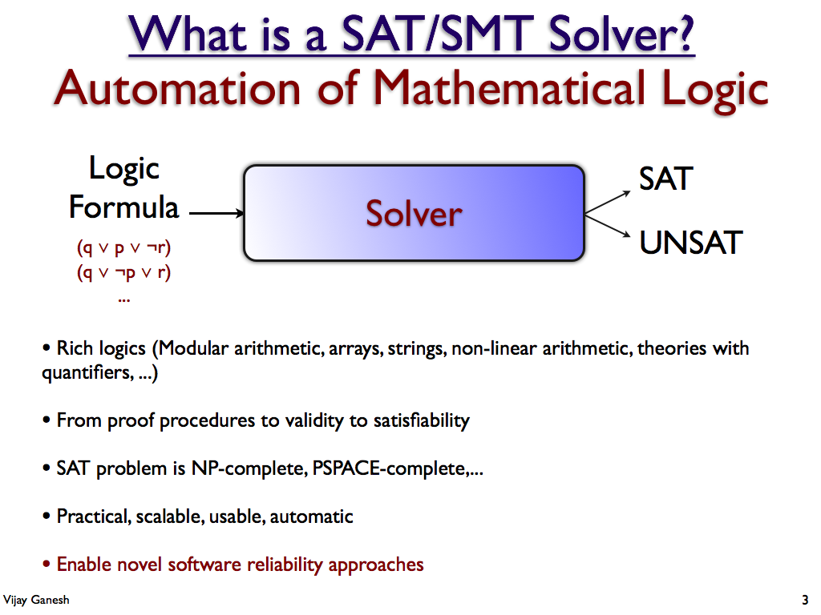

Slide 5
The boolean satisfiability problem some standard definitions
A literal p is a Boolean variable x or its negation ¬x. A clause C is a disjunction of literals: x₂ ∨ ¬x₄₁ ∨ x₁₅
A CNF is a conjunction of clauses: (x₂ ∨ ¬x₁ ∨ x₅) ∧ (x₆ ∨ ¬x₂) ∧ (x₃ ∨ ¬x₄ ∨ ¬x₆)
An assignment is a mapping from variables to Boolean values (True, False). A unit clause C is a clause with a single unbound literal
The Boolean SAT problem is
Find an assignment such that each input clause has a true literal (aka input formula is SAT) OR establish that input formula has no solution (aka input formula is UNSAT)
SAT solvers are required to output a solution if input is SAT (many solvers also produce a proof if input is UNSAT)
Boolean formulas are typically represented in DIMACS Format

Slide 6
DPLL SAT Solver Architecture The Basic Solver
DPLL(Θcnf, assign) {
Propagate unit clauses;
if ”conflict”: return FALSE;
if ”complete assign”: return TRUE;
”pick decision variable x”;
return
DPLL(Θcnf⎮x=0, assign[x=0])
|| DPLL(Θcnf⎮x=1, assign[x=1]);
}
Key Steps in a DPLL SAT Solver
Propagate (Boolean Constant Propagation)
Propagate inferences due to unit clauses
Most of solving “effort” goes into this step
Detect Conflict
Conflict: partial assignment is not satisfying
Decide (Branch)
Choose a variable & assign some value
Backtracking
Implicitly done via recursive calls in DPLL

Slide 7
Modern CDCL SAT Solver Architecture Key Steps and Data-structures
Input SAT Instance
Key steps
Decide()
Propagate() (Boolean constant propagation)
Conflict analysis and learning() (CDCL)
Backjump()
Forget()
Restart()
CDCL: Conflict-Driven Clause-Learning
Conflict analysis is a key step
Results in learning a learnt clause
Prunes the search space
Key data-structures (Solver state)
Stack or trail of partial assignments (AT)
Input clause database
Conflict clause database
Conflict graph
Decision level (DL) of a variable
Propagate()
(BCP)
Conflict?
All Vars
Assigned?
Conflict
Analysis()
Return
SAT
Decide()
TopLevel
Conflict?
Return
UNSAT
BackJump()

Slide 8
THE RESEARCH QUESTIONS IN UNDERSTANDING The UNREASONABLE EFFECTIVENESS OF CDCL SAT SOLVERS
Understand the input structure of SAT instances (e.g., community structure, backdoors,…) [WGS03, BSG09, AL12, NGFAS14,…]
Identify the most important techniques in CDCL SAT solvers [KSM11,…]
Define a precise model encompassing the most important techniques, e.g., branching [LGZC15]
Put all of this together in a complexity-theoretic framework [AFT11, PD11,…]

Slide 9
Talk Outline
Motivation
Background: Internals of SAT solvers
Problem statement
Our empirical discoveries
Characterizing industrial instances via community structure [LGRC15, NGFAS14]*
Understanding branching heuristics, a la, VSIDS [LGZC15]
LRB: A new branching heuristic [LGPC16, LGPC+16]**
Putting it all together, and conclusions
(* Won best paper award at SPLC 2015, and student paper award at SAT 2014. ** Won the SAT competition 2016)

Slide 10
Community Structure and SAT Solver Performance Graphs and their Community Structure
Question: How does one go about characterizing the structure of SAT instances?
Theorists have proposed a variety of metrics like backdoors, treewidth, …
We considered these measures, but found them to be inadequate in various ways. E.g., weak backdoors do not apply to unsatisfiable instances. Tree width has been shown to not correlate well with SAT solver performance.
Answer: The intuition we had was to focus on metrics that somehow mathematically characterize “important parts” of the SAT formula. We were hoping to argue that the solver somehow focuses on these “important parts” first, and thus solves very large instances without needing to “process” the entire formula.
Defining the “important part of a SAT formula” in a generic way is easier said than done
Community structure to rescue
View SAT formula as a variable-incidence graph. Partition the graph via the concept of community structure. Focus on highly-connected components.

Slide 11
A note on Community Structure in Graphs Applications in Various Domains
Community structure [GN03,CNM04,OL13] is used to study all kinds of complex networks.
Social Networks, e.g. Facebook
Internet
Protein networks
Neural network of the human brain
Citation graphs
Business networks
Populations
And more recently, the graph of logical formulas

Slide 12
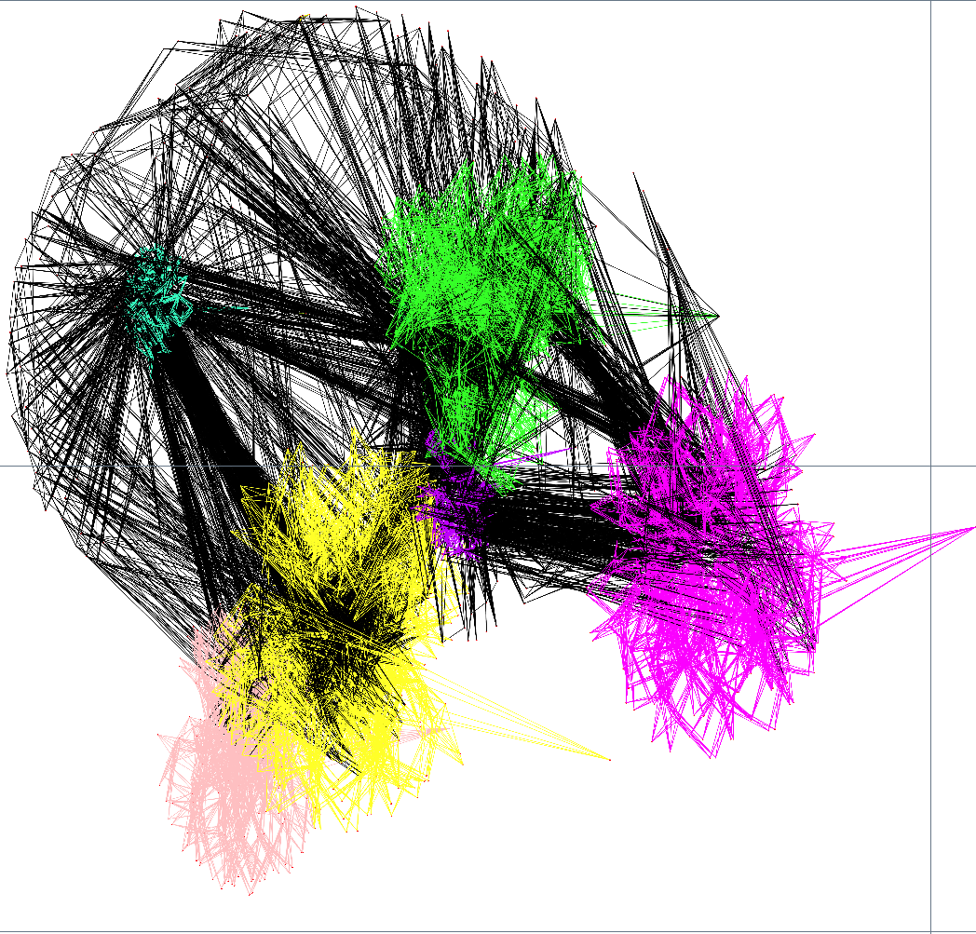
Community Structure in Graphs Variable-incidence Graph of Non-random Formula

Slide 13
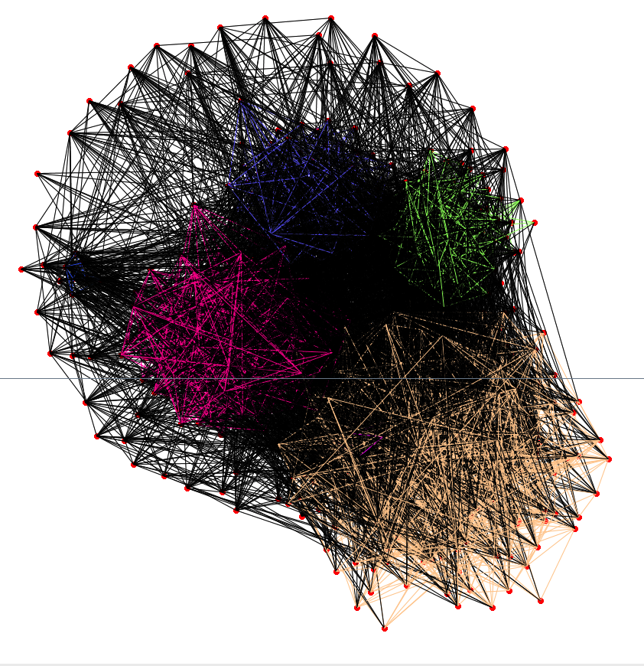
Community Structure in Graphs Variable-incidence Graph of Random Formula

Slide 14
Modularity and Communities in Graphs Community Structure in Graphs
Modularity (Q) of graph lies between 0 and 1
A weighted ratio of the number of edges inside communities to the total number of edges in the graph
Q measures quality
How separable are the communities in the graph
Higher Q implies “good community structure”, i.e. highly separable communities
Lower Q implies “bad community structure”, i.e. one giant hairy ball

Slide 15
Community Structure and SAT Solver Performance Empirical Results
Result #1: Hard random instances have low Q (0.05 ≤ Q ≤ 0.13)
Result #2: Number of communities and Q of SAT instances are more predictive of CDCL solver performance than other measures we considered
Result #3: Strong correlation between community structure and LBD (Literal Block Distance) in Glucose solver

Slide 16
Community Structure and SAT Solver Performance Characterizing Typical Inputs
Take-home Message
Community structure (the quality of which is measured using a metric called Q) of SAT instances strongly affect solver performance
Working towards
Small predictive set of features that forms the basis for a more complete explanation
Community structure idea needs to be constrained further to eliminate easy theoretical counter-examples
More broadly, community structure is a starting point for a line of research that enables us to identify “important sub-parts” of SAT formulas statically
Community structure and learning-sensitive with restarts (LSR) backdoors

Slide 17
Community Structure and SAT Solver Performance IMPACT of this idea
Impact of the Community Structure Idea
New techniques to exploit community structure by Giraldez-Cru, Levy, Simon,..
A flourishing of approaches being applied to partition SAT instances and identify the “most important” part to focus on first
Pseudo-industrial instance generators for SAT instances based on community structure
Theorists have been looking at community structure trying to refine it further
Comprehensive analyses of other structure metrics to explain SAT solver performance

Slide 18
Talk Outline
Motivation
Background: Internals of SAT solvers
Problem statement
Our empirical discoveries
Characterizing industrial instances via community structure [LGRC15, NGFAS14]*
Understanding branching heuristics, a la, VSIDS [LGZC15]
LRB: A new branching heuristic [LGPC16, LGPC+16]**
Putting it all together, and conclusions
(* Won best paper award at SPLC 2015, and student paper award at SAT 2014. ** Won the SAT competition 2016)

Slide 19
Modern CDCL SAT Solver Architecture Key Steps and Data-structures
Input SAT Instance
Key steps
Decide()
Propagate() (Boolean constant propagation)
Conflict analysis and learning() (CDCL)
Backjump()
Forget()
Restart()
CDCL: Conflict-Driven Clause-Learning
Conflict analysis is a key step
Results in learning a learnt clause
Prunes the search space
Key data-structures (Solver state)
Stack or trail of partial assignments (AT)
Input clause database
Conflict clause database
Conflict graph
Decision level (DL) of a variable
Propagate()
(BCP)
Conflict?
All Vars
Assigned?
Conflict
Analysis()
Return
SAT
Decide()
TopLevel
Conflict?
Return
UNSAT
BackJump()

Slide 20
What is a branching heuristic?
Partial Assignment
Decisions
Clause Learning
Propagations
Learnt Clause
A branching heuristic is a ranking function that computes a numeric metric called “activity”, and periodically dynamically ranks variables of an input formula based on activity
But the question remains “what computational problem does a branching heuristic solve?”

Slide 21
VSIDS (variable state independent decaying sum) Branching Heuristic
History
Bumping
Decaying
Proposed by the authors of the Chaff solver in 2001.
Give more weight to recent conflicts.
Little computational overhead.
Implemented by most competitive CDCL solvers.
Every variable has a floating-point number called “activity” score.
Activity scores are initialized to zero.
Add one (“bump”) to all the activities of variables occurring in conflict analysis.
Recent conflict analysis is more pertinent to the current state of the solving.
Multiply the activities of every variable by 0<d<1 after every conflict (“decay”).
21

Slide 22
VSIDS Questions
Answers
Why does VSIDS perform multiplicative decay?
Which variables does VSIDS bump, and why?
Does VSIDS demonstrate locality?
Exponential moving average (EMA)
High temporal degree variables, and bridge variables in the community structure
Yes, focuses on few communities
(Paper @ HVC 2015)

Slide 23
Problem Statement
ANSWER
What problem do branching heuristics solve? Define precisely the computational problem a branching heuristic is designed to solve.
Use the resultant understanding to improve the effectiveness of branching heuristics in CDCL SAT solvers.
View branching heuristic as technique to solve an optimization problem with a precise objective function, namely, learning rate. Use reinforcement learning to solve this problem.
The result is the LRB branching heuristic that outperforms VSIDS on a large, comprehensive set of benchmarks from SAT 2009-2014. MapleSAT solves 100+ more instances than MiniSAT. Also, MapleCMS is competitive against CMS, Glucose, and Lingeling.

Slide 24
Branching heuristic solves multi-objective Optimization problem
Partial Assignment
Decisions
Clause Learning
Propagations
Learnt Clause
Maximize:
Maximize the “quantity” of learnt clauses per unit time
Maximize learning rate
Maximize the “quality” of learnt clauses
We don’t know how to do this yet
Possible candidates for quality include clause length, firstUIP,…

Slide 25
Learning Rate Example
A = false, B = true, C = false,…
A = false, C = true, D = false,…
Student
Teacher
Student
Teacher
Learnt Clause: A or C
Learnt Clause: A or D
A = false, B = true, D = false,…
B = true, D = false,…
Student
Teacher
Student
Teacher
Learnt Clause: D or C
Learnt Clause: D or E
sampled_learning_rate(A) = 2/3
sampled_learning_rate(B) = 0/3

Slide 26
Learning Rate
learning_rate(X) = ℙ(X is in conflict analysis | X is assigned AND solver is in conflict)
Problem 1: Unfortunately, learning rate is hard to compute.
Can we estimate it?
Problem 2: Also, learning rate is constantly changing.
Need to adapt our estimate over time in an online fashion
Solution: Reinforcement learning techniques are ideal for such optimization problems
Notes:
The definition in paper is slightly different. X just has to be in the conflict analysis graph (this slide says X has to be in learnt clause for simplicity).

Slide 27
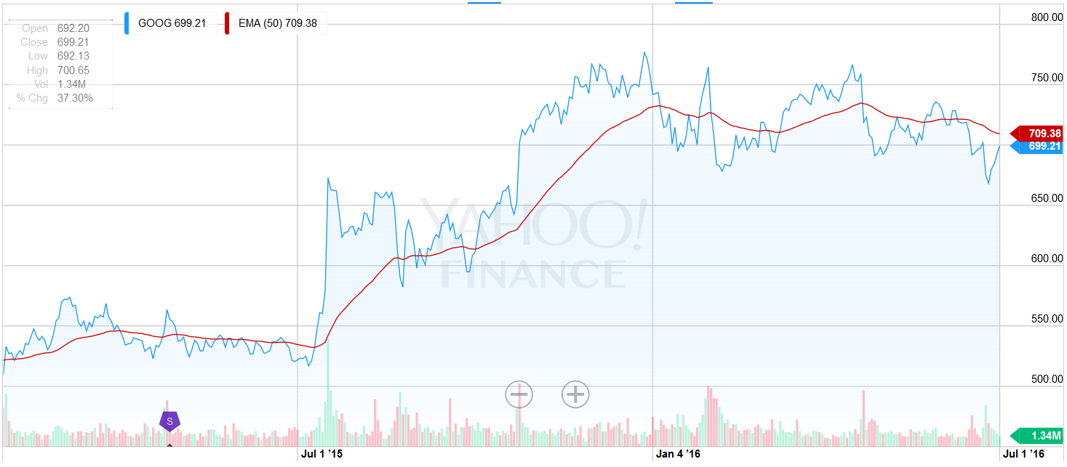
Exponential Moving Average (EMA)

Slide 28


Multi-Armed Bandit PROBLEM to MODEL BRANCHING HEURISTICS
p
p
p
$
$
$
Best slot machine to play (for now)
sample average = 1/3 × $4 + 1/3 × $3 + 1/3 × $1
exponential moving average = (1 – α)² × $4 + (1 – α)¹ × $3 + (1 – α)⁰ × $1
Less weight
More weight

Slide 29
Learning-Rate Branching (LRB) Example
A is assigned
A is assigned
B or D
A or D
C or D
B or C
A or E
B or E
C or E
A or B
A is unassigned
A is unassigned
“Rewards”
sampled_learning_rate(A) = 2/3
sampled_learning_rate(A) = 1/3
Activity(A)
exponential moving average = (1 – α)¹ × 2/3 + (1 – α)⁰ × 1/3

Slide 30
VSIDS
LRB (without Extensions)
The reward is a constant
Every time a variable appears in a learnt clause, its activity is additively bumped by a constant
The reward is not constant
Every time a variable appears in a learnt clause, the numerator of its learning rate reward is incremented. After each conflict, the denominator of each assigned variable’s learning rate reward is incremented
EMA performed for all variables at the same time
After each conflict, the activities of all variables are decayed
EMA performed only when variable goes from assigned to unassigned
When a variable is unassigned, the variable receives the learning rate reward, and the estimate Q is updated

Slide 31
Experimental SETUP
Benchmark consists of all the instances in the application and hard combinatorial categories from four previous SAT competitions (2009, 2011, 2013, 2014)
Total number of instances: 1975
Experiments performed on StarExec cluster with 5000 second timeout
The solvers we used in our experiments are:
MiniSat 2.2.0 with VSIDS replaced with CHB and LRB (MapleSAT)
CryptoMiniSat 4.5.3 with VSIDS replaced with LRB (MapleCMS)
Lingeling bal from 2015 SAT Race
Glucose 4.0
Notes:
Very small change in MiniSat source code.

Slide 32
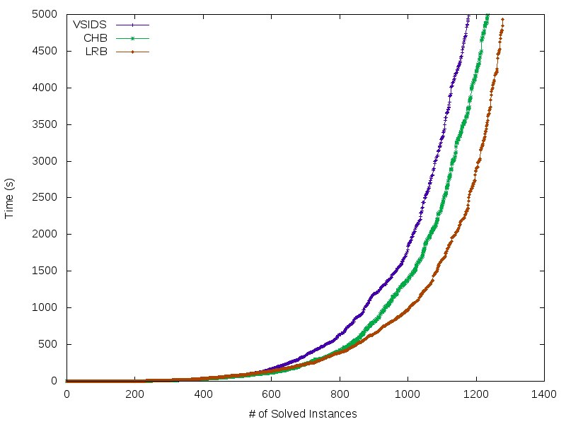
APPLE-TO-APPLE ResultS (Minisat WITH vsids vs. chb vs. lrb)
Notes:
Results generalize to Cryptominisat over the same benchmark

Slide 33
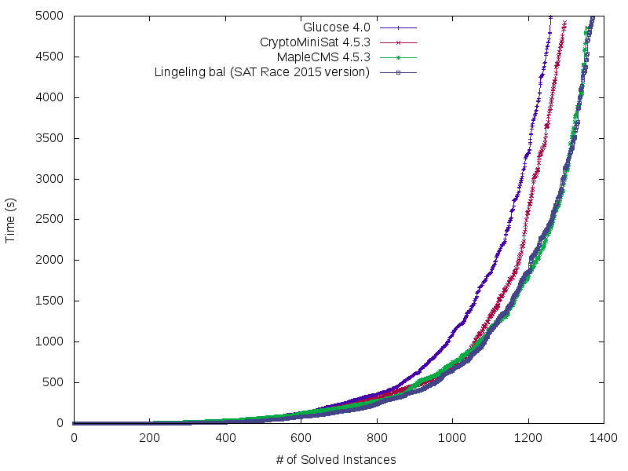
COMPARISON WITH STATE-OF-THE-ART: CryptoMinisat, MapleCMS, Glucose, and Lingeling
Notes:
Results generalize to Cryptominisat over the same benchmark

Slide 34
Result: Global Learning-Rate
Global Learning Rate: # of conflicts/# of decisions
Experimental setup: ran 1200+ application and hand-crafted instances on MapleSAT with VSIDS, CHB, LRB, Berkmin, DLIS, and JW with 5400 sec timeout per instance on StarExec
Branching Heuristic | Global Learning Rate
LRB | 0.452
MVSIDS | 0.410
CHB | 0.404
CVSIDS | 0.341
BERKMIN | 0.339
DLIS | 0.241
JW | 0.107

Slide 35
Future Work: Quality Of Learning
Simultaneously maximize learning rate and maximize the “quality” of learnt clauses.
Not all learnt clauses are created equal, good learnt clauses prune a lot of remaining search space.
Should branch on variables that will lead to high quality learnt-clauses.
Need to consider the trade-off between the two objectives: learning rate and quality.

Slide 36
Conclusion: Branching heuristics
LRB (and CHB) is shown to be a significant improvement over state-of-the-art VSIDS branching heuristic, for the first time in 15 years
View heuristics like the branching as an optimization problem with a learning rate objective function
Leverage reinforcement learning to solve such optimization problems, making use of the enormous amount of online data generated by a CDCL SAT solver
Online policy optimization is everywhere in SAT solvers

Slide 37
Talk Outline
Motivation
Background: Internals of SAT solvers
Problem statement
Our empirical discoveries
Characterizing industrial instances via community structure [LGRC15, NGFAS14]*
Understanding branching heuristics, a la, VSIDS [LGZC15]
LRB: A new branching heuristic [LGPC16, LGPC+16]**
Putting it all together, and conclusions

Slide 38
CONCLUSIONS: UNDERSTANDING The UNREASONABLE EFFECTIVENESS OF CDCL SAT SOLVERS
Result #1: Understand the input structure of industrial SAT instances (contrast with randomly hard ones)
Understanding: established empirically that community structure is more predictive of solver runtime than other measures
New techniques: many new proposals use community structure to refine SAT solver heuristics
Impact: potential deeper theoretical understanding, in conjunction with Result #2
Result #2: Branching heuristics are techniques to solve optimization problem of maximizing learning rate
Understanding: established much deeper understanding of branching heuristics via a model of SAT solver as a combination of reinforcement learning and a deductive corrective feedback algorithm
New techniques: invented LRB and CHB, first branching heuristics to beat VSIDS in 15+ years
Impact: winner of SAT competition 2016
Theoretical work? Ongoing

Slide 39
CURRENT PROJECTS AND Contributions
Name | Key Concept | Impact | Pubs
Z3-str String and Numeric Solver¹ | Novel techniques for string + integer combination | Analysis of Web Apps | FSE 2013 CAV 2015³
Maple Series of SAT Solvers, and understanding SAT | Branching heuristics, and community structure | Maple series of SAT solvers are among the fastest | AAAI 2016, SAT 2016 HVC 2015, SAT 2014³
MathCheck Conjecture Verifier | CAS+SAT combination | Finitely verified math conjectures | IJCAI 2016, CASC 2016, CADE 2015³
Undecidability results for theories over strings | New reductions | Solved open problems | HVC 2012, Under submission
Attack-resistance | A new approach to formally establishing the efficacy of security defenses |  | PLAS 2015
100+ research projects use STP, HAMPI, and Z3str2.
STP won the SMTCOMP 2006/2010 and second in 2011/2014 competitions for bit-vector solvers
Best paper awards/honors at various conferences including SAT, DATE, SPLC, CAV, and CADE
Retargetable Compiler (DATE 1999, 2008). Ten Year Most-influential paper award at DATE 2008.
Notes:
Impact formal methods, analysis, testing, etc.
Systems, logic and complexity

Slide 40
PAST Contributions
Name | Key Concept | Impact | Pubs
STP Bit-vector & Array Solver^{1,2} | Abstraction-refinement for solving | Concolic Testing | CAV 2007 CCS 2006 TISSEC 2008
HAMPI String Solver¹ | App-driven bounding for solving | Analysis of Web Apps | ISSTA 2009³ TOSEM 2012 CAV 2011
Taint-based Fuzzing | Data flow is cheaper than concolic | Scales better than concolic | ICSE 2009
Automatic Input Rectification | Automatic security envelope | New security approach | ICSE 2012
Undecidability results for theories over strings | New reductions | Solved open problems | HVC 2012
100+ research projects use STP, HAMPI, and Z3str2.
STP won the SMTCOMP 2006/2010 and second in 2011/2014 competitions for bit-vector solvers
Best paper awards/honors at various conferences including SAT, DATE, SPLC, CAV, and CADE
Retargetable Compiler (DATE 1999, 2008). Ten Year Most-influential paper award at DATE 2008.
Notes:
Impact formal methods, analysis, testing, etc.
Systems, logic and complexity

Slide 41
References
[WGS03] Williams, R., Gomes, C.P. and Selman, B., 2003. Backdoors to typical case complexity. In IJCAI 2003
[BSG09] Dilkina, B., Gomes, C.P. and Sabharwal, A., 2009. Backdoors in the context of learning. In SAT 2009
[AL12] Ansótegui, C., Giráldez-Cru, J. and Levy, J., 2012. The community structure of SAT formulas. In SAT
[NGFAS14] Newsham, Z., Ganesh, V., Fischmeister, S., Audemard, G. and Simon, L., 2014. Impact of community structure on SAT solver performance. In SAT 2014
[KSM11] Katebi, H., Sakallah, K.A. and Marques-Silva, J.P., 2011. Empirical study of the anatomy of modern SAT solvers. In SAT 2011
[LGZC15] Liang, J.H., Ganesh, V., Zulkoski, E., Zaman, A. and Czarnecki, K., 2015. Understanding VSIDS branching heuristics in conflict-driven clause-learning SAT solvers. In HVC 2015.
[MMZZM01] Moskewicz, M.W., Madigan, C.F., Zhao, Y., Zhang, L. and Malik, S., 2001. Chaff: Engineering an efficient SAT solver. In DAC 2001
[B09] Biere, A., 2008. Adaptive restart strategies for conflict driven SAT solvers. In SAT 2008
[LGPC16] Liang, J.H., Ganesh, V., Poupart, P., and Czarnecki, K. Learning Rate Based Branching Heuristic for SAT Solvers. In SAT 2016
[LGPC+16] Liang, J.H., Ganesh, V., Poupart, P., and Czarnecki, K. Conflict-history Based Branching Heuristic for SAT Solvers. In AAAI 2016
[LGRC15] Liang, J.H., Ganesh, V., Raman, V., and Czarnecki, K. SAT-based Analysis of Large Real-world Feature Models are Easy. In SPLC 2015

Slide 42
THANKS! MAPLE SERIES OF SAT SOLVERS HERE: https://sites.google.com/a/gsd.uwaterloo.ca/maplesat/ QUESTIONS?

