Slide 1
Counterexample Generation for Separation-Logic-Based Proofs
Arlen Cox
Samin Ishtiaq
Josh Berdine
Christoph Wintersteiger

Slide 2


SLAYER
Abstraction-based Static Analyzer
Uses Separation Logic
Proves Memory Safety of Heap Manipulating Programs
Shape Analysis
Abstraction-based Static Analyzer
Abstract Counterexamples
Failure to prove does not imply that a bug has been found
Even if the bug is real, the counterexample is still abstract

Slide 3
SLAYER Results
UNSAFE?
SAFE
UNSAFE
UNSAFE?
SAFE

Slide 4
Concrete Counterexamples
If unsafe, return a set of inputs causing failure
Program inputs
Nondeterministic assignments
Established Techniques
Symbolic Execution (Sage, KLEE)
Bounded Model Checking (CBMC)

Slide 5
Symbolic Execution
t := alloc(2)
*(t+next) := l
l := t
l := 0
l := *(l+next)
return

Slide 6
Symbolic Execution
t := alloc(2)
*(t+next) := l
l := t
l := 0
l := *(l+next)
return

Slide 7
Symbolic Execution
t := alloc(2)
*(t+next) := l
l := t
l := 0
l := *(l+next)
return

Slide 8
Symbolic Execution
t := alloc(2)
*(t+next) := l
l := t
l := 0
l := *(l+next)
return

Slide 9
Symbolic Execution
Heuristics guide the search
Whole paths are checked before checking other paths
No guarantees any particular bug will be found

Slide 10
Bounded Model Checking
t := alloc(2)
*(t+next) := l
l := t
l := 0
l := *(l+next)
return

Slide 11
Bounded Model Checking
l := 0

Slide 12
Bounded Model Checking
t := alloc(2)
*(t+next) := l
l := t
l := 0

Slide 13
Bounded Model Checking
t := alloc(2)
*(t+next) := l
l := t
t := alloc(2)
*(t+next) := l
l := t
l := 0
l := *(l+next)

Slide 14
Bounded Model Checking
t := alloc(2)
*(t+next) := l
l := t
t := alloc(2)
*(t+next) := l
l := t
t := alloc(2)
*(t+next) := l
l := t
l := 0
l := *(l+next)
l := *(l+next)
l := *(l+next)
return

Slide 15
Bounded Model Checking
Complete search up to some depth
Searching all branches may be time consuming
Depth of search may be insufficient
Use failed separation logic proof to prune branches

Slide 16
BMC on Abstract Counterexample
Program
Statements
Perform BMC on abstract counterexample, unrolling loops
Prune any states that are not on a path to error
Use state constraints to restrict search
(would work for symbolic execution as well)
Abstract State S (constraints)
Program
Statements
Abstract State S’ (constraints)

Slide 17




Abstract Counterexample
$$emp$$
l := 0
t := alloc(2)
*(t+next) := l
l := t
$$∃k. ls^{k}(l,0)$$
$$∃k. ls^{k}(l,0)$$
l := *(l+next)
$$ERROR$$

Slide 18



Abstract Counterexample
$$emp$$
l := 0
t := alloc(2)
*(t+next) := l
l := t
$$∃k. ls^{k}(l,0)$$
$$∃k. ls^{k}(l,0)$$
l := *(l+next)
$$ERROR$$

Slide 19
Practicalities
Use Z3 to perform BMC
Z3 doesn’t understand separation logic
Weaken formulas to first order
A different way of encoding BMC
Make Z3 do all of the work
No iteration: give Z3 a single problem

Slide 20
Prune and Weaken
emp
l := 0
First-order sub-formula
t := alloc(2)
*(t+next) := l
l := t
true
l := *(l+next)
ERROR

Slide 21
BMC Safety Violations
Satisfiable
Array/Structure out of bounds
Access unallocated memory/NULL
Double free
Free of incorrect memory
Unsatisfiable
No violation within bounds
Heap size
Unrolling limit

Slide 22
Precise Word-Level Memory Model
0
1
2
3
4
5
6
7
8
9
Heap
Alloc
Size
0
0
0
0
0
0
0
0
0
0

Slide 23
Precise Word-Level Memory Model
alloc(3)
0
1
2
3
4
5
6
7
8
9
Heap
Alloc
x
x
x
Size
0
0
3
0
0
0
0
0
0
0

Slide 24
Precise Word-Level Memory Model
*4 = 17
0
1
2
3
4
5
6
7
8
9
Heap
17
Alloc
x
x
x
Size
0
0
3
0
0
0
0
0
0
0

Slide 25
Precise Word-Level Memory Model
free(2)
0
1
2
3
4
5
6
7
8
9
Heap
17
Alloc
Size
0
0
0
0
0
0
0
0
0
0

Slide 26
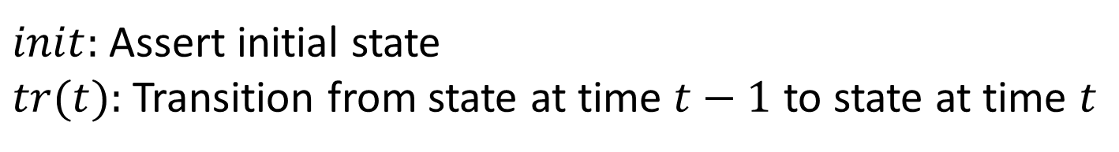
Encoding – High Level
Use UFBV logic: Quantified bit-vectors
with uninterpreted functions
$$init∧∀t. t>0∧t<n→tr(t)$$
$init:$ Assert initial state
$tr(t):$ Transition from state at time $t−1$ to state at time $t$

Slide 27
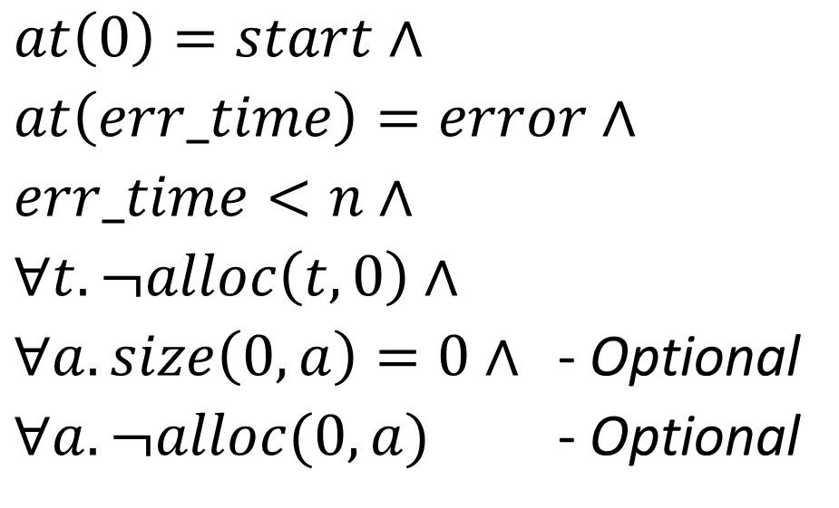
Initial state
$at\left(0\right)=start∧$
$at\left(err_time\right)=error∧$
$err_time<n∧$
$∀t. ¬alloc\left(t,0\right)∧$
$∀a. size\left(0,a\right)=0∧$ - Optional
$∀a. ¬alloc(0,a)$ - Optional

Slide 28

Transition
$tr\left(t\right)=$
$$\bigwedge_{v∈V}{at\left(t−1\right)=v→\bigvee_{\left(v,v^{′}\right)∈E}{encode(t,C\left(v,v^{′}\right))}}$$

Slide 29
Encode
Step whole basic block
Eliminates quantifiers based on structure of program
Use state in encoder
Maximize structure sharing
Reduce quantifiers and uninterpreted functions

Slide 30
Encode – Threading State
Initialize
State
Store State
To Successor
Encode
Stmt
Encode
Stmt
Encode
Stmt
…
To Error
To Error
To Error

Slide 31
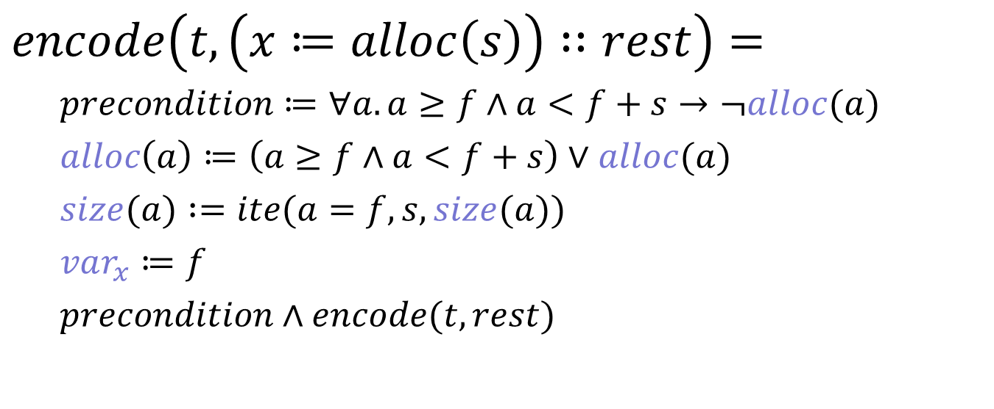
Encode - alloc
$encode\left(t,\left(x≔alloc\left(s\right)\right)∷rest\right)=$
$precondition≔∀a.a≥f∧a<f+s→¬alloc(a)$
$alloc\left(a\right)≔\left(a≥f∧a<f+s\right)∨alloc(a)$
$size(a) :=ite(a=f,s,size(a))$
$var_{x}≔f$
$precondition∧encode(t, rest)$

Slide 32
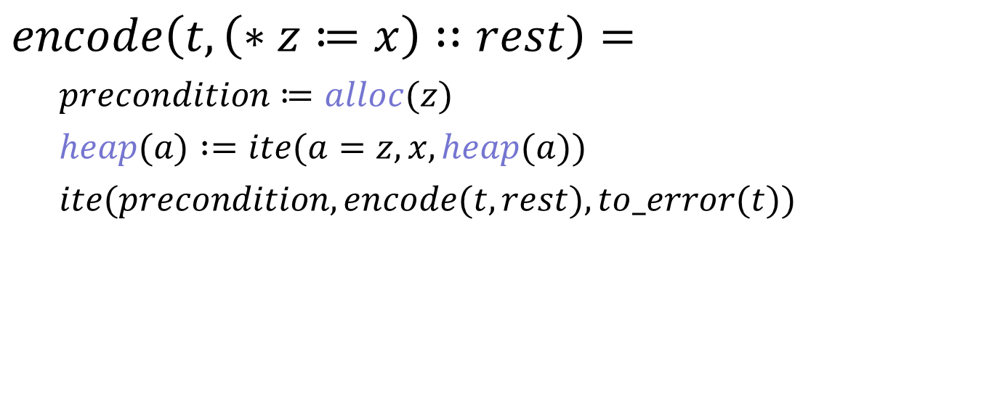
Encode - store
$encode\left(t,\left(∗z≔x\right)∷rest\right)=$
$precondition≔alloc(z)$
$heap(a) :=ite(a=z,x,heap(a))$
$ite(precondition, encode(t, rest), to_error(t))$

Slide 33
Process Summary
SLAYER
Separation Logic Analysis
C Program
SAFE
UNSAFE + COUNTEREXAMPLE
Abstract
Transition
System
SAT
BMC Encoder
Z3
UNSAFE?
SMT-LIB
UNSAT

Slide 34
Performance
Equivalent to SLAYER on sample problems
Problems like example < 0.5s
Scalability unknown
Not competitive with Sage or KLEE
Z3 could match or beat Sage or KLEE, though.

Slide 35
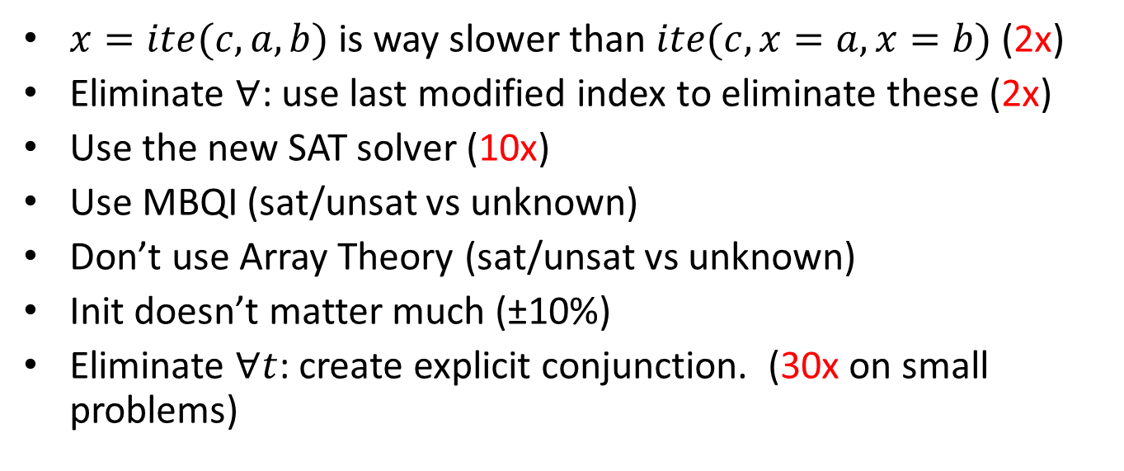
Z3 Pain Relief
$x=ite(c,a,b)$is way slower than $ite(c,x=a,x=b)$ (2x)
Eliminate $∀$: use last modified index to eliminate these (2x)
Use the new SAT solver (10x)
Use MBQI (sat/unsat vs unknown)
Don’t use Array Theory (sat/unsat vs unknown)
Init doesn’t matter much (±10%)
Eliminate $∀t$: create explicit conjunction. (30x on small problems)

Slide 36
Questions?

Slide 38
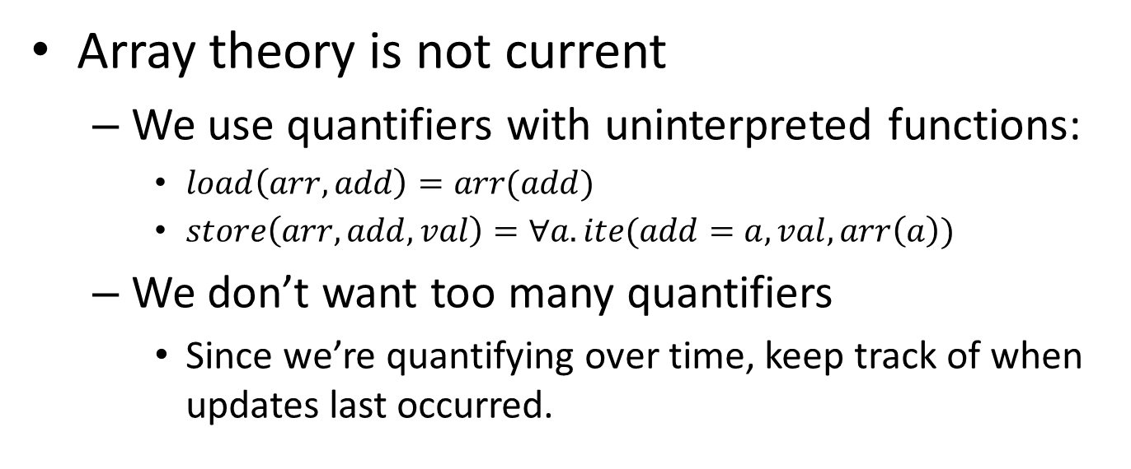
Array theory?
Array theory is not current
We use quantifiers with uninterpreted functions:
$load\left(arr,add\right)=arr(add)$
$store\left(arr,add,val\right)=∀a. ite(add=a,val,arr\left(a\right))$
We don’t want too many quantifiers
Since we’re quantifying over time, keep track of when updates last occurred.

Slide 39
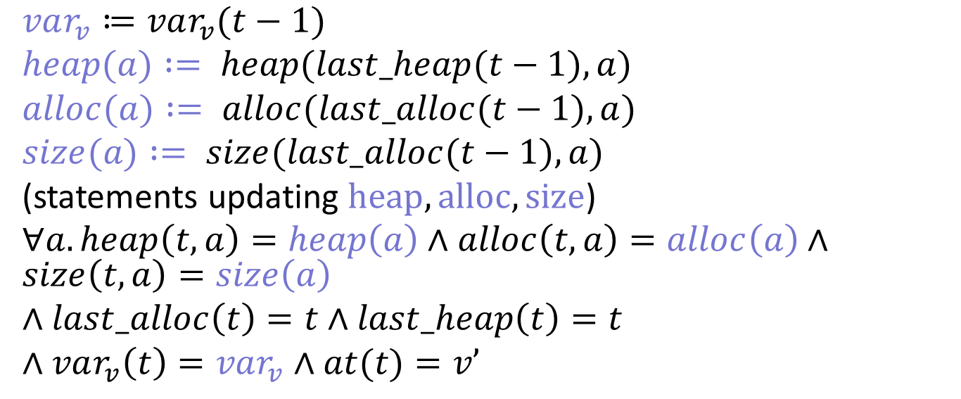
Encoding a basic block
$var_{v}≔var_{v}(t−1)$
$heap(a) := heap(last_heap(t−1),a)$
$alloc(a) := alloc(last_alloc(t−1),a)$
$size(a) := size(last_alloc(t−1),a)$
(statements updating $heap, alloc, size$)
$∀a. heap\left(t,a\right)=heap\left(a\right)∧alloc\left(t,a\right)=alloc\left(a\right)∧size\left(t,a\right)=size\left(a\right)$
$∧last_alloc\left(t\right)=t$ $∧last_heap\left(t\right)=t$
$∧var_{v}\left(t\right)=var_{v}$ $∧at(t)=v’$

