Slide 1
Solving trust issues using Z3
Moritz Y. Becker, Nik Sultana Alessandra Russo Masoud Koleini
Microsoft Research, Cambridge Imperial College Birmingham University
Z3 SIG, November 2011

Slide 2
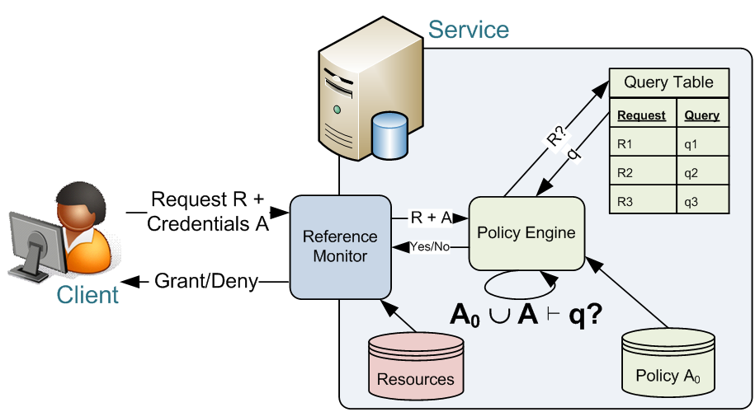
probe
e.g. SecPAL, DKAL, Binder, RT, ...
observe
What can be detected
about policy A₀?
Infer?

Slide 3



A simple probing attack
Svc says secretAg(Bob)!
[Gurevich et al., CSF 2008]
Alice says
A = {Alice says foo if secretAg(Bob)}
q = access?
Alice
1
Svc
$$A_{0}^{}$$
No: A₀ ∪ A ⊬ q
A = { Alice says foo if secretAg(Bob),
Alice says Svc cansay secretAg(Bob) }
q = access?
2
Yes: A₀ ∪ A ⊢ q
Svc says secrAg(B)⇒ Alice says secrAg(B)
Alice can detect “Svc says secretAg(Bob)”!
(There’s also an attack on DKAL2, to appear in: “Information Flow in Trust Management Systems”, Journal of Computer Security.)

Slide 4
Challenges
What does “attack”, “detect”, etc. mean?*
What can the attacker (not) detect?
How do we automate?
*Based on “Information Flow in Credential Systems”, Moritz Y. Becker, CSF 2010

Slide 6
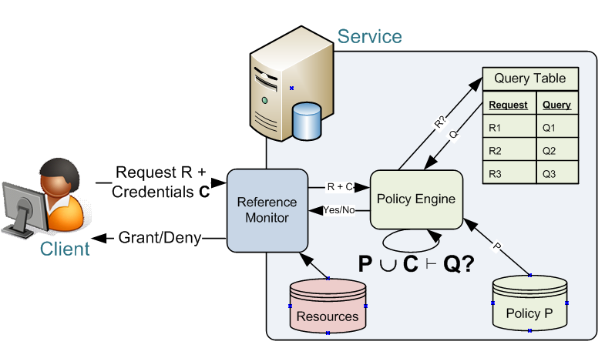
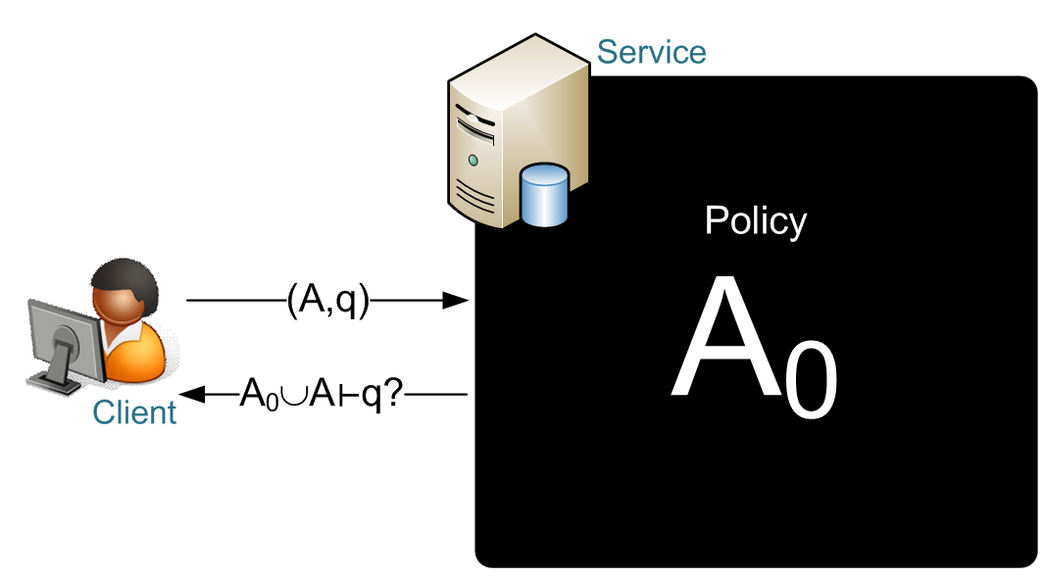
probe

Slide 7
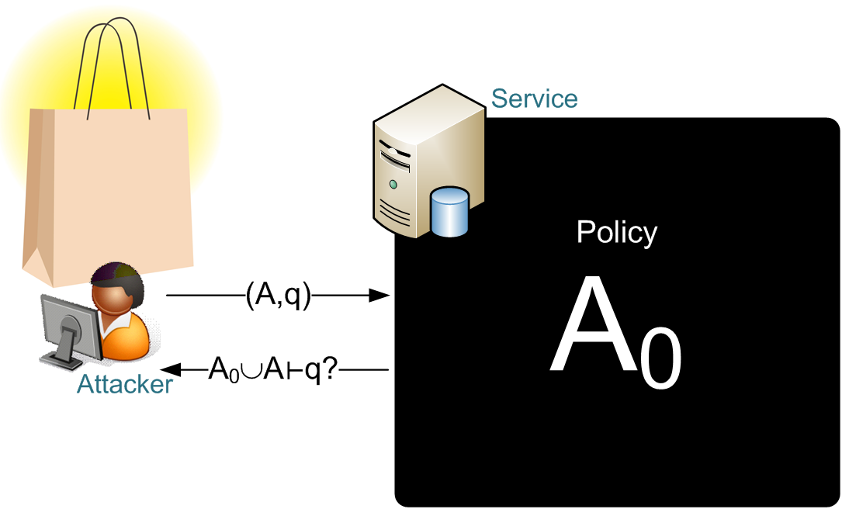




Available probes
$(A_{1},q_{1}$)
$(A_{2},q_{2}$)
$(A_{3},q_{3}$)
$(A_{4},q_{4}$)

Slide 8



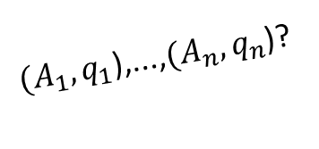

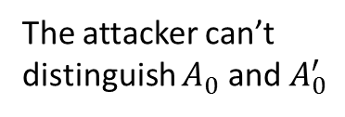
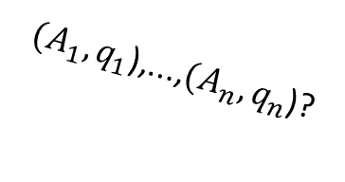
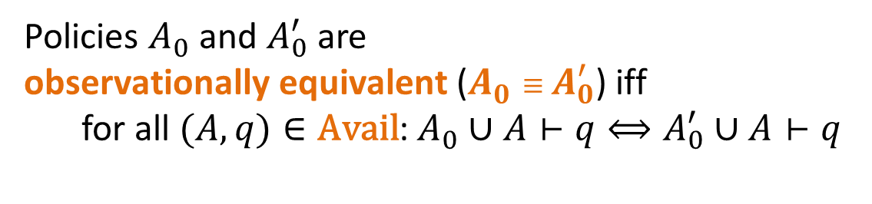
Available probes
$(A_{1},q_{1}$),...,$(A_{n},q_{n}$)?
$$A_{0}$$
The attacker can’t distinguish $A_{0}^{}$ and $A_{0}^{′}$
$(A_{1},q_{1}$)
$$≡$$
$(A_{1},q_{1}$)
$(A_{2},q_{2}$)
Yes, No, Yes, Yes, ...!
$(A_{3},q_{3}$)
$(A_{4},q_{4}$)
$(A_{1},q_{1}$),...,$(A_{n},q_{n}$)?
Yes, No, Yes, Yes, ...!
$$A_{0}^{′}$$
Policies $A_{0}^{}$ and $A_{0}^{′}$ are
observationally equivalent ($A_{0}^{}≡A_{0}^{′}$) iff
  for all $(A,q)∈\text{Avail}$:$A_{0}^{}∪A⊢q⟺A_{0}^{′}∪A⊢q$

Slide 9

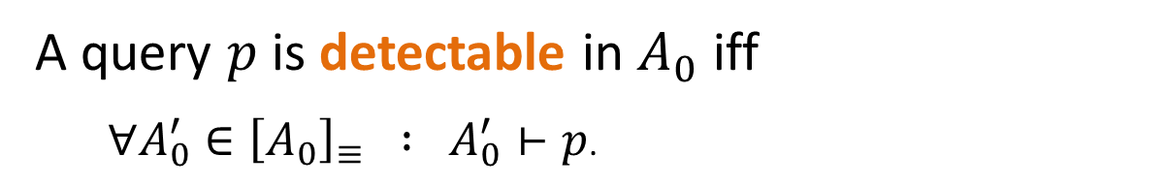

$$≡$$
$(A_{1},q_{1}$),...,$(A_{n},q_{n}$)?
$$A_{0}$$
$(A_{1},q_{1}$)
p
$(A_{1},q_{1}$)
$(A_{2},q_{2}$)
Yes, No, Yes, Yes, ...!
p
p
$(A_{3},q_{3}$)
$(A_{4},q_{4}$)
p
p
p!
A query $p$ is detectable in $A_{0}$ iff
  $∀A_{0}^{′}∈{\left[A_{0}\right]}_{≡} : A_{0}^{′}⊢p$.

Slide 10
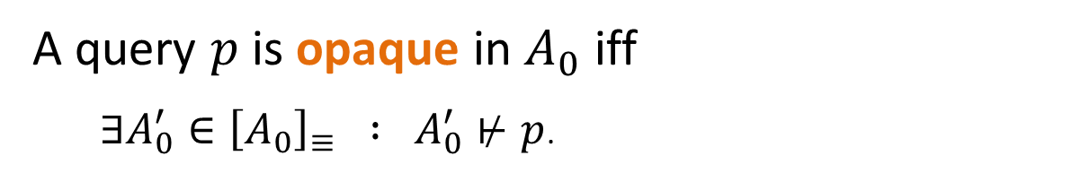

$$≡$$
$(A_{1},q_{1}$),...,$(A_{n},q_{n}$)?
$$A_{0}$$
$(A_{1},q_{1}$)
p
$(A_{1},q_{1}$)
$(A_{2},q_{2}$)
Yes, No, Yes, Yes, ...!
p
✗
p
$(A_{3},q_{3}$)
✗
$(A_{4},q_{4}$)
p
p
p??
A query $p$ is opaque in $A_{0}$ iff
  $∃A_{0}^{′}∈{\left[A_{0}\right]}_{≡} : A_{0}^{′}⊬p$.

Slide 11
Available probes
$$≡$$
$$A_{0}$$
({A says foo if secrAg(B)}, acc)
No!
secretAg(B)
secretAg(B)
({A says Src cansay secAg(B),
A says fooif secretAg(B)}, acc)
Yes!
secretAg(B)
secretAg(B)
secretAg(B)!
secretAg(B)
Svc says secretAg(B) is detectable in A₀!

Slide 12
Challenges
What does “attack”, “detect”, etc. mean?
What can the attacker (not) detect?*
How do we automate?
* Based on “Opacity Analysis in Trust Management Systems”, Moritz Y. Becker and Masoud Koleini (U Birmingham), ISC2011

Slide 13

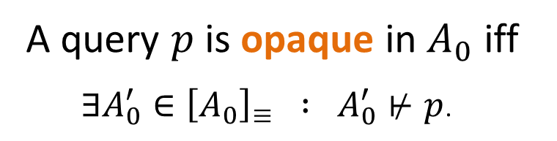
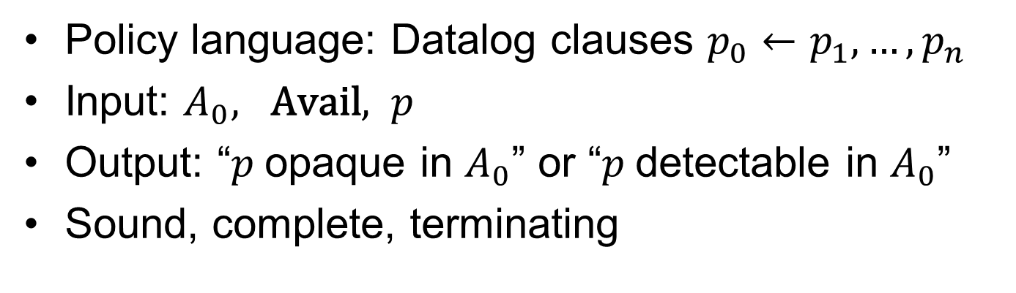
Is $p$opaque in $A_{0}$?
Policy language: Datalog clauses $p_{0}←p_{1},…,p_{n}$
Input: $A_{0}, \text{Avail}, p$
Output: “$p$opaque in $A_{0}$” or “$p$detectable in $A_{0}$”
Sound, complete, terminating
A query $p$ is opaque in $A_{0}$ iff
  $∃A_{0}^{′}∈{\left[A_{0}\right]}_{≡} : A_{0}^{′}⊬p$.

Slide 14
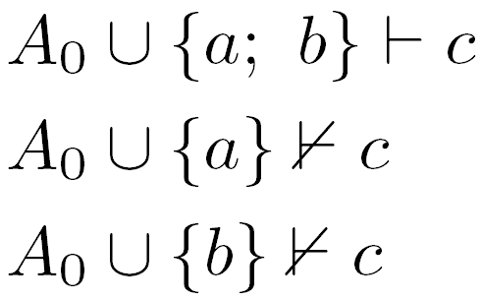
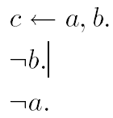



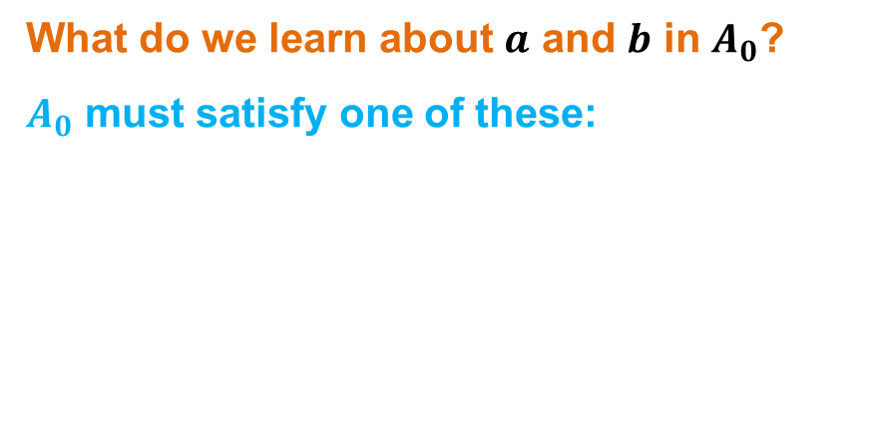
Example 1
What do we learn about $a$ and $b$ in $A_{0}$?
$A_{0}$ must satisfy one of these:
 ✗
 ✗
 ✗
✓

Slide 15
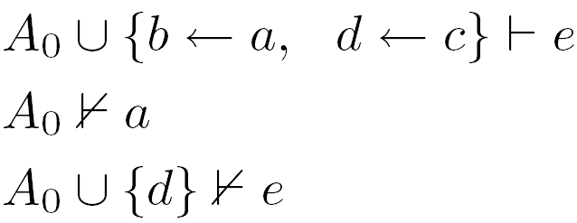
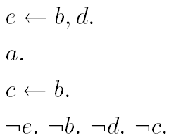
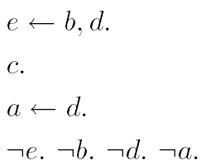
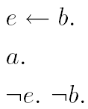
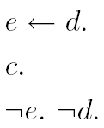
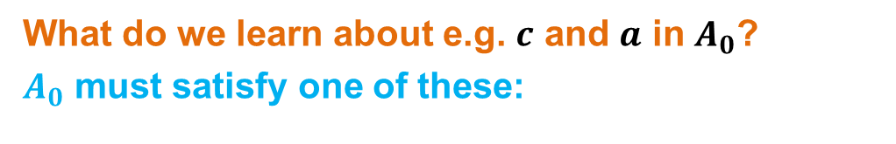
Example 2
 ✗
 ✗
What do we learn about e.g. $c$ and $a$ in $A_{0}$?
$A_{0}$ must satisfy one of these:
 ✗
 ✗
✓

Slide 16
Challenges
What does “attack”, “detect”, etc. mean?
What can the attacker (not) detect?
How do we automate?

Slide 17
How do we automate?
Previous approach:
Build a policy in which the sought fact is opaque.
Approach described here:
Search for proof to show that a property is detectable.

Slide 18
Reasoning framework
Policies/credentials, and their properties are mathematical objects
Better still, are terms in a logic (object-level)
Probes are just a subset of the theorems in the logic.
Semantic constraints: Datalog entailment, hypothethical reasoning.

Slide 19
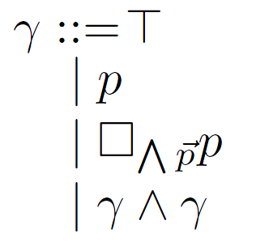
Policies
Empty policy
Fact
Rule
Policy union

Slide 20
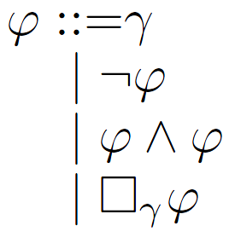
Properties
“phi holds if gamma”

Slide 21
Example 1

Slide 22
Example 2
Notes:
Advantage:
Not need to give A0,
Can reason about more than probes

Slide 23
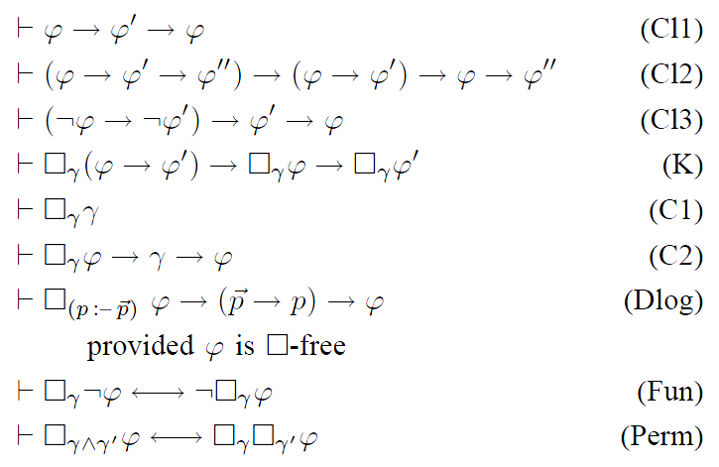
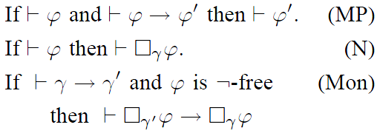
Calculus
+ PL
+ ML
+ Hy
Notes:
Hilbert-style axiomatisation
notoriously difficult to automate.
Sound and complete.
Can be dissected into subparts: propositional, modal, hypothethical

Slide 24
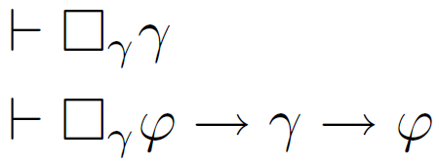
Reduced calculus
(modulo normalisation)
Notes:
Rely on
AxiomC1
C2
Prop8
Prop9
(modulo distribution, commutation)

Slide 25


Axioms C1 and C2

Slide 26
Props 8 and 9

Slide 27



Normal form

Slide 28
Naïve propositionalisation
Normalise the formula
Apply Prop9 (until fixpoint)
Instantiate C1, C2 and Prop8 for each
box-formula
Abstract the boxes

Slide 29
Improvements
Prop9 is very productive – in many cases this can be avoided – so it could be delayed.
Axiom C1 can be used as a filter.

Slide 30
Summary
What does “attack”, “protect”, etc. mean?
  Observational equivalence, opacity and detectability
What can the attacker (not) infer?
  Algorithm for deciding opacity in Datalog policies
  Tool with optimizations
How do we automate?
  Encode as SAT problem

