Slide 1
Effective Blog Advertising by Understanding Blogger’s Emotions & Needs
WEN-HSIANG LU (盧文祥),
YAO-SHENG CHANG (張耀升)
ys.chang1976@gmail.com
Web Mining & Multilingual Knowledge System Lab
Dept. of Computer Science and Information Engineering
National Cheng Kung University, Tainan, Taiwan, ROC
SIGIR 2011 workshop on IA, Beijing, China
Notes:
Bloggers usually write down what he happen today. Therefore, an event often triggers an emotion of blogger. It is said that the content in the blog is affective article. Finally, the blogger hopes that something makes him change emotion. We think that there is a hidden need in user affective article. From the above investigation, we try to identify the hidden needs from bloggers’ article, and then recommend bloggers interesting Ads

Slide 2
Outlines
Introduction
Proposed approach
Event-driven Emotion-Need-based Advertising model (EENA model)
Experiments
Conclusions and future works

Slide 3
Introduction
More and more advertising systems have been developed by Web service providers to display
contextual ads
Generally, most existing advertising systems adopt the following methods
topic-relevant advertising methods
keyword-matching-based advertising methods
advertiser-bidded topic keywords matching methods
Notes:
According to CNNIC report, up to june, 209, there are several trend in blogs.
1. 2. 3.
Furthermore, in 2007, Ni’s work “Exploring in the Weblog by Detecting Informative and Affective Articles” shows that 15% of web blog articles is the affective articles. The remainders is 15%.

Slide 4
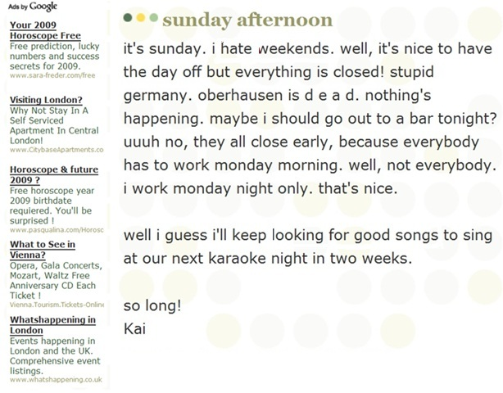
An unsuitable example of Ad recommendation
Google Ads
Emotion
Life Event
No correspondence
to bloggers’ needs
Need
Notes:
This is an example. We can see the three features, Event, emotion, need, in this article.
However, the left side is some advertisements recommended by Google.
The first one is about apartment reserve in London by yourself.
The second one is about horoscope.
The third one is about Vienna tourism introduction.
Finally, in fact, all of the advertisements are not matching bloggers need, looking for good songs.

Slide 5
Observation
The analysis of emotions and needs on the randomly selected 30 blog articles for five frequent life events.
Frequent Life Events | Frequent Emotions Terms |  | Frequent Needs
 | Positive | Negative
回家(go home) | 開心(joyful)、喜歡(enjoy)、可愛(cute) | 害怕(afraid)、小心(careful)、不好意思(embarrassing) | 感情(affection)、麻將(mahjong)、回台灣(return to Taiwan)
出門(leave home) | 喜歡(enjoy)、可愛(cute)、開心(joyful) | 害怕(afraid)、可惜(regretted)、懷疑(doubt) | 治安(public security)、餐廳(restaurant)、 環島(around the Island)
上課(attend class) | 開心(joyful)、喜歡(enjoy)、可愛(cute) | 可怕(fearful)、無聊(bored)、恐怖(terror) | 旅行(travel)、學分(credit points)、功課(homework)
上班(go to work) | 喜歡(enjoy)、希望(hope)、有趣(funny) | 擔心(worry)、討厭(dislike)、無聊(bored) | 旅遊(travel)、書籍(book)、換工作(change job)
休息(take a break) | 喜歡(enjoy)、不錯(not bad)、開心(joyful) | 緊張(nervous)、擔心(worry)、可惜(regretted) | 旅行(travel)、演唱會(concert)、 餐廳(restaurant)
Notes:
The event of the first two is about broken up. The emotion is sad, sorrow. The several hidden needs are matching users’ expectations. Such as drinking, singing, talking to friends and so on.

Slide 6
Observations & Goals
Observations
Blog Event
Bloggers write articles to describe something happened about life.
Blog Emotion
Life events cause various feelings.
Blog Need
Life events and emotion cause various needs (e.g., cake, ring and gift, etc.)
Goals
To understand bloggers’ (writers) hidden emotion & needs in the blog posts.
Then to recommend ads corresponding to bloggers’ (writers) hidden emotion & needs.
Notes:
From our further analysis of bog articles, there are three interesting features.

Slide 7
Challenge
However, a number of challenges in implementing this framework will be described below.
How to detect affective blog articles from any given blog article.
How to detect the terms of bloggers’ life event, emotions and needs from the unstructured text data in a given affective blog article.
How to deliver appropriate ads to an affective blog article.
Notes:
Definition : event emotion need
How to recommend interesting Ads? Training manual tag Ads in an article. After training, we get the probability of Ad given emotion and need. Finally, the system recommends the best one. Maybe we could recommend the top 3 to top 5.

Slide 8
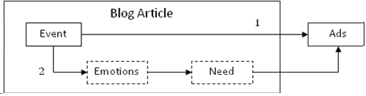
Idea
Utilize bloggers’ (writers) hidden emotion & needs to recommend suitable ads
Notes:
We want to recommend bloggers interesting Ads match blogger’ hidden need from their blog articles.
In fact, the relationship between articles and Ads is indirect. Therefore, we utilize several effective features to recommend interesting Ads for bloggers, such as event, emotion and needs.

Slide 9
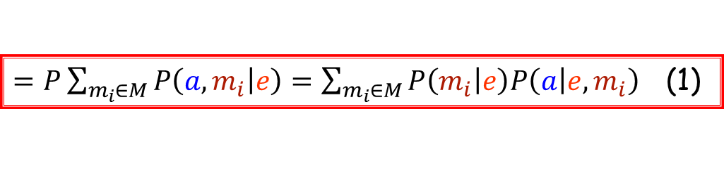


Proposed Method (1) Event-Driven Emotion-Need-Based Advertising Model
A blog article b can be represented as a triple
b = (e, m_{i}, n_{j}),
a life event e (assuming that a blog article has only one event)
some implicit emotion terms m_{i} ∈ M, and needs n_{j} ∈ N,
Given an affective blog article b and an advertising set A to recommend some appropriate ads a ∈ A
$$P\left(a | b\right)$$
$$P\left(a | b\right)  P\left(a | e\right)$$
$=P\sum_{m_{i}∈M}{P\left(a,m_{i} | e\right)}=\sum_{m_{i}∈M}{P\left(m_{i} | e\right)P\left(a | e,m_{i}\right)}$(1)

Slide 10
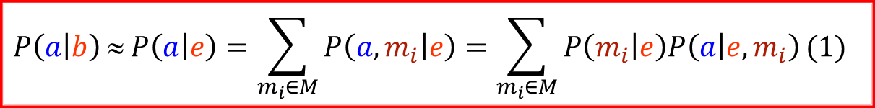
Proposed Method (2) Event-driven Emotion-Need-Based Advertising Model
$$P\left(a | b\right)  P\left(a | e\right)=\sum_{m_{i}∈M}{P\left(a,m_{i} | e\right)}=\sum_{m_{i}∈M}{P\left(m_{i} | e\right)P\left(a | e,m_{i}\right)}(1)$$
$P\left(a | e,m_{i}\right)=\sum_{n∈N}{P\left(n_{j} | e,m_{i}\right)}P\left(a | e,m_{i},n_{j}\right)$(2)
$P\left(a | e\right)=\sum_{m_{i}∈M}{P\left(m_{i} | e\right)\sum_{n_{j}∈N}{P\left(n_{j} | e,m_{i}\right)P\left(a | e,m_{i},n_{j}\right)}}$.(3)
Emotion model
Need model
Advertising model

Slide 11
Experiments Training Data Set
Blog articles (Pixnet): 115,551 articles
Advertisings (Kijiji): 61,424 ads.
Emotional terms
458 Chinese emotion words are collected from a Chinese website and then are extended with an additional 2,248 emotion words using a Chinese Synonym Thesaurus.
After manually filtering, 1,216 emotion words are divided into two categories, including “positive” and “negative”.
Notes:
Sorry, I forget exact numbers for the two categories. I will check for you after the session.

Slide 12
Experiments Baseline
Need Inference: Take blogger’s need inference as classification problem, thus each need is considered as a class.
SVM classifier as the baseline, with bag of words as features.
Ads Matching: keyword-matching-based advertising method as the baseline.
the event terms as keywords to match suitable ads from the collected ad corpus.

Slide 13
Experiments Need Inference
Event
“生日” (birthday), “分手” (break up), “結婚” (get marry).
Randomly selected 100 articles respectively as testing data.
Life Event | Need Model | SVM (baseline)
生日(birthday) | 0.3191 | 0.229
分手(break up) | 0.2745 | 0.278
結婚(get marry) | 0.4050 | 0.323

Slide 14
Experiments Ads Matching
The event “get marry”, the top-1 inclusion rate of our EENA model outperforms the baseline by 14.96% (0.2095 vs. 0.06).
However, the precision of the first event “birthday” is lower than that of baseline.
After our analysis, need for birthday is
too diverse to lead to good results.
the number of training data is not enough and thus make the recall rate is lower than baseline.
Metrics Events |  | Inclusion Rate |  | F-measure
 |  | EENA | Baseline | EENA | Baseline
生日 (birthday) | TOP 1 | 0.0590 | 0.0654 | 0.0037 | 0.0089
 | TOP 5 | 0.1196 | 0.1969 | 0.0143 | 0.0309
 | TOP 20 | 0.3259 | 0.4893 | 0.0518 | 0.0940
分手 (break up) | TOP 1 | 0.3429 | 0.1385 | 0.0667 | 0.0456
 | TOP 5 | 0.3429 | 0.2483 | 0.0512 | 0.0667
 | TOP 10 | 0.8143 | 0.5269 | 0.1708 | 0.1136
結婚 (get marry) | TOP 1 | 0.2095 | 0.0600 | 0.0196 | 0.0236
 | TOP 5 | 0.3552 | 0.2406 | 0.0488 | 0.0549
 | TOP 20 | 0.6702 | 0.4839 | 0.0930 | 0.0776

Slide 15
Correct Example
Notes:
I show several successful examples.
The event of the first one example is birthday. the article describes a flood disaster on the blogger’s birthday. The top-3 needs predicted from the article are disaster area, cake and gift. Actually, the top 1 advertisement recommended by our method is exactly matching the first one need.
Due to the time limitation, I skip the following example explanations.

Slide 16
Conclusion & Future work
We carefully proposed an event-driven emotion-need-based advertising model and developed a feasible framework to solve problems of conventional keyword-matching-based advertising approach which often recommends unsuitable ads.
In the future, we will develop an automatic mechanism to extract life events, emotions and needs for large-scale ad matching.

Slide 17
Thanks for your listening.
Q & A

