Slide 1
Classifying Business Messages on Facebook
Bei Yu¹ and Linchi Kwok²
School of Information Studies¹
David B. Falk College of Sport and Human Dynamics²
Syracuse University
2011 SIGIR Workshop on Internet Advertisement

Slide 2
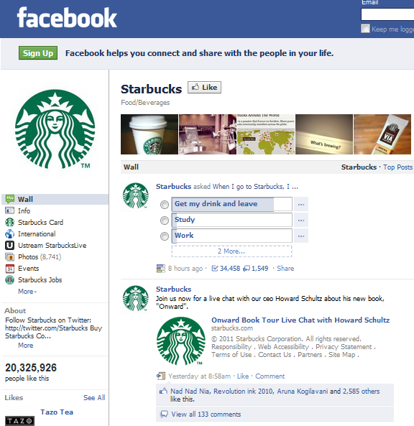
Marketing through Social Media
4% of all FB users

Slide 3
What are common marketing strategies in social media?
What kinds of messages did companies post?
How much attention did they receive?
Can we build automatic tools to monitor them?

Slide 4
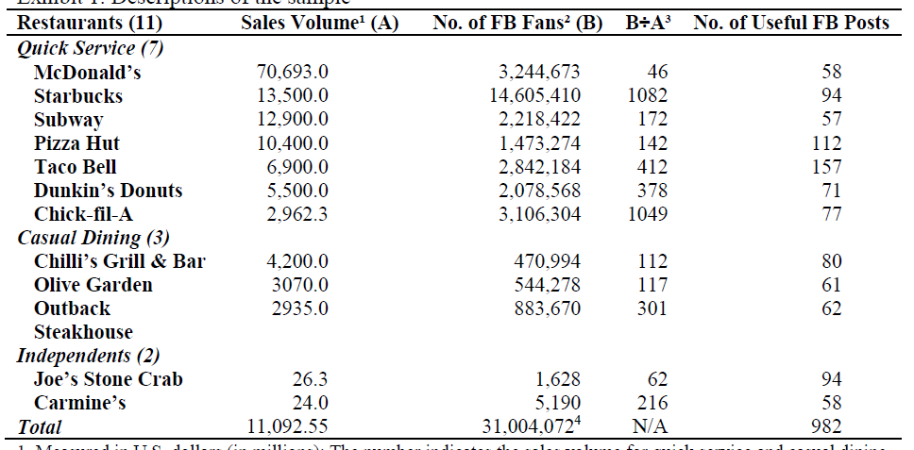
What are common marketing strategies in social media?
~1000 official messages from 12 restaurants

Slide 5
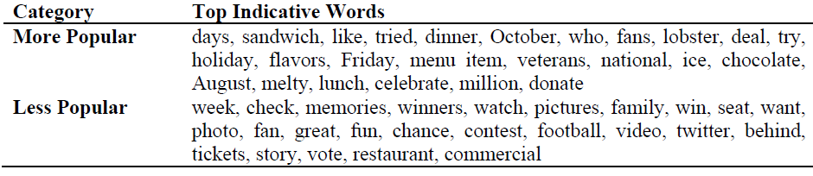
What messages are more popular by attracting more “like” responses?
- Normalized “like” responses
- SVM-boolean classifier to separate more and less popular messages, and rank the most indicative word features

Slide 6
What words distinguished popular and less popular messages?
More popular
Menu items (sandwich, lobster, chocolate)
Special occasions or days (October, Friday, August)
Actions or questions (like, who, try, celebrate)
Community commitment (veterans, donate)
Less popular
Marketing campaign (winner, win, chance, contest)
- Promotion (check, tickets)

Slide 7
A new typology of marketing strategies in social media
Manually code the message types based on grounded theory
Two-tier typology
  Marketing messages
    announcement, follow-up, reminder/call for action, results, product highlight, social responsibility, direct boasting, indirect boasting
  Communication messages
    provoke feedback, call for action, updates, advice/suggestions

Slide 8
A new typology - examples
Marketing message
  : “Hey Chili’s fans! We’re giving you a special sneak peek at one of our holiday offers! Starting today, you can receive 10 percent off any purchase of Chili’s gift cards totalling $100 or more! Only you, our Facebook fans know about this today! http://bit.ly/dDt6Jx.”
Communication message
  “Hey Chili’s fans! We hope everyone has a Happy Thanksgiving spent with family and friends. We’d love to hear your Turkey Day stories!”

Slide 9
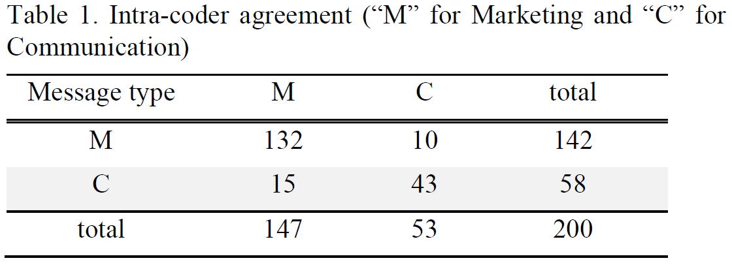
A new typology – reliability check
Cohen’s Kappa 0.69
Raw agreement 87.5%

Slide 10
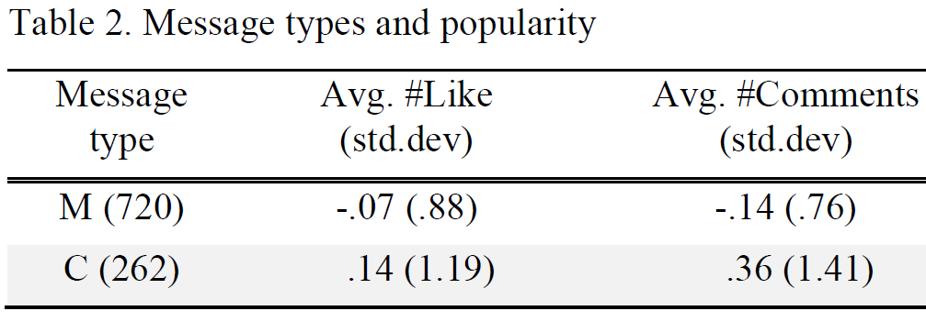
Message types and popularity
although the majority of company posts on Facebook are aimed for direct sales and promotions, it is their communication messages that received the most attention from customers.

Slide 11
Automatic monitoring business marketing behavior
Build automated classifier to separate marketing and communication messages
  Topic classification?
  Genre classification?
Challenge
  Messages are very short
    Twitter <=140 characters
    Facebook messages
      Marketing: min 17, max 374, avg. 169
      Communication: min 11, max 275, avg. 91

Slide 12
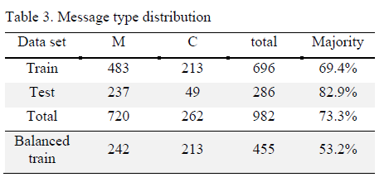
Training and testing data

Slide 13
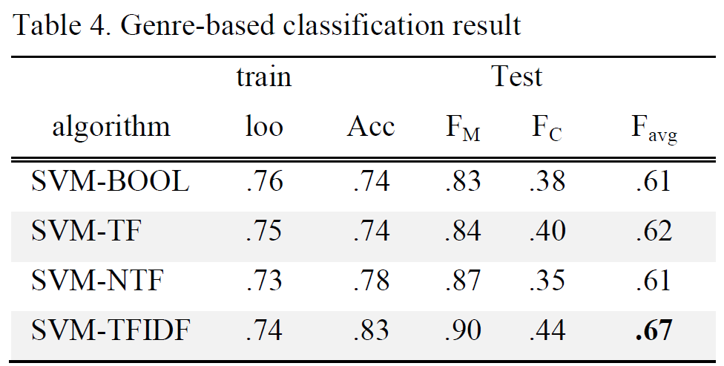
Genre classification
44 parts of speech as features

Slide 14
Genre classification
Marketing messages
  Numbers, determiners, interjections
  "1600 Carmine's cookbooks sold on QVC Tuesday night in 7 minutes .. wow"
Communication messages
  Wh- words, modals, superlative adjectives
  "What is your wish for the holidays? Share it with us: http://starbucks.com/share"

Slide 15
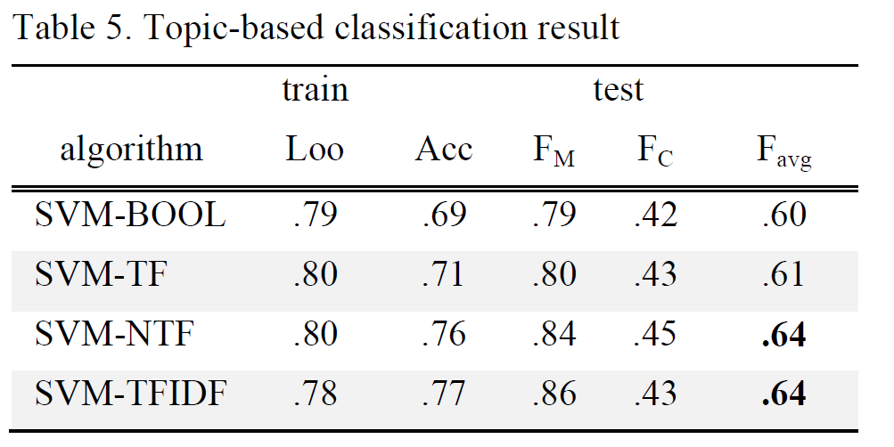
Topic classification
BOW features

Slide 16
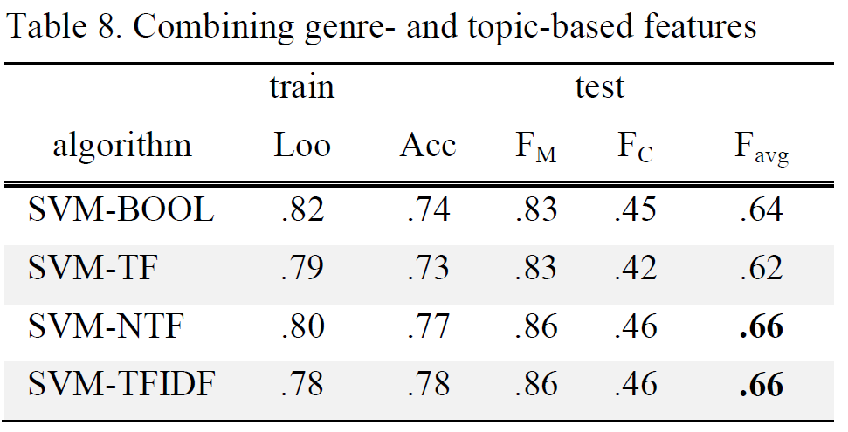
No gain by combining genre and topic features

Slide 17
Conclusion
Companies have not fully utilized the interactive function of social media.
Separating marketing and communication messages is more of a genre classification task than a topic classification.
It’s challenging to classifying such short messages, but it is still feasible to build automatic tool to monitor marketing behaviors in social media.

Slide 18
Acknowledgment
Special thanks to the Caesars Hospitality Research Center Grant Award Program from UNLV

