Slide 1
Differential Dataflow (and the Naiad system)
Frank McSherry, Derek G. Murray,
Rebecca Isaacs, Michael Isard
Microsoft Research, Silicon Valley

Slide 2
Data-parallel dataflow
1
k1:
1
4
5
A
2
3
k2:
2
B
C
4
5
6
k3:
3
6
D
E

Slide 3
Data-parallel dataflow
1
A
2
3
B
C
4
5
6
D
E

Slide 4
Data-parallel dataflow
i
j
k
1
A
2
3
B
C
4
5
6
D
E
i
ii
iii
iv
v

Slide 5
Data-parallel dataflow
i
j
k
1
A
2
3
B
C
4
5
6
D
E
i
ii
iii
iv
v

Slide 6
Data-parallel dataflow
Simple systems (Hadoop, Dryad) process entire collections.
Incremental updates. (StreamInsight, Incoop)
Fixed point iteration. (Datalog, Rex, Nephele)
Prioritized computation. (PrIter)
Hard to compose, for non-trivial reasons. (IVM rec-queries)
e.g. Maintaining the Strongly Connected Components
of a social graph as edges continually arrive/depart.

Slide 7
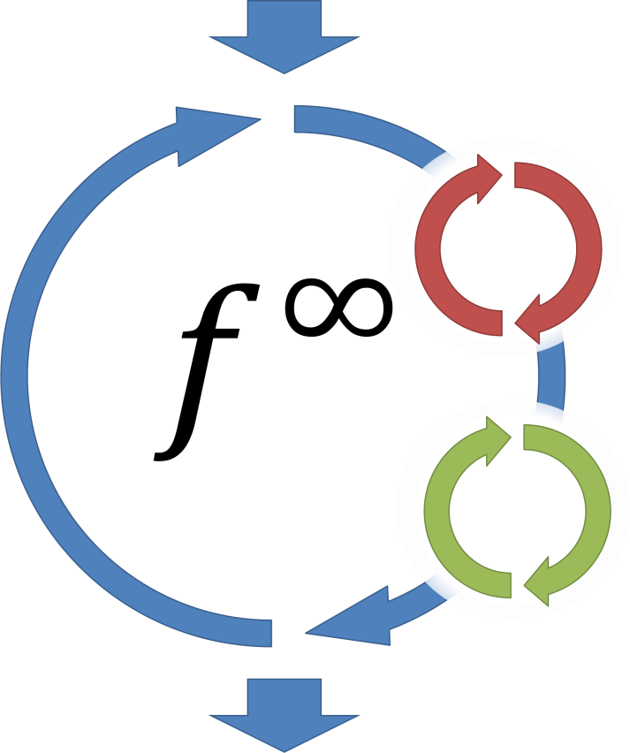
Naiad
Data-parallel compute engine using differential dataflow.
C#/LINQ programming model:
arbitrarily nested loops,
incremental updates,
prioritization,
…
fully composable.
Trades memory for performance:
Data-parallelism to scale memory.

Slide 8



Using Naiad
1. Programmer writes a declarative Naiad program.
Labels
Loop Body
$$\text{Edges}$$
$$⋈$$
$$∪$$
Min
Output

Slide 9
Using Naiad
1. Programmer writes a declarative Naiad program.
// produces a (name, label) pair for each node in the input graph.
public Collection<Node> DirectedReachability(Collection<Edge> edges)
{
// start each node in the graph with itself as a label
var nodes = edges.Select(x => new Node(name = x.src, label = x.src))
.Distinct();
// repeatedly update labels to the minimum of the labels of neighbors
return nodes.FixedPoint(x => x.Join(edges, n => n.name, e => e.src,
(n, e) => new Node(e.dst, n.label))
.Concat(nodes)
.Min(n => n.name, n => n.label));
}

Slide 10
Using Naiad
1. Programmer writes a declarative Naiad program.
// produces a (name, label) pair for each node in the input graph.
public Collection<Node> DirectedReachability(Collection<Edge> edges)
{
// start each node in the graph with itself as a label
var nodes = edges.Select(x => new Node(name = x.src, label = x.src))
.Distinct();
// repeatedly update labels to the minimum of the labels of neighbors
return nodes.FixedPoint(x => x.Join(edges, n => n.name, e => e.src,
(n, e) => new Node(e.dst, n.label))
.Concat(nodes)
.Min(n => n.name, n => n.label));
}

Slide 11
Using Naiad
2. Program is compiled to a cyclic dataflow graph.
// produces a (name, label) pair for each node in the input graph.
public Collection<Node> DirectedReachability(Collection<Edge> edges)
{
// start each node in the graph with itself as a label
var nodes = edges.Select(x => new Node(name = x.src, label = x.src))
.Distinct();
// repeatedly update labels to the minimum of the labels of neighbors
return nodes.FixedPoint(x => x.Join(edges, n => n.name, e => e.src,
(n, e) => new Node(e.dst, n.label))
.Concat(nodes)
.Min(n => n.name, n => n.label));
}

Slide 12
Using Naiad
2. Program is compiled to a cyclic dataflow graph.

Slide 13
Using Naiad
3. Graph is distributed across independent workers.
4. Computation stays resident, with interactive access.
var edges = new InputCollection<Edge>();
var labels = edges.DirectedReachability();
labels.Subscribe(x => ProcessLabels(x));
while (!inputStream.Closed())
edges.OnNext(inputStream.GetNext());

Slide 14
Incremental Dataflow
Data-parallel operators can operate on differences:
Collection : { ( record, count ) }
Operator
X
Y

Slide 15
Incremental Dataflow
Data-parallel operators can operate on differences:
Difference : { ( record, delta ) }
Operator
X
Y

Slide 16
Incremental Dataflow
Data-parallel operators can operate on differences:
Difference : { ( record, delta ) }
Operator
dX
dY

Slide 17
Incremental Dataflow
Data-parallel operators can operate on differences:
Difference : { ( record, delta ) }
Operator
dX
dY

Slide 18
Incremental Dataflow
Data-parallel operators can operate on differences:
Difference : { ( record, delta ) }
Operator
dX
dX
dY
dY

Slide 19
Incremental Dataflow
Data-parallel operators can operate on differences:
Difference : { ( record, delta ) }
Operator
dX
dX
dY
dY

Slide 20
Incremental Dataflow
Data-parallel operators can operate on differences:
Difference : { ( record, delta ) }
Operator
dX
dX
dX
dY
dY
dY

Slide 21
Incremental Dataflow
Data-parallel operators can operate on differences:
Difference : { ( record, delta ) }
Operator
dX
dX
dX
dY
dY
dY

Slide 22
Incremental Dataflow
Data-parallel operators can operate on differences:
Difference : { ( record, delta ) }
Operator
dX
dX
dX
dY
dY
dY

Slide 23
Incremental Dataflow
Data-parallel operators can operate on differences:
Difference : { ( record, delta ) }
Operator
dX
dX
dX
dY
dY
dY

Slide 24
Incremental Dataflow
Data-parallel operators can operate on differences:
Difference : { ( record, delta ) }
Up until this point, this is all old news.
Operator
dX
dX
dX
dY
dY
dY

Slide 25
Differential Dataflow
Data-parallel operators can operate on differences:
Difference : { ( record, delta, version ) }
Operator
dX
dX
dX
dY
dY
dY

Slide 26
Differential Dataflow
Data-parallel operators can operate on differences:
Difference : { ( record, delta, version ) }
Important: A version can be more than just an integer.
Operator
dX
dX
dX
dY
dY
dY

Slide 27
Differential Dataflow
Data-parallel operators can operate on differences:
Difference : { ( record, delta, version ) }
Important: A version can be more than just an integer.
Operator
dX
dX
dX
dY
dY
dY
dX

Slide 28
Differential Dataflow
Data-parallel operators can operate on differences:
Difference : { ( record, delta, version ) }
Important: A version can be more than just an integer.
Operator
dX
dX
dX
dY
dY
dY
dX
dY

Slide 29
Differential Dataflow
Data-parallel operators can operate on differences:
Difference : { ( record, delta, version ) }
Important: A version can be more than just an integer.
Operator
dX
dX
dX
dY
dY
dY
dX
dY

Slide 30
Differential Dataflow
Data-parallel operators can operate on differences:
Difference : { ( record, delta, version ) }
Important: A version can be more than just an integer.
Operator
dX
dX
dX
dY
dY
dY
dX
dX
dY
dY

Slide 31
Differential Dataflow
Data-parallel operators can operate on differences:
Difference : { ( record, delta, version ) }
Important: A version can be more than just an integer.
Operator
dX
dX
dX
dY
dY
dY
dX
dX
dY
dY

Slide 32
Differential Dataflow
Data-parallel operators can operate on differences:
Difference : { ( record, delta, version ) }
Important: A version can be more than just an integer.
Operator
dX
dX
dX
dY
dY
dY
dX
dX
dX
dY
dY
dY

Slide 33
Differential Dataflow
Data-parallel operators can operate on differences:
Difference : { ( record, delta, version ) }
Important: A version can be more than just an integer.
Operator
dX
dX
dX
dY
dY
dY
dX
dX
dX
dY
dY
dY

Slide 34
Differential Dataflow
Data-parallel operators can operate on differences:
Difference : { ( record, delta, version ) }
Important: A version can be more than just an integer.
Operator
dX
dX
dX
dY
dY
dY
dX
dX
dX
dY
dY
dY

Slide 35
Differential Dataflow
Data-parallel operators can operate on differences:
Difference : { ( record, delta, version ) }
Operator
dX
dX
dX
dY
dY
dY
dX
dX
dX
dY
dY
dY
dX
dX
dX
dY
dY
dY

Slide 36
Differential Dataflow
Data-parallel operators can operate on differences:
Difference : { ( record, delta, version ) }
Operator
dX
dX
dX
dY
dY
dY
dX
dX
dX
dY
dY
dY
dX
dX
dX
dY
dY
dY

Slide 37
Differential Dataflow
Data-parallel operators can operate on differences:
Difference : { ( record, delta, lattice ) }
Operator
dX
dX
dX
dY
dY
dY
dX
dX
dX
dY
dY
dY
dX
dX
dX
dY
dY
dY

Slide 38
Differential Dataflow
Data-parallel operators can operate on differences:
Difference : { ( record, delta, lattice ) }
Operator
dX
dX
dX
dY
dY
dY
dX
dX
dX
dY
dY
dY
dX
dX
dX
dY
dY
dY

Slide 39
Empirical Efficacy
baseline
differences (size of dX)
incremental
inner iterations

Slide 40
Strongly Connected Components
Nested fixed-point computation.
Two inner loops re-use existing DirectedReachability() query.
The entire computation is also
automatically incrementalized.
Declarative program uses 23 LOC.

Slide 41
Strongly Connected Components
// repeatedly remove edges until fixed point.
Collection<Edge> SCC(this Collection<Edge> edges)
{
return edges.FixedPoint(y => y.TrimAndTranspose()
.TrimAndTranspose());
}
// retain edges whose endpoint are reached by the same nodes.
Collection<Edge> TrimAndTranspose(this Collection<Edge> edges)
{
var labels = edges.DirectedReachability();
return edges.Join(labels, x => x.src, y => y.name, (x,y) => x.Label1(y))
.Join(labels, x => x.dst, y => y.name, (x,y) => x.Label2(y))
.Where(x => x.label1 == x.label2)
.Select(x => new Edge(x.dst, x.src));
}

Slide 42
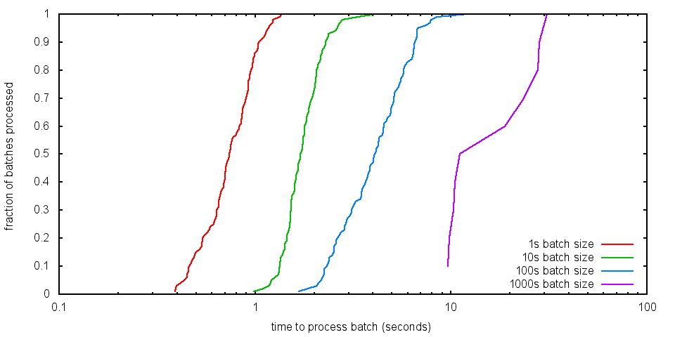
Streaming SCC on Twitter
CDFs for 24 hour windowed SCC of @mention graph.

Slide 43
Concluding Comments
The generality of differential dataflow allows Naiad arrange computation more naturally and efficiently.
Better re-use of previous work, by changing “previous”.
Millisecond-scale updates for complex computations.
Enables new and richer program patterns.
ex: SCC, also graph coloring, partitioning, …
Bringing declarative data-parallel closer to imperative.

Slide 44
Naiad Status
Public code release available at project page:
http://research.microsoft.com/naiad/
http://bigdataatsvc.wordpress.com/
Code release is C#: Windows (.NET), Linux, OS X (Mono).
Come see our poster and demo, processing tweets.

Slide 45

Questions?
$$f^{∞}$$

