Slide 1

MEVAL: A Practically Efficient System for Secure Multi-party Statistical Analysis
Koki Hamada
NTT Secure Platform Laboratories

Slide 2
Overview
Introduction of our MPC system MEVAL (Multi-party EVALuator)
Main features of MEVAL:
8.7 MIPS (million instructions per second) 61-bit multiplication
6.9 seconds for Sorting 1 million 20-bit items

Slide 3
Outline
Overview of MEVAL
Performance
Techniques
Demonstration

Slide 4
Overview of MEVAL

Slide 5
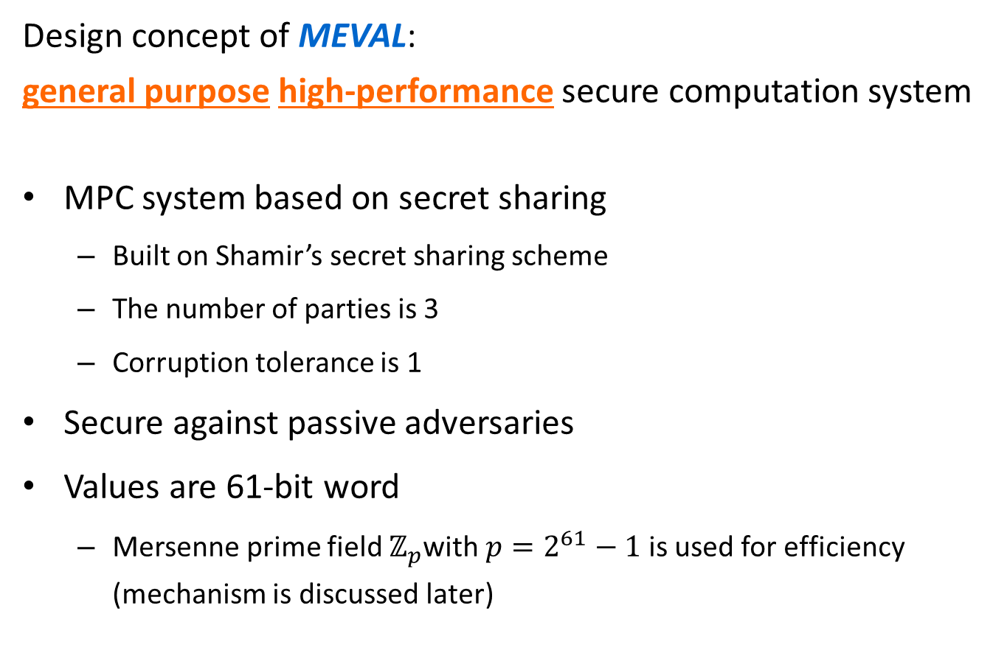
MEVAL (Multi-party EVALuator)
Design concept of MEVAL: general purpose high-performance secure computation system
MPC system based on secret sharing
Built on Shamir’s secret sharing scheme
The number of parties is 3
Corruption tolerance is 1
Secure against passive adversaries
Values are 61-bit word
Mersenne prime field $ℤ_{p}$with $p=2^{61}−1$ is used for efficiency (mechanism is discussed later)

Slide 6



Intended application
Secure outsourcing of data storage and analysis
Data holders outsource data storage to MEVAL servers
Servers conduct analysis on request and return the result
Requirement: MEVAL servers never see the stored data
1.
MEVAL servers
2.
$$⋯$$

Slide 7
Implemented operations
Basic MPC protocols
Dealing, revealing
Addition, multiplication
Bet-decomposition, comparison, equality test
Shuffling
Sorting
Statistical functions
Count, sum, min, max, median, sum of squares
Mean, variance, Student’s t-test
Fully realized
as MPC protocols
Computed from
revealed count, sum, and sum of squares

Slide 8
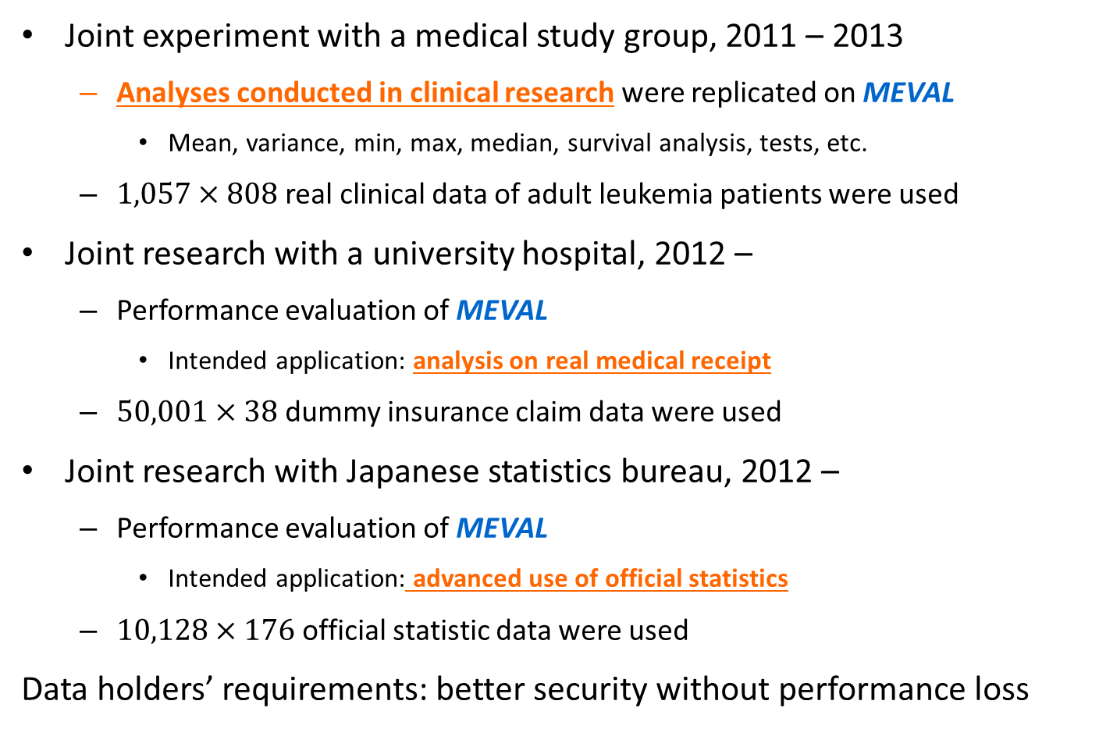
Practical accomplishments of MEVAL
Joint experiment with a medical study group, 2011 – 2013
Analyses conducted in clinical research were replicated on MEVAL
Mean, variance, min, max, median, survival analysis, tests, etc.
$1,057×808$ real clinical data of adult leukemia patients were used
Joint research with a university hospital, 2012 –
Performance evaluation of MEVAL
Intended application: analysis on real medical receipt
$50,001×38$ dummy insurance claim data were used
Joint research with Japanese statistics bureau, 2012 –
Performance evaluation of MEVAL
Intended application: advanced use of official statistics
$10,128×176$ official statistic data were used
Data holders’ requirements: better security without performance loss

Slide 9
Performance of meval

Slide 10
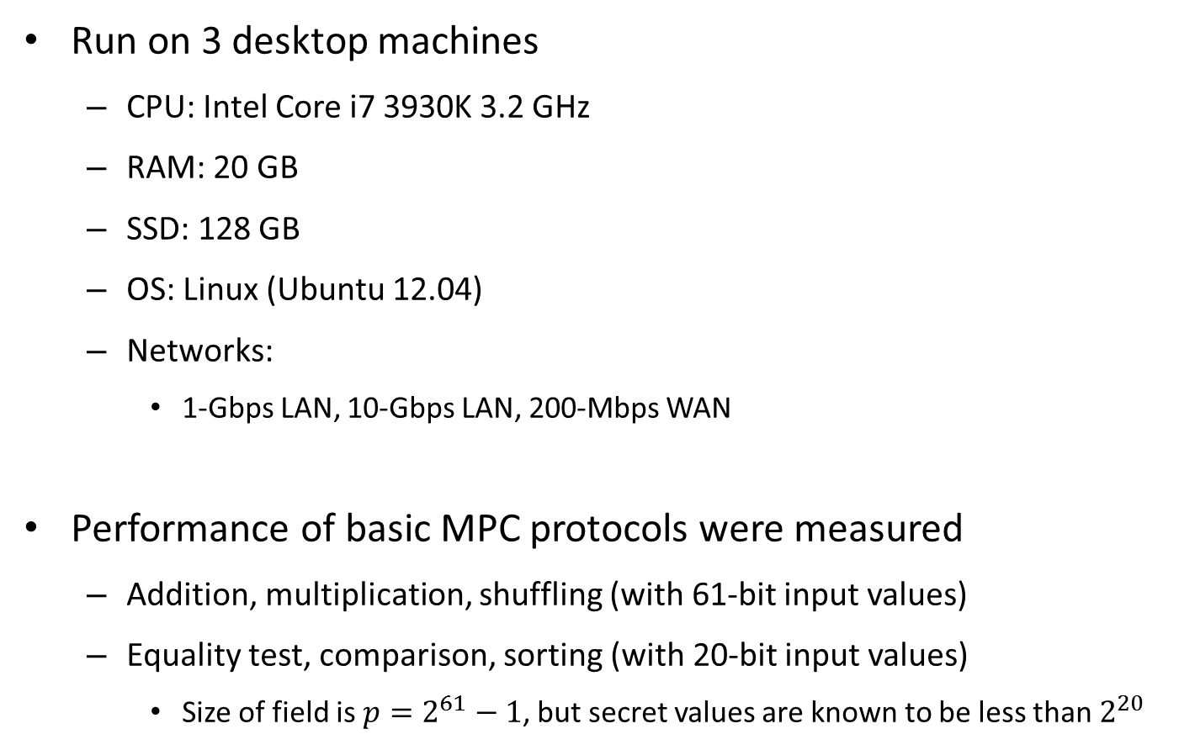
Experimental outline
Run on 3 desktop machines
CPU: Intel Core i7 3930K 3.2 GHz
RAM: 20 GB
SSD: 128 GB
OS: Linux (Ubuntu 12.04)
Networks:
1-Gbps LAN, 10-Gbps LAN, 200-Mbps WAN
Performance of basic MPC protocols were measured
Addition, multiplication, shuffling (with 61-bit input values)
Equality test, comparison, sorting (with 20-bit input values)
Size of field is $p=2^{61}−1$, but secret values are known to be less than $2^{20}$

Slide 11
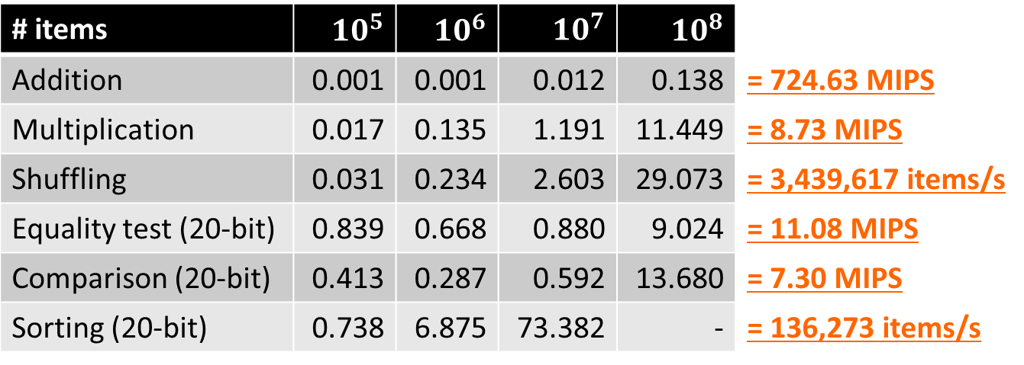
Performance on 1-Gbps LAN
Running-time on 1-Gbps LAN in seconds
Input values were randomly chosen
# items | $10^{5}$ | $10^{6}$ | $10^{7}$ | $10^{8}$
Addition | 0.001 | 0.001 | 0.012 | 0.138 | = 724.63 MIPS
Multiplication | 0.017 | 0.135 | 1.191 | 11.449 | = 8.73 MIPS
Shuffling | 0.031 | 0.234 | 2.603 | 29.073 | = 3,439,617 items/s
Equality test (20-bit) | 0.839 | 0.668 | 0.880 | 9.024 | = 11.08 MIPS
Comparison (20-bit) | 0.413 | 0.287 | 0.592 | 13.680 | = 7.30 MIPS
Sorting (20-bit) | 0.738 | 6.875 | 73.382 | - | = 136,273 items/s

Slide 12
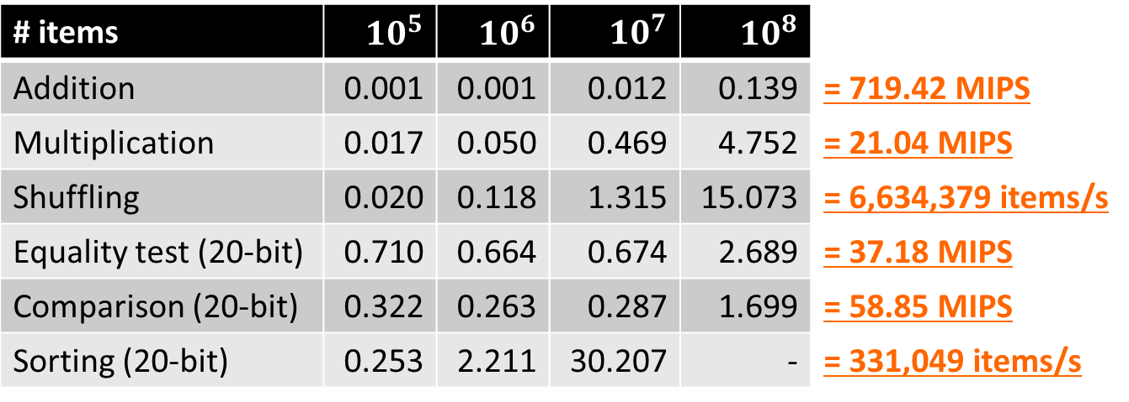
Performance on 10-Gbps LAN
Running-time on 10-Gbps LAN in seconds
Input values were randomly chosen
# items | $10^{5}$ | $10^{6}$ | $10^{7}$ | $10^{8}$
Addition | 0.001 | 0.001 | 0.012 | 0.139 | = 719.42 MIPS
Multiplication | 0.017 | 0.050 | 0.469 | 4.752 | = 21.04 MIPS
Shuffling | 0.020 | 0.118 | 1.315 | 15.073 | = 6,634,379 items/s
Equality test (20-bit) | 0.710 | 0.664 | 0.674 | 2.689 | = 37.18 MIPS
Comparison (20-bit) | 0.322 | 0.263 | 0.287 | 1.699 | = 58.85 MIPS
Sorting (20-bit) | 0.253 | 2.211 | 30.207 | - | = 331,049 items/s

Slide 13
Performance on WAN
Running-time on WAN in seconds
200-Mbps best-effort delivery network was used
Network delay between machines were 24.6 , 36.1 and, 46.7 ms
Input values were real medical data
# items | 1 | 100 | 1,547 | 10,829 | 108,290
Addition | - | 0.001 | 0.001 | 0.001 | 0.002 | = 54.009 MIPS
Multiplication | - | 0.091 | 0.063 | 0.074 | 0.233 | = 0.464 MIPS
Shuffling | - | 0.059 | 0.062 | 0.125 | 0.671 | = 161,385 items/s
Equality test (20-bit) | 0.970 | 0.930 | 1.030 | 1.591 | 5.468 | = 0.019 MIPS
Comparison (20-bit) | 0.634 | 0.771 | 0.961 | 1.647 | 6.174 | = 0.017 MIPS
Sorting (20-bit) | 1.075 | 1.032 | 0.772 | 1.595 | 12.723 | = 8,511 items/s

Slide 14
Techniques used in meval

Slide 15
Techniques used in MEVAL
Implementation techniques
Efficient high-level protocols

Slide 16
Implementation techniques
Careful implementation was done for real-world performance
Main points of our efficient implementation are:
Asynchronous processing
Pseudorandom secret sharing technique implemented with AES-NI
Optimized field operations on Mersenne prime field

Slide 17

Without asynchronous processing
In our settings, times consumed by data transfer and local computation are comparable
So, naïve implementation leaves many resources unused
Example: cascade conductions of MPC protocols
1st conduction
2nd conduction
Receive
Compute
Send
Receive
Compute
Send
Receive
$$⋯$$
Network
usage
CPU usage

Slide 18
Implementation techniques
Careful implementation was done for real-world performance
Main points of our efficient implementation are:
Asynchronous processing
Pseudorandom secret sharing technique implemented with AES-NI
Optimized field operations on Mersenne prime field
Running time details (before applying our ideas):
Time consumed by sending/receiving
Time consumed by local computation
Running time

Slide 19


Asynchronous processing
Asynchronous implementation enables better resource usage
Thread 1
Receive
Compute
Send
Receive
Compute
Send
$$⋯$$
Thread 2
Receive
Compute
Send
Receive
Compute
Thread 3
Receive
Compute
Send
$$⋯$$
Network
usage
CPU usage

Slide 20

Implementation techniques
Careful implementation was done for real-world performance
Main points of our efficient implementation are:
Asynchronous processing
Pseudorandom secret sharing technique implemented with AES-NI
Optimized field operations on Mersenne prime field
Running time details:
Time consumed by sending/receiving
Time consumed by local computation
Running time

Slide 21
Balancing resource usage
If implementation is asynchronous, maximum of resource usages determines total running time
Balancing resource usage is important for reducing running time on asynchronous implementation
Case #1
Case #2
Case #3
Sending/receiving
Computation
Running time
30 s
8 s
18 s
8 s
30 s
20 s
30 s
30 s
20 s

Slide 22








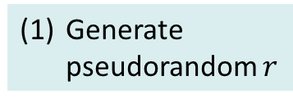



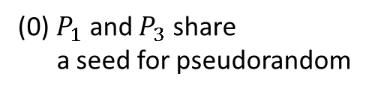
Pseudorandom secret sharing
Pseudorandom secret sharing technique [CDI05] is used to convert network communication to local computation
Almost half of communications can be converted to local computation
AES-NI is used to obtain 30-Gbps pseudorandom generation
Typical communication on 3-party MPC: mask and send
(0) $P_{1}$ and $P_{3}$ share a seed for pseudorandom
(1) Generate random $r$
(1) Generate pseudorandom $r$
$$P_{1}$$
$$P_{1}$$
(2) Send $x+r$
(2) Send $r$
(2) Send $x+r$
Generate pseudorandom $r$
$$P_{2}$$
$$P_{3}$$
$$P_{2}$$
$$P_{3}$$

Slide 23
Implementation techniques
Careful implementation was done for real-world performance
Main points of our efficient implementation are:
Asynchronous processing
Pseudorandom secret sharing technique implemented with AES-NI
Optimized field operations on Mersenne prime field
Running time details:
Time consumed by sending/receiving
Time consumed by local computation
Running time

Slide 24
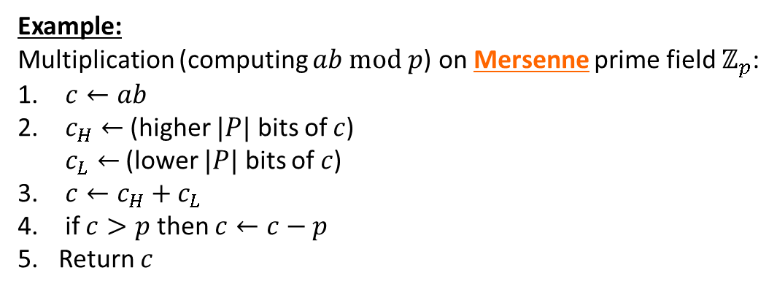
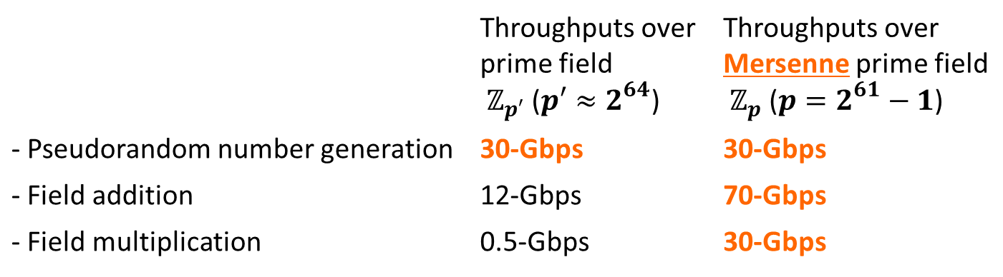
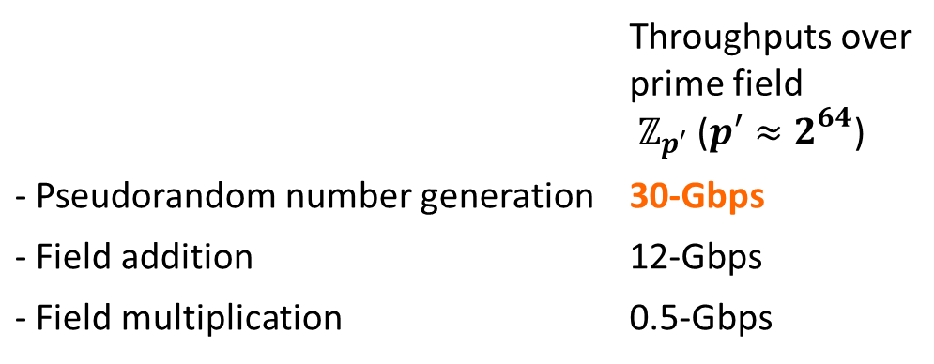
Mersenne prime field operation
Local computations mainly consist of the following operations:
 | Throughputs over prime field $ℤ_{p′}$ ($p′≈2^{64}$)
- Pseudorandom number generation | 30-Gbps
- Field addition | 12-Gbps
- Field multiplication | 0.5-Gbps
 | Throughputs over prime field $ℤ_{p′}$ ($p′≈2^{64}$) | Throughputs over Mersenne prime field $ℤ_{p}$ ($p=2^{61}−1$)
- Pseudorandom number generation | 30-Gbps | 30-Gbps
- Field addition | 12-Gbps | 70-Gbps
- Field multiplication | 0.5-Gbps | 30-Gbps
Example:
Multiplication (computing $ab mod p$) on Mersenne prime field $ℤ_{p}$:
$c←ab$
$c_{H}←$ (higher $|P|$ bits of $c$) $c_{L}←$ (lower $|P|$ bits of $c$)
$c←c_{H}+c_{L}$
if $c>p$ then $c←c−p$
Return $c$

Slide 25
Implementation techniques
Careful implementation was done for real-world performance
Main points of our efficient implementation are:
Asynchronous processing
Pseudorandom secret sharing technique implemented with AES-NI
Optimized field operations on Mersenne prime field
Running time details:
Time consumed by sending/receiving
Time consumed by local computation
Running time

Slide 26
Our efficient protocols
Efficient high-level protocols were also investigated:
Bit-decomposition for small number of parties
Radix sort protocol

Slide 27

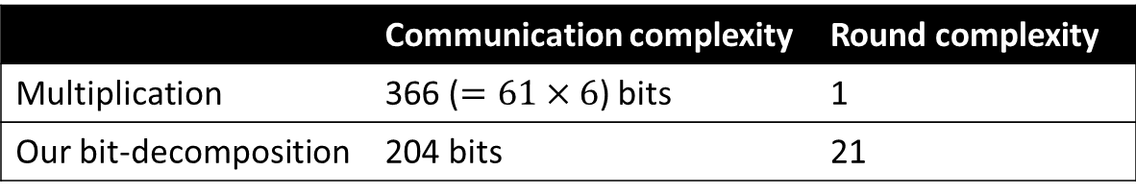
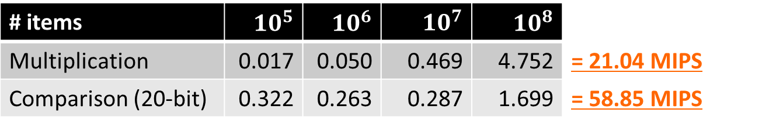
Our bit-decomposition protocol
Bit-decomposition protocol for when bit-length $ℓ$ of secret is known to be small was developed
Communication complexity: $10ℓ+4$ bits
➔ Better than that of multiplication ($6\log{p}$) when $ℓ$ is small
Round complexity: $ℓ+1$
Example: $ℓ=20$ and $p=2^{61}−1$
 | Communication complexity | Round complexity
Multiplication | 366 ($=61×6$) bits | 1
Our bit-decomposition | 204 bits | 21
Running time on 10-Gbps LAN
# items | $10^{5}$ | $10^{6}$ | $10^{7}$ | $10^{8}$
Multiplication | 0.017 | 0.050 | 0.469 | 4.752 | = 21.04 MIPS
Comparison (20-bit) | 0.322 | 0.263 | 0.287 | 1.699 | = 58.85 MIPS

Slide 28
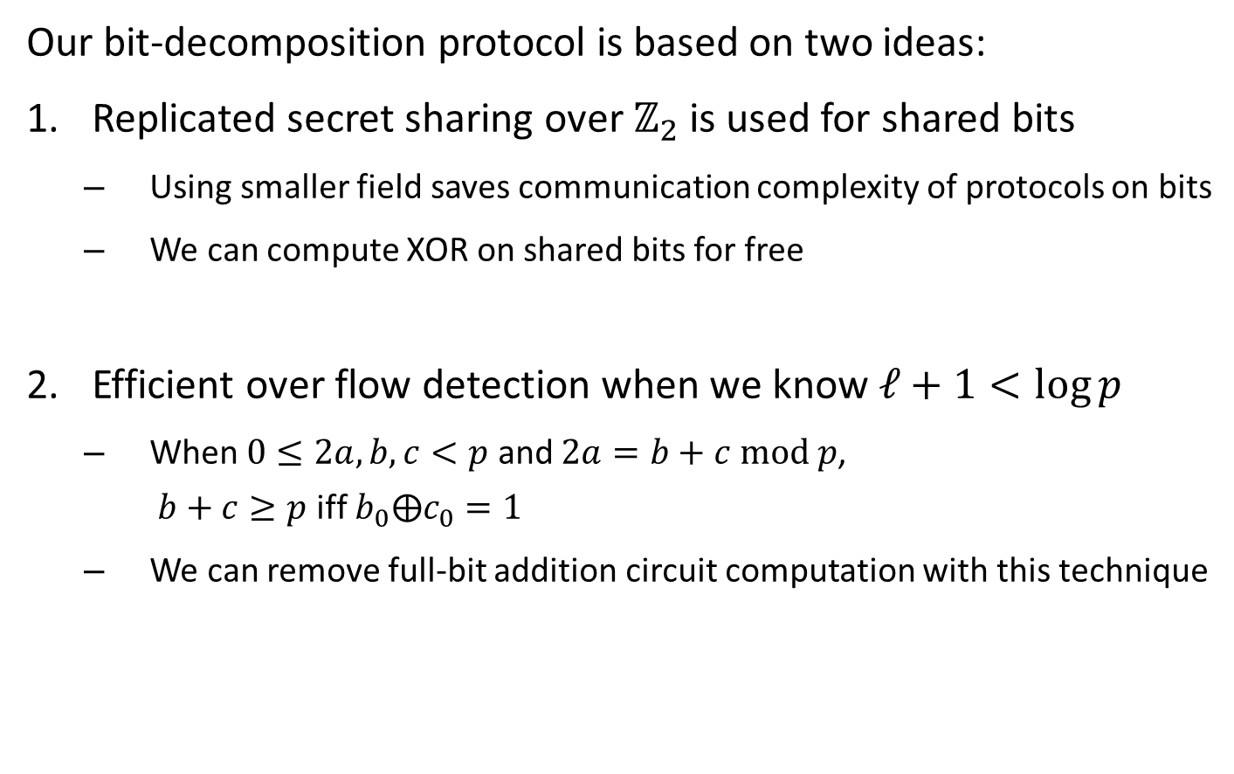
Our bit-decomposition protocol (contd.)
Our bit-decomposition protocol is based on two ideas:
Replicated secret sharing over $ℤ_{2}$ is used for shared bits
Using smaller field saves communication complexity of protocols on bits
We can compute XOR on shared bits for free
Efficient over flow detection when we know $ℓ+1<\log{p}$
When $0≤2a,b,c<p$ and $2a=b+c mod p$, $b+c≥p$ iff $b_{0}⨁c_{0}=1$
We can remove full-bit addition circuit computation with this technique

Slide 29





Our sorting protocol
Sorting protocol with $O\left(n\log{n}\right)$ communication in $O\left(1\right)$ rounds was developed
$n$ is # input items
# parties and field size $p$ are assumed to be constant
Our sorting protocol is based on radix sort algorithm
➔ Bit-decomposition and bitwise stable sort protocols are sufficient to construct MPC radix sort protocol
Radix sort algorithm:
$$\begin{matrix}1 & 1 & 0 \\ 1 & 0 & 1 \\ 1 & 0 & 1 \\ 0 & 1 & 1 \\ 1 & 0 & 0\end{matrix}$$
$$\begin{matrix}1 & 1 & 0 \\ 1 & 0 & 0 \\ 1 & 0 & 1 \\ 1 & 0 & 1 \\ 0 & 1 & 1\end{matrix}$$
$$\begin{matrix}1 & 0 & 0 \\ 1 & 0 & 1 \\ 1 & 0 & 1 \\ 1 & 1 & 0 \\ 0 & 1 & 1\end{matrix}$$
$$\begin{matrix}0 & 1 & 1 \\ 1 & 0 & 0 \\ 1 & 0 & 1 \\ 1 & 0 & 1 \\ 1 & 1 & 0\end{matrix}$$

Slide 30






Our sorting protocol (contd.)
Our technique: “Shuffle and reveal”
In addition, “Shuffle and reveal” technique is again used to improve efficiency of resultant MPC radix sort protocol
MPC bitwise stable sort:
Computing destinations
Shuffling
Revealing
$$\begin{matrix}1 \\ 0 \\ 0 \\ 1 \\ 0\end{matrix}$$
$$\begin{matrix}4 \\ 1 \\ 2 \\ 5 \\ 3\end{matrix}$$
$$\begin{matrix}0 \\ 0 \\ 1 \\ 1 \\ 0\end{matrix}$$
$$\begin{matrix}4 \\ 3 \\ 2 \\ 1 \\ 5\end{matrix}$$
$$\begin{matrix}0 \\ 0 \\ 0 \\ 1 \\ 1\end{matrix}$$
$$\begin{matrix}1 \\ 2 \\ 3 \\ 4 \\ 5\end{matrix}$$

Slide 31
demonstration

Slide 32
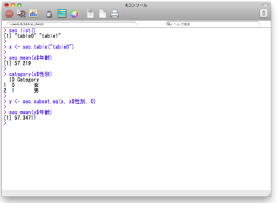
Outline of demonstration
MEVAL is demonstrated on this laptop PC
Client program (R with add-on) runs on host OS (Windows 7)
Three server programs runs on a single virtual machine (Ubuntu 12.04)
This laptop PC (Thinkpad)
Virtual machine (Ubuntu 12.04)
Process #1
(MPC server #1)
Process #2
(MPC server #2)
R with add-on
(Client program)
Process #3
(MPC server #3)

