Slide 1

^{MiniLEGO:} Efficient Secure Two-Party Computation From General Assumptions
Tore Frederiksen, Thomas Jakobsen, Jesper Nielsen, Peter Nordholt, Claudio Orlandi

Slide 2
What we will present
A protocol for maliciously secure two-party computation based on cut-and-choose of Yao garbled circuits.

Slide 3
Outline
Introduction
What is the setting?
Garbled circuits
Why should we look at this?
Preliminaries
Free XOR
XOR-homomorphic commitments
The LEGO approach
Overall idea
New problems
Conclusion
Practical efficiency
Future work
Notes:
This talk is short, so there is plenty of time for questions and details
But if no questions, then I have prepared 10 more slides outlining an XOR homomorphic commitment scheme based on ECC

Slide 4








What is the problem?
Secure two-party computation
x
y
f(x, y)=(f_{A}(x, y), f_{B}(x, y))
f_{A}(x, y)
f_{B}(x, y)
Notes:
Alice has private data/Bob has private data
Want to compute function on data to achieve private output
E.g. Millionaire problem
We achieve this in different models, e.g. passive security/active security

Slide 5


Why is it worth solving?
Set intersection
Patients:
Alice Cooper
Cher
David Bowie
Gary Moore
Otep
Customers:
Alice Cooper
Chibi
La Roux
Madonna
Notes:
E.g. Set intersection without any trusted 3rd party
Set intersection can be used for the following problem.

Slide 6
How can it be solved?
Secure computation zoo
Notes:
Can be based on many things; e.g. secret sharing, homomorphic encryption, or garbled circuits
Some only gives passive, some gives active, and we can compile an active protocol from a private

Slide 7
Introduction
What is the setting?
Approach:
Yao’s garbled circuits
(Gate level) Cut-and-choose approach for malicious security
Using XOR-homomorphic commitment
UC secure
OT-hybrid security

Slide 8
Introduction
Passive to active security
Yao’s garbled circuits are passively secure.
Active security can be achieved with compilers [IPS08] or cut-and-choose [LP07, LP11, sS11, sS13, FN13, …].

Slide 9

Introduction
Constructing a garbled circuit
Notes:
Consider a function expressible as a Boolean circuit, for simplicity, and in rest of talk assume output only to one party (can be fixed with encryption and mac)
→One party (constructor, Alice) associate random keys with each wire instead of bits.
Want intermediate values to be secret for evaluator
→One construct garbled table for each gate (encrypt each gate). Which will then be sent to other part who evaluates
View Boolean truth table of gate, but instead of output bit, have encryption of output key under input key bits
(However, problem is now that we want semantic knowledge of key secret, i.e. hide intermediate values.
So now since gate is based on truth table we know what the key is when we decrypt, so we randomize the order of entries
However, we do not know which entry to decrypt.)
Now have entire circuit and given only one key on input wire makes it possible to evaluation obliviously all the way down
Final problem is output: simple solution is to have final gates encrypt a single bit instead of new key

Slide 10
Introduction
Yao’s garbled circuit with passive security
Notes:
Protocol becomes quite intuitive from this
Alice garble circuit
Send one key for each input wire in correspondence her binary input
-> Do OT for Bob to learn his keys. Bit select exactly one of the other parties inputs. Which he learns
With this Bob can decrypt circuit and learn output
Only passive secure: Alice can garble a wrong circuit

Slide 11

Introduction
The cut-and-choose approach to get malicious security
Commit
Challenge:
Challenge
Open
Notes:
Use statistics: instead of having Alice garble one circuit she garbles many and Bob check half of these correct
She can cheat by making some incorrectly, but if she does so with many, with large prob she will be busted
She starts by making all, commit to them towards Bob
Half circuits are randomly chosen as check circuits, which she opens and Bob verifies

Slide 12
Introduction
The cut-and-choose approach to get active security
Open
Challenge:
Notes:
Alice then sends keys for her input to remaining circutis
They do OT for the Bobs keys.
Bob evaluates and takes majority output to be real output
Need majority as malicious circuits can be correct except if Bobs first bit is 0
Notice we abstract away several issues (consistency of both alice and bob, selective failure

Slide 13
Introduction
The cut-and-choose approach to get active security
Simple
Information theoretical security
Fast (limited use of public key operations)
Asymptotic increase in complexity of O(s)
LEGO reduces the overhead to O(s/log(|C|)
Original LEGO [NO09] needs public key operations for each gate
Notes:
What do we get from this protocol?
CnC has large asymptotic complexity, but good in practice, because of little PK primitives
In fact, if no preprocessing CnC is most efficient, scales well in parallel
We keep round optimal, amount of heavy operations optimal, but lower compexity
Compared to original lego we also eliminate the need for public key operations for each gate.

Slide 14
Introduction
Comparison to general cut-and-choose
Efficiency depends on many things:
Rounds (amount of batches of messages)
Complexity
Constants
Types of operations
Notes:
Why we care about the approach
We already have this, so our goals can be, speed, simplicity of presentation, minimal amount of assumptions, weak assumptions, asymptotic efficiency, different computation models
We keep round optimal, amount of heavy operations optimal, but lower compexity

Slide 15
Outline
Introduction
What is the setting?
Garbled circuits
Why should we look at this?
Preliminaries
Free XOR
XOR-homomorphic commitments
The LEGO approach
Overall idea
New problems
Conclusion
Practical efficiency
Future work
Notes:
2 min
----- Meeting Notes (08/11/13 15:36) -----
16 min

Slide 16
Free XOR
[KS08]
Each 0-key is chosen randomly
Each 1-key is the 0-key XOR’ed with a random value, common for the entire garbled circuit
1-keys for i and i+1:
0-output key for XOR gate:
Computing XOR gate:
Truth table:
1-output key for XOR gate:

Slide 17
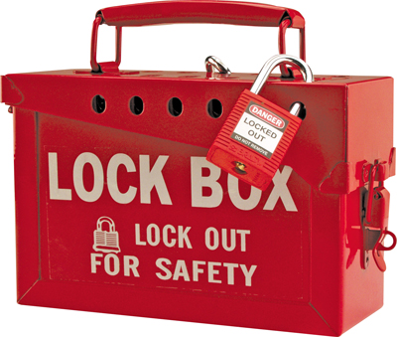
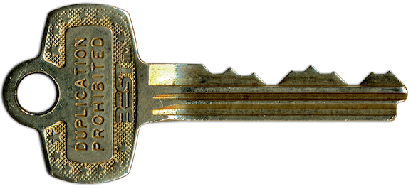

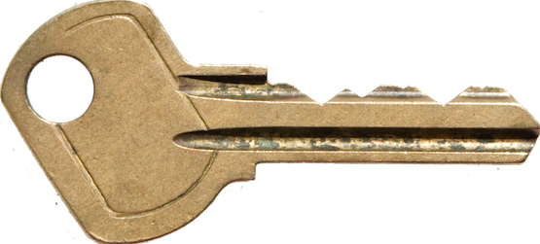
XOR-homomorphic commitments
M₁
M₂
Commit
Open
M₁
M₁
M₂

Slide 18
Outline
Introduction
What is the setting?
Garbled circuits
Why should we look at this?
Preliminaries
Free XOR
XOR-homomorphic commitments
The LEGO approach
Overall idea
New problems
Conclusion
Practical efficiency
Future work
Notes:
2 min
----- Meeting Notes (08/11/13 15:36) -----
22 min

Slide 19




The LEGO approach
The Overall idea
Commit
Cut-and-choose
Open
Notes:
Remember the cut and choose approach
Gates consists of garbled computation table and XOR homomorphic commitment to 0-keys
Sends gates and commitments to Bob

Slide 20
The LEGO approach
Horizontal soldering
Notes:
----- Meeting Notes (08/11/13 12:23) -----
21 min
----- Meeting Notes (08/11/13 12:51) -----
The bad gates are now randomly distributed in the buckets. We know that only a few bad gates are remaining, so with very large probability no more than 1 bad gate will end up in the same bucket. Now we can do normal majority as in generel CnC, which will be correct with large probability

Slide 21
The LEGO approach
Vertical soldering

Slide 22
The LEGO approach
Vertical soldering

Slide 23
The LEGO approach
Input soldering

Slide 24
The LEGO approach
Input soldering
Send inputs

Slide 25
The LEGO approach
Evaluation
Send output keys

Slide 26
The LEGO approach
New problems
Soldering:
Horizontal
Vertical
Input
Notes:
----- Meeting Notes (08/11/13 12:30) -----
24 min
----- Meeting Notes (08/11/13 15:36) -----
29 min

Slide 27
The LEGO approach
Horizontal soldering
head

Slide 28
The LEGO approach
Horizontal soldering
head
Majority

Slide 29
The LEGO approach
Vertical soldering
Bucket j
Majority

Slide 30
The LEGO approach
Input soldering
OT
head
Horizontal soldering

Slide 31
Outline
Introduction
What is the setting?
Garbled circuits
Why should we look at this?
Preliminaries
Free XOR
XOR-homomorphic commitments
The LEGO approach
Overall idea
New problems
Conclusion
Practical efficiency
Future work
Notes:
2 min
----- Meeting Notes (08/11/13 15:36) -----
39 min

Slide 32
Conclusion
Practical efficiency
Better asymptotic complexities
Practical efficiency depends directly on XOR-homomorphic commitments
Or the size of the garbled circuit, because of asymptotic increase in efficiency
O(s/log(|C|)) replication factor
Notes:
Normal cut and choose we base replication on security parameter, here we base it on gates in circuit. Which Is in general greater. Furthermore, we use each of the result to do several majorties. The rest comes form combinatorial proof
38 min

Slide 33
Conclusion
Practical efficiency
In [NO09] Pedersen Commitments were used
3 public-key operations on each gate per party
In [FJNNO13] XOR-homomorphic commitments constructed from error correcting codes+OT
Based on symmetric primitives when using OT extension, but codes leads to constants of around 40

Slide 34
Conclusion
Future work
The Aarhus Crypto-group is working on making cheaper XOR-homomorphic commitments and thus a more efficient LEGO protocol.
Hopefully more efficient than normal cut-and-choose even for smaller circuits

Slide 35
Conclusion
 | Free XOR | Symmetric | Asymmetric | Rounds
MiniLEGO | Yes | O(s|C|/log(|C|)) | O(s) | O(1)
LEGO | No | O(s|C|/log(|C|)) | O(s|C|/log(|C|)) | O(1)
[LP11, sS11, sS13, L13, FN13, …] | Yes | O(s|C|) | O(sn) | O(1)
[NNOB12] | Yes | O(s|C|/log(|C|)) | O(s) | O(d)
[DPSZ12] | Yes | O(|C|) | O(|C|) | O(d)
s is statistical security parameter, |C| is circuit size, d is circuit depth,
n is input/output bits
Thanks you!
Questions?
Notes:
6+10+11+4
Mention test case again!

Slide 36
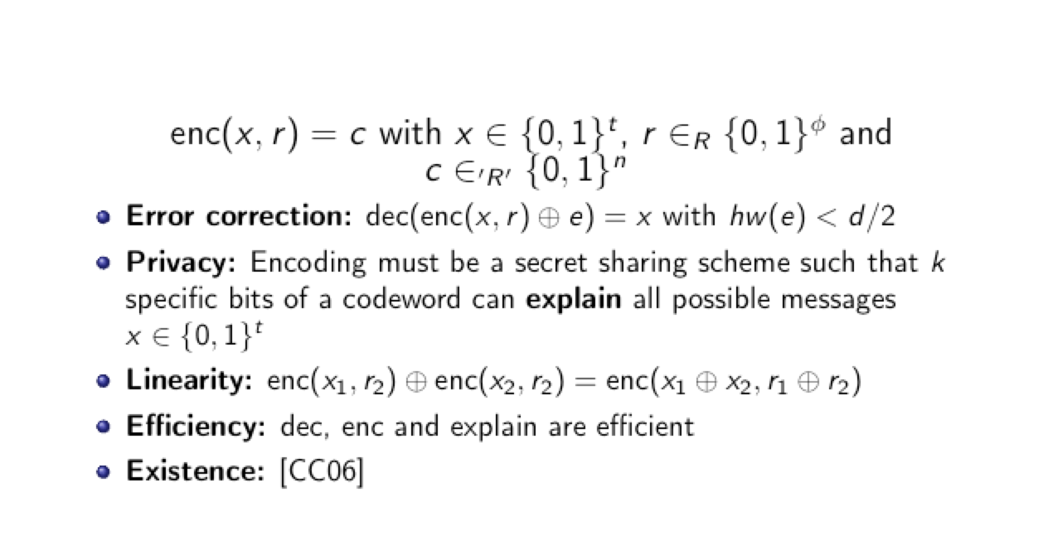
XOR-homomorphic commitments
The error correcting code
Notes:
Error correction gives us large distance between codewords, which makes it impossible for Alice to get away with opening commitments wrongly since with large probability at least one watch bit position will change

Slide 37
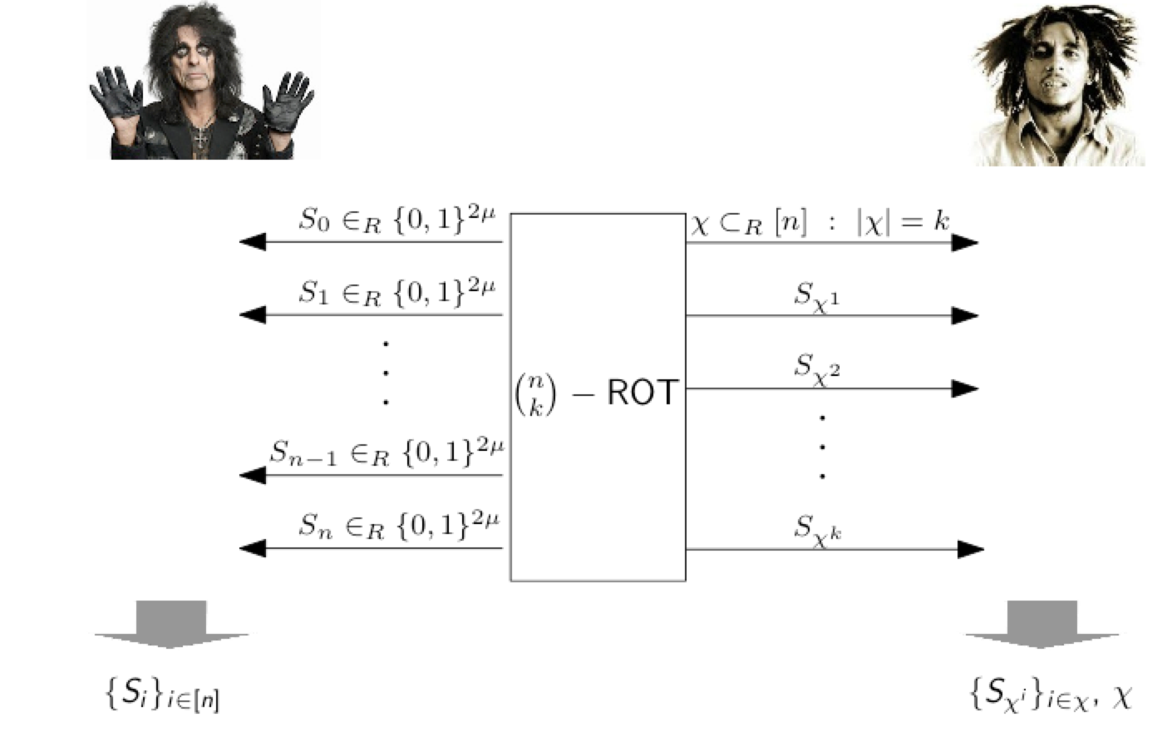
XOR-homomorphic commitments
The protocol - Setup
Notes:
Idea is to use an error correcting code with “nice” properties to encode messages
Encoded messages are then committed to by padding some randomness (hiding), where some of the randomness is leaked to the opener (Bob) (binding)
Commitments must be preprocessed. So we need an upper bound on the amount of commitments
In fact messages are random and then corrected to specific values by linearity of the code
We start by doing a big ROT
Mu is the amount of commitments we wish to make
n, is the size of a commitment (40*s).
K is a small number close to s

Slide 38
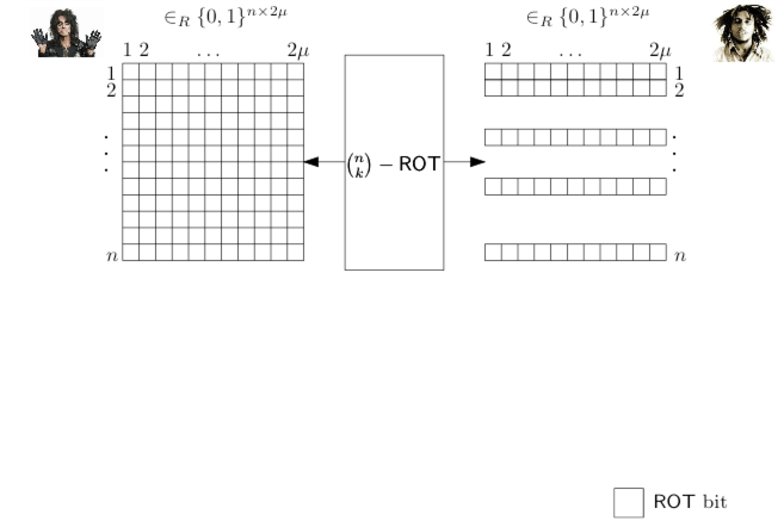
XOR-homomorphic commitments
The protocol - Setup
Notes:
View the output of the ROT as a matrix

Slide 39
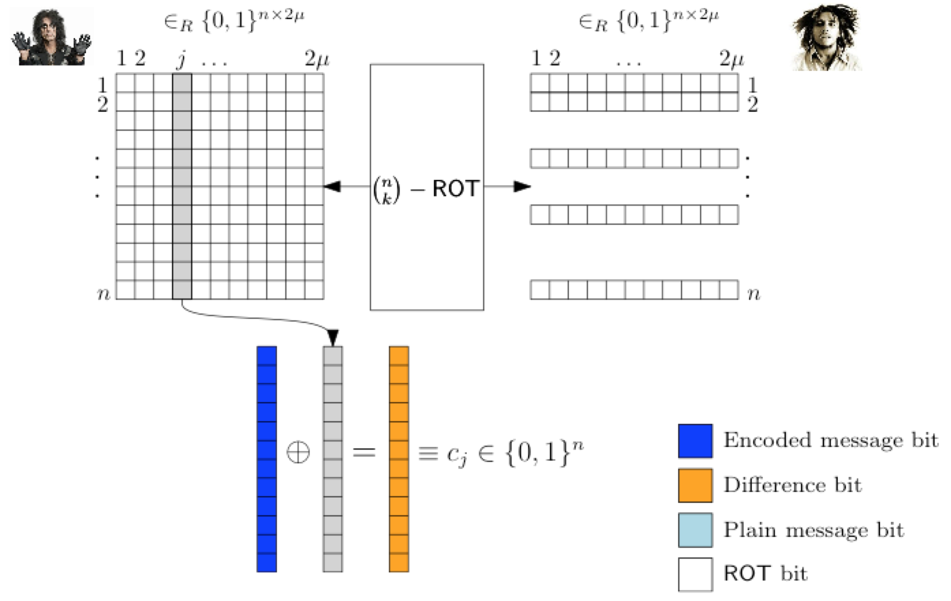
XOR-homomorphic commitments
The error correcting code
Notes:
Idea is to use the columns of the random matrix as padding

Slide 40
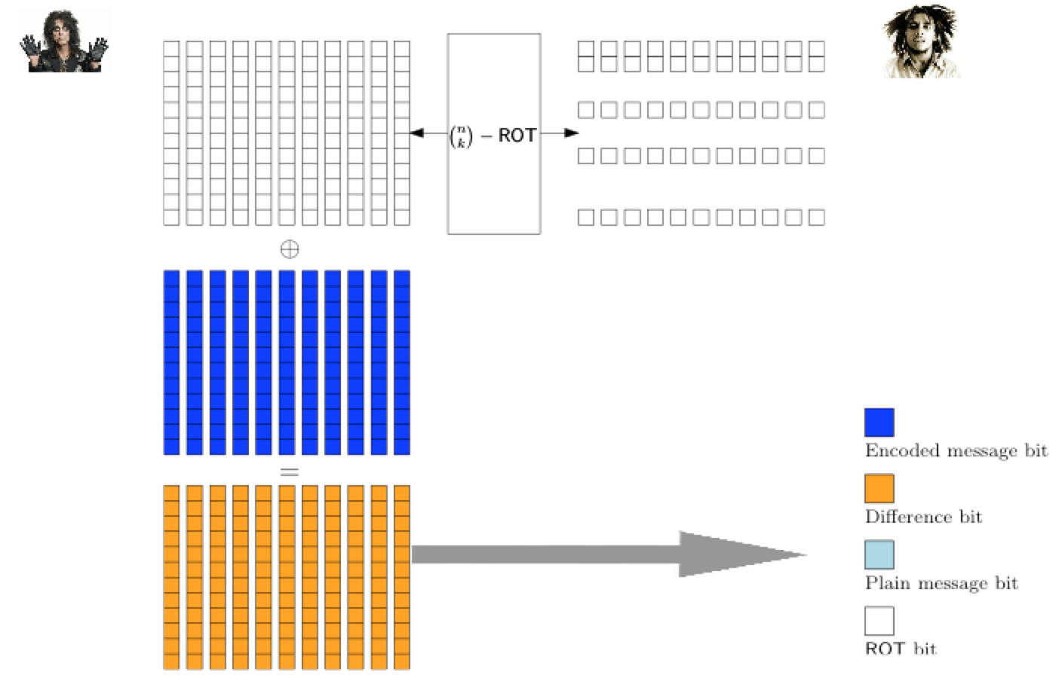
XOR-homomorphic commitments
The protocol - Setup
Notes:
Alice chooses 2mu random messages and encode them.
She XORs the result to the outcome of the ROT and sends this to Bob
(This will work as a commitment to random messages)

Slide 41
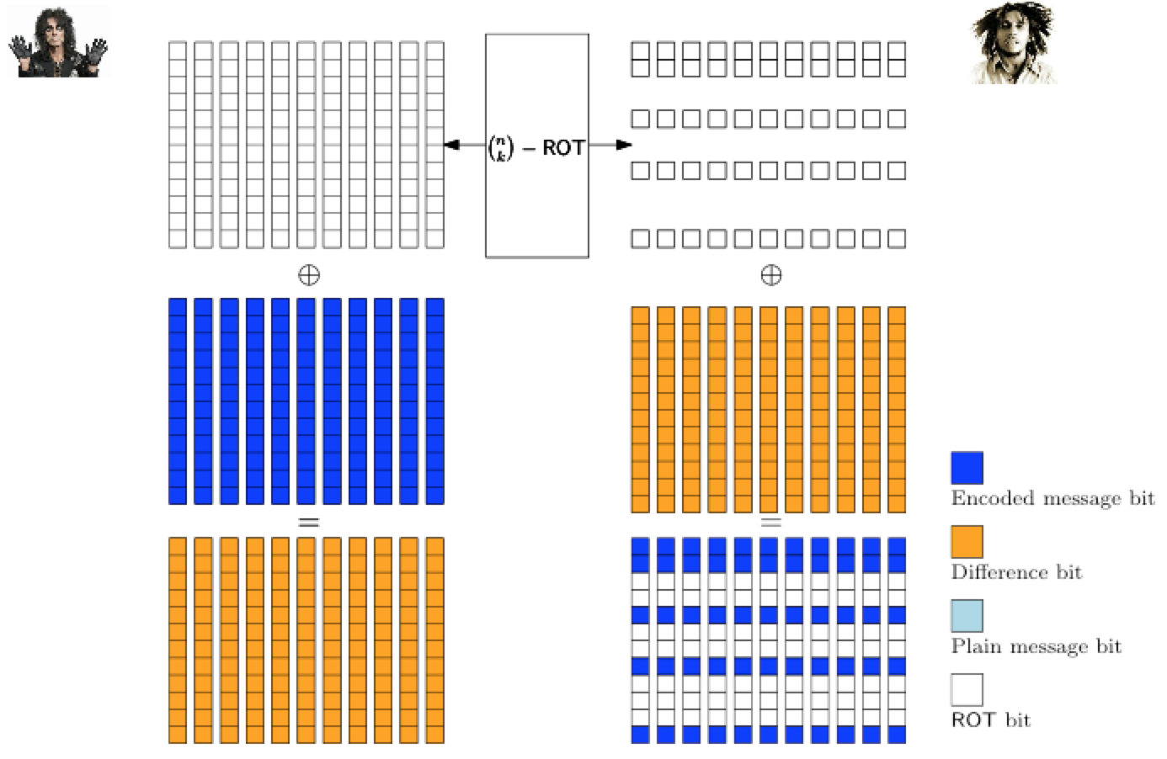
XOR-homomorphic commitments
The protocol - Setup
Notes:
The k row of the matrix Bob learn are known as the “watch bits”
He then XORs this with the random commitments and learns k bits of each encoded message, not a problem because of secret sharing property

Slide 42
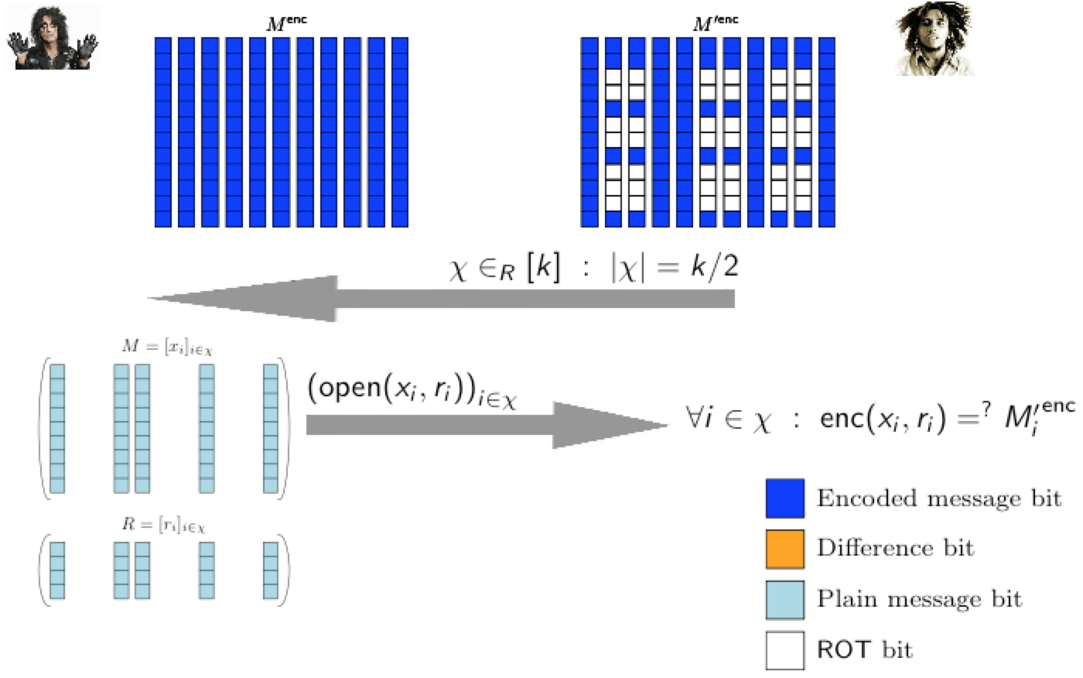
XOR-homomorphic commitments
The protocol - Setup
Notes:
A CnC step is performed and Bob learns half of the messages. He encodes them and verifies them against the watch bits he knows

Slide 43
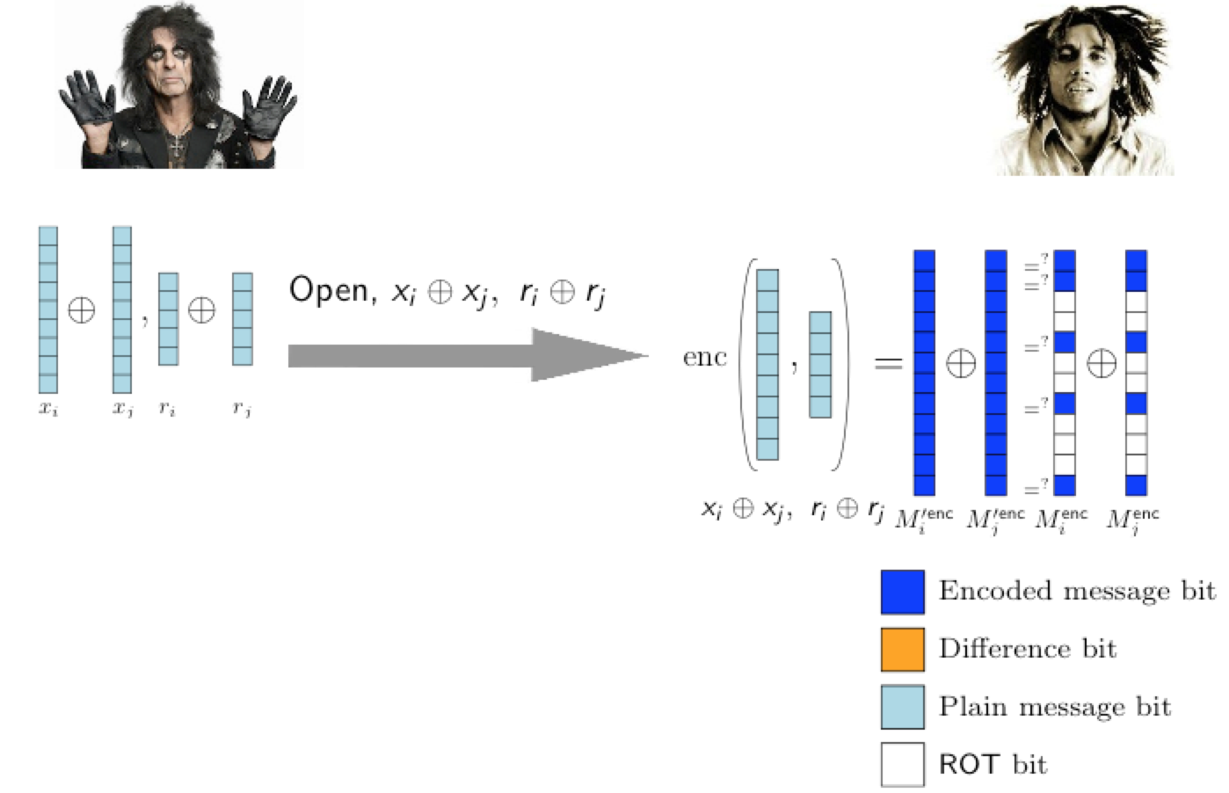
XOR-homomorphic commitments
The protocol – Committing and opening
Notes:
When Alice wants to commit she sends the XORing needed to change the random encoding into what she wants to commit to.
To open she sends the XOR of the padding for all the messages she wants to XOR together.
Bob encodes these and verifies them against the watch bits

Slide 44
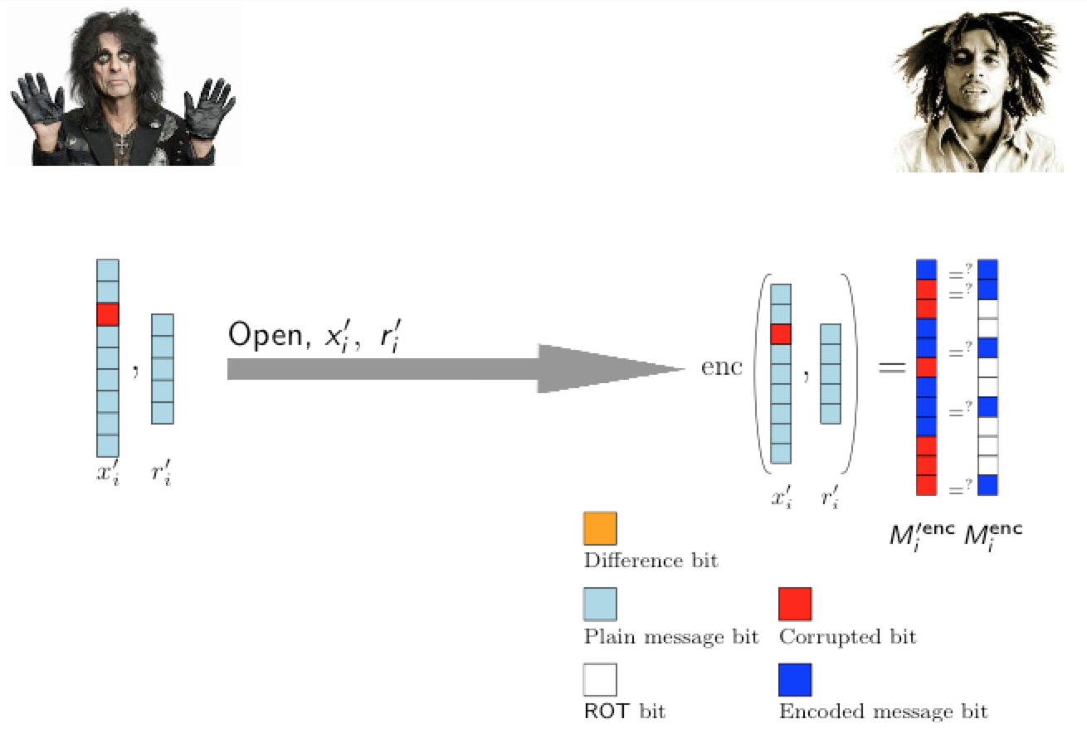
XOR-homomorphic commitments
The protocol - Security
Notes:
If there is a different bit in the opening. Then the encoding will cascade it to many positions and with overwhelming probability one of the positions will be a watch bit

Slide 45
XOR-homomorphic commitments
Which code?
In [FJNNO13] we find a code that works due to Chen and Cramer based on algebraic geometry.
However, recent work shows that we can use a random matrix instead:
Binary linear by construction
Messages will be keys, so extra randomness not needed in our context
Secret sharing comes from randomness of the codewords
Efficient decoding does not seem to be needed
Notes:
Constants will go down from around 44 to 14

