Slide 1

Spectrum Aware Load Balancing for WLANs
Victor Bahl
Ranveer Chandra
Thomas Moscibroda
Yunnan Wu

Slide 2

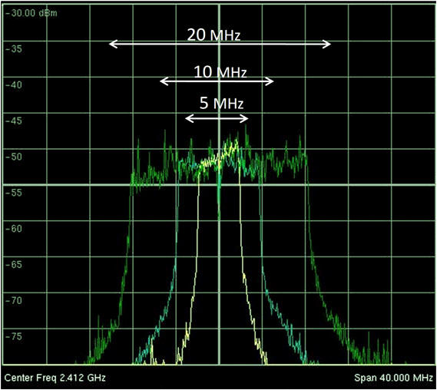
Adaptive Channel Width (ACW)
Adaptive Channel Width is a key enabling technology
for Cognitive Radio Networking
Why?

Slide 3
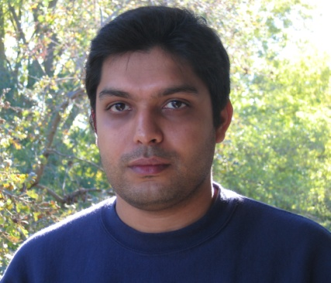
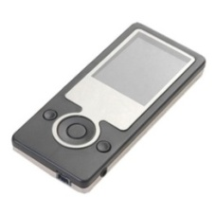
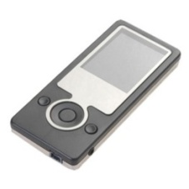
Adaptive Channel Width (ACW)
Adaptive Channel Width is a key enabling technology
for Cognitive Radio Networking
Why?
Nice Properties (range, power, throughput)
Application: Music sharing, ad hoc communication, …

Slide 4

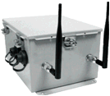
Adaptive Channel Width (ACW)
Adaptive Channel Width is a key enabling technology
for Cognitive Radio Networking
Why?
Cope with Fragmented Spectrum
(Primary users)
Application: TV-Bands, White-spaces, …

Slide 5

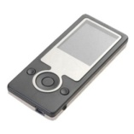
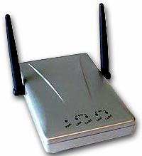


Adaptive Channel Width (ACW)
Adaptive Channel Width is a key enabling technology
for Cognitive Radio Networking
Why?
(A new knob for)
Optimizing Spectrum Utilization
Application: Infrastructure-based networks!
This talk!

Slide 6
Outline
Adaptive Channel Width is a key enabling technology
for Cognitive Radio Networking
Nice Properties (range, power, throughput)
Cope with Fragmented Spectrum
This talk
Optimizing Spectrum Utilization
Cognitive Networking MATH…?
This talk
Models
Algorithms
Theory
MATH

Slide 7
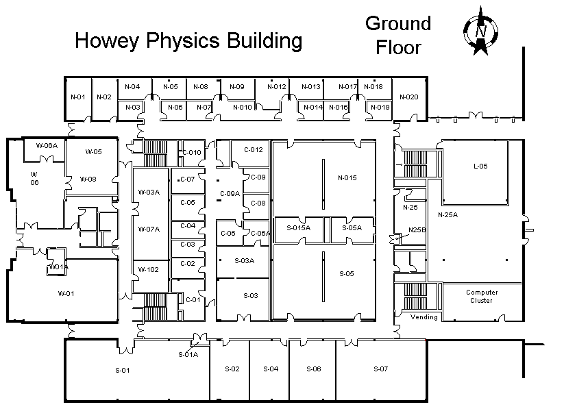
Infrastructure-Based Networks (e.g. Wi-Fi)
Each client associates with AP that offers best SINR
Hotspots can appear
→ Client throughput suffers!
Idea:
Load-Balancing

Slide 8
Previous Approaches - 1
Change associations between clients and access points (APs) e.g. [Bejerano, Mobicom’04] , [Mishra, Infocom’06]

Slide 9
Previous Approaches - 1
Change associations between clients and access points (APs) e.g. [Bejerano, Mobicom’04] , [Mishra, Infocom’06]
Problem:
Clients connect to far APs
Lower SINR → Lower datarate / throughput

Slide 10
Previous Approaches – 1I
Cell-breating: Use transmission powers for load balancing e.g. [Bahl et al. 2006]

Slide 11
Previous Approaches – 1I
Cell-breating: Use transmission powers for load balancing e.g. [Bahl et al. 2006]
Problem:
Not always possible to achieve good solution
Clients still connected to far APs
TPC - Difficult in practice

Slide 12
Previous Approaches – III
Coloring: Assign best (least-congested) channel to most-loaded APs
e.g. [Mishra et al. 2005]
Channel 1
Channel 1
Channel 2
Channel 2
Channel 1
Channel 3
Channel 3
Channel 2
Channel 3
Channel 1
Channel 2
Channel 3

Slide 13
Previous Approaches – III
Coloring: Assign best (least-congested) channel to most-loaded Aps
e.g. [Mishra et al. 2005]
Channel 1
Channel 1
Channel 2
Channel 2
Problem:
Good idea – but limited potential.
→ Still only one channel per AP !
Channel 1
Channel 3
Channel 3
Channel 2
Channel 3
Channel 1
Channel 2
Channel 3

Slide 14
Load-Aware Spectrum Allocation
Our idea: Assign spectrum where spectrum is needed! (Adaptive Channel Width)
→ ACW as a key knob of optimizing spectrum utilization
Notes:
Don’t think in terms of channels!

Slide 15
Load-Aware Spectrum Allocation
Our idea: Assign spectrum where spectrum is needed! (Adaptive Channel Width)
→ ACW as a key knob of optimizing spectrum utilization
Advantages:
Assign Spectrum where spectrum is needed
Clients can remain associated to optimal AP
Better per-client fairness possible
Channel overlap can be avoided
→ Conceptually, it seems the natural way of solving the problem

Slide 16
Load-Aware Spectrum Allocation
Problem definition:
Assign (non-interfering) spectrum bands to APs such that,
Overall spectrum utilization is maximized
Spectrum is assigned fairly to clients
Trade-off
Assignment with optimal
spectrum utilization:
→ All spectrum to leafs!
Load: 2
Load: 2
Load: 2
Load: 2
Load: 2

Slide 17
Load-Aware Spectrum Allocation
Problem definition:
Assign (non-interfering) spectrum bands to APs such that,
Overall spectrum utilization is maximized
Spectrum is assigned fairly to clients
Trade-off
Assignment with optimal
spectrum utilization:
→ All spectrum to leafs!
Assignment with optimal
per-load fairness:
→ Every AP gets half
the spectrum
Load: 2
Load: 2
Load: 2
Load: 2
Load: 2

Slide 18
Our Results [Moscibroda et al. , submitted]
Different spectrum allocation algorithms
1) Computationally expensive optimal algorithm
Computationally less expensive approximation algorithm
→ Provably efficient even in worst-case scenarios
Computationally inexpensive heuristics
Significant increase
in spectrum utilization!

Slide 19
Why is this problem interesting?
Traditional channel assignment / frequency assignment problems map to graph coloring problems (or variants thereof!)
Self-induced fragmentation
2
6
2
5
2
1. Spatial reuse
(like coloring problem)
1
2
2. Avoid self-induced fragmentation
(no equivalent in coloring problem)
MATH
→ Fundamentally new problem domain
→ More difficult than coloring!

Slide 20

Cognitive Networks: Challenges
MATH
Models:
New wireless communication paradigms
(network coding, adaptive channel width, ….)
→ How to model these systems?
→ How to design algorithms for these new models…?
→ Changes in models can have huge impact!
(Example: Physical model vs. Protocol model!)
→ Understand relationship between models

Slide 21
Example: Graph-based vs. SINR-based Model
Hotnets’06 IPSN’07
A wants to sent to D, B wants to send to C (single frequency!)
A
B
C
D
4m
1m
2m
Graph-based models
(Protocol models)
→ Impossible
SINR-based models
(Physical models)
→ Possible
Models influence protocol/algorithm-design!
→ Better protocols possible when thinking in new models

Slide 22
Example: Improved “Channel Capacity”
Consider a channel consisting of wireless sensor nodes
What throughput-capacity of this channel...?
time
Channel capacity is 1/3

Slide 23
Example: Improved “Channel Capacity”
No such (graph-based) strategy can achieve capacity 1/2!
For certain wireless settings, the following strategy is better!
time
Channel capacity is 1/2

Slide 24
Cognitive Networks: Challenges
MATH
Algorithms / Theory:
Cognitive Networks will potentially be huge
Cognitive algorithms are local, distributed algorithms!
Theory of local computability ! [PODC’04, PODC‘05, ICDCS‘06, SODA‘06, SPAA‘07 ]
1) Certain tasks are inherently global
MST
(Global) Leader election
Count number of nodes
2) Other tasks are trivially local
Count number of neighbors
etc...
3) Many problems are “in the middle“
Clustering, local coordination
Coloring, Scheduling
Synchronization
Spectrum Assignment, Spectrum Leasing
Task Assignment

Slide 25
Summary
Load-balancing in infrastructure-based networks
Assign spectrum where spectrum is needed!
Huge potential for better fairness and spectrum utilization
Building systems and applications important!
But, also plenty of fundamentally new theoretical problems
→ new models
→ new algorithmic paradigms (algorithms for new models)
→ new theoretical underpinnings
MATH

