Slide 1
Neighbourhood Sampling for Local Properties on a Graph Stream
A. Pavan, Iowa State University
Kanat Tangwongsan, IBM Research
Srikanta Tirthapura, Iowa State University
Kun-Lung Wu, IBM Research

Slide 2
Graph Streams
Example: Network Monitoring
  IP addresses are vertices of a graph
  Edges represent connections between vertices
Edges of the Graph Arrive in Sequence
Continuously Maintain a Property of the Evolving Graph
  Local Property: Count subgraphs within 1-neighbourhood of a vertex

Slide 3
Big Data, Small Machines
Algorithm can be deployed on a single machine, reasonable resources
Single Pass Through Data
  Online arrivals
  Also suitable for disk-resident data
Effective use of a multicore machine
  Ex: process a 167GB graph in 1000 seconds, on 12 core machine

Slide 4
Problem: Triangle Counting
Problem: Count the number of triangles
in a simple undirected graph

Slide 5
Why Triangle Counting (1)
Number of triangles is a basic structural property
Social Network Analysis:
  Transitivity Coefficient = 3 * # Triangles / # connected triples
  Related Clustering Coefficient
  Measure how dense the graph is

Slide 6
Why Triangle Counting (2)
Web Spam Detection (Becchetti et al. 2008)
  A higher-than usual number of triangles is an indicator of web spam
Biological Networks (Przulj et al. 2006, Kashtan et al. 2002)
  Generalizations of Triangle Count used in Graphlets and Network Motifs
  “Structural Summary” of a Graph = vector, containing the number of occurrences of various subgraphs

Slide 7
Contributions
Neighborhood Sampling: Simple random sampling method for graph streams
Applications:
  Counting and Sampling Triangles in a Graph
  Counting Higher order cliques K₄, K₅, etc
  Directed Cycles in directed graphs
Experiments showing this is a practical method

Slide 8
Prior Work
Streaming Triangle Counting
  Bar-Yossef, Kumar, Sivakumar (2003): Reductions to frequency moments of appropriately defined streams
  Jowhari and Ghodsi (2005): Sampling-based and Sketch-based estimators
  Buriol et al. (2006): Another Sampling-based Estimator
  Ahn, Guha, McGregor (2012): Sketch-based, insertions and deletions
  Kane et al. (2012), Manjunath et al. (2011): sketch-based, more general subgraphs
  Seshadri, Pinar, Kolda (2012)
Batch (non-streaming) Triangle Counting
  Pagh and Tsourakakis (2012)
  Suri and Vassilvitskii (2011)
  …

Slide 9
Graph Model
Simple Undirected Graph (extends to directed graphs easily)
n vertices, m edges
Problem: Estimate τ(G) = number of triangles in G
Adjacency Stream Model: Edges arrive in an arbitrary order
Incidence Stream Model: all edges incident to a vertex arrive together

Slide 10
Sampling and Counting
Suppose a procedure A that on graph G:
  If “succeeded”, then return a triangle from G, chosen uniformly at random
  Else, return “failure”
Procedure A can be used in triangle counting
  Probability of A succeeding proportional to # triangles
  Repeat Procedure A many times, use fraction of successes
Accuracy of Estimate depends on the probability that A fails

Slide 11
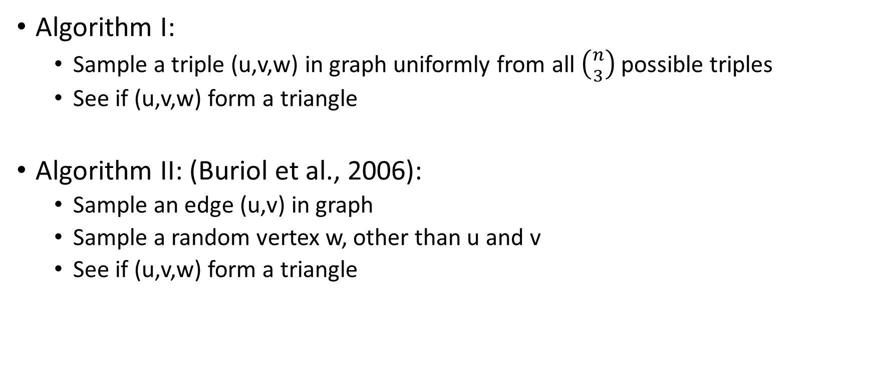
Example Triangle Sampling Procedures
Algorithm I:
  Sample a triple (u,v,w) in graph uniformly from all $\left({n \atop 3}\right)$ possible triples
  See if (u,v,w) form a triangle
Algorithm II: (Buriol et al., 2006):
  Sample an edge (u,v) in graph
  Sample a random vertex w, other than u and v
  See if (u,v,w) form a triangle

Slide 12
Neighborhood Sampling Idea
Two edges are adjacent
if they share a vertex
Choose a random edge r₁ in the graph
Choose a random edge r₂, that appears after r₁, and is adjacent to r₁
See if triangle defined by r_{1,} r₂ is completed by a third edge
Above procedure can be done in a constant number of words in a streaming manner.

Slide 13
Sampling Bias
e₈
e₇
e₉
e₁
e₃
e₁₁
e₄
e₁₀
e₂
e₆
e₅

Slide 14
Sampling Bias
e₈
e₇
e₉
e₁
e₃
e₁₁
e₄
e₁₀
e₂
e₆
e₅

Slide 15
Sampling Bias
e₈
e₇
e₉
e₁
e₃
e₁₁
e₄
e₁₀
e₂
e₆
e₅

Slide 16
Sampling Bias
e₈
e₇
e₉
e₁
e₃
e₁₁
e₄
e₁₀
e₂
e₆
e₅
For edge e, define c(e) = Number of edges adjacent to e, and that follow e

Slide 17
Sampling Bias
e₈
e₇
e₉
c(e₁) = 2
e₁
e₃
e₁₁
e₄
e₁₀
e₂
e₆
e₅
c(e₄) = 7
For edge e, define c(e) = Number of edges adjacent to e, and that follow e

Slide 18
Sampling Bias
e₈
e₇
e₉
Pr[Triangle T, where e is the first edge]
e₁
e₃
e₁₁
e₄
e₁₀
e₂
e₆
e₅

Slide 19
Handling Sampling Bias
For sampling a triangle uniformly at random
  Use neighbourhood sampling
  Compute (online) the bias in sampling a triangle
  Reject the sample, probability proportional to bias
For counting triangles
  Use neighbourhood sampling as described
  Compute (online) the bias in sampling a triangle
  Incorporate bias directly into estimator

Slide 20
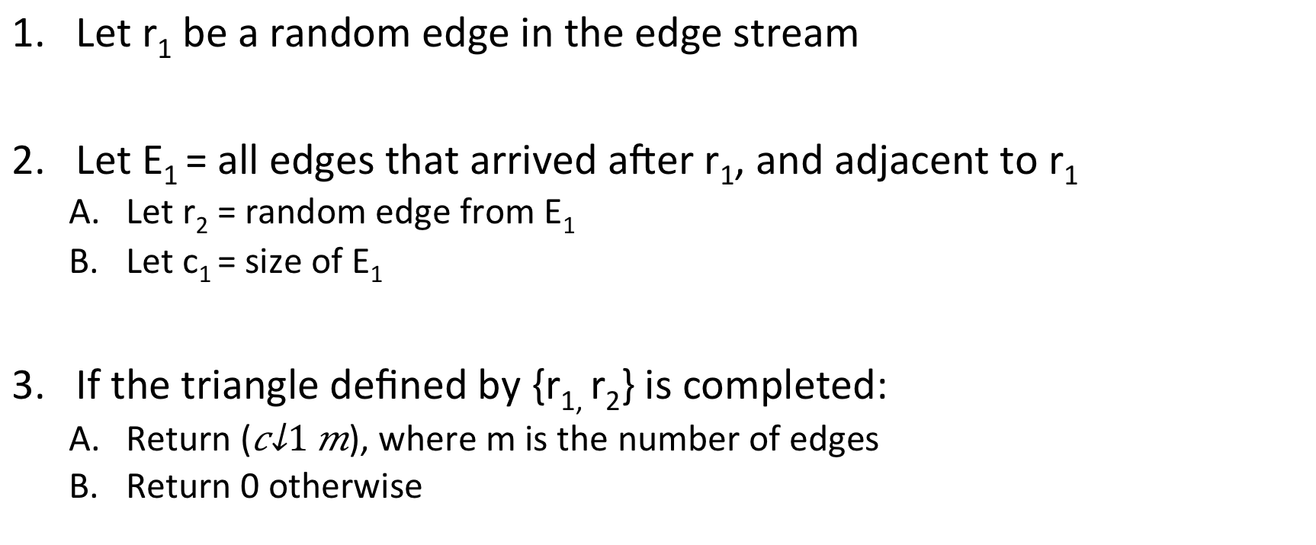
Counting Triangles in a Graph
Let r₁ be a random edge in the edge stream
Let E₁ = all edges that arrived after r₁, and adjacent to r₁
  Let r₂ = random edge from E₁
  Let c₁ = size of E₁
If the triangle defined by {r_{1,} r₂} is completed:
  Return ($c_{1}m$), where m is the number of edges
  Return 0 otherwise

Slide 21
Estimator Properties
Let X be the return value of the algorithm
E[X] = # triangles in G
Take mean of O((# edges) * (max degree) / (# triangles)) estimators to get a good approximation

Slide 22
Time Complexity
Running r estimators in parallel means O(r) time per update?
Bulk Processing, process w edges at a time:
  For each estimator, first level random sample updated in O(1) time
  Second level update is more complex, two passes through the batch
Using a batch size w = O(r), entire batch of w edges can be processed in O(w) time, yielding an amortized processing time of O(1) per edge

Slide 23
Counting and Sampling 4-Cliques
Choose a random edge r₁ in the graph
Choose a random edge r₂, that appears after r₁, and is adjacent to r₁
Choose a random adjacent edge r₃, which appears after {r₁,r₂} and has one endpoint in common with {r₁,r₂}
  Any edge with both endpoints in {r₁,r₂} is surely retained
Wait for 4-clique defined by {r₁,r_{2,}r₃} to be completed
But this misses out cliques whose first two edges are not adjacent to each other – another case to handle such cliques.

Slide 24
Extensions
Transitivity Coefficient of a Graph = 3 * # triangles / # connected triples
Sliding Windows
Directed 3-cycles in a directed graph
Counting patterns that have temporal constraints: “how many instances where A →B, followed by B →C, followed by C →A?”

Slide 25
(Preliminary) Experimental Results
Orkut Graph
  3 million vertices
  117 million edges
  max degree = 67,000
  Number of triangles = 633 million
# Estimators | 1 K | 128 K | 1 M
Relative Error | 4.6 % | 2.13 % | 1.48 %
Time Taken | 52 sec | 75 sec | 103 sec (33 IO)

Slide 26
Runtime versus number of estimators
Livejournal graph
4 M vertices
35 M edges
30 K max degree
178 M triangles
Youtube graph
1 M vertices
3 M edges
57 K max degree
3 M triangles

Slide 27
Relative Error versus Number of Estimators
Livejournal graph
4 M vertices
35 M edges
30 K max degree
178 M triangles
Youtube graph
1 M vertices
3 M edges
57 K max degree
3 M triangles

Slide 28
Conclusions
General Sampling Method for Estimating Cardinality of Graph Patterns
  Small sized cliques
  Extendible for special cases – ex: temporal constraints, edge directions
  “Sticky sampling” for graph streams
Technique:
  Sample within neighbourhood of current edges
  Compute the bias online
  Incorporate the bias into the estimator
Fast Implementations
  Multicore Machine: Synthetic Graph of size 167GB in 1000 sec on a 12 core machine

Slide 29
Thank you
Reference:
Counting and Sampling Triangles from a Graph Stream
Research Report RC25339, IBM
http://domino.research.ibm.com/library/cyberdig.nsf/papers/A9F14726B795E13185257AEE0058FCD3
http://www.ece.iastate.edu/~snt/

