Slide 1


Learning to Active Learn with Applications in the Online Advertising Field of Look-Alike Modeling
James G. Shanahan
Independent Consultant
EMAIL: James_DOT_Shanahan_AT_gmail.com
July 27, 2011
[with Nedim Lipka, Bauhaus-Universität Weimar, Germany]
http://research.microsoft.com/en-us/um/beijing/events/ia2011/
Notes:
Socialize ideas

Slide 2
Outline
Look-alike Modeling (LALM)
Active Learning
Learning to active learn
Results
Conclusions

Slide 3

Formal Relationship between Adv and Pub
Marketing Message
Advertiser wishes to reach consumers
Consumers
Publisher has
Ad Slots for sale
Ads
Advertiser
P
u
b
l
i
s
h
e
r
Formal Relationship

Slide 4
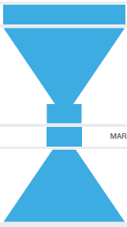
What marketers want?
Deliver marketing messages to customers
  Buy products/services (long term vs. short term)
Goal
Activity
Introduce:Reach
Media Planning
Ad Effectiveness
(CTR, site visits)
Influence:Brand
Marketing Effectiveness
(Transactions, ACR,
Credit Assignment)
Close
Grow Customers
Referrals/Advocacy/LALM

Slide 5
Advertising Planning Process
Advertising Objectives
Brand Positioning
Target Market
Budget Decisions
Creative Strategy
Media Strategy
Campaign Evaluation

Slide 6
Ad Targeting is getting more granular
Previously: Built general purpose models that ranked ads given a context (target page, and possibly user characteristics)
  Used to be about location, location, location
  Joe the media buyer (Rule-based) → Model-based
Recently: Build targeting models for each ad campaign
  Targeting is about user, user, user
  Look-alike modeling (LAL)
  Number of conversions per campaign is very small
    (conversions per impression for the advertisers is generally less than 10⁻⁴, giving rise to a highly skewed training dataset, which has most records pertaining to the negative class).
  Campaigns with very few conversions are called as tail campaigns, and those with many conversions are called head campaigns.

Slide 7
Behavioral Targeting: Modeling The User
Target ads based on user’s online behavior
  Users views and actions across website(s) to infer interests, intents and preferences (search, purchases, etc.)
  Users who share similar Web browsing behaviors should have similar preference over ads
Domains of Application
  Ecommerce (e.g., Amazon, NetFlix)
  Sponsored search (e.g., Google, Microsoft)
  Non-Sponsored search (e.g., contextual, display) (E.g., Blue Lithium (acq by Yahoo!, $300M), Tacoda (acq by AOL, $275M), Burst, Phorm and Revenue Science, Turn.com, and others…)
Generally leads to improved performance
Key concern: infringes on user’s privacy
[ For more background see: http://en.wikipedia.org/wiki/Behavioral_targeting ]

Slide 8
Personalization via BT
Intuition:
  the users who share similar Web browsing behaviors will have similar preference over ads
Selling Audiences (and not sites)
  Traditionally did this based on panels (user surveys or using Comscore/NetRatings); very broad and not very accurate
  Through a combination of cookies and log analysis BT enables very specific segmentation
Domains of Application
  Sponsored search
  Non-Sponsored search (e.g., contextual, display)

Slide 9
Consumers who transacted and who didn’t
Marketing Message
Advertiser wishes to reach consumers
Consumers
Publisher has
Ad Slots for sale
Ads
Advertiser
P
u
b
l
i
s
h
e
r
Build a look-alike classifier
Formal Relationship

Slide 10
Paper Motivations
Look-alike modeling (LALM) is challenging and expensive
  Creation of Look-alike Models for tail campaigns is very challenging and tricky using popular classifiers (e.g., Linear SVMs) because of the very few number of positive class examples such campaigns contain.
  Active Learning can help get conversion labels more expediently by targeting consumers who provide the most information to improve the quality of our the targeting model prediction
Active Learning relies on adhoc rules for selecting examples
  Propose a data-driven alternative

Slide 11
Outline
Look-alike Modeling (LALM)
Active Learning
Learning to active learn
Results
Conclusions

Slide 12
Active Learning
Active learning is a form of supervised machine learning in which the learning algorithm is able to interactively query the teacher to obtain a label for new data points.
Advantages of active learning
  There are situations in which unlabeled data is abundant but labeling data is expensive.
  In such a scenario the learning algorithm can actively query the user/teacher for labels.
    Since the learner chooses the examples, the number of examples to learn a concept can often be much lower than the number required in normal supervised learning.
    With this approach there is a risk that the algorithm might focus on unimportant or even invalid examples.

Slide 13
Active Learning Key Challenge
Interesting challenge: choosing which examples are most informative
Increasingly important: problems are huge and on-demand labelers are available
  Experts
  “Volunteer armies”: ESP game, Wikipedia
  Mechanical Turk
  Consumers converting on marketer’s message
Key question: How to identify the most informative queries?

Slide 14
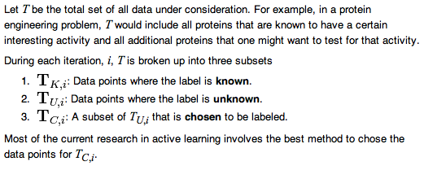
Active Learning Training Data
Notes:
Let T be the total set of all data under consideration. For example, in a protein engineering problem, T would include all proteins that are known to have a certain interesting activity and all additional proteins that one might want to test for that activity.
During each iteration, i, T is broken up into three subsets
: Data points where the label is known.
: Data points where the label is unknown.
: A subset of TU,i that is chosen to be labeled.
Most of the current research in active learning involves the best method to chose the data points for TC,i.

Slide 15
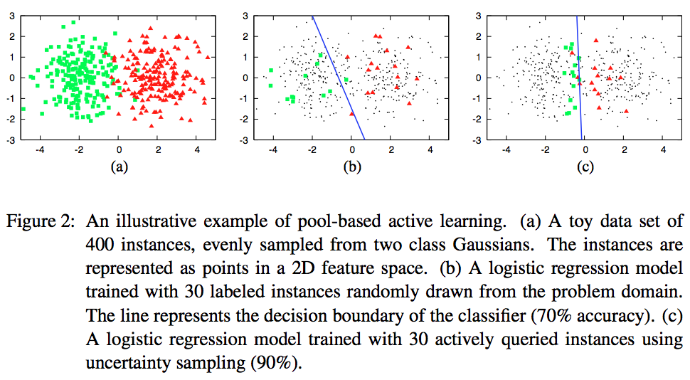
Active Learning Example
Training data with labels exposed
LR with 30 labeled training data; 70% accuracy
LR with 30 actively queried data (uncertainty sampling); 90% accuracy
[Settles 2010]

Slide 16
Active Learning using an SVM
Uncertainty Sampling
Exploit the structure of the SVM to determine which data points to label. Such methods usually calculate the margin, W, of each unlabeled datum in T^{U,i}
Minimum Marginal Hyperplane methods assume that the data with the smallest W are those that the SVM is most uncertain about and therefore should be placed in T^{C,i} to be labeled.
[Lewis, Gail 1994]
Unlabeled → Choosen

Slide 17
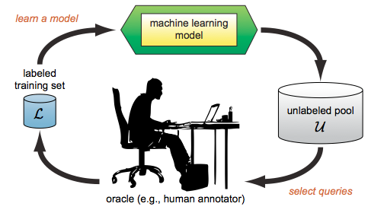
Active Learning: Pool-based
[Settles 2010]

Slide 18

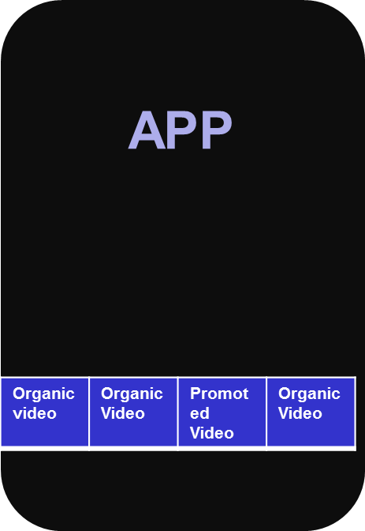
Active Learning of Look- alike Models
Data Source
Demographic
Psychographic
Intent
Interests
3rd Party Data
Unlabeled examples
Learning Algorithm
Consumer
Request for the Label of an Example
A Label for that Example
Request for the Label of an Example
A Label for that Example
. . .
Algorithm outputs a classifier
    The machine learner can choose specific examples to be labeled, i.e., ads to be shown to the consumer.
    Use fewer labeled examples.
Notes:
This talk focus on linear classifiers

Slide 19
Active Learning of Look-alike Models
Active SVM works well in practice
At any time during the alg., we have a “current guess” of the separator: the max-margin separator of all labeled points so far.
Unlabeled examples in green
Pick green example for labeling
Possible Strategy: request the label of the example closest to the current separator.
[Tong & Koller, ICML 2000]

Slide 20
Instance Selection Policy
Traditionally, instance selection has been based upon various example selection frameworks or heuristics
E.g.,
  uncertainty sampling (for example, when using a probabilistic model for binary classification, uncertainty sampling simply queries the instance whose posterior probability of be- ing positive is nearest 0.5); small margins
  query-by-committee; have multiple classifiers and vote
  expected model change; expected error reduction; variance reduction etc.
Here we propose a more general frame- work based upon machine learning where new examples are selected by a selection model that is machine learned

Slide 21
Learn Instance Selection Policy
New unlabeled examples are selected by a selection model that is machine learned
  from training examples that are collected from real-world cases
In digital advertising labeling a selected example corresponds to showing an ad to a website visitor;
  this results in either a transaction or not.
Active Selectivion of a target page
  The active selection of a particular context to show to a particular ad is not made in isolation but in the context of many other contexts.

Slide 22
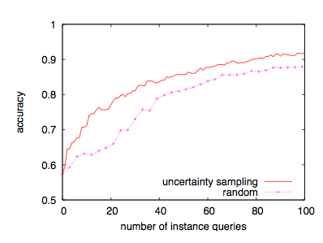
Typical Active Learning Curve
uncertainty sampling (active learning)
versus
random sampling (passive learning).
Notes:
Learning curves for text classification: baseball vs. hockey. Curves plot classification accuracy as a function of the number of documents queried for two selection strategies: uncertainty sampling (active learning) and random sampling (passive learning). We can see that the active learning approach is superior here because its learning curve dominates that of random sampling.

Slide 23
SVMs are notoriously conservative!
x₂
+
+
+
-
+
+
+1
-
-
+
+
+
-
-
+
+
-
+
-
+
+
+
+
-
-
+
+
-
-
-
-
+
+
-
-
+
-
-
+
-
-
+
-
-
+
-
-
+
-
-
-
-
-
-
-
+
-
-
+
-
-
+
Class
-
-
-
-
+
-
-
-
-
-
+
-
-
-∞ 0 +∞
-
-
-
-
-
-
-
+
-
-
+
θ
-
-
-
-
-
-
-
-
-
-
-
-
-
-
-
-
-
SVM Score
-
-
-
-
-
-
-
-
-
-
-
-
-
-
-
-
-
-
-
-
-
-
-
-
-
-
-
-
-
-
-
-
-
-
-
-
-
-
-
-
-
-
-
-
-1
x₁

Slide 24
Tune SVM Threshold:TREC2001 Results
Classification Approach | T10SU | F_{0.5} | Precision | Recall | CPU Time
Asymmetric SVM [Lewis, 2001] | 0.41 | 0.60 | 0.75 | 0.45 | 500 (hrs)
CC Continuous βγ SVMs | 0.41 | 0.58 | 0.64 | 0.51 | 5
CC Discrete βγ SVMs | 0.40 | 0.56 | 0.64 | 0.50 | 5
k-Nearest Neighbour [Ault and Yang 2001] | 0.32 | 0.49 | 0.63 | 0.36 | -
CC Linear SVM | 0.31 | 0.50 | 0.75 | 0.31 | -
Information Retrieval [Arampatzis, 2001] | 0.31 | 0.51 | 0.57 | 0.41 | -
RBF SVM [Mayfield et al 2001] | 0.28 | 0.46 | 0.55 | 0.44 | -
[Shanahan and Roma, 2003]
Reuters RV1 corpus:
Paired t-test P-value, when comparing Continuous (Continuous βγ SVMs) approach to a baseline SVM with respect to T11SU is 0.0000000016

Slide 25
Outline
Look-alike Modeling (LALM)
Active Learning
Learning to active learn
Results
Conclusions

Slide 26
Learning to Active Learn
Proposed Algorithm
Train N Base Classifiers using active learning to generate training data for the selection step
For each Class
  Do Active Learning for M iterations (e.g., 100)
    If the example selected at iteration i improves the current model by K% then label this example as positive
    If the example selected at iteration i decreases the current model by K% then label this example as positive
    Otherwise drop example
Learning “example selection” model from labeled data (see above)
  Positive and negative example selection examples
  Learn how select examples from the unlabeled pool
+
-

Slide 27
Feature Set
Current features
  Disagreement vote: the absolute value of the sum of the predicted classes −1, +1 by a k-nearest neighbour classifier, a linear SVM, and a Naive Bayes classifier.
  Predicted class probability by a linear SVM for an in- stance (estimated by by logistic regression)
  Predicted class probability by a k-nearest neighbour for an instance (estimated by 1/distance)
  Predicted class probability by a Naive Bayes classifier for an instance
Currently expanding this feature set to consider distributional features and their summary statistics and many others

Slide 28
Outline
Look-alike Modeling (LALM)
Active Learning
Learning to active learn
Results
Conclusions

Slide 29
Test Set: TREC-2001 Dataset
Reuters RCV1 Corpus
One year of Reuters news data in English: 1.5 GB, 810,000 news stories (Aug 96 – Aug. 97)
84 topics or categories
Training data limited to the last 12 days of August 96 (23K examples); the remaining 11 months were used as test data

Slide 30
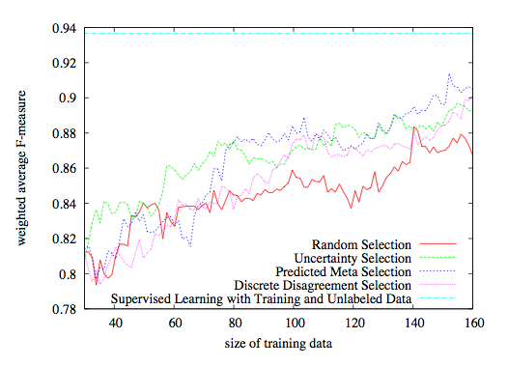
Categories: Predictive sampling
Predictive Sampling learnt from 10 classes

Slide 31
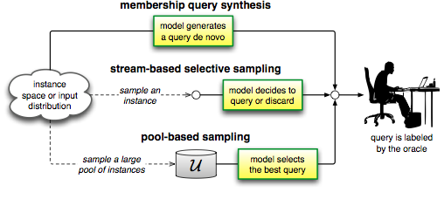
Active Learning For LALM
Traffic Forecasts
Learn user selection model from a subset of campaigns and use for new campaigns

Slide 32
Outline
Look-alike Modeling (LALM)
Active Learning
Learning to active learn
Results
Conclusions

Slide 33
Conclusions
Presented an algorithm to learn the example selection policy within active learning (i.e., learning to active learn)
Proposed algorithm is currently being evaluated in traditional active learning settings with a lot of promise
Over the coming months plan to evaluate on real online advertising data in the context of look-alike modeling

Slide 34
By The Way
My clients are hiring (big data analytics)
E.g., __________ (San Jose and San Francisco Offices)

Slide 35
Bibliography (partial)
D. D. Lewis and W. A. Gale. A sequential algorithm for training text classifiers. In SIGIR, pages 3–12, 1994.
Hinrich Schütze, Emre Velipasaoglu, Jan O. Pedersen: Performance thresholding in practical text classification. CIKM 2006: 662-671
A feature-pair-based associative classification approach to look-alike modeling for conversion-oriented user-targeting in tail campaigns [Ashish Mangalampalli, et al, WWW 2011]
S. Pandey, C. Olston, 2006, Handling Advertisements of Unknown Quality in Search Advertising
http://en.wikipedia.org/wiki/Active_learning_(machine_learning)
Active Learning Literature Survey, Burr Settles, 2010
  http://www.cs.cmu.edu/~bsettles/pub/settles.activelearning.pdf
Tong & Koller, ICML 2000, Active learning using SVMs

Slide 36
THANKS!
Questions?
EMAIL: James_DOT_Shanahan_AT_gmail.com

