Slide 1
MAXWell Lab
Environmental Evolution in 4G Testing
Ashok K. Agrawala
Director
A Joint Lab of UMIACS and OIT
Notes:
1

Slide 2
MAXWell Lab Rapid Access Environment
WiMAX Forum Applications Lab
  The only one in the western hemisphere
  Application development and testing.
  Functional Mobile Wireless Network -
Instrumentation throughout network to measure, record and provide real time and historical performance meta data to lab participants
Plans include phased deployment of RF sensor grid across campus to monitor Quality of Wireless Service
Lab Integration based upon commercial application colocation hosting model; rapid deployment and supporting services in place and functional
Notes:
2

Slide 3
MAXWell Lab Partners
LTS
NRL
NIST
…
ClearWire
Livecast
Sprint
Telcordia
Motorola
Intel
…

Slide 4
Spectrum Allocation
MAXWell Lab
2.5 GHz Band
  Have FCC license for 200 MHz BANDWIDTH
  Coordinate with metro area spectrum owners to develop partnerships in testing and deployment
Notes:
4

Slide 5
Flexible IP and Wireless Network Architecture
  Seamlessly integrates wireless functionality with IP equipment
    RF topology adjustable in real time
    IP network overlay topology eases topology changes and network quality testing without impact to transport infrastructure
    QoS, MPLS and VPN capable network infrastructure day one
  MAXWell Lab includes full IMS solution, and is enabled to service additional colocated solutions of all aspects of WiMAX testing
  Lab design supports virtual collaboration with peer labs and service providers
Notes:
5

Slide 6
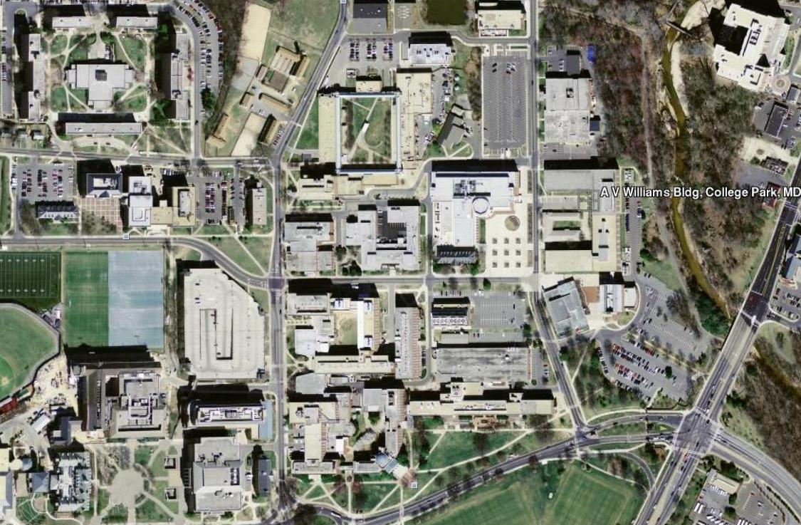
Notes:
6

Slide 7
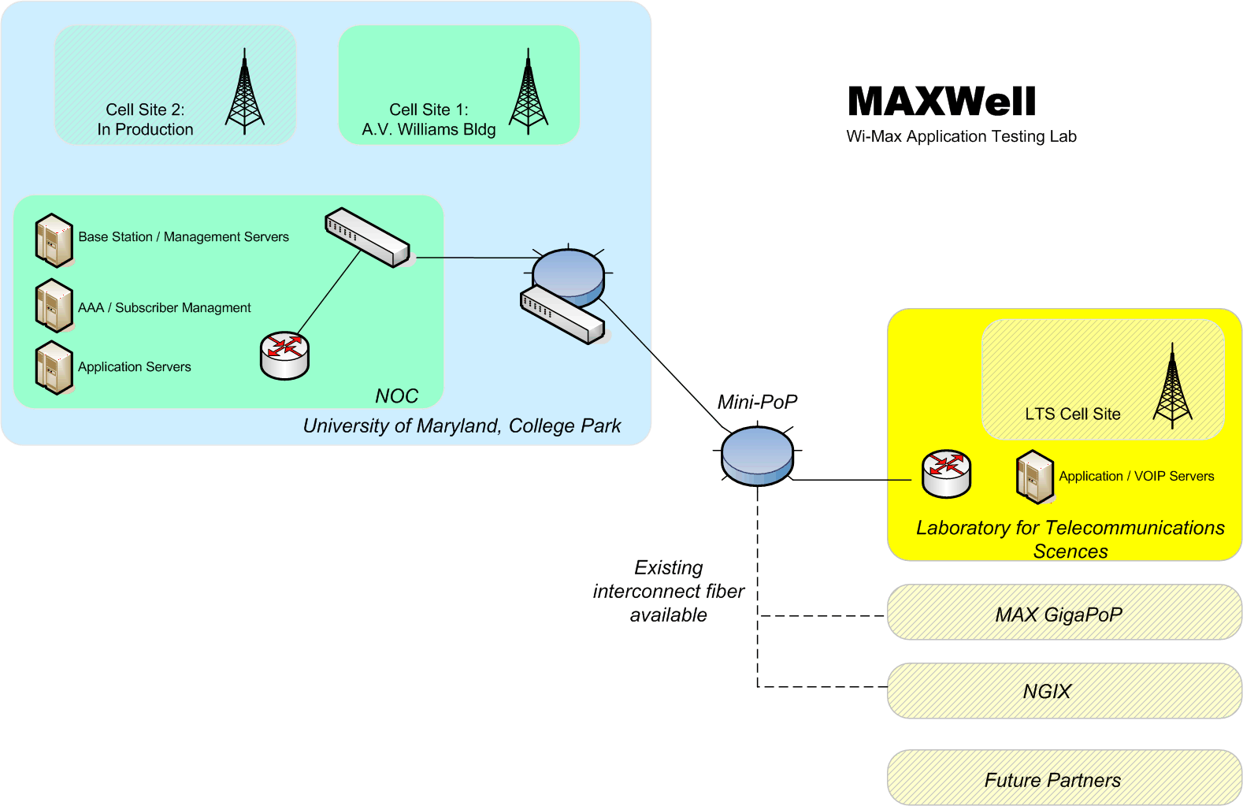

Slide 8
Equipment Deployment
Mobile WiMAX equipment
  Motorola DAP 400 (3 BS, 13 CPE, CAP-C)
    Installation under way TODAY
      Challenges lie in non technical requirements
IMS Integration
  Location Aware applications -- REAL network users
  Ericsson IMS Common System (here)‏
Additional 16e BS/CPEs
  Phased Array
  Additional and flexible spectrum provisioning
  Transition/handoff between 3G/WiFi/WiMAX networks; seamless mobility
LTE
Notes:
8

Slide 9
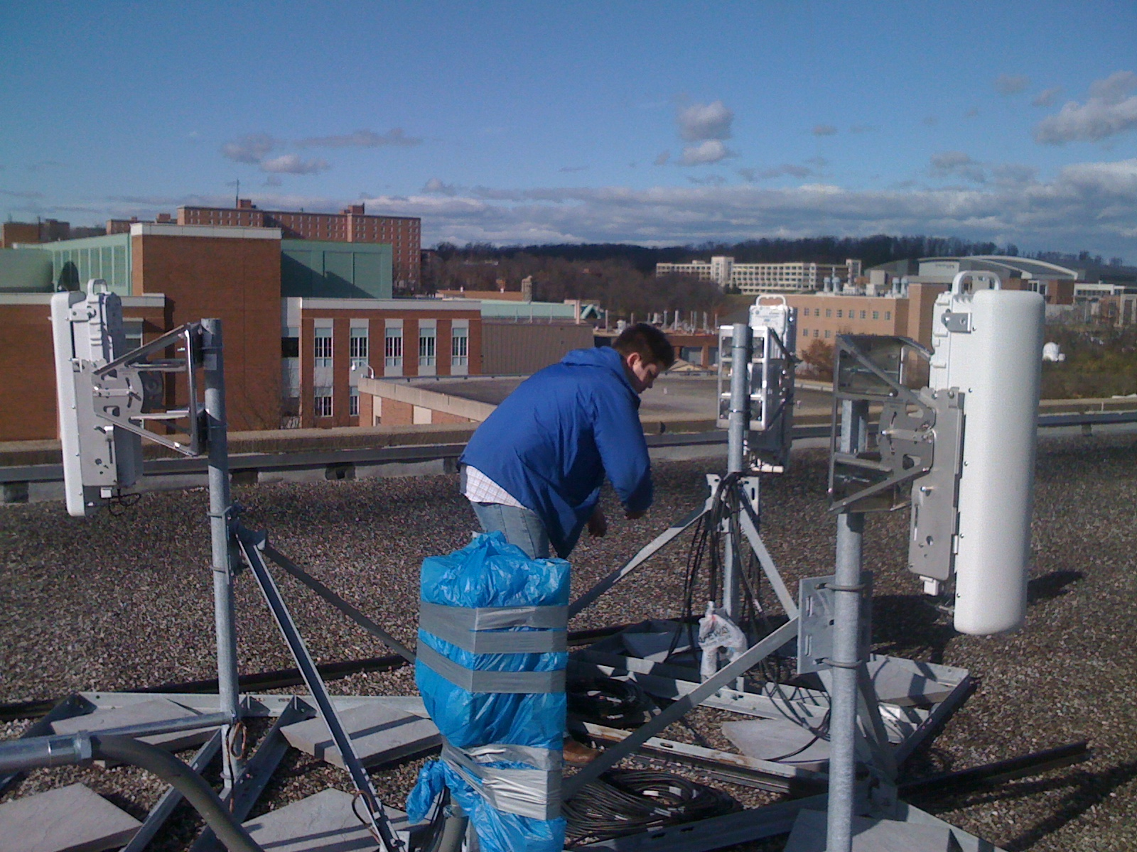

Slide 10
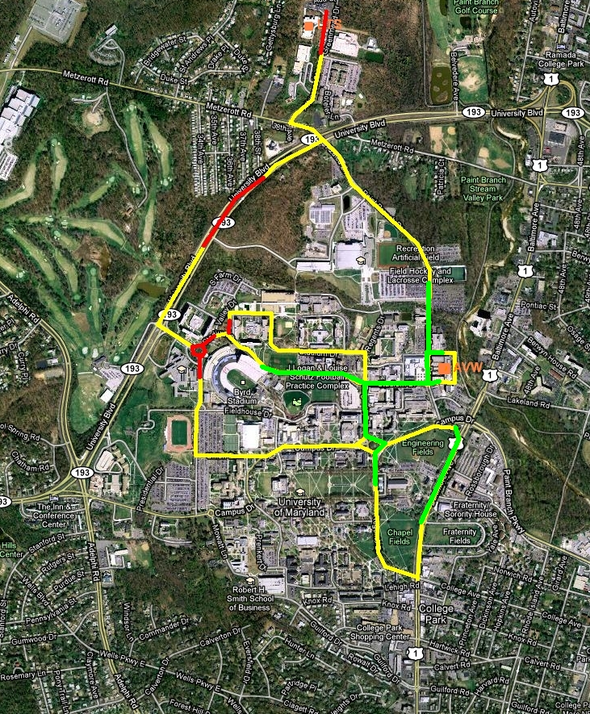
Campus Coverage

Slide 11
Physical Facilities
Lab location (College Park, Maryland, Close Proximity to the first widely deployed mobile WiMAX network by ClearWire in Baltimore/Washington area)‏
Lab space
Network Coverage (College Park Campus)‏
User Groups
  Demographics (College Students, Faculty and Staff), Community of 50,000, active users expected – up to 1000.
Notes:
11

Slide 12
Activities
Internal Developments
  Incubation of Ideas
  Applications Development/Testing
  MyeVyu Application – location Aware applications
  Simulation Facilities – NS2
3rd Party Support
  Applications Integrations
  Benchmarking
  Independent Performance Testing
  Will support as needed
Open House/Show Case
  At Least Once a year
Notes:
12

