Slide 1
MAUI: Enabling Fine-Grained Code Offload for Resource-Intensive Smartphone Applications
Alec Wolman, Stefan Saroiu, Ranveer Chandra, Victor Bahl – Microsoft Research
Eduardo Cuervo – Duke
Aruna Balasubramanian – U Mass Amherst
Dae-ki Cho - UCLA

Slide 2
Enabling Fine-Grained Code Offload
Cloudlets & CloneCloud propose VM-based techniques to enable computational offload for mobile handhelds
[Satya et al., IEEE Pervasive Computing 2009]
[Chun et al., HotOS 2009]
MAUI leverages a modern language runtime to enable
fine-grained offload, an alternative to VM-based approaches

Slide 3
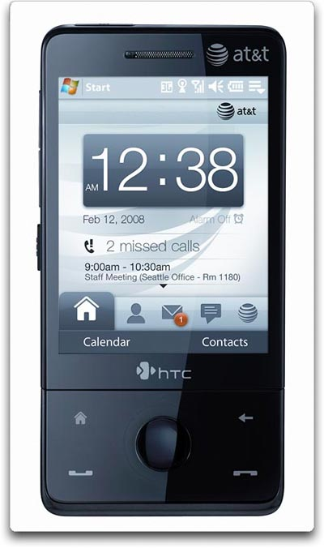
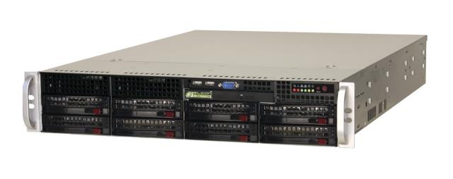
Application Partitioning
Smartphone
Application
Partitioned Application
(Client-Side)
Partitioned Application
(Server-Side)
Identify code and data within running program to migrate to server
Notes:
Identify which methods to offload, and the program state.
Re-evaluate periodically, to adapt to changing conditions.

Slide 4
MAUI Architecture
MAUI Runtime
MAUI Runtime
Server Proxy
Client Proxy
RPC
Application
Application
Profiler
Profiler
Solver
Solver
MAUI
Controller
Smartphone
MAUI Server
Notes:
Proxies: handle the mechanics of control and data transfer.
Profiler: 1/ monitors the program, produces an annotated call graph. 2/ Understands the device’s energy characteristics, and 3/ characteristics of the network connection to the current MAUI server.
Solver: takes input from profiler, solves an ILP to slice the application. Evaluates state transfer cost of offload vs CPU energy savings from offload.

Slide 5
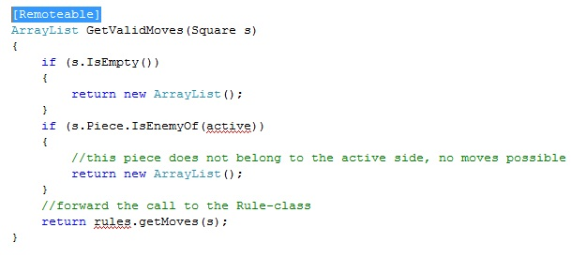
How Does a Programmer Use MAUI?
Goal: make it dead-simple for developer to MAUI-ify their application
  Programmer builds a standalone phone app
  Programmer adds .NET attributes to indicate “remoteable”
    Remoteable indicates safe to offload, not should be offloaded
  MAUI decides at runtime whether to offload, to save energy

Slide 6
MAUI Proxy: Handles Control and Data Transfer
MAUI supports fine-grained offload at the method-level
At compile time:
Find [remoteable] methods
Produce client- and server-side stubs for all remoteable methods
At run time:
Decide whether to invoke local or remote method
Perform state synchronization when control transfers (in either direction)
  Identify what program state to transfer
  Serialize (deep copy): method parameters, class member variables, public static members
  Use deltas to reduce the data transfer overhead

Slide 7
Language Run-Time Support For Partitioning
Portability: Mobile devices (mostly) use ARM instruction set, servers typically use x86 instructions.
  .NET Framework uses “CIL” – a language independent byte code that is dynamically compiled to the CPU instruction set
Type-Safety:
  Automate state extraction: need run-time type info to follow pointers
Reflection: programmatic inspection of the appication binaries
  Can identify methods with the [remoteable] tag,
  without parsing the source code
  Can extract type signatures of remoteable methods,
  to automate generating RPC stubs
Notes:
Type safety enables the MAUI runtime to identify which program’s in-memory data structures it needs to copy: which state is potentially referenced by a given method.

Slide 8
Evaluation of Fine-Grained Partitioning
How does MAUI adapt to changes in program behavior and network conditions?
We evaluate this using an Arcade game ported to MAUI, using an off-the-shelf physics engine
  Scenario 1: no missiles, shortly after initialization
  Scenario 2: 5 missiles, well into the game

Slide 9
Arcade Game Offload Behavior
HandleEnemies
HandleEnemies
Scenario 1: RTT > 10 ms
Scenario 1: RTT < 10 ms
Scenario 2: RTT < 30 ms
Scenario 2: 30 ms < RTT < 60 ms
11KB +
(60 * # missiles)
DoFrame
DoLevel
DoLevel
HandleBonuses
HandleBonuses
11KB +
(60 * # missiles)
60 * # missiles
HandleMissiles
HandleMissiles
Filled oval indicates an offloaded method
Notes:
HandleMissles performs the physics computation, scales with # of active missiles

Slide 10
Conclusion
MAUI uses language runtime support from .NET framework to enable fine-grained code offload
  Dynamic compilation, type-safety, reflection
There is much more to MAUI
  See our MobiSys 2010 paper for the rest

Slide 11
Backup Slides

Slide 12
MAUI Profiler and Solver
Profiler produces annotated call graph
  Vertex: method annotated with computation energy and delay for execution
  Edge: method invocation annotated with total state transferred
R
L
C
R
L
L
L
R
L
A
10KB
B
L
R
R
L
45mJ, 30 ms
L
R
D
L
Solver identifies “islands” in the call graph, where:
Energy cost of data transfer < CPU energy saved w/remote execution
Notes:
Solver runs periodically as new inputs are generated by the profiler.
Using program history to predict the benefits.

Slide 13
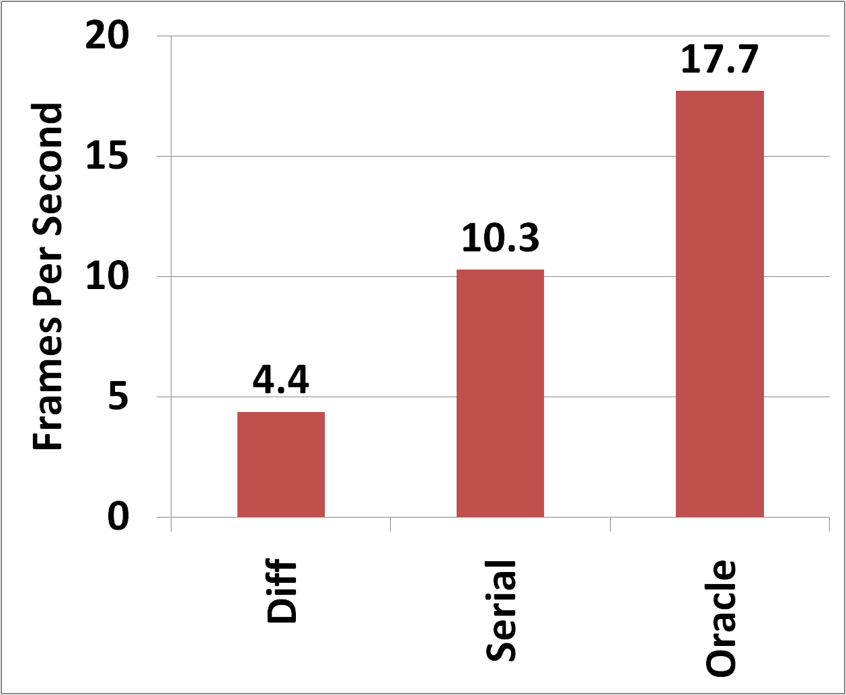
How expensive is online profiling?
Expensive part of profiling is estimating size of state transfer
Notes:
We use heuristics to reduce this overhead. Don’t serialize on every invocation…

Slide 14
How much can MAUI reduce energy consumption (and improve perf)?
For face recognizer, energy consumption reduced by an order of magnitude
Notes:
Performance: 19 sec => 2 sec
For apps such as chess & arcade game, energy savings on the order of 50%

Slide 15
Arcade Game Energy Savings
Legend (L to R):
Smartphone Only
10 ms, Wi-Fi
25 ms, Wi-Fi
50 ms, Wi-Fi
100 ms, Wi-Fi
220 ms, 3G*
Energy (Joules)
Latency to server impacts the opportunities for fine-grained offload
Notes:
40% reduction in energy to nearby server…

Slide 16
MAUI Offload Scenarios
WLANs are key to effective fine-grained offload
  High bandwidth, low latency to MAUI servers,
  energy efficient
  Offload to the cloud, over 3G: high latency, congestion
Enterprise: shared, trusted servers
  Co-locate MAUI servers with WLAN switches
Home: use Wi-Fi to reach trusted desktop PC
Public places:
  Near term: offload to cloud, long latencies
  Long term: offload to nearby infrastructure (HotSpots)

Slide 17
Why Not Use Static Partitioning?
Failure model: when phone is disconnected, or even intermittently connected, applications don’t work
Developers need to revisit application structure as device characteristics change
The portion of an app that makes sense to download changes based on the latency to the MAUI server

Slide 18
Why is the [remoteable] tag necessary?
External side-effects (e.g. purchase an item from the Web):
Need to understand if a sequence of I/O calls is undoable
This is a very hard problem, unlikely to be addressed with static analysis
Limitations of our current implementation:
Need to classify calls into .NET Framework built-in APIs as local or remote
Internal side-effects:
Handling multi-threaded apps & async I/O
In the long term, static program analysis should be able to address these limitations

Slide 19
MAUI Partitioning Limitations
Failure model: lose contact with server,
re-execute from last sync point
Limited support for multi-threaded programs & async I/O
Methods with external side effects cannot be offloaded
  E.g. Buying a book from Amazon

Slide 20
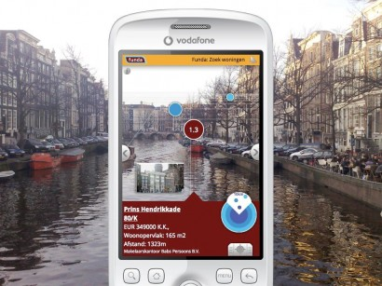
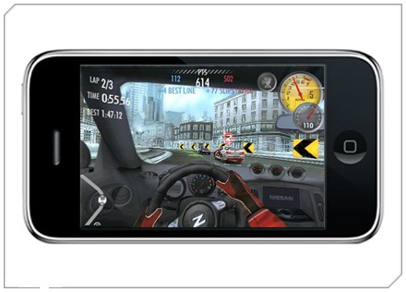

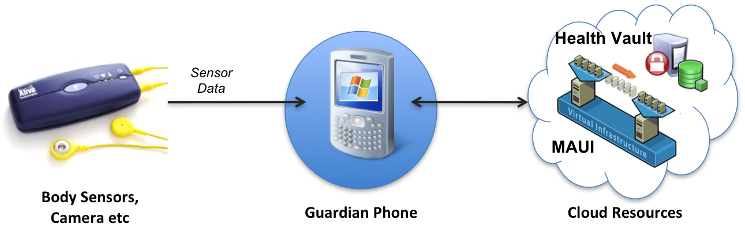
Enable Resource-Intensive Apps
Augmented Reality
  Example: Help a person with memory loss
Corrective Human Behavior
  Example : Immediate fact corrections during a speech
Mobile Gaming
Healthcare
  Offload analysis of sensed data from body-worn sensors
  Low end-to-end latency critical for interactive apps
  These energy-intensive tasks can rapidly drain the battery

