Slide 1



Leveraging fast VM fork for next generation mobile perception
Eyal de Lara
Department of Computer Science
University of Toronto

Slide 2
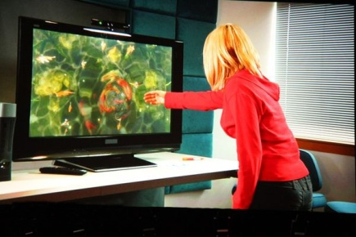


Motivation
Next gen context aware solutions
  High data rate sensors (Cameras and microphones)
  Compute intensive (real time classification & online learning)
  Interactive
Puts huge pressure on mobile devices in terms
of compute capacity, communication, and power budget

Slide 3


Approach
Cloudlet: “data center in a box”
  One network hop from the client
Leverage fast VM fork
Migrate computation to
nearby cloud
Scale application on cloud
802.11n AP with a n-core CPU
    Low latency, high bandwidth

Slide 4
SnowFlock: VM Fork
Stateful swift cloning of VMs
State inherited up to the point of cloning
Local modifications are not shared
Clones make up an impromptu/transient cluster
Virtual
Network
VM 0
VM 1
VM 2
VM 3
VM 4
Host 0
Host 1
Host 2
Host 3
Host 4
Notes:
Fork: read-only mem, they die

Slide 5
SnowFlock API
tix = sf_request_ticket(howmany)
prepare_computation(tix.granted)
me = sf_clone(tix)
do_work(me)
if (me != 0)
send_results_to_master()
sf_sync()
else
receive_results()
sf_join(tix)
Just like UNIX fork()
Block…
scp … more in the future
Child VMs are gone
Notes:
Drive analogies with fork()

Slide 6
SnowFlock Insights
VMs are BIG: Don’t send all the state!
Clones need little state of the parent
Clones exhibit common locality patterns
Clones generate lots of private state
Notes:
Insights: locality, little actual state

Slide 7
Why SnowFlock is Fast
Send only what you really need
Multicast
  Network hardware parallelism
  Prefetch: exploit locality patterns
Heuristics
  Don’t send if I’ll overwrite
  Malloc: exploit apps generating new state

Slide 8
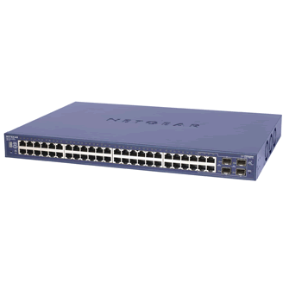
The Secret Sauce
3. Multicast: exploit net hw parallelism
4. Multicast: exploit locality to prefetch
5. Heuristics: don’t fetch if I’ll overwrite
1. Start only with the basics
2. Fetch state on-demand
State:
Disk, OS, Processes
Clone 1
Private
State
Virtual
Machine
?
Multicast
VM Descriptor
VM Descriptor
VM Descriptor
  Metadata
  “Special” Pages
  Page tables
  GDT, vcpu
  ~1MB for 1GB VM
Clone 2 Private State
?
Notes:
Let us now walk through the animation that introduces the key mechanisms
- we start of with a VM

Slide 9

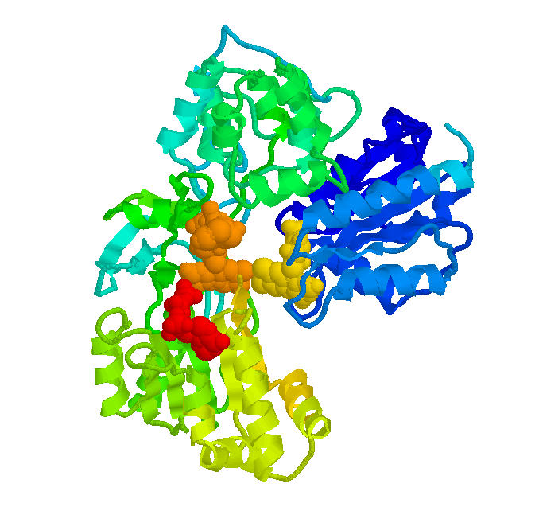


Application Run Times
143min
87min
110min
61min
7min
20min
128 processors
  (32 VMs x 4 cores)
1-4 second overhead
Notes:
Ideal is really ideal
Low is good

Slide 10
Open Challenges
Hierarchical VM fork support
VM fork over wireless

Slide 11
Conclusions
VM fork: natural intuitive semantics
The cloud bottleneck is the IO
  Clones need little parent state
  Generate their own state
  Exhibit common locality patterns
Sub-second cloning time
Negligible runtime overhead
Scalable: experiments with 128 processors
Notes:
Let people finish their questions

Slide 12

Thanks!
http://sysweb.cs.toronto.edu/snowflock
http://sourceforge.net/projects/snowflock
delara@cs.toronto.edu
Questions?

