Slide 1


Breaking Spectrum Gridlock through Cognitive and Cooperative Radios
Andrea Goldsmith
Stanford University
Quantenna Communications, Inc
MSR Cognitive Wireless
Networking Summit
June 5-6, 2008

Slide 2
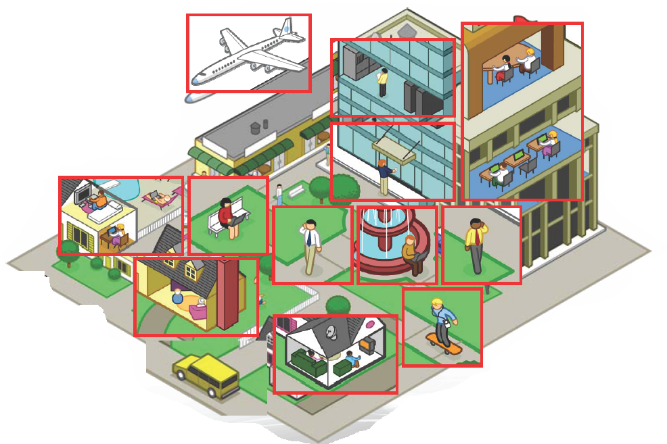
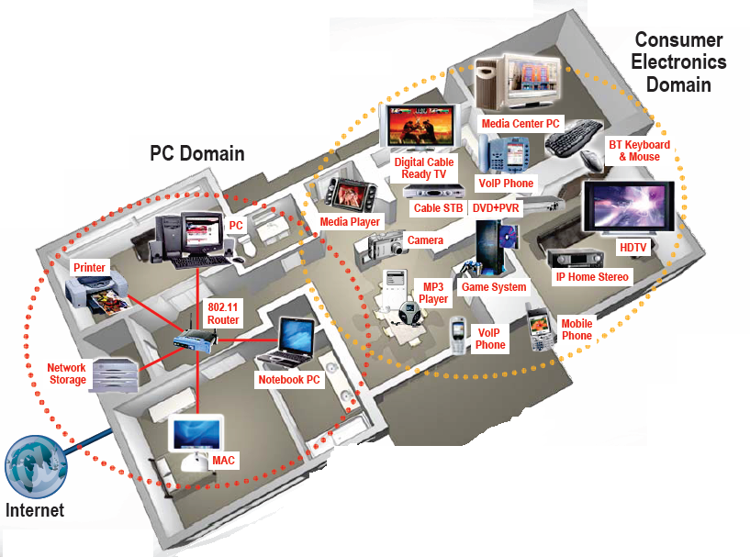
Future Wireless Networks
ce
Killer Apps:
Ubiquitous video in the home
- Better user experience

Slide 3
Most Important Problems to Solve
Improving the efficiency of wireless spectrum use
Building small low-power devices with multiple or cognitive radios and many antennas
Building reliable wireless networks that are seamless with ubiquitous high-speed coverage
Guaranteeing a good user experience by meeting hard performance requirements of applications

Slide 4
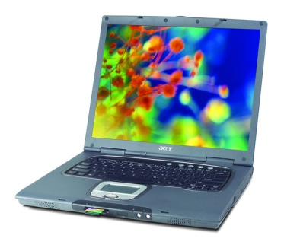
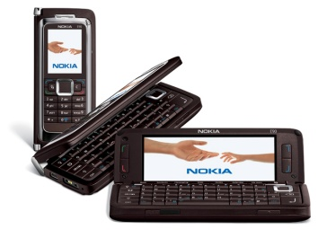
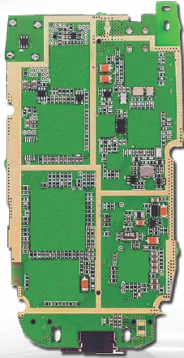
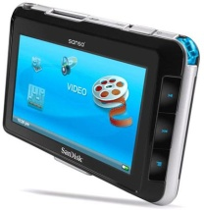
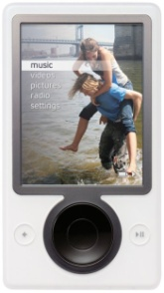
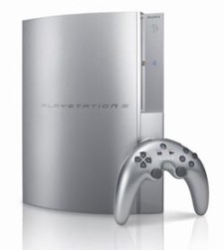

Everything Wireless in One Device

Slide 5
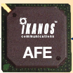
Small Low-Power Devices
RF, A/D, antenna technology, and processor algorithms/breakthroughs will drive convergence
BT
Multiradio Convergence
FM/XM
Everything
Else
Wide
Area
(LTE)_
GPS
Wide
Area
DVB-H
Apps
Processor
WLAN
Application
& Media
Processor
Media
Processor
UWB
MIMO is a requirement
Not an option

Slide 6
Meeting Network Challenges requires Crosslayer Design
Application
Network
Access
Link
Hardware
Reliable wireless networks that guarantee the desired user experience requires interaction and adaptation across layers
Notes:
Interdisciplinary research, design, and development very challenging, but necessary to meet the requirements of future wireless applications

Slide 7



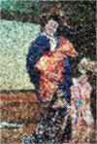
Video over MIMO Channels
Use antennas for multiplexing:
Use antennas for diversity
High-Rate
Quantizer
ST Code
High Rate
Decoder
Error Prone
Low-Rate
Quantizer
ST Code
High
Diversity
Decoder
Low P_{e}
How should antennas be used?
Depends on the application.

Slide 8
Extending ideas to networks
Network Metrics
C
B
Network Fundamental Limits
A
Capacity
Delay
D
FLoWS
Robustness (or Range)
Fundamental Limits
of Wireless Systems
(DARPA ITMANET program)
Cross-layer Design and
End-to-end Performance
Capacity
Research Areas
Cooperation and cognition
Network performance tradeoffs
Resource allocation
Layering and Cross-layer design
End-to-end performance
optimization and guarantees
(C*,D*,R*)
Delay
Robustness
Application Metrics

Slide 9
Spectral efficiency in wireless channels: Some basics
Radio is a broadcast medium
Radios in the same spectrum interfere
Interference degrades performance
Regulation used to avoid/control interference
Has lead to spectrum gridlock

Slide 10

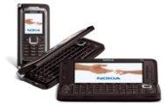
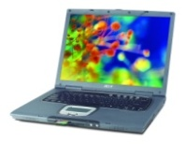
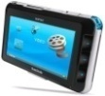
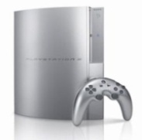

Spectral Reuse
Due to its scarcity, spectrum is reused
In licensed bands
and unlicensed bands
BS
Cellular, Wimax
Wifi, BT, UWB,…
Reuse introduces interference

Slide 11
Interference: Friend or Foe?
If treated as noise: Foe
If decodable: Neutral (neither friend nor foe)
Increases BER, reduces capacity
Multiuser detection can
completely remove interference

Slide 12
Ideal Multiuser Detection
Signal 1
-
=
Signal 1
Demod
Iterative
Multiuser
Detection
Signal 2
Signal 2
Demod
-
=

Slide 13
If exploited via cooperation and cognition
Interference: Friend or Foe?
Friend
Especially in a network setting

Slide 14
Cooperation in Wireless Networks
Many possible cooperation strategies:
Virtual MIMO , generalized relaying, interference forwarding, and one-shot/iterative conferencing
Many theoretical and practice issues:
Overhead, forming groups, dynamics, models, …

Slide 15
Generalized Relaying
TX1
RX1
X₁
Y₄=X₁+X₂+X₃+Z₄
relay
Y₃=X₁+X₂+Z₃
X₃= f(Y₃)
Y₅=X₁+X₂+X₃+Z₅
X₂
TX2
RX2
Relaying strategies:
Relay can forward all or part of the messages
Much room for innovation
Relay can forward interference
To help subtract it out

Slide 16
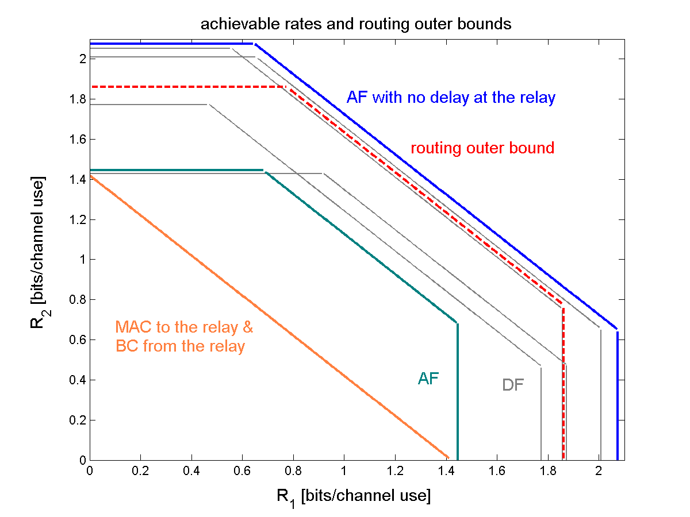
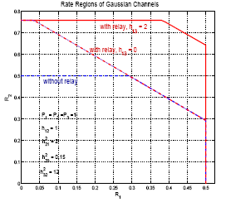
Capacity Gains
Multisource Multicast
Multisource Unicast

Slide 17
Intelligence beyond Cooperation: Cognition
Cognitive radios can support new wireless users in existing crowded spectrum
Without degrading performance of existing users
Utilize advanced communication and signal processing techniques
Coupled with novel spectrum allocation policies
Technology could
Revolutionize the way spectrum is allocated worldwide
Provide sufficient bandwidth to support higher quality and higher data rate products and services

Slide 18
Cognitive Radio Paradigms
Underlay
Cognitive radios constrained to cause minimal interference to noncognitive radios
Interweave
Cognitive radios find and exploit spectral holes to avoid interfering with noncognitive radios
Overlay
Cognitive radios overhear and enhance noncognitive radio transmissions
Knowledge
and
Complexity

Slide 19
Underlay Systems: Avoid Interference
Cognitive radios determine the interference their transmission causes to noncognitive nodes
Transmit if interference below a given threshold
The interference constraint may be met
Via wideband signalling to maintain interference below the noise floor (spread spectrum or UWB)
Via multiple antennas and beamforming
I_{P}
NCR
NCR
CR
CR

Slide 20
Underlay Challenges
Measurement challenges
Measuring interference at NC receiver
Measuring direction of NC node for beamsteering
Both easy if NC receiver also transmits, else hard
Policy challenges
Underlays typically coexist with licensed users
Licensed users paid $$$ for their spectrum
Licensed users don’t want underlays
Insist on very stringent interference constraints
Severely limits underlay capabilities and applications

Slide 21
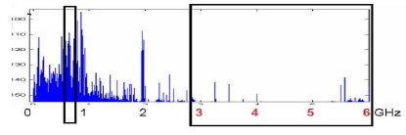
Interweave Systems: Avoid interference
Measurements indicate that even crowded spectrum is not used across all time, space, and frequencies
Original motivation for “cognitive” radios (Mitola’00)
These holes can be used for communication
Interweave CRs periodically monitor spectrum for holes
Hole location must be agreed upon between TX and RX
Hole is then used for opportunistic communication with minimal interference to noncognitive users

Slide 22
Interweave Challenges
Spectral hole locations change dynamically
Need wideband agile receivers with fast sensing
Spectrum must be sensed periodically
TX and RX must coordinate to find common holes
Hard to guarantee bandwidth
Cross-layer design needed
Detecting and avoiding active users is challenging
Fading and shadowing cause false hole detection
Random interference can lead to false active user detection
Policy challenges
Licensed users hate interweave even more than underlay
Interweave advocates must outmaneuver incumbents

Slide 23
Overlay Systems: Exploit interference
Cognitive user has knowledge of other user’s message and/or encoding strategy
Used to help noncognitive transmission
Used to presubtract noncognitive interference
CR
RX1
RX2
NCR
See poster by Ivana Maric

Slide 24
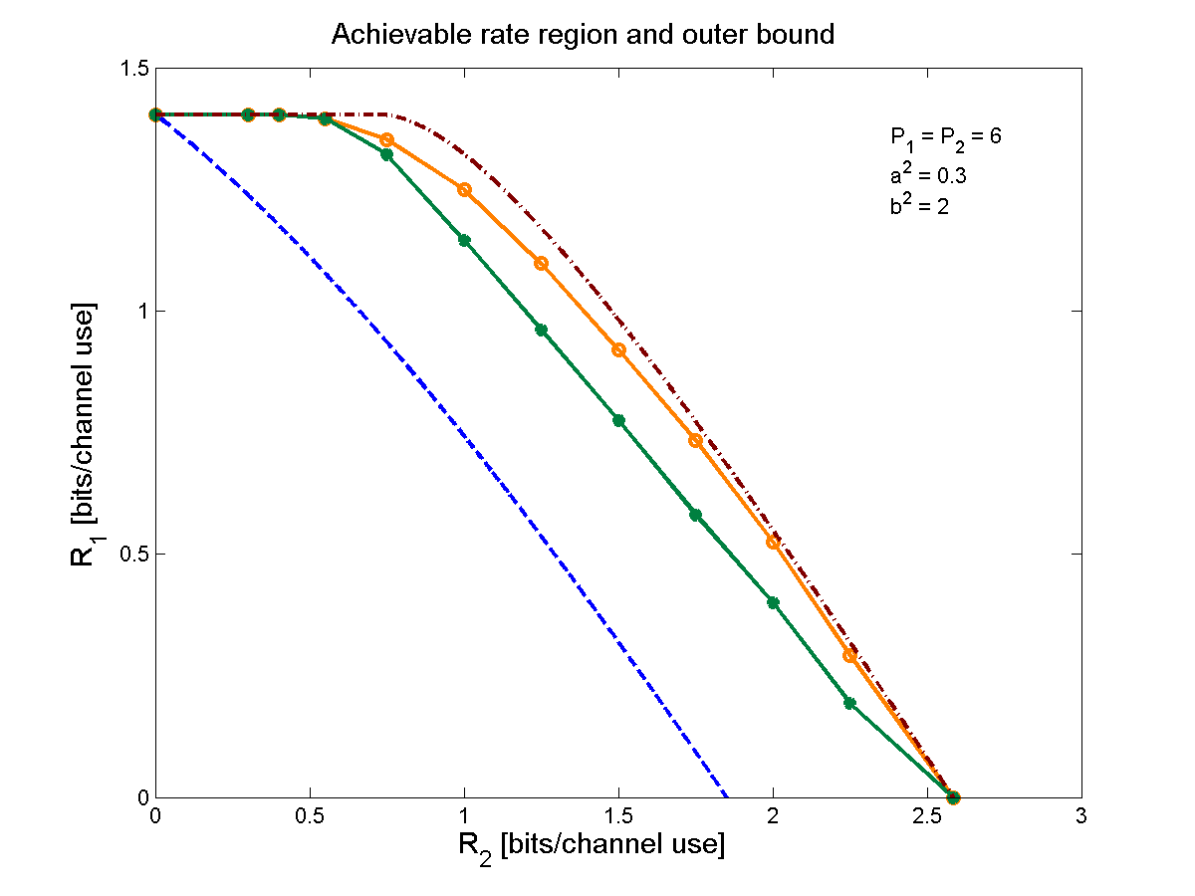
Performance Gains from Cognitive Encoding
outer bound
our scheme
prior schemes
CR
broadcast bound

Slide 25
Summary
Challenges to expanding wireless access and improving the user expereince include scarce wireless spectrum and device/network challenges
Exploit interference via cooperation and cognition to improve spectrum utilization and performance
Much room for innovation
Philosophical changes in system design and spectral allocation policy required
Need to define metrics for success

