Slide 1


Smartphones as distributed system with extreme heterogeneity
Lin Zhong
Rice Efficient Computing Group (recg.org)
Dept. of Electrical & Computer Engineering
Rice University

Slide 2
Today’s smartphone
Application processor

Slide 3








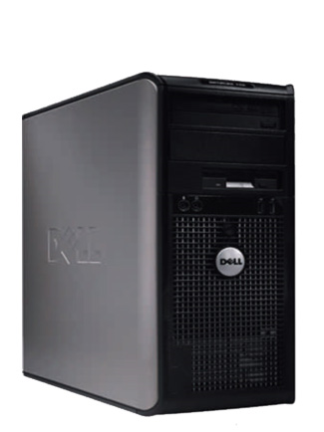
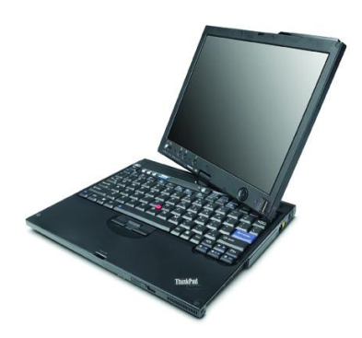
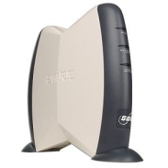
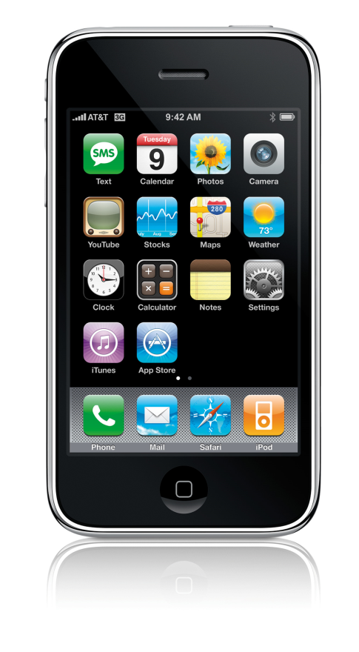
rackspace

Slide 4
Heterogeneous multiprocessor
Application processor
µ-controller
Turducken-like systems

Slide 5


Heterogeneous body-area network

Slide 6
Smartphone 2020
Cloud processor
Cloud processor
Cloud processor
Cloud processor
µ-controller
Cloud processor
Cloud processor
Cloud processor
Application processor
µ-controller
µ-controller

Slide 7
Challenges to programming
Cloud processor
Cloud processor
Cloud processor
Cloud processor
µ-controller
Cloud processor
Cloud processor
Cloud processor
Application processor
µ-controller
µ-controller
Resource disparity
ISA disparity

Slide 8
Challenges to programming
Cloud processor
Cloud processor
Cloud processor
Cloud processor
µ-controller
Cloud processor
Cloud processor
Cloud processor
Application processor
µ-controller
µ-controller
Resource limitation on “small” processors
Virtual machine and coherent memory difficult

Slide 9
Challenges to programming
Cloud processor
Cloud processor
Cloud processor
Cloud processor
µ-controller
Cloud processor
Cloud processor
Cloud processor
Application processor
µ-controller
µ-controller
Separation of hardware vendors, application developers, and users
Developer blind of external computing resources and runtime context

Slide 10
Challenges to programming
Cloud processor
Cloud processor
Cloud processor
Cloud processor
µ-controller
Cloud processor
Cloud processor
Cloud processor
Application processor
µ-controller
µ-controller
Established programming model and OS

Slide 11
Existing solutions
mPlatform etc.
CPU+GPU systems
Offloading systems (active disk, Hydra etc.)
Virtual machine
Single ISA
Turducken-like cohort systems
Complete transparency
No transparency
Prohibitively expensive
High burden on application developers

Slide 12

Reflex: Transparent programming of heterogeneous mobile systems
http://reflex.recg.rice.edu/
Inspired by the heterogeneous distributed nervous system
Notes:
http://scienceblogs.com/neurophilosophy/upload/2007/07/descartes-reflex.jpg

Slide 13
Enough transparency
mPlatform etc.
CPU+GPU systems
Virtual machine
Offloading systems (active disk, Hydra etc.)
Reflex
Single ISA
Turducken-like cohort systems
Complete transparency
No transparency
Ease of programming
Execution efficiency

Slide 14
Key ideas
Cloud processor
Cloud processor
Cloud processor
Cloud processor
µ-controller
Cloud processor
Cloud processor
Cloud processor
Application processor
µ-controller
µ-controller
Light weight virtualization of sensor data acquisition, timer, and memory management

Slide 15
Key ideas
Cloud processor
Reflex runtime
Cloud processor
Cloud processor
Reflex runtime
Cloud processor
µ-controller
Cloud processor
Cloud processor
Reflex runtime
Cloud processor
Reflex runtime
Application processor
µ-controller
Reflex runtime
µ-controller
Distributed runtime for transparent message passing

Slide 16
Key ideas
Cloud processor
Reflex runtime
Cloud processor
Cloud processor
Reflex runtime
Cloud processor
µ-controller
Cloud processor
Cloud processor
Reflex runtime
Cloud processor
Reflex runtime
Application processor
µ-controller
Reflex runtime
µ-controller
Automatic code partition through a collaboration between runtime and compiler

Slide 17
Key ideas
Cloud processor
Reflex runtime
Cloud processor
Cloud processor
Reflex runtime
Cloud processor
µ-controller
Cloud processor
Cloud processor
Reflex runtime
Cloud processor
Reflex runtime
Application processor
µ-controller
Reflex runtime
µ-controller
Identify a small coherent memory segment
Maintain by message passing through the runtime

Slide 18
Key ideas
Cloud processor
Reflex runtime
Cloud processor
Cloud processor
Reflex runtime
Cloud processor
µ-controller
Cloud processor
Cloud processor
Reflex runtime
Cloud processor
Reflex runtime
Application processor
µ-controller
Reflex runtime
µ-controller
Type safety for dynamic process migration

Slide 19
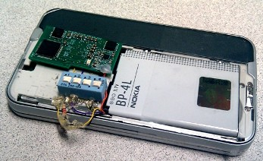
Reflex Prototype (board integration)
Programmable accelerometer (TI MSP430)
Wired sensor through UART port
Nokia N810
Rice Orbit Sensor
Serial connection

Slide 20
Fall detection with N810
Average Power
100mW
20mW
Legacy
Reflex
The secret: we do not fall very often

Slide 21
Coded as part of Smartphone program
class SenseletFall : public SenseletBase {
public:
SenseletFall () { _avg_energy = 0; };
void OnCreate() { RegisterSensorData(ACCEL, 50); };
void OnData(uint8_t *readings, uint16_t len) {
uint16_t energy = readings[0]*readings[0] + \
readings[1]*readings[1] + \
readings[2]*readings[2];
//do a simple low-pass filtering
_avg_energy = _avg_energy / 2 + energy / 2;
// detect fall accident with the filtered energy
if (_avg_energy > THRESHOLD) {
theMainBody.FallAlert(); //RMI
}
}
void OnDestroy() { UnRegisterSensorData(ACCEL); };
private:
uint16_t _avg_energy;
};

Slide 23
Even accelerometer is power-hungry!
200mW
90mW
7mW
2mW
Standby
Accelerometer
Read
Read & simple calculation
Nokia N900

Slide 24
Energy-proportional computing
Work per unit time, e.g. CPU utilization and bandwidth utilization
Energy consumption = a × Work

Slide 25
Cruel reality: disproportionality
Work per unit time, e.g. CPU utilization and bandwidth utilization
Energy = f (Work) + C
Notes:
C: static power and system overhead
Peak efficiency is usually achieved at peak performance (observed for both processors and wireless interfaces)

Slide 26
Cruel reality: disproportionality
Work per unit time, e.g. CPU utilization and bandwidth utilization
Energy = f (Work) + C
Notes:
C: static power and system overhead
Peak efficiency is usually achieved at peak performance (observed for both processors and wireless interfaces)

Slide 27
Ongoing work
Automatic code partition
Global variables/memory to a small coherent shared memory
Message passing to maintain the coherency

