Slide 1
Predictable performance optimization for wireless networks
Ratul Mahajan
Microsoft Research
Joint work with
Yi Li, Lili Qiu, Eric Rozner, Yin Zhang (UT, Austin)

Slide 2
Wireless performance is unpredictable
Even basic questions are hard to answer
  How much traffic can a given network support?
  What happens if a new flow starts?
  What happens if a node is removed?
Arguably the most frustrating aspect of wireless
  Mysteriously inconsistent performance
  Makes it almost impossible to plan and manage

Slide 3
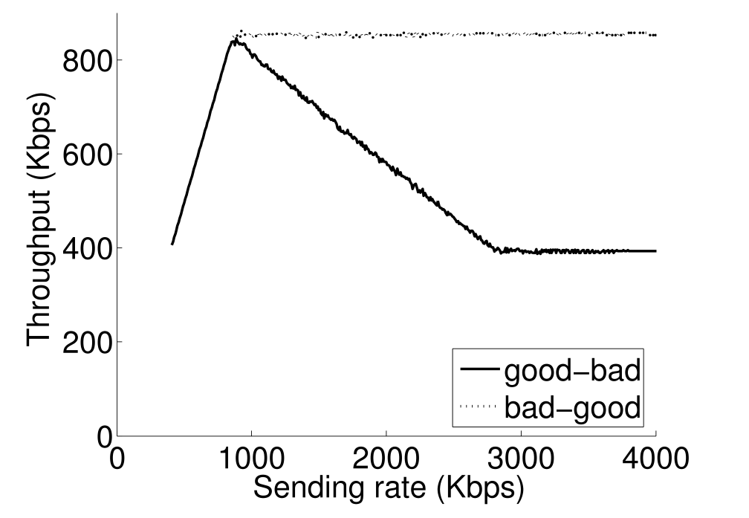
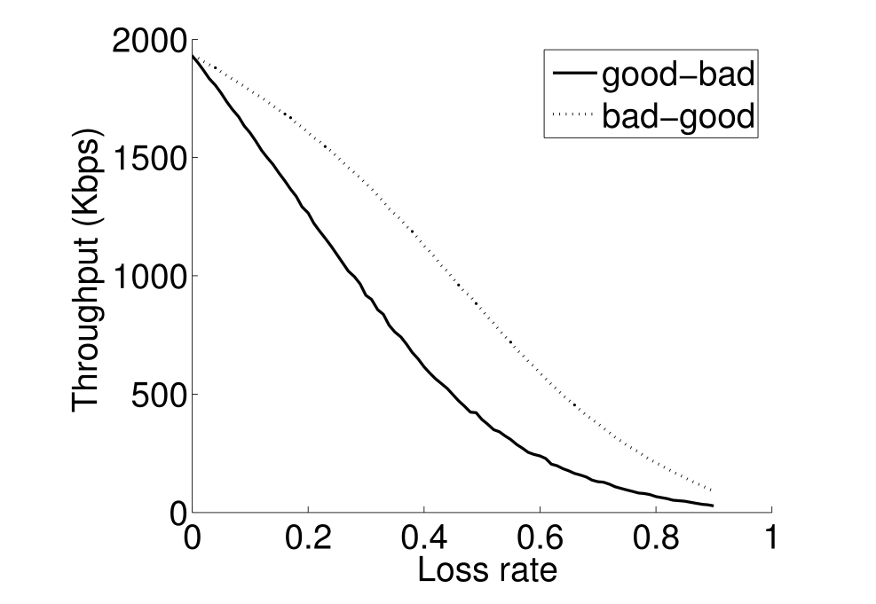
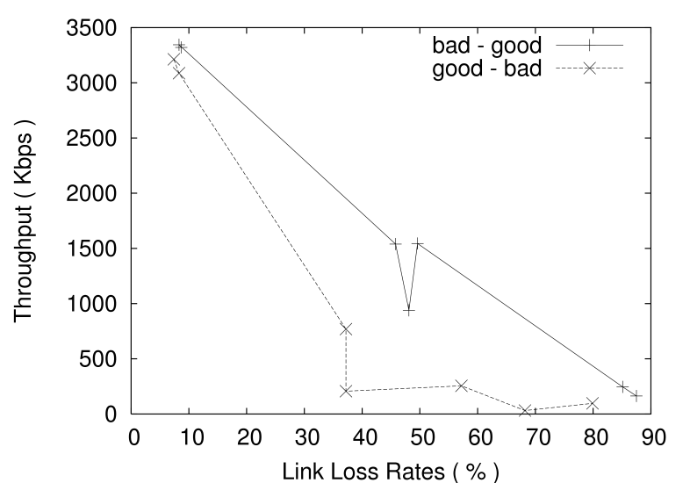
An example of performance weirdness
Bad
Good
Source
Relay
Sink
Good
Bad
Source
Relay
Sink
Testbed
bad-good
Simulation
bad-good
bad-good
UDP throughput (Kbps)
UDP throughput (Kbps)
UDP throughput (Kbps)
good-bad
good-bad
2x
good-bad
Loss rate on the bad link
Source rate (Kbps)
Loss rate on the bad link

Slide 4
Predictable performance optimization
Given a (multi-hop) wireless network:
Can its performance for a given traffic pattern be predicted?
Can it be systematically optimized per a desired objective such as fairness or throughput?
Yes, and Yes, at least in the context of WiFi

Slide 5
Our approach: measurement-based modeling and optimization
Measure the RF profile of the network
Constraints on sending rate and loss rate of each link
Find compliant source rates that meet the objective

Slide 6
Measurements
Measure the RF profile of the network
One or two nodes broadcast at a time
Yields information on loss and deferral probabilities
Constraints on sending rate and loss rate of each link
Find compliant source rates that meet the objective

Slide 7
Modeling
Measure the RF profile of the network
O(n²) constraints
Link throughput is a function of loss rate and tx probability
Link tx probability is a function of tx probability of other links and deferral probability
Link loss rate depends on tx probability of other links
Tx probability is bounded by a function of loss rate
Constraints on sending rate and loss rate of each link
Find compliant source rates that meet the objective

Slide 8
Optimization
Measure the RF profile of the network
Inputs:
Traffic matrix
Routing matrix
Optimization objective
Output:
Per-flow source rate
Constraints on sending rate and loss rate of each link
Find compliant source rates that meet the objective

Slide 9
Accuracy of throughput prediction in a testbed

Slide 10
Benefit of throughput optimization in a testbed

Slide 11
Lessons learned
Simple measurements on off-the-shelf hardware can provide accurate and tractable RF profile [SIGCOMM2006]
  Compare with abstract models (e.g., distance) or direct, detailed measurements
It is possible to model interference, MAC, and traffic in a way that balances fidelity and tractability [MobiCom2007]
  The three are inter-dependent
Holistically controlling source rates is important for achieving desired outcomes [SIGCOMM2008]
  Impact of transmissions not limited to the traversed path

Slide 12
More challenges ahead
Changing spectrum availability and no fixed transmission channels
Newfangled receivers
Heterogeneous MACs
Multiple competing networks
……
As we move towards a brave new wireless world, performance predictability should be a central goal

