Slide 1

Towards Context-Aware Computing via the Mobile Social Cloud
Prof. Rick Han
University of Colorado at Boulder

Slide 2
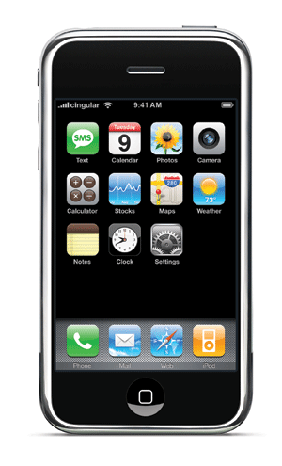




Context-Aware Mobile Social Networks
Social Networks
Who?
Where?
My Preferences
My Friends
Context-Aware “System”
Context-Aware Mobile Applications
Notes:
Mention Aaron Beach

Slide 3
The SocialFusion Project
Social Networks
What?
Sensor activity,
Mood, etc.
Who?
Where?
My Preferences
My Friends
SocialFusion
[HotMobile10]
Individually
Context-Aware
App’s
Group Context-Aware App’s
WhozThat?
Mobile Social Network
[IEEENetwork08]
Loopt, Foursquare, etc.
Context-Aware Group
Video
SocialAwareFlicks [MS09]
Context-Aware Group
Audio - Music Jukebox
New apps…

Slide 4

Distributing SocialFusion in the Cloud
Who?
What?
Who?
What?
Who?
What?
Where?
Where?
Where?
DB
Mobile
Cloud
Services
(Context-
Aware),
e.g. Azure,
EC2, etc.
Distributed
…
Data Mining
Inference
“Layer”
DM1
DM2
DMN
DML2
DML2
Recommendation
Or Actuation
“Layer”
…
REC1
REC2
REC2
[CUTechReport09]
RECX
Context-Aware
App’s
Minority Report
App
Mobile Social
Networks
Context-Aware Group Video
And Audio Apps

Slide 5
Privacy in the Context-Aware Mobile Cloud
Who?
What?
Where?
PRIVACY
PRIVACY
PRIVACY
Aaron Beach:
PP-Anonymity
vs. K-Anonymity
DB
“Group” Privacy
Issues, anonymize
before releasing to
3rd parties downstream
PRIVACY ANONYMIZATION
Data Mining/Inference
Recommendation
Context-Aware Mobile App’s

Slide 6
CawbWeb - The Context-Aware Mobile Web/Cloud
How do we make developing a context-aware app easy? (and the results reusable)
Specify what you “want” to do in CawbWeb, e.g. in a series of intentions
Compile these intentions into a working app
Compiler hides details of how to compose Web services, e.g. WSDL, etc.
[CawbWeb CU Tech Report 2010]

Slide 7
Summary
Research challenges encountered (and not solved):
What are the important attributes to track?
Group inference and recommendation
Privacy of individuals and groups
How to make building context-aware app’s easy and reusable?
rhan@cs.colorado.edu

