Slide 1
Intentional Networking
Brett Higgins, Azarias Reda,
Timur Alperovich, Jason Flinn,
T.J. Giuli (Ford), Brian Noble,
David Watson (Ford)

Slide 2


The problem
Mobile devices experience significant network diversity
  as they move…
  …as other devices come and go…
  …across many different technologies.
Not all messages are created equal
  some traffic latency sensitive,
  for some, eventual delivery is okay,
  some is purely opportunistic.
Current systems either
  hide all of these details, inevitably mismatching traffic, or
  expose all the messy details, complicating applications

Slide 3



The Insight
Separate concerns
  system layer tracks, measures connectivity options
  applications describe their traffic
  system matches traffic to the right alternative
Be qualitative
  applications specify only simple labels
  foreground vs. background; small vs. large
Embrace concurrency
  multiple networks ~ multiple cores
  abstractions for safe (network) concurrency

Slide 4
Abstraction: Multi-Sockets
Client
Server
A socket: single connection between correspondent hosts

Slide 5
Abstraction: Multi-Sockets
Client
IN
IN
Server
Multi-sockets provide a “virtual connection”

Slide 6
Multi-Sockets
Client
IN
IN
Server
Multi-sockets provide a “virtual connection”
as alternatives come and go

Slide 7
Multi-Sockets
Client
IN
IN
Server
Multi-sockets provide a “virtual connection”
as alternatives come and go
and measure the performance of each

Slide 8

Multi-sockets extend interface
Can use the standard interface
  application provided with TCP semantics
  transparently pick the “best” option available at any time
Easy extension: what should “best” mean?
  optional label: small (latency) or large (bandwidth)
Interesting extension: what is important?
  another label: foreground or background
  foreground always* goes first

Slide 9
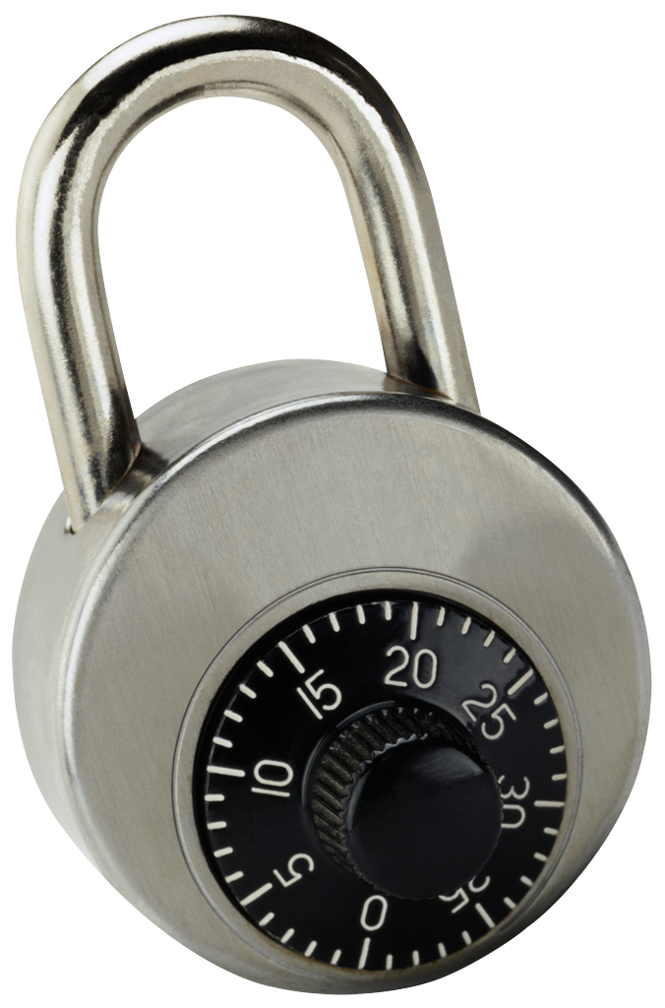
Not ordered! That’s crazy talk!
Not with the right abstractions
  mutual exclusion
  happens-before
Applications can specify units of mutual exclusion...
  one or more send calls
…and the partial order on those units
  naming prior units as dependencies
By default, each send() depends on the prior one
  applications must explicitly relax ordering

Slide 10
Example Application: BlueFS
A DFS for mobile devices, consumer electronics
  RPC plus a bulk-transfer protocol
  on-demand and speculative fetches
  writes propagated asynchronously
Intentional Networking modifications
  RPC stub generator: takes labels, ordering constraints
  on-demand block fetch: {foreground, small}
  data pre-fetch, write-back: {background, large}
  writes must be played back in order
Less than 550 lines of code (out of >44K)
  ~400 in stub generator

Slide 11
How did we do?
Evaluation environment: trace-based replay
    network observed during two live vehicle drives
    run Andrew-style benchmark under those conditions
Compare Intentional Networking to three selection strategies
  always the lowest latency
  always the highest bandwidth
  minimum latency, sum of all bandwidths
Intuition
  Total task time: beat single-networks, approach blend
  Response time: leverage hints for a big win

Slide 12
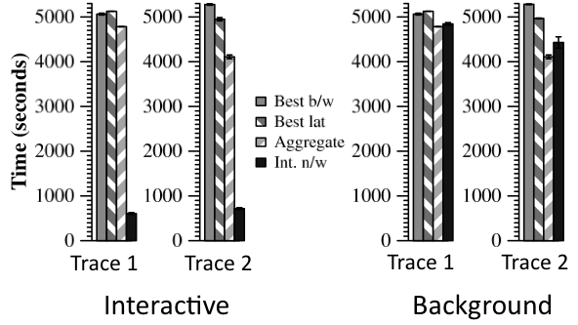





Results
Time (seconds)
Time (seconds)

Slide 13
Scratching the surface
More details
  expose events to applications
  keep background traffic out of the way
  more applications, experiments
Other things to think about
  infer labels in existing applications?
  infer “foreground” from user behavior?
  express cross-application tradeoffs easily?
A couple other things in the hopper
  information access in the developing world (Azarias)
  “smooshed migration” of clients across access points

