Slide 1
Talk Outline
Overview of Project
Illustrative Example
Details of What We’re Providing
Comments from Suman and Romit

Slide 2
Overview
The goal of the Hawaii Project is to enable you to build applications that incorporate cloud services in order to enhance the end-user experience on mobile devices.
We want to encourage the creation of cloud-enabled mobile applications to better understand the systems and networking infrastructure needed to enable the next generation of applications.

Slide 3
Project hawaii
Victor Bahl, Jitu Padhye, Alec Wolman and Brian Zill
Networking Research Group

Slide 4
Cloud-enabled Mobile Apps
These “cloud-enabled mobile applications” are essentially distributed systems involving a potentially large number of components:
Mobile Device – UI, sensors, computation, storage.
Web Site or Service – Web UI, computation, storage.
Authentication – Cross-system identity verification.
Location – Determining mobile device’s location from environmental clues.
Mapping – Conversion between location representations (lat/long to map, or street address).
Notification – Resource-efficient messaging.

Slide 5
Example
A “Find My Phone” application to help people find their lost phones.
Scenario:
User loses their phone (oops).
Logs into the “Find My Phone” website.
Issues request for the phone to report in…
Views the phone’s location on a map.

Slide 6
What’s Involved
Windows Live ID
Authentication
Hawaii Notification Service
Bing Maps
Hawaii Location Service
Find My Phone

Slide 7
Download and Register
Windows Live ID
Authentication
Hawaii Notification Service
Bing Maps
Hawaii Location Service
Find My Phone

Slide 8
Phone is Lost
Windows Live ID
Authentication
Hawaii Notification Service
Bing Maps
Hawaii Location Service
Find My Phone

Slide 9
Login and Request Update
Windows Live ID
Authentication
Hawaii Notification Service
Bing Maps
Hawaii Location Service
Find My Phone

Slide 10
Phone Phones Home
Windows Live ID
Authentication
Hawaii Notification Service
Bing Maps
Hawaii Location Service
Find My Phone

Slide 11
User Maps Location
Windows Live ID
Authentication
Hawaii Notification Service
Bing Maps
Hawaii Location Service
Find My Phone

Slide 12
Hawaii Platform Details
We will be providing phones, tools, SDKs, sample code
HTC Pure
A touch-screen smartphone running Windows Mobile 6.5.
Windows Azure
Hosted utility for web site/service and database services.
Windows Live ID
Web login service.
Hawaii Location Service and mobile device API
Provides current Latitude/Longitude/Altitude.
Bing Maps
Provides maps and imagery for a particular location.
Hawaii Notification Service
A persistent notification channel.

Slide 13
Status
Three universities
USC (Ramesh Govindan)
Duke (Romit)
U. of Wisconsin (Suman)
Similar program run in Israel
Next year:
More services (e.g. a video streaming and transcoding service)
At least 5 universities, including one or two outside US.
We’ll announce the program formally at MobiSys 2010
Many of you have already been invited …
http://research.microsoft.com/hawaii/

Slide 14
Backup

Slide 15
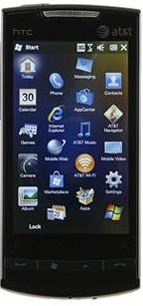
Mobile Device Details
We have standardized on the “HTC Pure” mobile phone for the Hawaii project.
Windows Mobile 6.5 professional
3.2” touch-screen (800 x 480 resolution)
3G radio compatible with AT&T’s network
Wi-Fi (802.11 b/g)
Bluetooth 2.0 with EDR
GPS
5MP auto-focus camera
Also: accelerometer, ambient light sensor, FM radio

Slide 16
Windows Mobile Development
Development Environment
Visual Studio 2008 Professional SP1
Windows Mobile 6 Professional SDK
.NET Compact Framework 3.5
Windows Mobile Device Center 6.1
Similar to programming for the desktop
.NET Compact Framework is subset of full framework.
Demo of simple “Hello World” app
Most things can be tested using the device emulator.

Slide 17
Hawaii Location API
We will be providing a prototype service and API
Not yet public. Please don’t distribute!
Simple API for determining location
Provides current Latitude/Longitude/Altitude.
Handles GPS and radio-location for you.
Collects location information from local sensors (GPS readings, WiFi AP bssids, cell phone towers, etc).
Back-end service provides algorithms/database for determining location based on sensor information.
Note privacy concerns on next slide.

Slide 18
Privacy Concerns
Users don’t like it when programs expose potentially private information to others without telling them.
Some countries/jurisdictions have legal requirements.
Your applications MUST get the user’s consent before calling the location API.
Once the user has consented, your app may remember this fact rather than ask on each run.
Exact language required is specified in the SDK.

Slide 19
Location API Details
LiveLocation.CAB
Installs on the phone.
Extends the OS to include location capability.
Applications link with LiveLocationLib.dll.
LiveLocationWrapper provides a .NET API.
API can be called two ways:
One-shot.
Provide asynchronous callback updates.
Demo of simple location app.

Slide 20
Bing Maps API
Provides information about a location.
Street maps, imagery, etc.
Translates between location representations.
E.g. street address to lat/long, place names, etc.
AJAX API for calling from browser.
Interactive SDK: http://www.microsoft.com/maps/isdk/ajax
Other APIs (e.g. Web Services) available.
See http://msdn.microsoft.com/library/dd877180.aspx
Demo of simple map display in a browser.

Slide 21
Bing Maps Example
<html>
<head>
<meta http-equiv="Content-Type" content="text/html; charset=utf-8">
<script type="text/javascript” src="http://ecn.dev.virtualearth.net/mapcontrol/mapcontrol.ashx?v=6.2"></script>
<script type="text/javascript">
var map = null;
function GetMap()
{
map = new VEMap('myMap');
map.LoadMap(new VELatLong(33.8125, -117.919), 18, 'h', false);
}
</script>
</head>
<body onload="GetMap();">
<div id='myMap' style="position:relative; width:400px; height:400px;"></div>
</body>
</html>

Slide 22
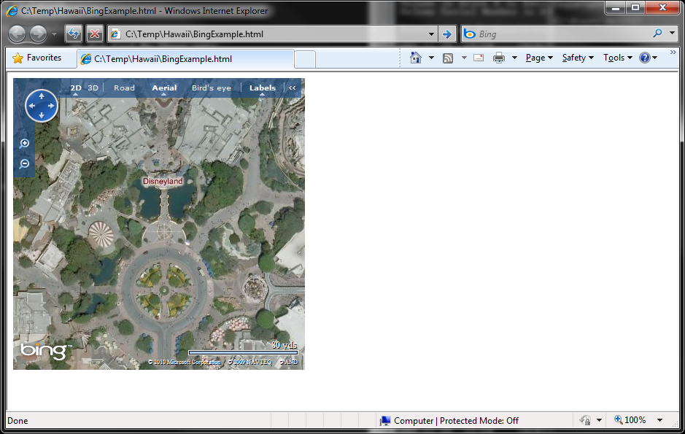
Bing Maps Example

Slide 23
Windows Azure Primer
We will be providing you with Azure accounts.
Azure is essentially web and database services in the cloud.
Hosted ASP.NET web site/service
Looks like IIS with web management interface.
Websites are given URLs of the form http://<YourNameHere>.cloudapp.net/

Slide 24
Windows Azure Development
Development Environment
Visual Studio 2008 Professional SP1
Windows Azure Tools for Visual Studio 2008
Windows Azure SDK
“Azure Tools for Visual Studio” streamlines the process of building Azure services:
Project to hold Azure configuration.
Project to hold standard ASP.NET website.
Results can be directly uploaded to Azure.

Slide 25
ASP.NET Environment
Each Web site is an “Application”.
Applications isolated by .NET runtime:
Runs on App Pool thread(s).
Created upon first HTTP request.
Can timeout if no requests (default 20 mins).
Most code runs as handlers to HTTP requests:
The “Page_Load” event being the most common.

Slide 26
ASP.NET Handlers
Application/Session event handlers
Specified in global.asax file.
Application/Session start, end, error, etc.
Page handlers for HTTP requests
Filename.aspx (for layout and optional code).
UI objects may be declared in layout and manipulated in code.
Filename.aspx.cs (optional place for code).
Raw HTTP handlers
Mapped to arbitrary parts of namespace.
E.g. http://website.com/PurchaseOrder/*
Asynchronous or Synchronous.

Slide 27
Keeping State in ASP.NET
Application State
Defined on Application instance.
“Application” dictionary object of name/object pairs.
Session State
In process, state server, SQL server options.
“ViewState” dictionary object of name/object pairs.
Page State
Instance of Page object created per request.
Only static members of object persist across calls.

Slide 28
Windows Live ID Primer
Live ID provides an authentication service.
Handles web site “sign in” for you.
Provides an unique ID for each signed-in user.
Web Authentication SDK
Source code for WindowsLiveLogin class.
Example code for service callback handler.
Example code showing use of API to get user id.
Must register your web site URL with service:
Register callback handler page.
Get application id (use when calling service).

Slide 29
Hawaii Notification Service
We will be providing an experimental notification service and example code for calling it.
Provides a simple method of signaling mobile.
Why a Notification Service?
Mobile devices rarely have fixed public IP addresses.
Power is limited, more efficient to have single system.
Apps allocate channel(s) from service.
Clients subscribe to channel(s).
Channels can be signaled, waking clients.

Slide 30
Hawaii Forum
Questions? Problems? Need Help?
Discussion Forum for Hawaii Project:
http://community.research.microsoft.com
Hawaii Project forum is private.
Please create an account for yourself:
See “Join” link at top of main page.
Email me (bzill@microsoft.com) your account name and I’ll add you to the forum’s access list.
Ask questions of us or your fellow students.
http://community.research.microsoft.com/forums/149.aspx

Slide 31
Resources
General:
Visual Studio 2008 Professional Edition Service Pack 1
From MSDN http://www.msdn.com or DreamSpark http://www.dreamspark.com
Microsoft Web Platform Installer: http://www.microsoft.com/web/downloads/platform.aspx
.NET Framework 3.5 Service Pack 1 Download: http://msdn.microsoft.com/netframework/aa569263.aspx
.NET Framework Information: http://msdn.microsoft.com/netframework
Windows Mobile 6.5 Development:
Windows Mobile Developer Center: http://msdn.microsoft.com/windowsmobile
Core Downloads for Windows Mobile Development: http://msdn.microsoft.com/windowsmobile/bb264327.aspx
Windows Mobile 6 Professional SDK: http://go.microsoft.com/fwlink/?LinkId=87437
Windows Mobile Device Center 6.1 (for Vista/7) or Microsoft ActiveSync (for XP).
.NET Compact Framework 3.5 Redistributable http://www.microsoft.com/downloads/details.aspx?familyid=E3821449-3C6B-42F1-9FD9-0041345B3385

Slide 32
Resources Continued
Web Application/Service using Windows Azure:
Azure Developer Center: http://www.microsoft.com/windowsazure/developers
Windows Azure Tools for Visual Studio 2008 (includes Windows Azure SDK): http://go.microsoft.com/fwlink/?LinkId=128752
Windows Azure SDK Online documentation: http://msdn.microsoft.com/library/dd179367.aspx
Windows Azure Platform Training Kit: http://www.microsoft.com/downloads/details.aspx?familyid=772990DA-8926-4DB0-958F-95C1DA572C84
Identification using Windows Live ID:
Windows Live ID Web Auth SDK: http://go.microsoft.com/fwlink/?LinkID=91761
Windows Live ID Web Authentication Online Documentation: http://msdn.microsoft.com/library/bb676633.aspx
Mapping using Bing Maps (formerly known as Virtual Earth):
Interactive SDK: http://www.microsoft.com/maps/isdk/ajax
All Bing Maps SDKs: http://msdn.microsoft.com/library/dd877180.aspx

Slide 33
Appendix

Slide 34
Random App Ideas
Pothole Reporter - App for reporting potholes (w/ pictures) to a website that can display their location on a map.
Directional Poke - Ping people in a particular physical region.
Parking Assistant - Find public parking near you, tell others about open parking spaces, find your parked car.
Taxi Fare Predictor - Crowd-sourced database and logic for estimating taxi fare between two points.
Commute Logger - Determine which of your alternate routes is best for a particular day of week and time of day.
Crowd News Reporting - Let a news site alert you to newsworthy events near you so you can cover the event.
Virtual Graffiti - Post notes that only appear to other people who later visit the same physical location.
Workout Monitor - Use the accelerometer to determine things about a person's workout.
Lecture Review - App and website for sharing reviews of a lecture with the other people present.
Physical Presence Proof - Some means of proving your presence in a physical location, such as responding to some sort of challenge/response.
Battery Monitor - Crowd-sourced comparison of your battery usage with other peoples to identify when your battery is no longer holding as good a charge.
Photo Tagger - Geo-tag photos.
Walking Route Suggestion - Find the optimal way around your College campus.
Social Heat Map - See if your friends are around, or where they are congregating.

Slide 35
Running Your Own Server
Server 2008 R2
Has IIS 7.5 (non R2 has IIS 7.0)
IIS 7.0/7.5
May need to enable using Server Manager
Roles -> Roles Summary -> Add Roles
ASP.NET
Need to enable using Server Manager
Roles -> Role Services -> Add Role Services
Features -> Add Features -> .NET Framework 3.5.1 Features

Slide 36
Web Sites in IIS
Use IIS Manager to create web sites
Connect to server, Select server -> Sites, Add Web Site…
Important site properties
Name (not externally visible)
Application Pool (usually one per web site)
Content Directory (usually under C:\InetPub)
Binding (defines external access point)
Host name, IP address(es), Port, Protocol
Global IIS configuration kept in XML files
%SystemRoot%\System32\inetsrv\config\*
Site-specific configuration kept in XML file
<Content Directory>\Web.Config

