Slide 1
The Case of Software Defined Radio with MSRA
(work-in-progress)
Yongguang Zhang
with Kun Tan, Fan Yang, Jiansong Zhang, Haitao Wu, Chunyi Peng, Songwu Lu
Microsoft Research Asia
June 2008

Slide 2
Fundamental Challenges of SDR
Digital baseband processing
  Super computation required
  E.g. traditional 802.11a requires > 50Gops
Tight real-time response
  E.g. generate MAC response within 10us
High level of programmability
  Accommodate a large range of heterogeneous PHY algorithms and MAC protocols
Notes:
Intel Xeon provides 13Gops

Slide 3
Impending Technology Sea Change
Emerging multi-core/many-core GPP
  Today’s nVidia GPU: 256 core, 600GFlops
  Intel 80-core CPU: TFlops, IBM Cell: 200GFlops
  Predicted to possess 1000 cores in a few years
Opportunities
  Sufficient computational power and parallelism
  PHY MAC NET … APP processing in one place
Question: is general-purpose PC architecture suitable for SDR?

Slide 4
Our Project Goals
Explore new ways of building DSR based on standard multi-core PC architecture
Develop a complete software stack
  High-speed PHY processing on GPP
  Support for time-critical MAC control
Provide a software system research platform for wireless communication and networking
Notes:
Should we customize this goal for the talk????

Slide 5
System Architecture
GPP+MEM
Network layer and above
Multi-core
Software
Radio
Architecture
Link-layer Processing
SDR mgnt
MAC Processing
Baseband Processing
PCIe Bus
Flexible RF Hardware
Antenna
LPA/Sampling Convertor/DAC/ADC
Latency critical radio control (AGC/PD)

Slide 6
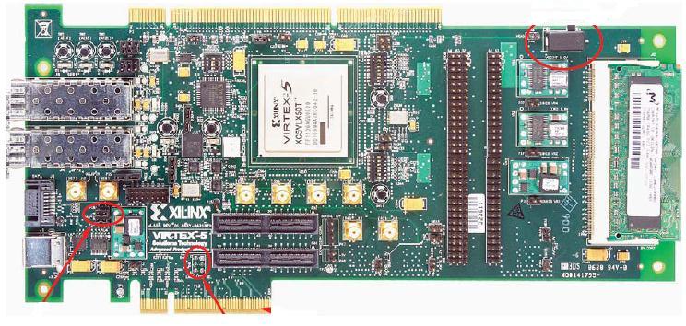
Flexible Radio Control Hardware
FPGA board to connect RF and PC bus
  PCIe-8x, Descriptor-based DMA, 256MB onboard SDRAM cache
Basic functions
  Fast sample transport b/w RF and PC memory
  AGC
  Packet Detection
  Early interrupt trigger
  Timing control
Xilinx Vertex5
FPGA
GPIO: connect to RF
PCI-e Link to PC

Slide 7
Baseband Processing with GPP
Exploit parallelisms in PHY for multi-core
  Batching for SIMD and inter-symbol parallelism
  Control batch size to meet latency requirement
Exploit large memory and high-speed L2 cache
  Pre-calculations and lookup tables
    Convolution encoding
    (de)scramble, (de)interleaving, (de)mapper, …
Two paths
  Multi-core CPU (intel quad-core)
  Many-core GPU (nvidia GeForce 8800)

Slide 8
Performance Results (intermediate)
Hardware throughput
Baseband processing speed (over link speed)
 | Rx | Tx
PCIe-x4 | 842 Mbps | 839 Mbps
PCIe-x8 | 1684 Mbps | 1675 Mbps
 |  | Parameters | Speedup
1-core CPU | 802.11b TX | Long preamble, 11Mbps | 29.59x
 |  | Short preamble, 11Mbps | 28.82x
 | 802.11b RX | Long preamble, 11Mbps | 2.83x
 |  | Short preamble, 11Mbps | 2.67x
128-core GPU | 802.11a TX | 54Mbps | 1.39x
 | 802.11a RX (w/o viterbi) | 54Mbps | 1.56x
 | 802.11a RX (w/ viterbi) | 54Mbps | 0.53x

Slide 9
Performance Results (cont'd)
Hardware latency
 | DMA Read | DMA Write | Interrupt
PCIe-x4 | 0.36µs | 0.72µs | 7~10µs
PCIe-x8 | 0.34µs | 0.68µs | 7~11µs
 | TX Path | RX Path
RCB | 0.75µs | 1.75µs
RxTxTurnaroundTime < 5µs
RxTxSwitchTime < 5µs
Channel estimation
Data demodulation & decoding
CRC check and MAC hdr check
ACK Prep.
ACK send
PLCP
GPP
Packet Detected
AGC Settle down
Interrupt
SIFS.
H/W
Preamble
PLCP
Header
Data
Rx Latency.
Tx Latency.
Notes:
RxTxTurnaroundTime ::= The maximum time that the PHY requires to change from receiving to transmitting the start of the first symbol.
RxTxSwitchTime ::= The nominal time that the PMD takes to switch from Receive to Transmit.

Slide 10
Research Opportunities
Operating system support for SDR
  Resource management for multi-core
  High-resolution timer, scheduler
Programmability
  Library, reusable components
  Development tools
New thinking in wireless communications under extra computational power

Slide 11
MAC Core: Precise Timing Control
Kernel service for time-critical MAC processing
  On-demand dedicate core for MAC state-machine
    Polling for events when going into time-critical task
    Microsecond level timing control
  Two-phase transmission transaction
    Pre-catch frame symbols in RCB
Time synchronization
  H/W timestamp for transceiving events
  Library functions to manage time mappings
Notes:
Preparation phase – load frame symbols onto RC board
Medium access phase – involve MAC state-machine to control channel access

Slide 12
Modular Link Layer
Modular software architecture for none time-critical link layer functions
  Extensibility
  Code reuse
Abstract each component into an object with typed interfaces
  Decouple functionalities into small objects
  Objects are interconnected with interfaces

Slide 13
Graph Presentation of Link Layer
Flexible definitions of interfaces
  Data passing interfaces vs. control interfaces
Versatile connection types
  One-to-one; one-to-many; many-to-one; many-to-many
Components – realized as C++ objects
XML description for configuration file
IfDataPush
IfDataPull
IfPreempt
HighQ
IfFlush
Classifier
Sched
ARQ
CA
LowQ

Slide 14
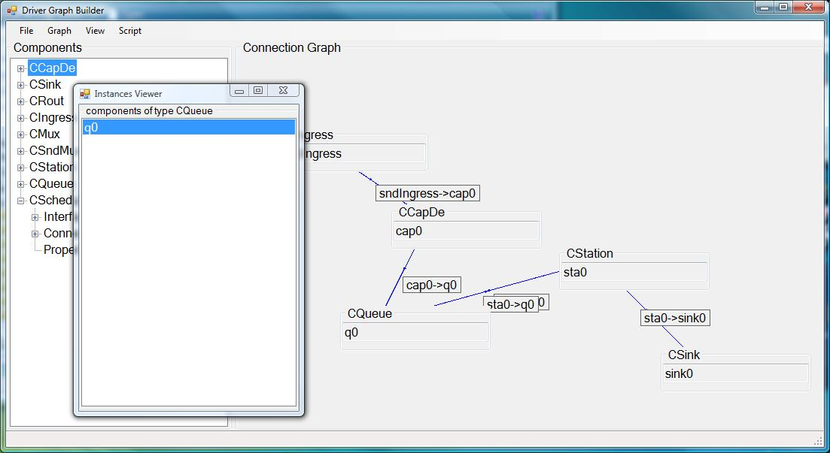
GUI-based Graph Generator
<?xml version="1.0"?>
<DriverGraph xmlns:xsi=http://www.w3.org/2001/XMLSchema-instance
xmlns:xsd="http://www.w3.org/2001/XMLSchema">
<Components>
<Component>
<Name>CCapDe</Name>
<Interfaces> <string>IfDataPush</string> </Interfaces>
<Connectors> <string>IfDataPush</string> </Connectors>
<Properties />
</Component>
</Components>
...
<ComponentInstances>
<ComponentInstance>
<Name>cap0</Name>
<TypeName>CCapDe</TypeName>
<PropertyNames />
<PropertyValues />
</ComponentInstance>
<ComponentInstance>
<Name>q0</Name>
<TypeName>CQueue</TypeName>
...
</ComponentInstance>
</ComponentInstances>
…
<Connections>
<Connection>
<CompAName>cap0</CompAName>
<CompBName>q0</CompBName>
<connectorName>IfDataPush</connectorName>
<interfaceName>IfDataPush</interfaceName>
<connectorNum>0</connectorNum>
</Connection>
</Connections>
</DriverGraph>
Type definition
Objects definition
Links definition
Notes:
Note1: Add a screen

Slide 15
Summary and Status
A new software radio stack based on PC architecture that supports
  High-speed PHY processing
  Low latency and time-critical MAC
  Modular architecture for link layer functions
Current status
  PCIe-based flexible radio control board
  Prototype and evaluate GPU and CPU based BB modules
  Prototype for MAC-Core runtime and modular link layer
  Integrating the whole research platform
Notes:
Note 1: Add

Slide 16
Thanks and Questions!

