Slide 1
A Data Centered Collaboration Portal to Support Global Carbon-Flux Analysis
Deb Agarwal (BWC), Marty Humphrey (Uva), and Norm Beekwilder (Uva)

Slide 2
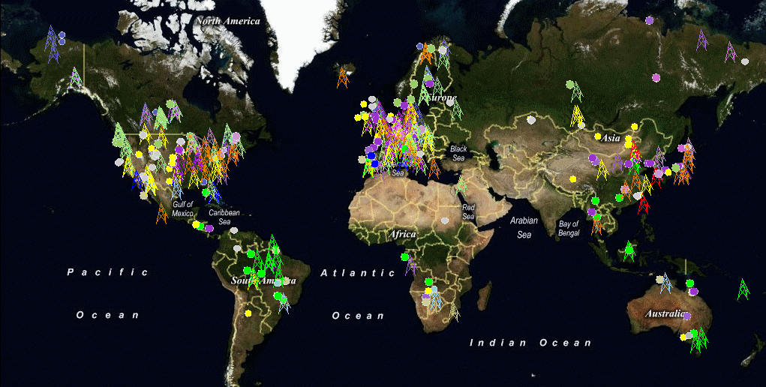
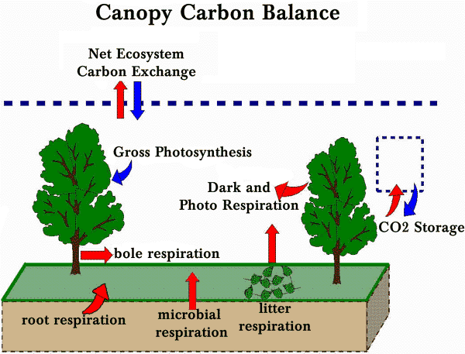
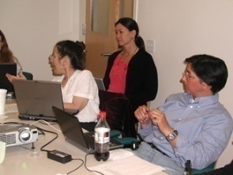
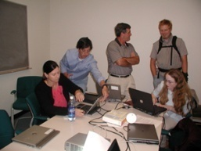
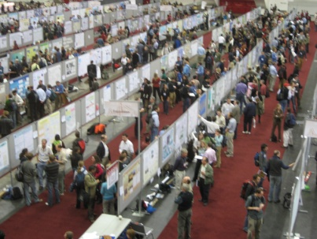
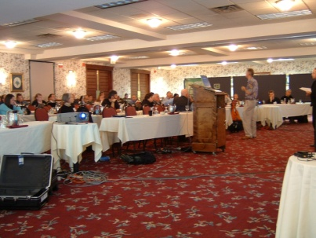
Fluxnet Global Carbon Flux Network

Slide 3
Fluxnet Synthesis Workshops
Marconi Workshop – June 2000 - Marconi Conference Center, California
Data from 38 sites
~96 site years of data
17 half/hourly variables
15 synthesis papers - published in a special issue of the Agriculture and Forest Meteorology, Volume 113, 2002
La Thuile Workshop – February 2007 – La Thuile, Italy
Data from 253 sites (sensor, derived, and ancillary)
~960 site years of data
41 half/hourly variables
~70 active synthesis papers underway

Slide 4


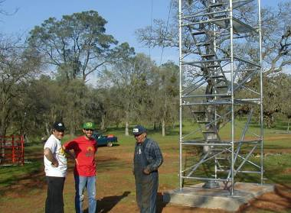

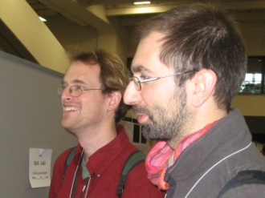






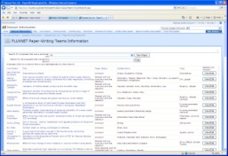
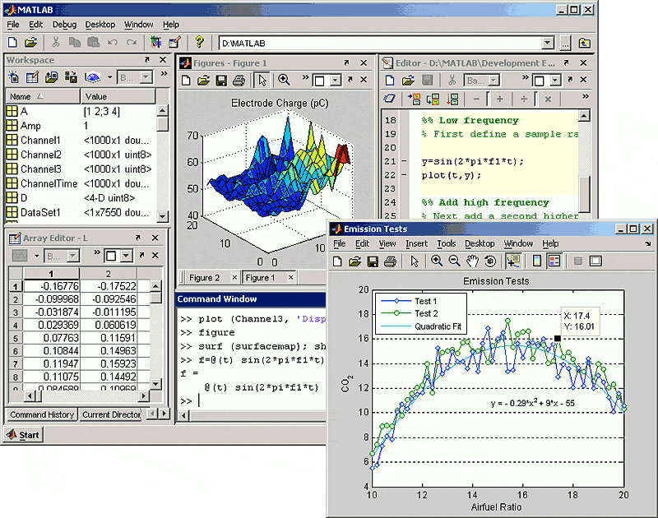
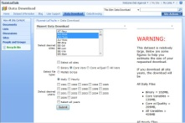
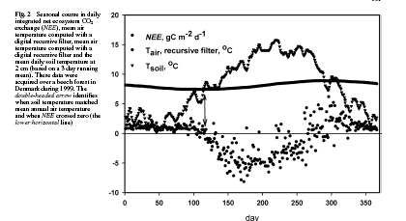

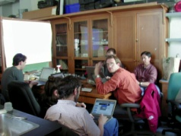
Fluxnet Collaboration data flow
Measurement Site Scientists
Regional Networks
Quality Assess and Gap Fill
Synthesis activities
Data Access and Summaries, Site Biological and Ancillary Metadata, and Collaboration Support
T SOIL
T AIR
Onset of photosynthesis

Slide 5




Synthesis Collaboration interactions
Steering Committee of Regional Networks
Site Measurement Scientists (129)
Permission to pursue synthesis activity on the data
Fluxdata web site
Ancillary site data
Data usage permission
Credit/co-authorship
Contribution to analysis
Synthesis Paper Teams (70)
Data access, updates, and corrections
Collaboration support
Information on other teams
Quality and Gap Fill (2)
Clarification
Correction
Interpretation

Slide 6
Fluxdata Portal Users/USES
Synthesis teams
Site selection and communication with site scientists
Data access (ancillary and flux/meteorological)
Data analysis support
Site Measurement Scientists
Information about and communication with synthesis teams
Correct site ancillary information
Access the FLUXNET version of site data
Public
Potential synthesis activity investigation
Funding agent verification of funding value
Modeler understanding of measurements
Updated information about the collaboration

Slide 7
Fluxdata design Philosophy
Minimize the barrier to entry
Focus on functionality targeted at improving the science experience (get familiar with the science)
Include critical content needed by a majority of collaborators
Avoid adding extraneous functionality
Listen to the target scientists (learn some of their science)
Develop a relationship of mutual trust
Anticipate changes in users’ practices due to introduction of collaborative tools

Slide 8
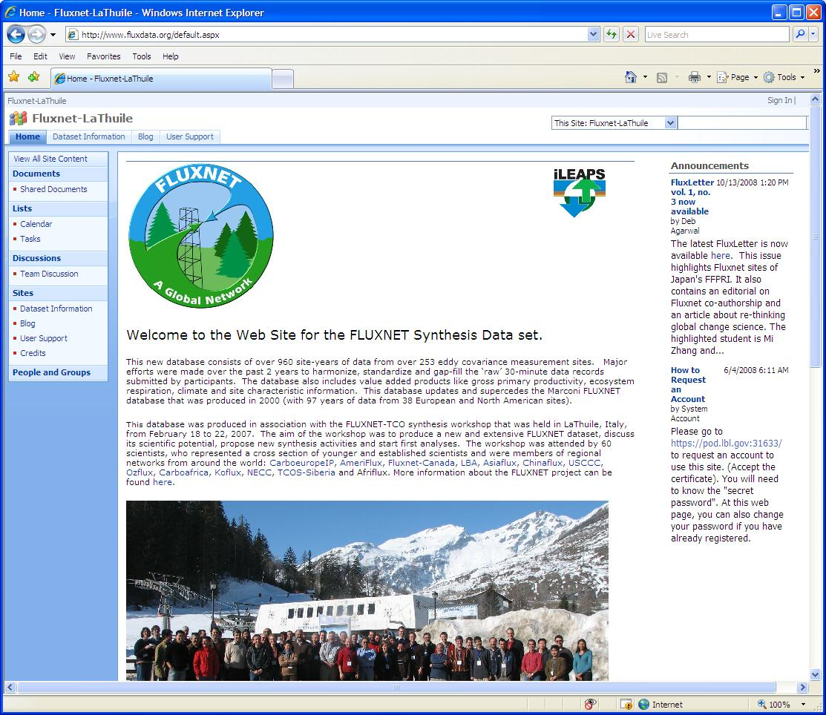
Fluxdata public VIEW - Home

Slide 9
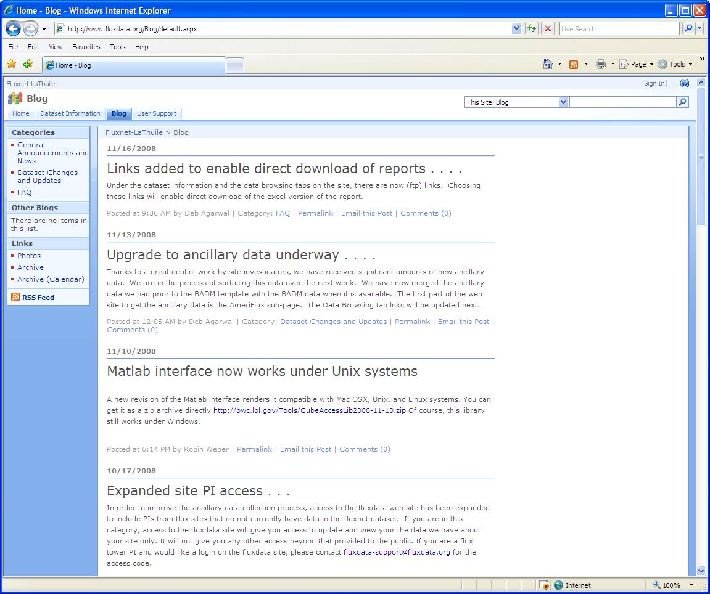
Fluxdata public VIEW - Blog

Slide 10
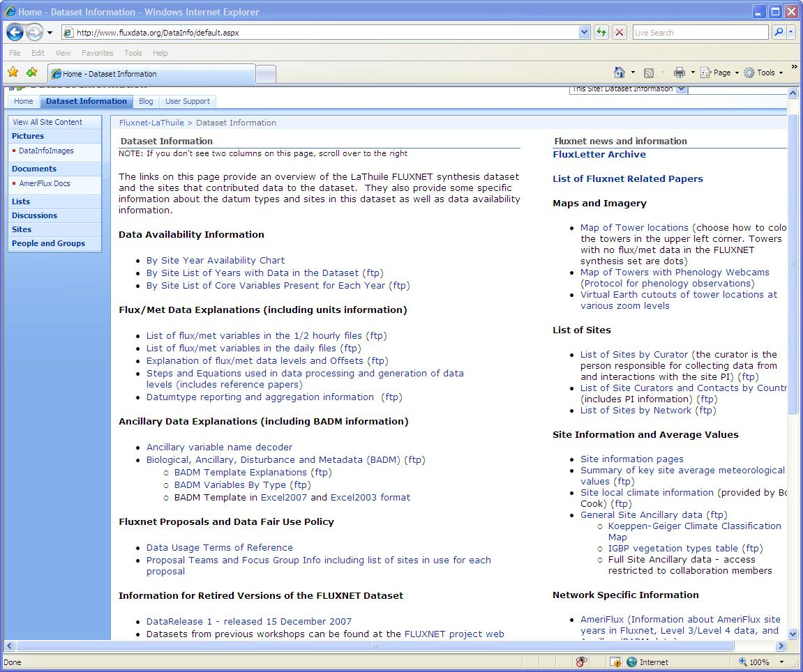
Fluxdata public VIEW

Slide 11
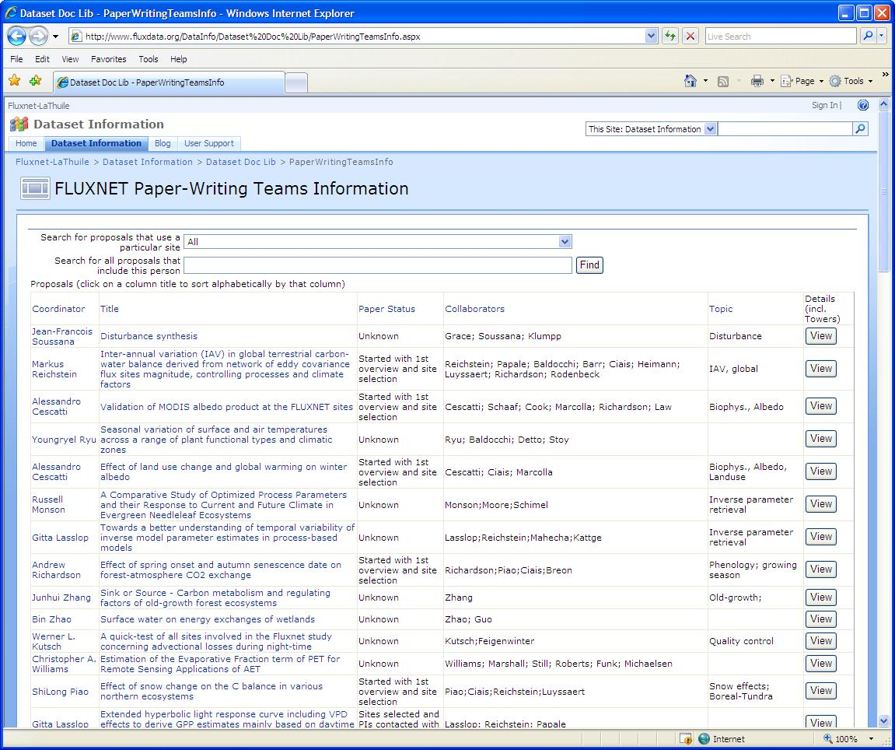
Fluxdata public VIEW – synthesis teams

Slide 12
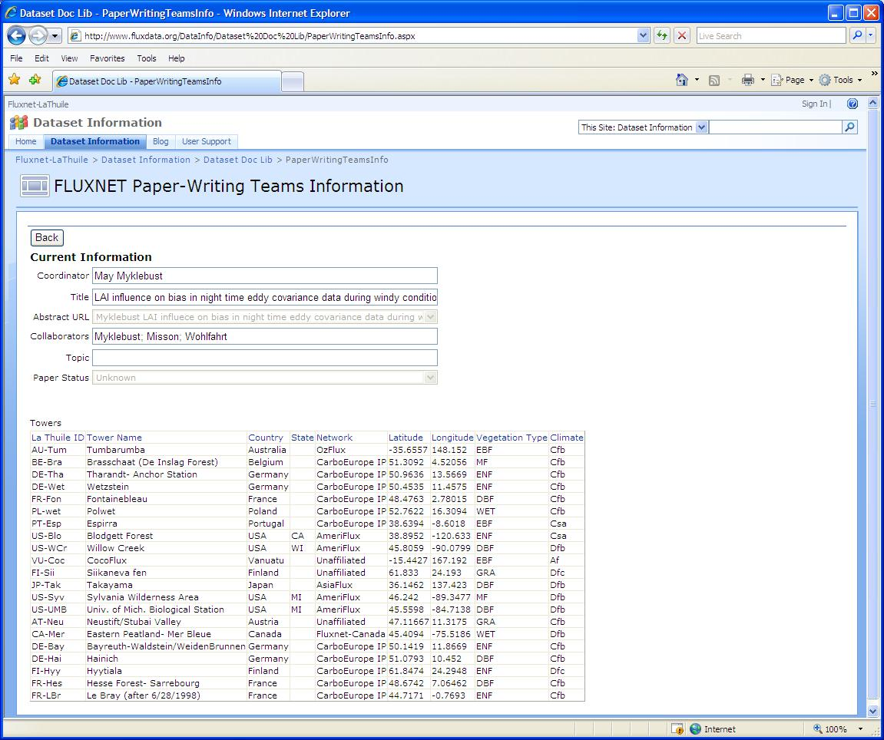
Fluxdata public VIEW – Paper Detail

Slide 13
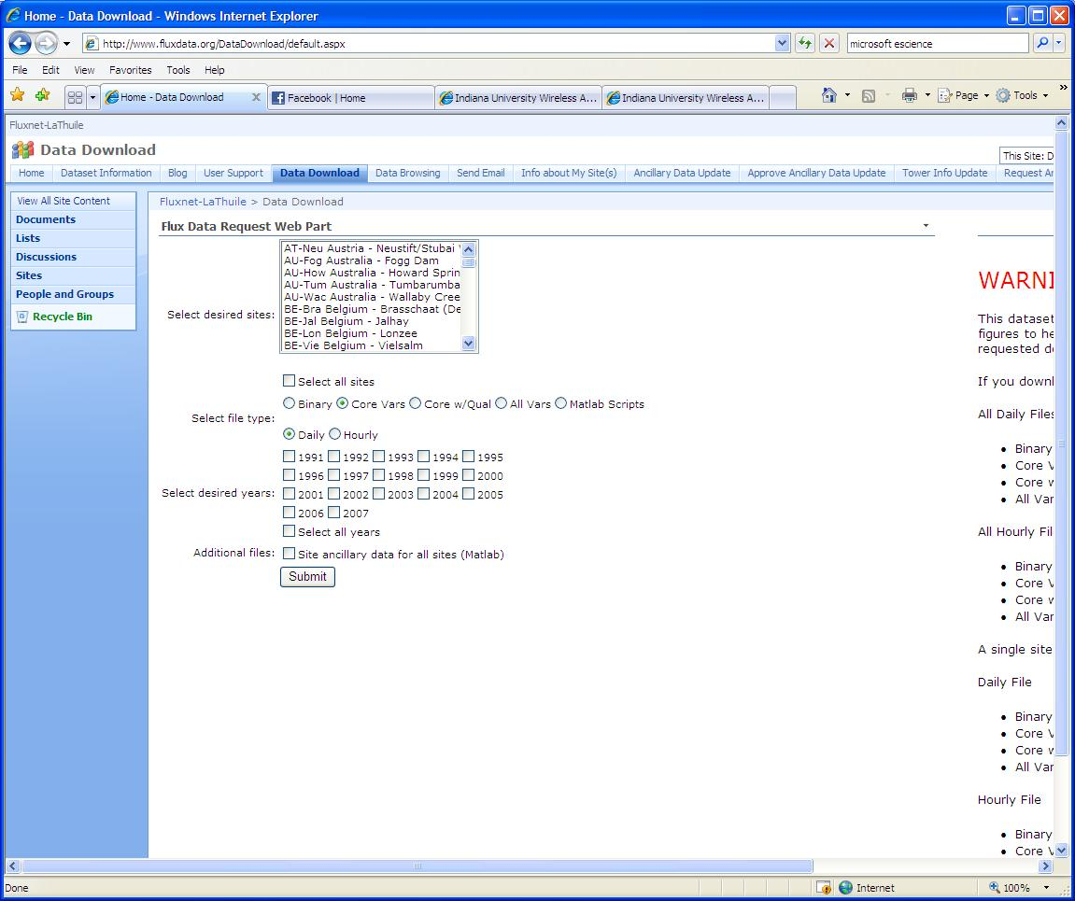
Fluxdata Synthesis VIEW - Download

Slide 14
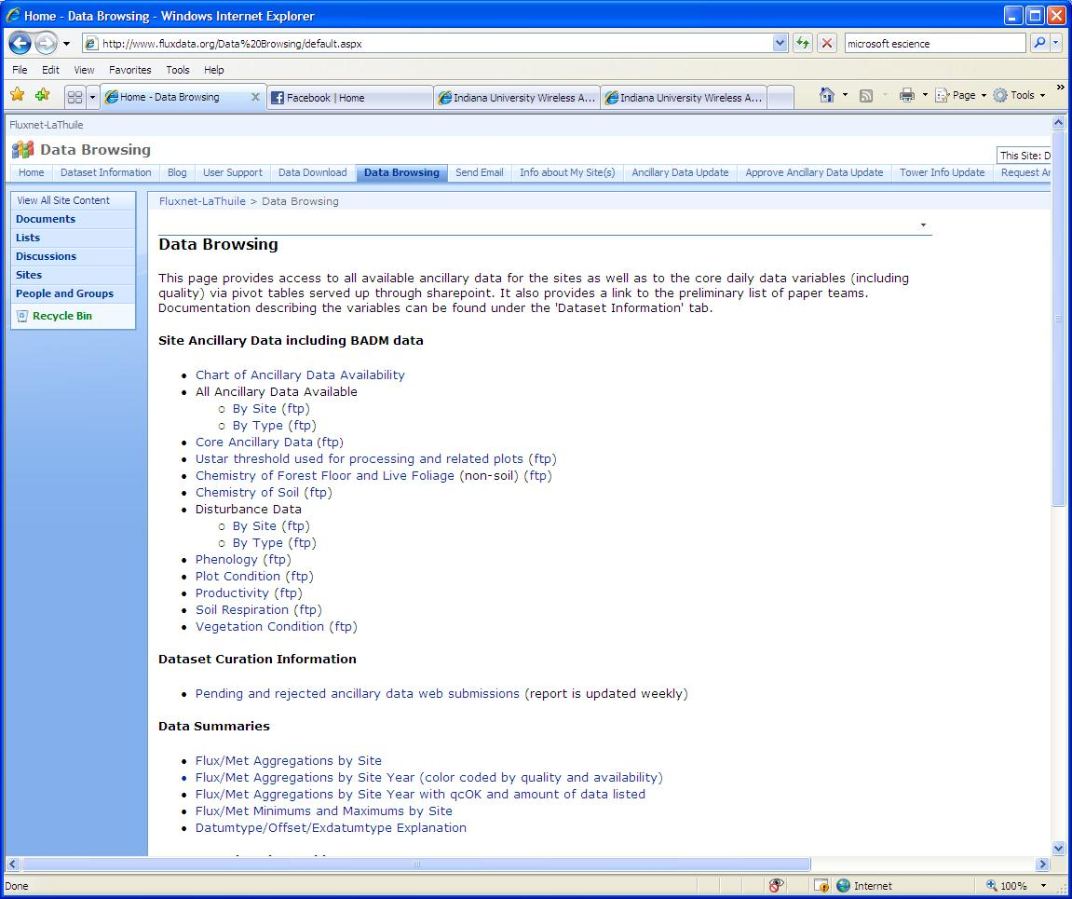
Fluxdata Synthesis VIEW - Browsing

Slide 15
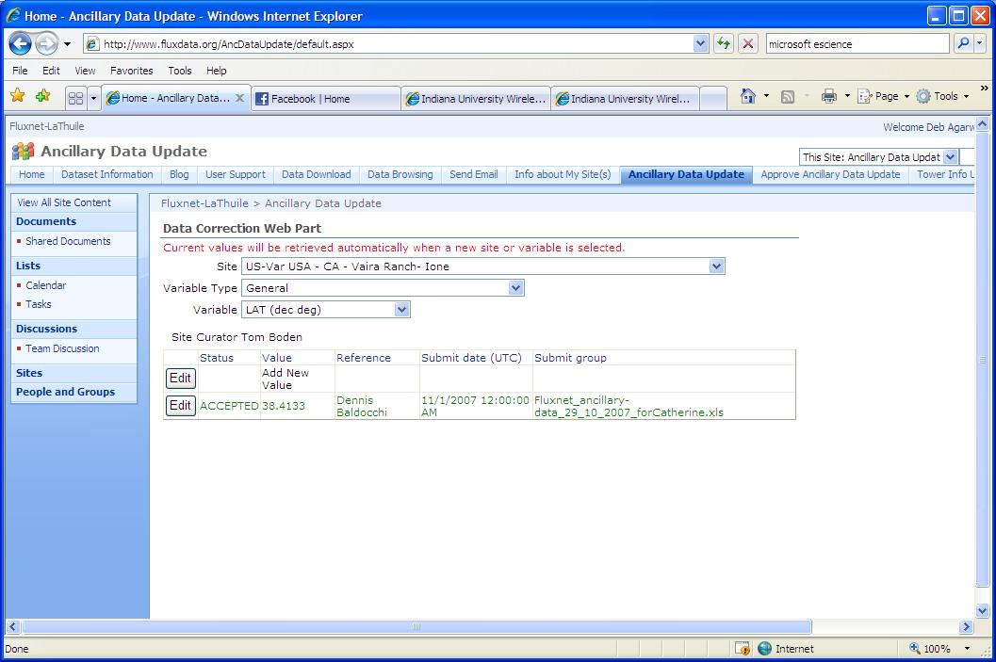
Fluxdata Synthesis VIEW – Anc Update

Slide 16
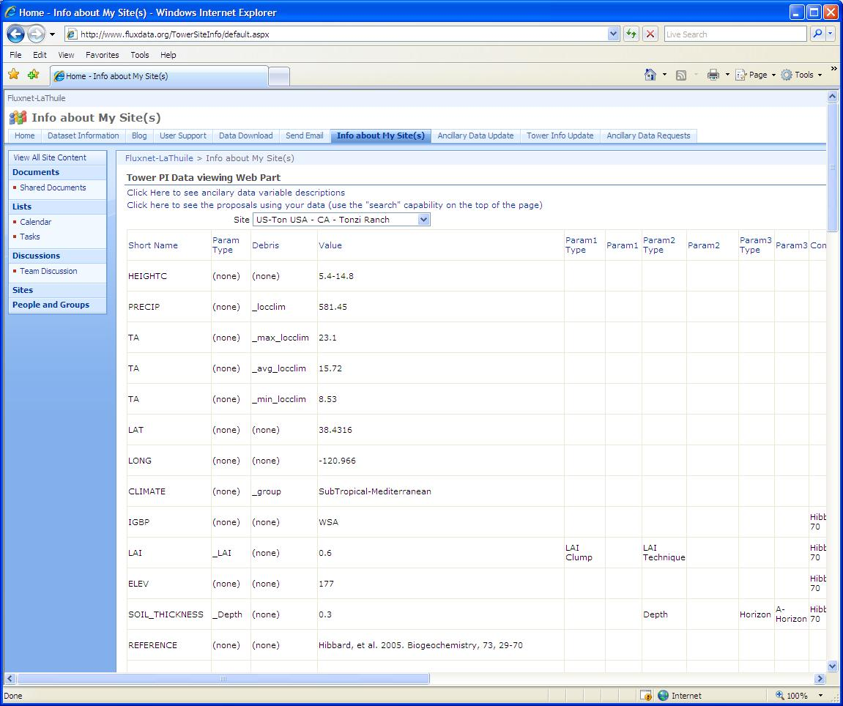
Fluxdata Site Scientist VIEW - Home

Slide 17
Fluxdata design
Minimize the barrier to entry
Put as much as possible in the public domain
Focus on functionality targeted at improving the science experience
Aggregate and data quality reports
Data browsing
Easy communication with measurement site scientists
Easy ability to generate typical analysis graphs
Include critical content needed by a majority of collaborators
Data download
Access to ancillary data about sites
Avoid adding extraneous functionality
Listen to the target users
Understand what is important to them
Read their papers and identify typical analyses and techniques
How they work with the data (units/time periods/etc)
Develop a relationship of mutual trust
Anticipate changes in users’ practices due to introduction of collaborative tools

Slide 18
Acknowledgements
Berkeley Water Center, University of California, Berkeley, Lawrence Berkeley Laboratory
Jim Hunt (UCB)
Deb Agarwal (LBL)
Robin Weber (UCB)
Monte Good (LBL)
Rebecca Leonardson (UCB student)
Matt Rodriguez (SDSC Student)
Carolyn Remick (UCB)
Susan Hubbard (LBL)
University of Virginia
Marty Humphrey
Norm Beekwilder
Microsoft
Catharine van Ingen
Bora Beran
Jayant Gupchup (student)
Nolan Li (student)
Stuart Ozer
Tony Hey
Dan Fay
Savas Parastidis
Andy Sterland
Jing De Jong-Chen
SQL product team
Jim Gray
Ameriflux Collaboration
Beverly Law (UOregon)
Youngryel Ryu (UCB postdoc)
Tara Stiefl (UO student)
Chris Williamson (UO student)
Gretchen Miller (UCB student)
Tom Boden (ORNL)
North American Carbon Program
Peter Thornton (ORNL)
Kevin Schaefer (NSIDC)
Daniel Ricciuto (ORNL)
FLUXNET Collaboration
Dennis Baldocchi (UCB)
Rodrigo Vargas (UCB postdoc)
Dario Papale (UTuscia)
Markus Reichstein (Max Plank)
Bob Cook (ORNL)
Dorothea Frank (Max Plank)
URLs: http://bwc.berkeley.edu and http://www.fluxdata.org
E-mail: fluxdata-support@fluxdata.org

Slide 19
















