Slide 1
Processes and Constraints in Scientific Model Construction
Will Bridewell† and Pat Langley†‡
†Cognitive Systems Laboratory, CSLI, Stanford University
‡CIRCAS, Arizona State University

Slide 2

Where Are We Going?
Introduction to inductive process modeling
Constraints in inductive process modeling
Learning constraints

Slide 3
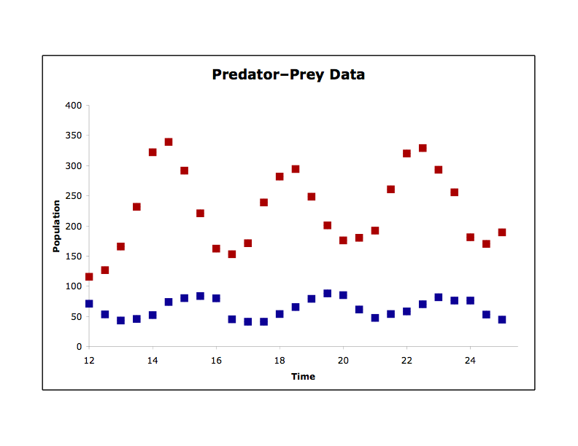
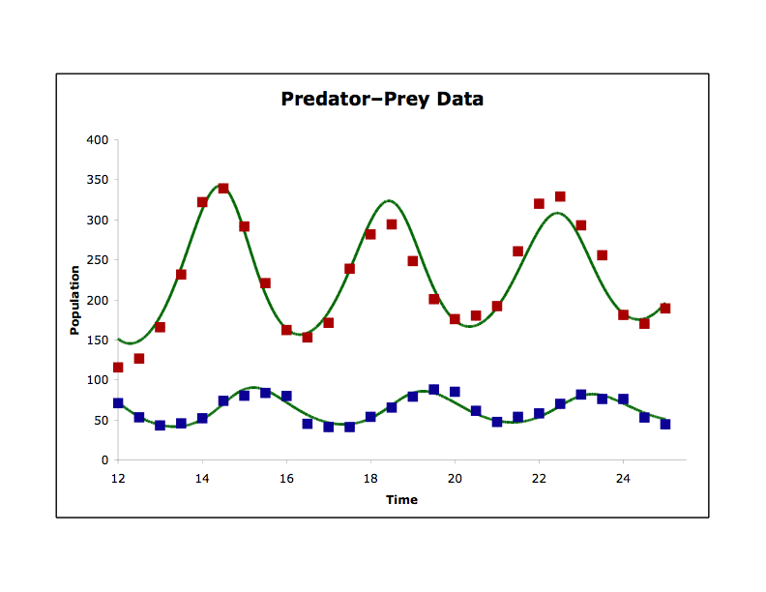

Inductive Process Modeling
Model
Observations
Predictions
Model Objectives: Explanation and Prediction
Langley et al. 2002, ICML; Bridewell et al. 2008, ML

Slide 4
Quantitative Process Models
Ordinary Differential Equations
Processes
dhare.density/dt = 2.5 * hare.density + −0.1 * hare.density * wolf.density
dwolf.density/dt = −1.2 * wolf.density + 0.3 * 0.1 * hare.density * wolf.density
process exponential_growth
equations d[hare.density, t, 1] = 2.5 * hare.density
process exponential_loss
equations d[wolf.density, t, 1] = −1.2 * wolf.density
process predation_holling_type_1
equations d[hare.density, t, 1] = −0.1 * hare.density * wolf.density
d[wolf.density, t, 1] = 0.3 * 0.1 * hare.density * wolf.density

Slide 5
Advantages of
Quantitative Process Models
Process models offer scientists a promising framework because:
they embed quantitative relations within qualitative structure;
that refer to notations and mechanisms familiar to experts;
they provide dynamical predictions of changes over time;
they offer causal and explanatory accounts of phenomena;
while retaining the modularity needed for induction/abduction.
Quantitative process models provide an important alternative to formalisms used currently in computational discovery.

Slide 6
Modularity in
Quantitative Process Models
Ordinary Differential Equations
Processes
dhare.density/dt = 2.5 * hare.density + −0.1 * hare.density * wolf.density
dwolf.density/dt = −1.2 * wolf.density + 0.3 * 0.1 * hare.density * wolf.density
process exponential_growth
equations d[hare.density, t, 1] = 2.5 * hare.density
process exponential_loss
equations d[wolf.density, t, 1] = −1.2 * wolf.density
process predation_holling_type_1
equations d[hare.density, t, 1] = −0.1 * hare.density * wolf.density
d[wolf.density, t, 1] = 0.3 * 0.1 * hare.density * wolf.density

Slide 7
Modularity in
Quantitative Process Models
Ordinary Differential Equations
Processes
dhare.density/dt = 2.5 * hare.density
dwolf.density/dt = −1.2 * wolf.density
process exponential_growth
equations d[hare.density, t, 1] = 2.5 * hare.density
process exponential_loss
equations d[wolf.density, t, 1] = −1.2 * wolf.density

Slide 8
Modularity in
Quantitative Process Models
Ordinary Differential Equations
Processes
dhare.density/dt = 2.5 * hare.density + −0.1 * hare.density * wolf.density /
(1 + 0.2 * –0.1 * hare.density)
dwolf.density/dt = −1.2 * wolf.density + 0.3 * 0.1 * hare.density * wolf.density /
(1 + 0.2 * –0.1 * hare.density)
process exponential_growth
equations d[hare.density, t, 1] = 2.5 * hare.density
process exponential_loss
equations d[wolf.density, t, 1] = −1.2 * wolf.density
process predation_holling_type_2
equations d[hare.density, t, 1] = −0.1 * hare.density * wolf.density /
(1 + 0.2 * –0.1 * hare.density)
d[wolf.density, t, 1] = 0.3 * 0.1 * hare.density * wolf.density /
(1 + 0.2 * –0.1 * hare.density)

Slide 9
Generic Processes
generic process predation_Holling_1
entities P1{prey}, P2{predator}
parameters r[0, infinity], e[0, infinity]
equations d[P1.density, t, 1] = −1 * r * P1.density * P2.density
d[P2.density, t, 1] = e * r * P1.density * P2.density

Slide 10
Generic Processes
generic process predation_Holling_1
entities P1{prey}, P2{predator}
parameters r[0, infinity], e[0, infinity]
equations d[P1.density, t, 1] = −1 * r * P1.density * P2.density
d[P2.density, t, 1] = e * r * P1.density * P2.density
P1: hare | P2: wolf
r: 0.1 | e: 0.3
Instantiation

Slide 11
Generic Processes
generic process predation_Holling_1
entities P1{prey}, P2{predator}
parameters r[0, infinity], e[0, infinity]
equations d[P1.density, t, 1] = −1 * r * P1.density * P2.density
d[P2.density, t, 1] = e * r * P1.density * P2.density
P1: hare | P2: wolf
r: 0.1 | e: 0.3
Instantiation
process wolves_eat_hares
equations d[hare.density, t, 1] = −1 * 0.1 * hare.density * wolf.density
d[wolf.density, t, 1] = 0.3 * 0.1 * hare.density * wolf.density

Slide 12

The IPM System
(a naive approach)
  Given:
    A library of generic entities and processes
    Instantiated entities
    Data
    Ground the generic processes with instantiated entities
    Generate all combinations of the ground processes
    Fit the numeric parameters of each structure
  Output: The best models based on fit to the data

Slide 13
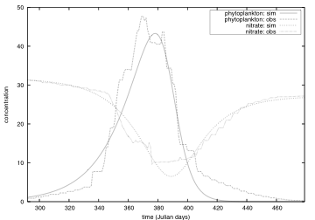
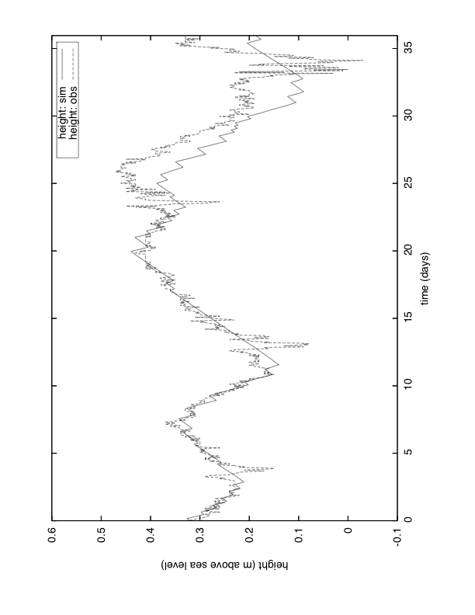
Applications
Aquatic Ecosystems
Fjord Dynamics
See Bridewell et al. 2008, Machine Learning, 71, 1–32
also, biochemical kinetics, protist interactions, photosynthesis

Slide 14
Life After IPM
Early versions of inductive process modeling systems:
help scientists formalize their modeling knowledge;
let scientists consider several alternative models;
reduce some of the drudgery of model construction;
speed exploration and evaluation.
However, IPM produces several structurally implausible models, some of which account quite well for the data.

Slide 15
Model Constraints
Constraints on the structure of models:
eliminate implausible models;
reduce the size of the search space;
make complex domains tractable;
improve model accuracy during incomplete search.
Structural constraints differ from constraints on model behavior most importantly because they do not require simulation.
HIPM, Todorovski et al. AAAI-05

Slide 16
SC-IPM Constraints:
Necessary
Name: Nutrient-Replenishment
Type: necessary
Processes:
nutrient_mixing(N), remineralization(N,_ )
Specifies Required Processes
P = primary producer
G = grazer
N = nutrient

Slide 17
SC-IPM Constraints:
Always-Together
Name: Growth-Limitation
Type: always-together
Processes:
limited(P), nutrient_limitation(P, N)
All or None
P = primary producer
G = grazer
N = nutrient

Slide 18
SC-IPM Constraints:
Exactly-One
Name: Growth-Alternatives
Type: exactly-one
Processes:
exponential(P), logistic(P), limited(P)
Mutual Exclusion
P = primary producer
G = grazer
N = nutrient

Slide 19
SC-IPM Constraints:
At-Most-One
Name: Optional-Grazing
Type: at-most-one
Processes:
holling_1(P,G), holling_2(P,G), holling_3(P,G)
Enables Optional Processes
P = primary producer
G = grazer
N = nutrient

Slide 20
The SC-IPM System
Ground the generic processes with instantiated entities.
Treat ground processes as Boolean literals.
Conjoin the individual constraints.
Rewrite the constraints in conjunctive normal form.
Apply a SAT solver (e.g., DPLL,WalkSAT).
Instant model structure!
Fit parameters, etc.

Slide 21
Advantages of SC-IPM
SC-IPM adds several powerful features to IPM, such as:
constraints that limit the consideration of implausible models;
constraint modularity that eases control of the search space.
The constraints used by SC-IPM typically come from a scientist’s implicit knowledge, and we can both elicit them through examples and learn them computationally.

Slide 22
Learning Constraints
Goal:
Identify implicit or unknown constraints
to use in future modeling tasks
Plan:
Analyze the space of model structures
Use machine learning techniques to help
Key Idea:
Don’t throw away any models
Even the bad ones contain valuable information
Bridewell & Todorovski 2007, ILP and KCAP

Slide 23
Learning Constraints
Build and parameterize process models
Store the models for analysis
Formally describe the structure of the models
Identify good and bad models
Use ILP to generate descriptions of accurate and inaccurate model structures
Convert the descriptions into SC-IPM constraints
We chose Aleph by Ashwin Srinivasan due to its ready availability and capabilities.

Slide 24
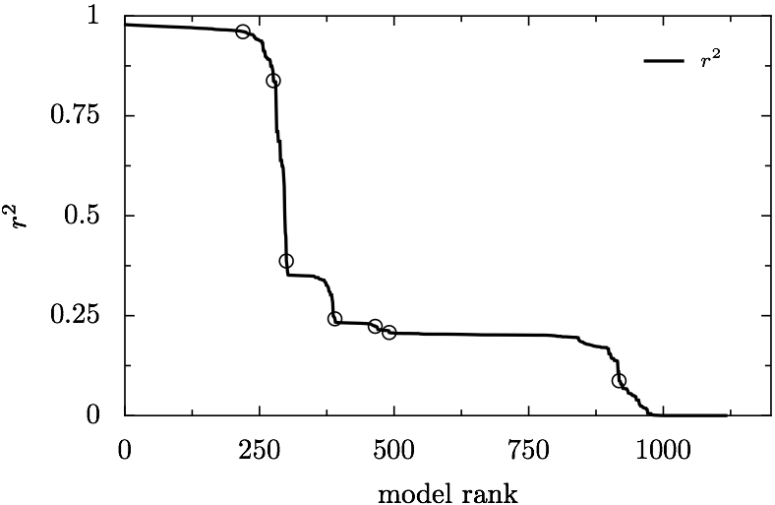
Good and Bad Models
Good
Bad
1996–1997 Ross Sea
Notes:
Plateau!!!
Underdetermination!!!

Slide 25
Extracted Constraints
A model that includes a second-order exponential mortality process for phytoplankton will be inaccurate. (positive:560, negative: 0)
A model that includes the Lotka–Volterra grazing process will be inaccurate. (positive: 80, negative: 0)
A model that lacks both the first and second order Monod growth limitation process between iron and phytoplankton will be inaccurate. (positive: 448, negative: 0)

Slide 26
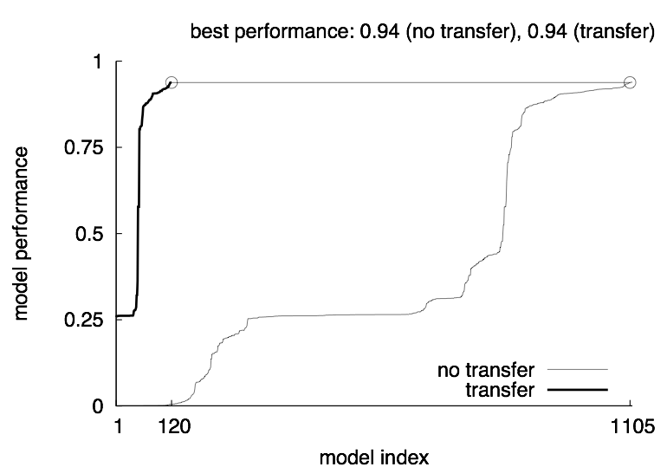
Apply Constraints to
Other Problems
Ross Sea Across Years
Search Spaces: 9x–16x smaller
Model Distribution: more accurate

Slide 27
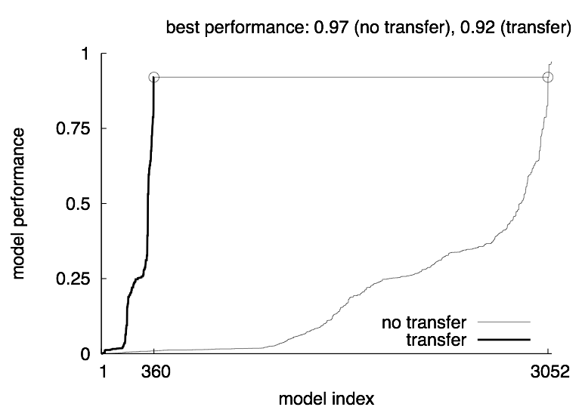
Apply Constraints to
Other Domains
Ross Sea to Bled Lake
Bridewell & Todorovski AAAI-08 (Transfer Learning Workshop)

Slide 28
Related Work
Other quantitative modelers
    Lagramge (Todorovski & Dzeroski)
    PRET (Bradley & Stolle)
Metalearning and others
    Learning Constraint Networks via Version Spaces (Bessiere et al.)
    Relational Clichés (Silverstein & Pazzani; Morin & Matwin)
    Mode Declarations in ILP (McCreath & Sharma)
    Rule Reliability from Prior Performance (Mark Reid)

Slide 29
Future Directions
We are currently working in several directions which include:
continuing the analysis of constraint transfer;
closing the automated modeling + constraint learning loop;
basing new analyses and methodologies on model ensembles;
adapting the general strategies to other tasks;
supporting other modeling paradigms.
Inductive process modeling is a fruitful paradigm for exploring knowledge representation, modeling, discovery, and creativity in scientific practice.

Slide 30
Modular Constraints
Name: <Unique Identifier>
Type: {always-together,
exactly-one,
at-most-one,
necessary}
Processes:
<list of generic processes>

Slide 31
Descriptive Rules
Run 1: Generate a theory for accurate models.
accurate_model(A) :-does_not_include_process(A,death_exp2),
  includes_process_entity(A,monod_lim,iron).
Run 2: Generate a theory for inaccurate models.
inaccurate_model(A) :-
  does_not_include_process_entity(A,monod_2nd,iron), does_not_include_process_entity(A,monod_lim,iron).
inaccurate_model(A) :-
  includes_process(A,death_exp2),
  includes_process_entity(A,deangelis_beddington,phytoplankton).
We chose Aleph by Ashwin Srinivasan due to its ready availability and capabilities.

Slide 32
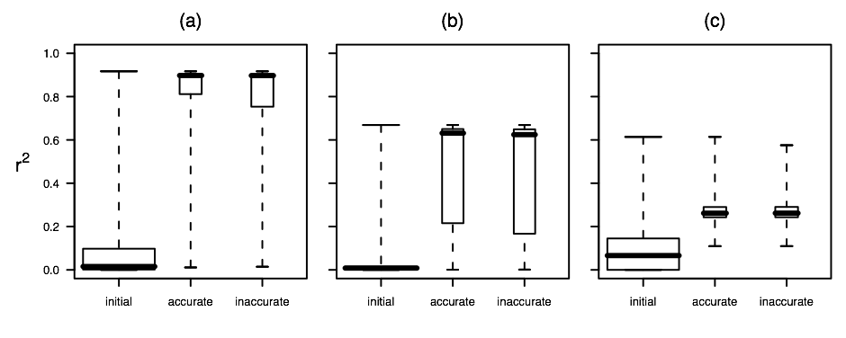
Cross Problem Transfer
Distribution of Models in the Search Space
Training
Test 1
Test 2
Two Protist Ecosystem
The search spaces are 9x–16x smaller

Slide 33
Ross-96 to Ross-97

Slide 34
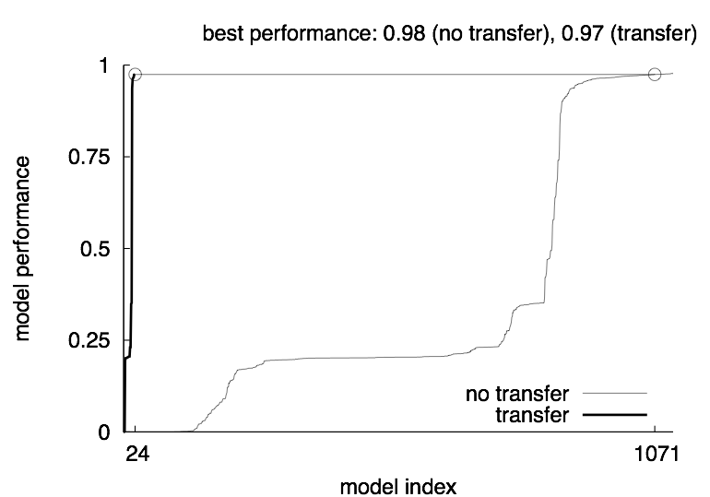
Bled-02 to Ross-96

Slide 35
Convert Descriptions into Structural Constraints
Rules for accurate models become sufficient conditions for retaining model structures
The negation of rules for inaccurate models become necessary conditions for retaining the model structures.

