Slide 1
Microsoft Computational Finance Server as a platform for computational biology
A pilot application
Robert Bukowski and Jarek Pillardy
Computational Biology Service Unit
Cornell University

Slide 2
Computational Biology Service Unit (CBSU) provides computational support to biologists at Cornell University
Maintains several Windows –based compute clusters, making them available to Cornell community and users world-wide
Convenience of access to HPC is a major issue

Slide 3
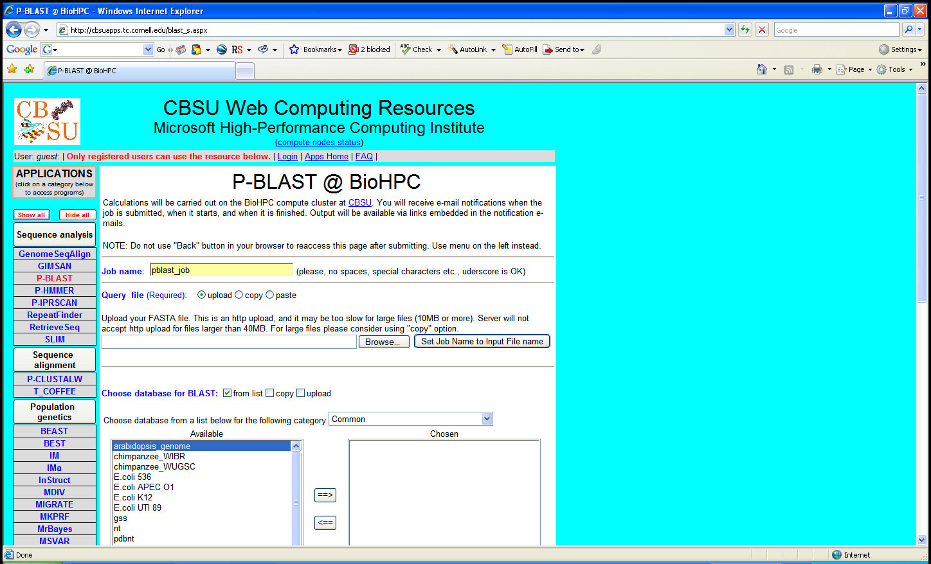
BioHPC.org – a popular web-based (ASP.NET) interface to HPC clusters created by CBSU – see our poster

Slide 4
Web service-based interface?
Would allow to incorporate HPC applications in analysis pipelines
Would allow convenient user interfaces other than web forms, such as Excel

Slide 5
Microsoft Computational Finance Server (CompFin)
Recently developed by Microsoft HPC++ Labs for computational finance applications (http://hpc.microsofthpc.net/)
Deployment and execution platform for HPC
Web service - based
Features Excel 2007 user interface
As a “proof of principle” and feasibility test, we decided to adapt a few computational biology applications to CompFin
Our pilot application: STRUCTURE Genetics [J. K. Pritchard et al., Genetics 155, 945 (2000); D. Falush et al., Genetics 164, 1567 (2003)]– one of the most popular population genetics programs run on CBSU clusters (via our web interface BioHPC.org)

Slide 6
Outline
What is STRUCTURE ?
What is CompFin ?
STRUCTURE @ CompFin
Conclusions

Slide 7
What is STRUCTURE ?
Objective: split a group of individuals into populations (or clusters) based on known genetic characteristics of individuals
Method: Model-based clustering
Input:
X – genomic data (alleles at a several loci for a set of individuals)
K – the guessed number of populations
Model variables (multi-dimensional vectors):
Z – assignment of individuals to populations
P – allele frequencies within populations
Probability of observing X: Pr(X | P,Z)
Which (P,Z) “fit the data” best?
Look at posterior probability distribution
Pr(Z,P | X) ~ Pr(X | Z,P) Pr(Z) Pr(P)

Slide 8
What is STRUCTURE ?
Pr(P,Z | X) estimated by Markov Chain Monte Carlo (MCMC) simulation
(Z,P)⁽¹⁾, (Z,P)⁽²⁾, ………, (Z,P)^{(N)}
Output : various quantities (summary statistics) derived from Pr(Z,P |X), e.g.:
Inferred ancestry of individuals (a list of probabilities of each individual belonging to each population; roughly – average Z)
Inferred allele frequencies within populations (roughly – average P)
STRUCTURE is a “legacy code”; input and output in text files

Slide 9
What is STRUCTURE ?
For a given dataset X, multiple independent simulations are usually needed
For different numbers of populations (K) – to infer the best one
With the same K – to make sure results are consistent
With different MCMC control parameters
Each of the multiple simulations is long (hours to days)
STRUCTURE analysis is an HPC task !
Would benefit from Excel user interface

Slide 10
What is CompFin ?
API - .NET programmer’s interface which abstracts from implementation details of job scheduler and storage
Web services to submit/monitor jobs and retrieve output data
Taskpane (Excel add-in) – client consuming the above web services
Share Point Server for storage of Excel templates and model binaries and for job management
MS SQL Server for data storage (other physical storage implementations are also possible)
Cluster running Windows Server 2008 with HPC Server 2008 (or Windows Server 2003 with CCS)
SQL Database of historical market data (accessible using Financial APIs)

Slide 11
What does it take to deploy a CompFin application ?
Excel 2007
Taskpane
Prepare Excel 2007 template workbook with XML-mapped input/output tables
Template workbook
Table(s) with input data
Table(s) with output data
XML Maps
XML Maps
Prepare a C# wrapper code (a “model”) which uses CompFin’s API to
handle XML input/output by converting to/from Data Contracts
Partition job into multiple-tasks; seamlessly interact with job scheduler
Input (XML)
C# wrapper
[DataContract]s
Launch tasks
Create input txt files
Launch structure.exe
Parse output txt files
Create input txt files
Launch structure.exe
Parse output txt files
Web service
[ResultsDataContract]
[ResultsDataContract]
Output (XML)
Output (XML)
Upload the C# assembly (with all necessary binaries) and the Excel template workbook to the Share Point site
SQL

Slide 12
Running a CompFin application
SharePoint
Compute cluster
Excel template
Job scheduler
C# wrapper + binaries
1
3
User’s laptop
Job Repository
API
C#+binaries
2
3
IE
Input XML
Excel
Web services
3
3
Job launch monitoring
4
SQL
Results retrieval
4

Slide 13
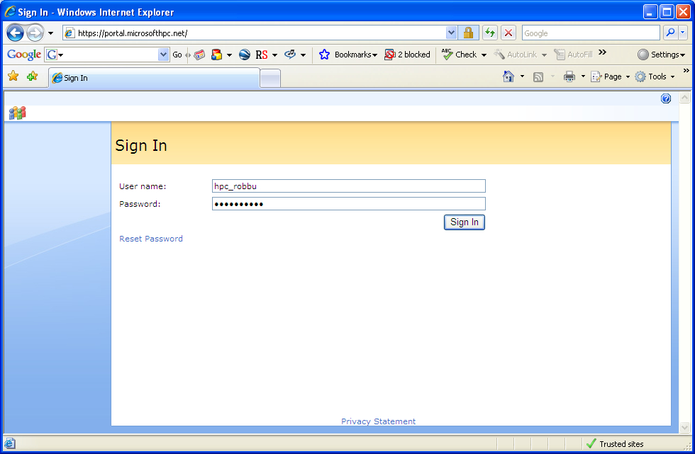
STRUCTURE at CompFin

Slide 14
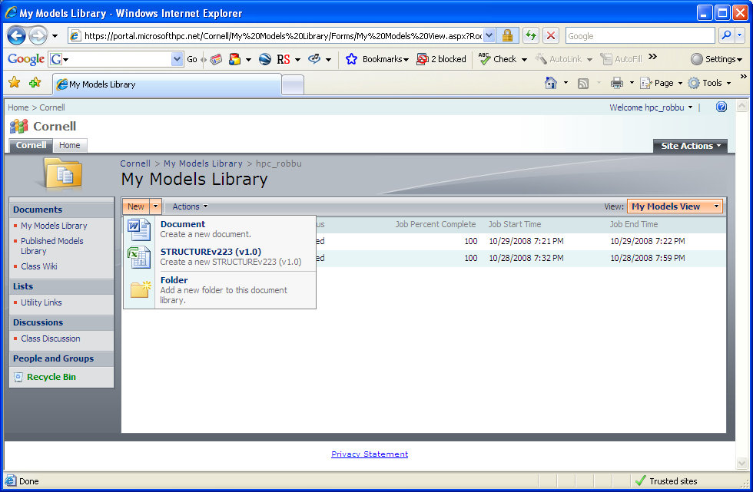

Slide 16
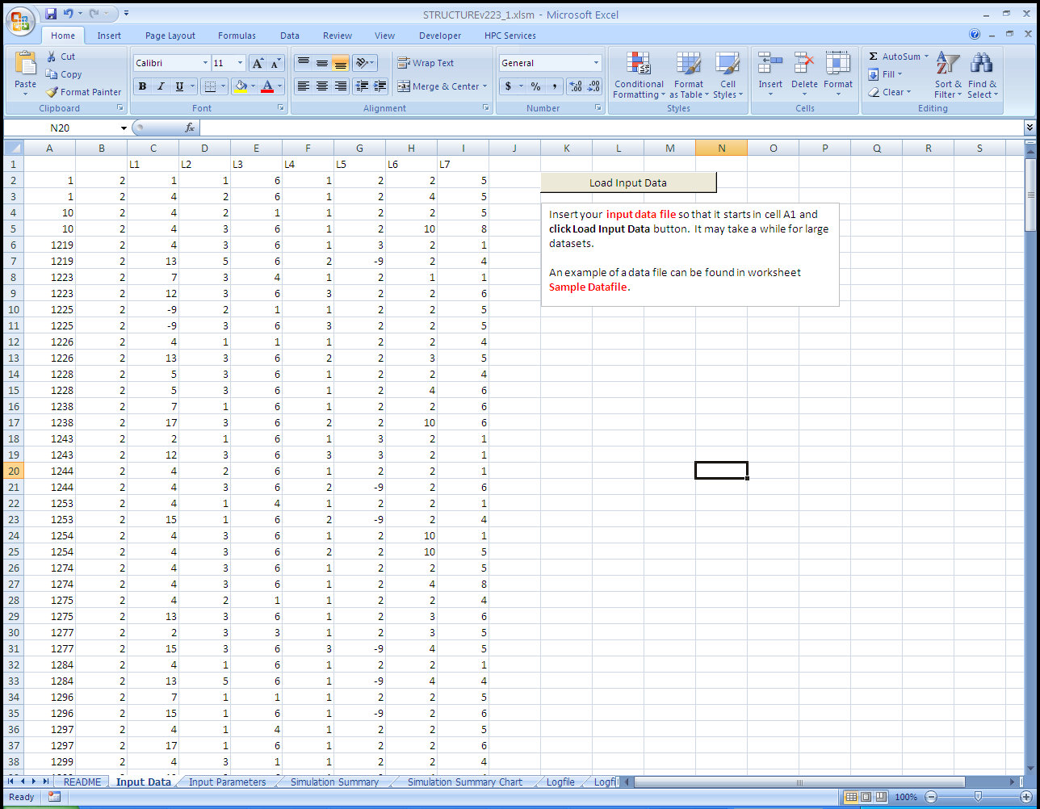

Slide 17
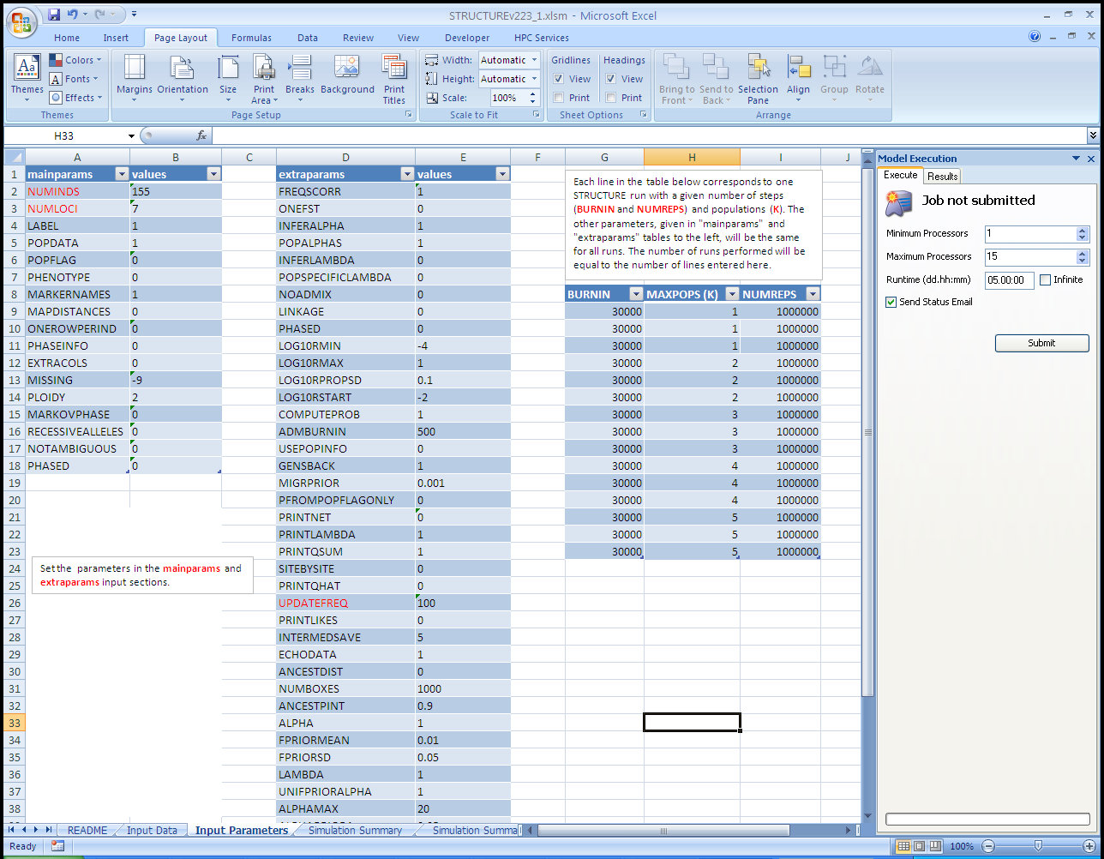

Slide 18
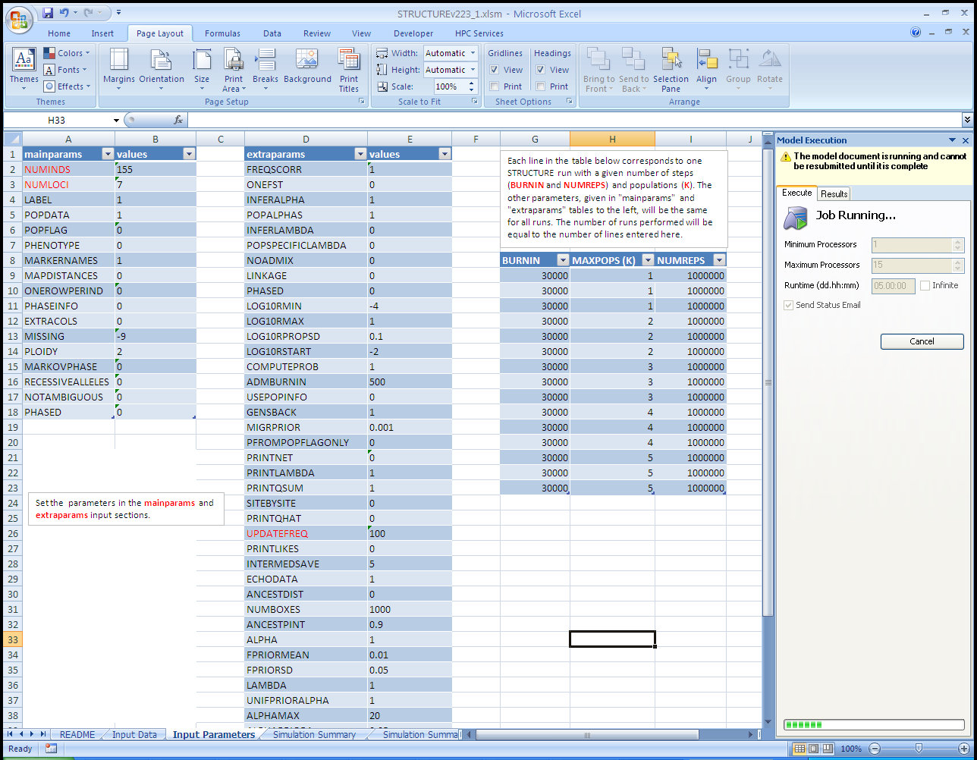

Slide 19
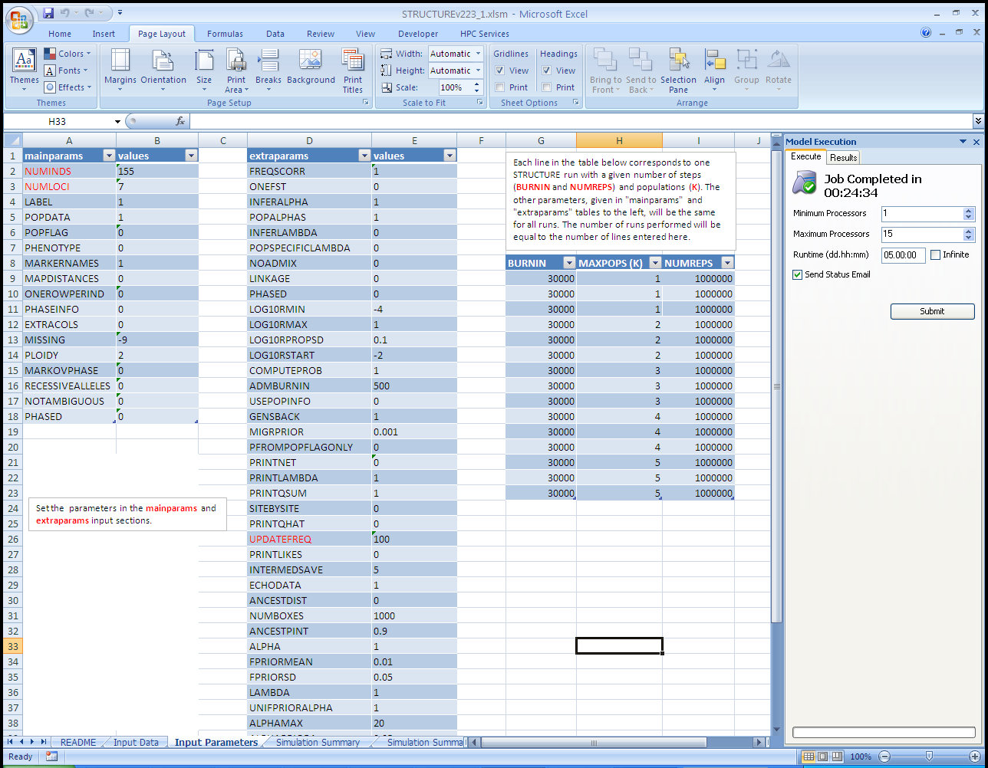

Slide 20
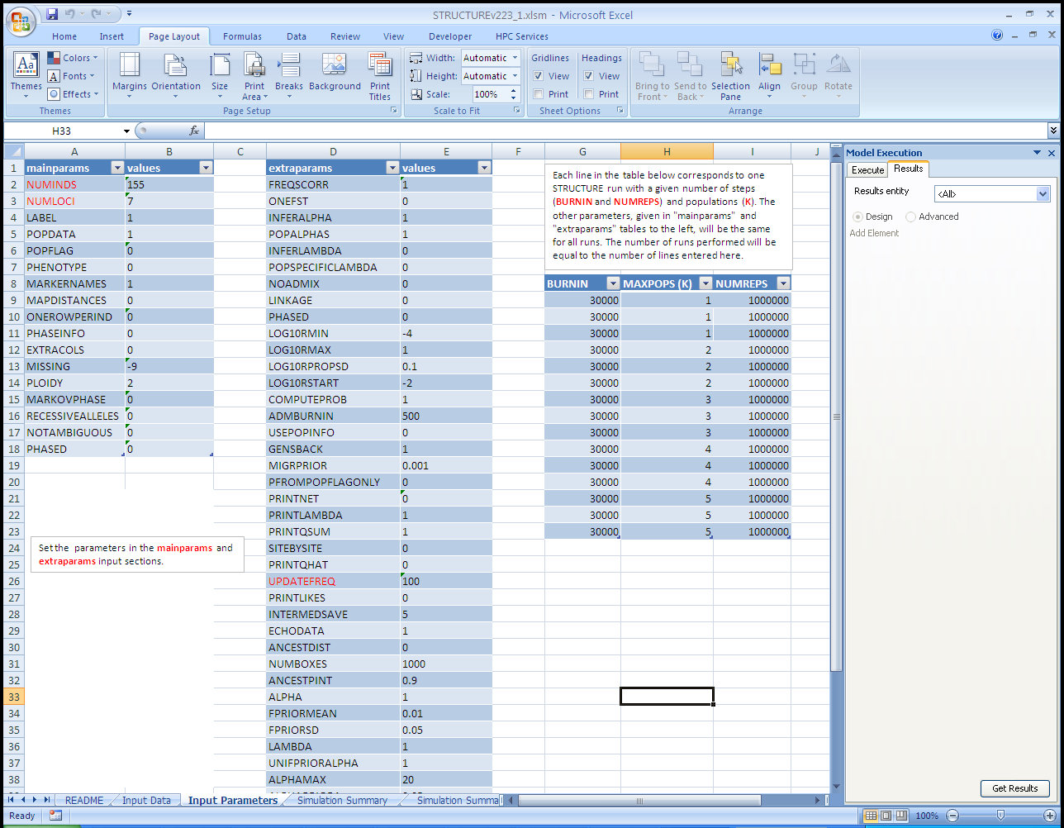

Slide 21
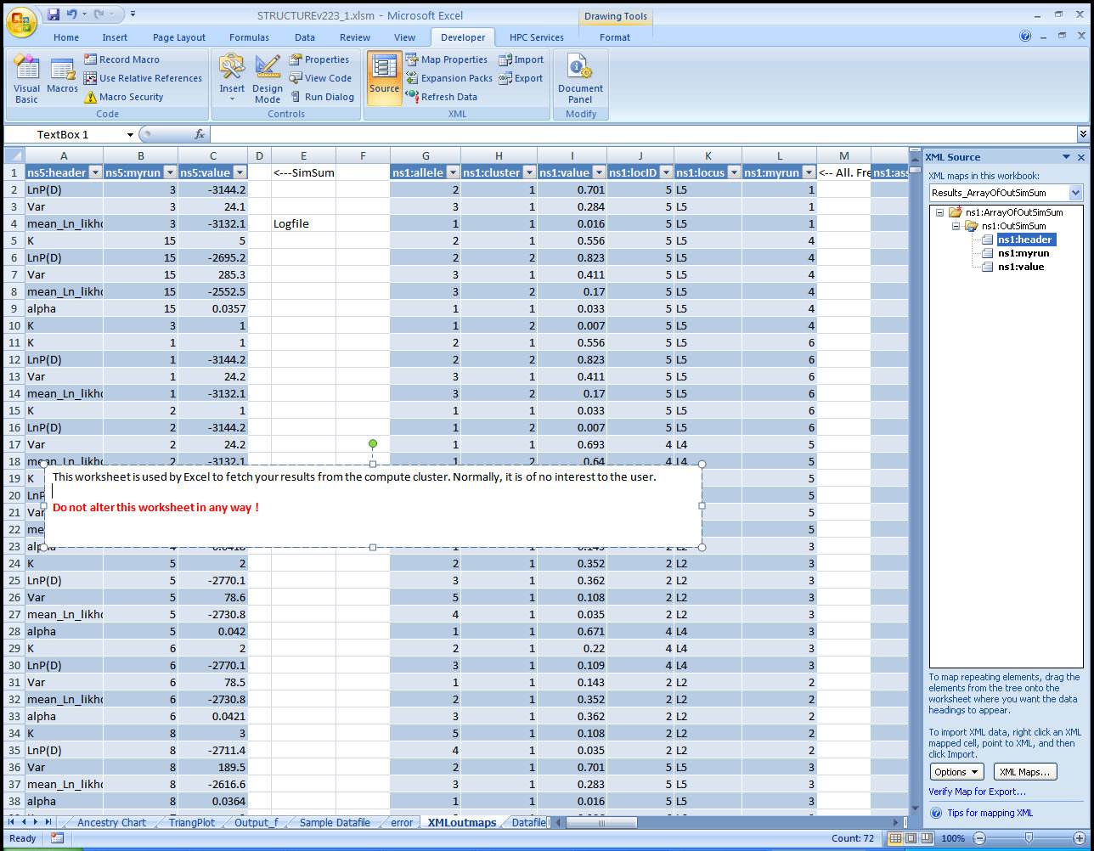

Slide 22
Output information from XML maps is visualized using
pivot tables
pivot charts
VB macros

Slide 23
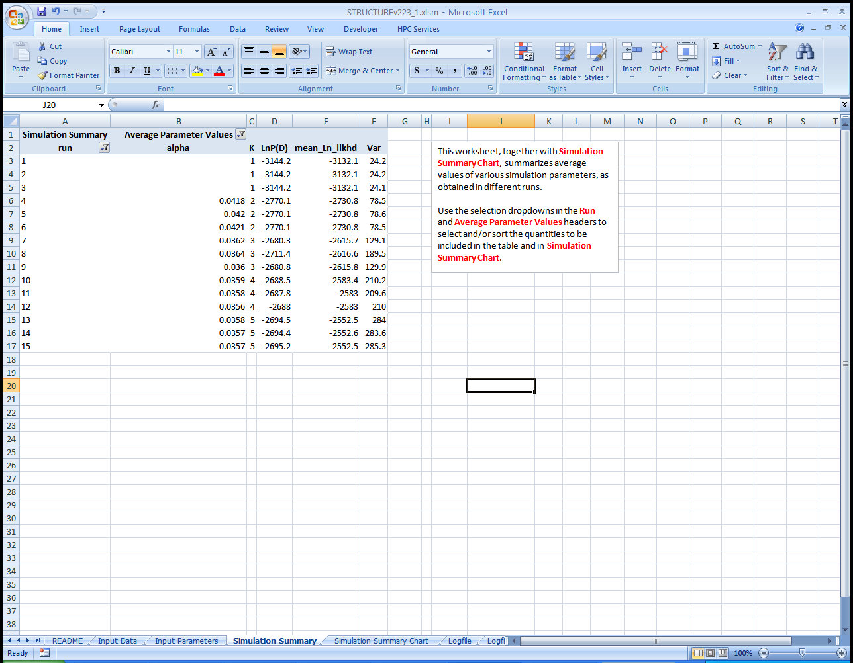

Slide 24
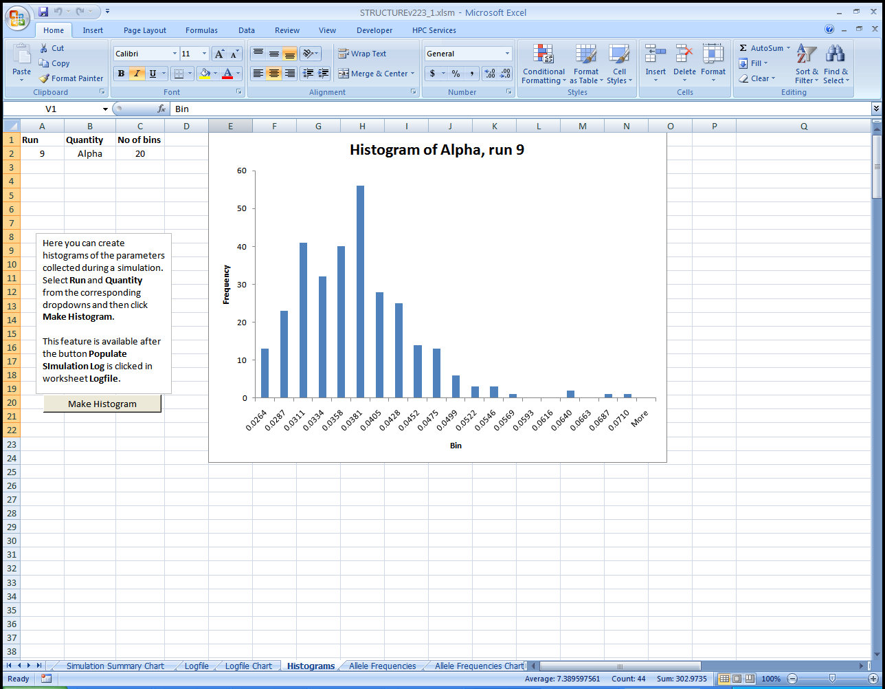

Slide 25
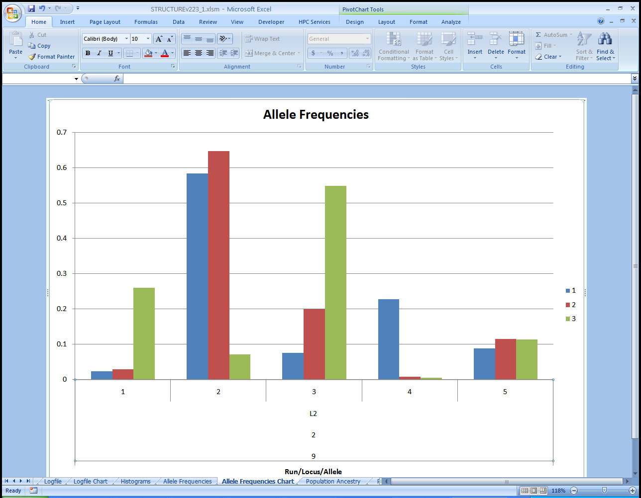

Slide 26
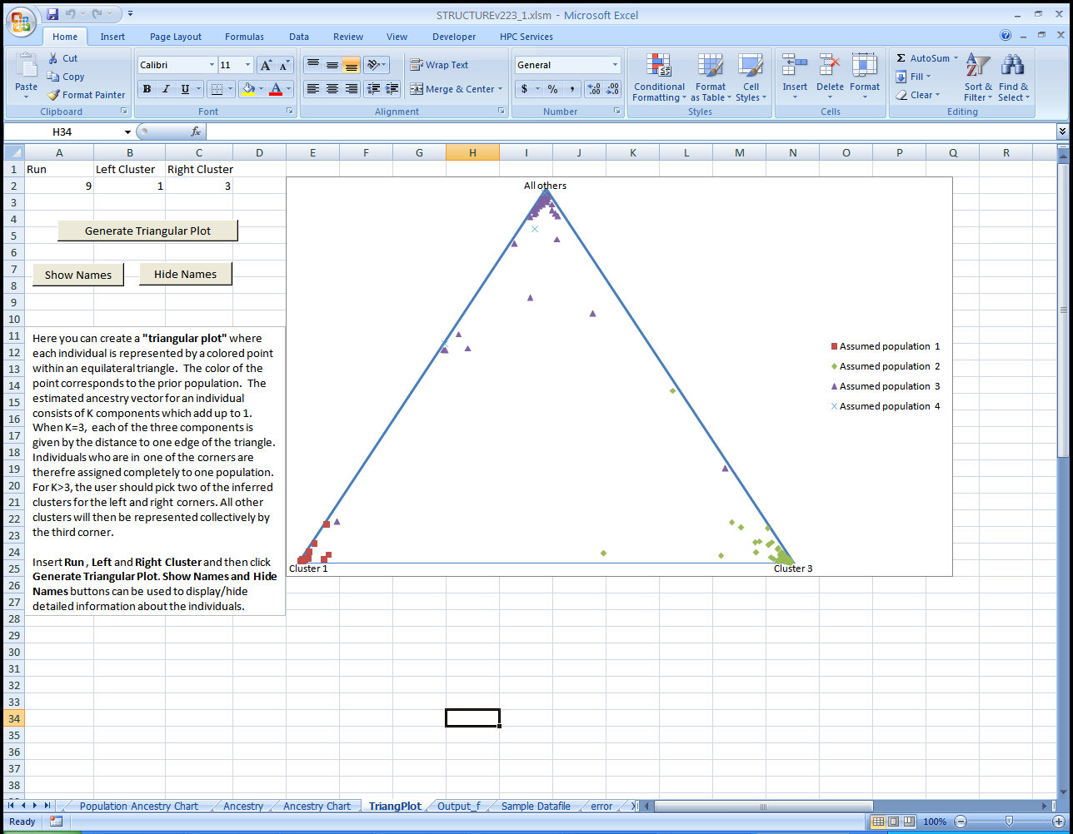

Slide 27
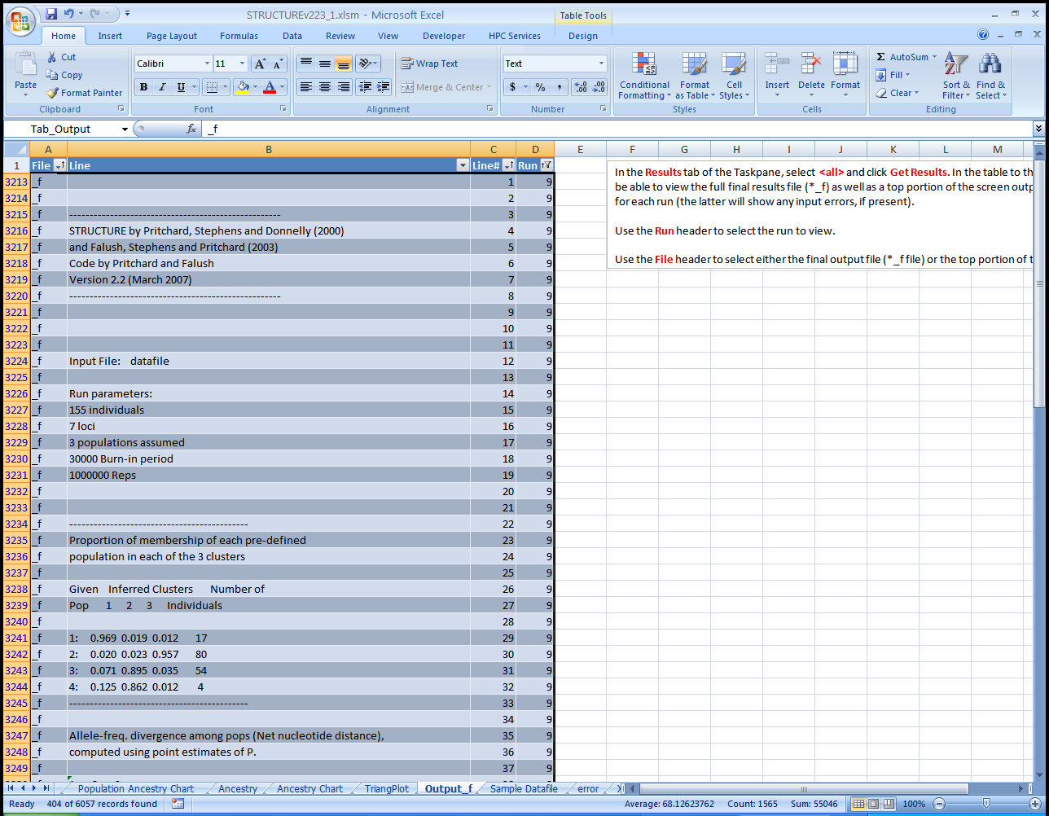

Slide 28
CompFin as a platform for computational biology
Pros:
Powerful Excel user interface
Easy deployment
On-site (on-cluster) data storage (not used here, but with great potential for data-intensive applications, such as Next Generation Sequencing data analysis)
CompFin developed with the idea of bringing computational power to the data (rather than data to computational power)
Directions of future development
Currently, input/output data transfer is through Excel only. Basic file transfer functionality is needed.
Raw biological data usually too big or not “pretty” enough to be put into Excel
Output transfer from on-cluster SQL storage to Excel XML maps not too efficient for large datasets (although greatly improved as a result of this project)
User needs domain account on cluster – good for small, closed organization, not so much for an open university research environment

Slide 29
We acknowledge support from
Microsoft HPC Institute program
Microsoft Research
…. and collaboration with MS HPC Team
Richard Ciapala
Daniel Simon

