Slide 1
Cyberinfrastructure Collaboration for Digital Preservation
Microsoft eScience Workshop
December 2008
Chris Jordan, David Minor, Robert H. Mcdonald, Ardys Kozbial

Slide 2

The Frame
NSF-funded national supercomputer centers
Centers have hosted significant projects:
  TeraGrid, NPACI, GEON, SCEC, Chronopolis
Fostered development of major tools:
  SRB/iRODS, Mosaic, Globus, Visualization and Portal tools
And have been a locus for multi-disciplinary research:
  LC/NDIIPP, NARA, DOE, DOD, NASA
San Diego Supercomputer Center
Texas Advanced Computing Center
National Center for Supercomputing Applications
Pittsburgh Supercomputer Center

Slide 3
Cyberinfrastructure is the collection of ...
Resources
Computers, data storage, networks,
scientific instruments, experts, etc.
+ Glue
Integrating software, systems,
organizations, etc.

Slide 4
“Cyberinfrastructure enables distributed knowledge communities that collaborate and communicate across disciplines, distances and cultures. These research and education communities extend beyond traditional brick-and-mortar facilities, becoming virtual organizations that transcend geographic and institutional boundaries.”
NSF Cyberinfrastructure Vision for 21st Century Discovery

Slide 5
Cyberinfrastructure for Preservation
Components:
  Technical and Policy Expertise
  Interfaces and Services
  Data Grid Technologies
  Distributed, Heterogeneous Storage
  High-Performance Networks

Slide 6

Grid-based Environments
  Replication and distribution of data
  Protect against rare but inevitable failures
  Supercomputer centers have long realized:
    Value of utilizing networks to distribute computation
    Importance of locally-available, distributed data
    Significant problems in implementing these services
      Non-pervasive high-speed networking
      Multiple administrative domains with unique policies
  TeraGrid, Open Science Grid, others have developed expertise with problems and solutions

Slide 7
Data Grid Technologies
  SRB / iRODS
  Complete suites of data grid functionality
  Suitable for data-intensive computing applications
  Well-made for digital library applications
    Virtual namespaces, data replication and verification
  Heavily utilized by national and international organizations, libraries and data centers
  iRods software was developed specifically to aid in servicing the complex policy and management needs of long-term digital repositories

Slide 8
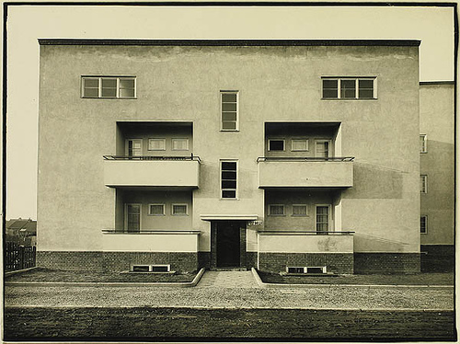
Long-Term Archival Storage
  Mostly focused on “bit preservation”
    But this includes: format information, program code for reading and writing data, translation or recompilation of executables into forms suitable for new generations of software, etc.
SDSC, NCSA, PSC operating since 1985
  2-4 complete system migrations
  Large number of tape and disk migrations
  Still have access to files created in the 1980’s

Slide 9
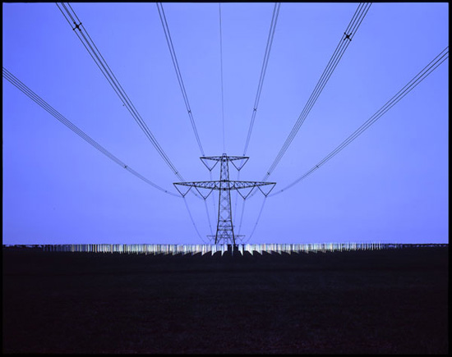
High-Performance Networks
  Goal is not simply to preserve digital data in an inaccessible archive
  Take advantage of the endlessly reproducible nature of digital data to enable wide dissemination of that data
  Supercomputer centers instrumental
  in development of National Lambda Rail
  and Internet2
  Continue to participate in maintaining
  Research and Education Networks

Slide 10
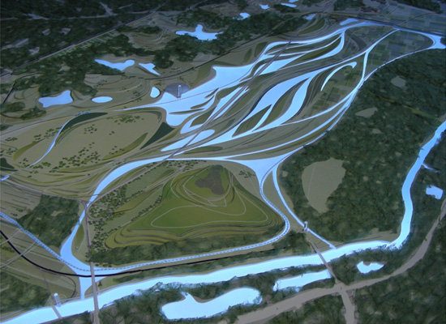
Hybrid, Multilayer Solutions
  Globus Toolkit contains a number of tools for managing data in grid environments:
  GridFTP mechanism for high-performance data transfer
  Reliable File Transfer service to manage movement of large numbers of files across multiple resources
  Cross-realm authentication and security services
  TeraGrid integrates authentication and other services with:
    GPFS, Lustre file systems over Wide Area Networks
    iRODS Preservation Environment

Slide 11
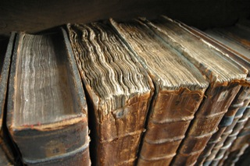
Libraries in the Digital Age
How can a library with a data center designed 30 years ago for completely different purposes meet the new challenges of:
  Rapidly increasing digital collections
  Much wider variety of data types
  New forms of data access
  Evolving campus research needs
All with budgetary and physical constraints

Slide 12
Characterizing Collaboration
Partnerships between Libraries and Supercomputer Centers
  Libraries use:
    Supercomputer centers’ storage infrastructure and tools
    Supercomputing centers’ technical expertise
  Supercomputer Centers use:
    Libraries’ expertise in curation and preservation, etc.
    Libraries’ foundational budget
Both organizations gain new options for funding and growth

Slide 13

Private-Sector Collaboration
Supercomputer Centers have a long history of R&D collaboration with the commercial sector
National CI efforts provide a testing environment otherwise impossible (or expensive!) to achieve
Preservation and access of science data beginning to reach a similar level of need & capability

Slide 14


TACC and Texas Digital Library
TDL includes 15 Texas schools
TACC manages national-scale cyberinfrastructure
TDL provides interface to Texas Higher Education
TACC provides storage and replication services
Each institution focuses on its core competency

Slide 15



Indiana University and HathiTrust
HathiTrust includes all 12 libraries of the Committee on Institutional Cooperation (CIC).
Includes involvement from both libraries and central information technology units. Is a collaboration of administrative, research, and academic computing.
Provides petascale level storage and preservation for the CIC Google Books Content.
Currently involves two nodes Ann Arbor and Indianapolis.
Using wide area file system and Isilon storage units.

Slide 16
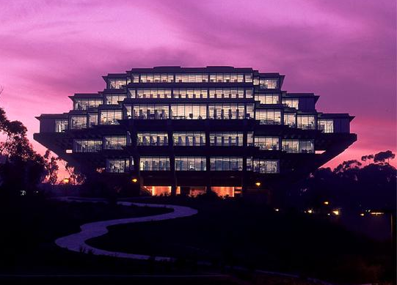
SDSC and UCSD Libraries
Campus federations and alliances
  SDSC / UCSD Libraries collaborations
    Melding of expertise and staff
      Some direct reports, some matrices
    Some services project-based, some provided via Service Level Agreements using recharge mechanisms
    Libraries can significantly reduce data center costs
      SDSC: Storage, networking, facilities, SRB support
      UCSD Libraries: Access and curation

Slide 17
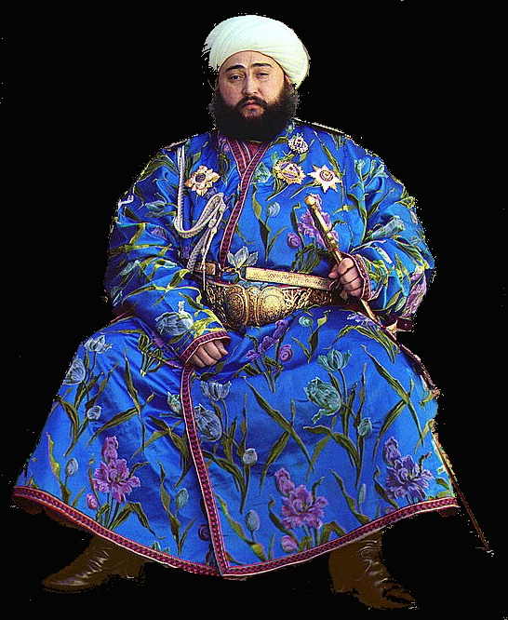
SDSC Pilot Project
Transferred and replicated two collections from Library of Congress at SDSC – 6+ TBs
  Webcrawl archives, Prints and Photographs collection
Configured high speed network
Used GridFTP tools to transfer data
Relied on SRB to provide replication and monitoring

Slide 18
Chronopolis Project
Fully functioning data nodes at SDSC, NCAR, UMD
50 TB data storage available at each location
Automatic collection replication
using UMD tools over SRB
Data from four partners – California Digital Library, Inter-University Consortium for Political and Social Research, Scripps Institution of Oceanography and North Carolina State University

Slide 19
We are all generalists now
The next generation of digital science will be orders of magnitude larger and more sophisticated
The next generation of national and international CI collaborations will be more diverse and serve broader communities
The next generation of libraries may not have bookshelves
“And I think to myself, what a wonderful world …”
- George Weiss/Bob Thiele

Slide 20
Any Questions?

Slide 21
References
SDSC – http://www.sdsc.edu
UCSD Libraries - http://libraries.ucsd.edu
Chronopolis – http://chronopolis.sdsc.edu
TACC - http://www.tacc.utexas.edu/
TDL - http://www.tdl.org/
Indiana University Libraries - http://libraries.iub.edu/
HathiTrust – http://www.hathitrust.org

