Slide 1
Consistency Options for Replicated Storage in the Cloud
Ken Birman, Cornell University

Slide 2
Brewer: CAP Conjecture
In a 2000 PODC keynote, Brewer speculated that Consistency is in tension with Availability and Partition Tolerance
  “P” is often taken as “Performance” today
  Assumption: can’t get scalability and speed without abandoning consistency
CAP rules in modern cloud computing

Slide 3

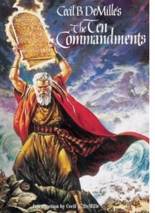
eBay’s Five Commandments
As described by Randy Shoup at LADIS 2008
Thou shalt…
  1. Partition Everything
  2. Use Asynchrony Everywhere
  3. Automate Everything
  4. Remember: Everything Fails
  5. Embrace Inconsistency

Slide 4

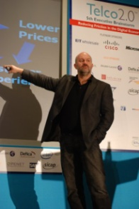
Vogels at the Helm
Werner Vogels is CTO at Amazon.com…
His first act? He banned reliable multicast*!
  Amazon was troubled by platform instability
  Vogels decreed: all communication via SOAP/TCP
This was slower… but
  Stability and Scale dominate Reliability
  (And Reliability is a consistency property!)
* Amazon was (and remains) a heavy pub-sub user

Slide 5


James Hamilton’s advice
Key to scalability is decoupling,
loosest possible synchronization
Any synchronized mechanism is a risk
  His approach: create a committee
  Anyone who wants to deploy a highly consistent mechanism needs committee approval
…. They don’t meet very often

Slide 6
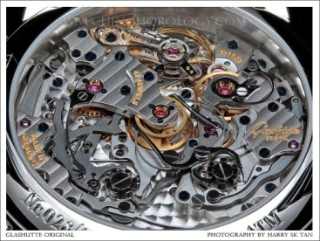


What’s so great about consistency?
A consistent distributed system will often have many components, but users observe behavior indistinguishable from that of a single-component reference system
Reference Model
Implementation

Slide 7
Where does it come from?
Transactions that update replicated data
Atomic broadcast or other forms of reliable multicast protocols
Distributed 2-phase locking mechanisms

Slide 8
A Consistency Property: Virtual Synchrony
A=3
B=7
B = B-A
A=A+1
Non-replicated reference execution
Synchronous execution
Virtually synchronous execution
Synchronous runs: indistinguishable from non-replicated object that saw the same updates (like Paxos)
Virtually synchronous runs are indistinguishable from synchronous runs

Slide 9
Why fear consistency?
They see consistency as a “root
cause” for meltdowns, thrashing
What ties consistency to such issues?
  They claim: Systems that put guarantees first don’t scale
  For example, any reliability property forces a system to retransmit lost messages, use acks, etc
Most networks drop messages if overloaded…
  So struggling to guarantee consistency will increase load
  just when we prefer to shed load

Slide 10

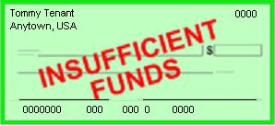
Dangers of Inconsistency
My rent check bounced?
That can’t be right!
Inconsistency causes bugs
  Clients would never be able to
  trust servers… a free-for-all
Weak or “best effort” consistency?
  Strong security guarantees demand consistency
  Would you trust a medical electronic-health records system or a bank that used “weak consistency” for better scalability?
Jason Fane Properties 1150.00
Sept 2009 Tommy Tenant

Slide 11
Challenges
To reintroduce consistency we need
  A scalable model
    Should this be the Paxos model? The old Isis one?
  A high-performance implementation
    Can handle massive replication for individual objects
    Massive numbers of objects
    Won’t melt down under stress
    Not prone to oscillatory instabilities or resource exhaustion problems

Slide 12
ReIntroducing Isis²
ReIntroducing Isis²
I’m reincarnating group communication!
  Basic idea: Imagine the distributed system as a world of “live objects” somewhat like files
  They float in the network and hold data when idle
  Programs “import” them as needed at runtime
    The data is replicated but every local copy is accurate
    Updates, locking via distributed multicast; reads are purely local; failure detection is automatic & trustworthy

Slide 13
How will Isis² look?
A library… highly asynchronous…
  Group g = new Group(“/amazon/something”);
  g.register(UPDATE, myUpdtHandler);
  g.Send(UPDATE, “John Smith”, new_salary);
  public void myUpdtHandler(string empName, double salary)
  { …. }

Slide 14
Example: Parallel search
Just ask all the members to do “their share” of work:
  Replies = g.query(ALL, LOOKUP, “Name=*Smith”);
  Replies.doCallback(myReplyHndlr);
  public void lookup(string who) {
  double myAnswer =
  mySearch(who, myRank, nMembers);
  reply(myAnswer);
  }
  public void myReplyHndlr(double[] whatTheyFound) { … }

Slide 15
Example: Parallel search
Group g = new Group(“/amazon/something”);
g.register(LOOKUP, myLookup);
  Replies = g.Query(ALL, LOOKUP, “Name=*Smith”);
public void myLookup(string who) {
double myAnswer =
mySearch(who, myRank, nMembers);
reply(myAnswer);
}
  Replies.doCallback(myReplyHndlr);
  public void myReplyHndlr(double[] fnd) {
  foreach(double d in fnd)
  avg += d;
  …
  }

Slide 16
Key points
The group is just an object.
User doesn’t experience sockets… multicast…. marshalling… preprocessors… protocols…
  As much as possible, they just provide arguments as if this was a kind of RPC, but no preprocessor
  Sometimes they provide a list of types and Isis does a callback
Groups have replicas… handlers… a “current view” in which each member has a “rank”

Slide 17
Virtual synchrony vs Paxos
Can’t we just use Paxos?
  In recent work (collaboration with MSR SV) we’ve merged the models. Our model “subsumes” both…
This new model is more flexible:
  Paxos is really used only for locking.
  Isis can be used for locking, but can also replicate data at very high speeds, with dynamic membership, and support other functionality.
  Isis² will be much faster than Paxos for most group replication purposes (1000x or more)
[Building a Dynamic Reliable Service. Ken Birman, Dahlia Malkhi and Robbert van Renesse. Available as a 2009 technical report, in submission to PODC10 and ACM Computing Surveys...]

Slide 18
Isis² includes additional “tools”
End user codes in C# or any of the other ~40 .NET languages, or uses Isis² as a library via remoting on Linux platforms from C++, Java, etc
Really fast pub/sub
Really fast replication
BFT,
DB xtns
DHTs, Overlays
Virtual Synchrony Multicast
(sender or total order, group views, …)
Safe (Paxos) Multicast
Gossip Objects
Basic Isis² Process Groups

Slide 19
Security?
Isis² has a built in security architecture
  Can authenticate join requests
  And can encrypt every multicast using dynamically created keys that are secrets guarded by group members and inaccessible even to Isis² itself
The system also uses AES to compress messages if they get large

Slide 20
Core of my challenge
To build Isis² I need to find ways to achieve consistency and yet also achieve
  Superior performance and scalability
  Tremendous ease of use
  Stability even under “attack”

Slide 21
Core of my challenge
It comes down to better “resource management” because ultimately, this is what limits scalability
The most important example: IPMC is an obvious choice for updating replicas
But IPMC was the root cause of the oscillation shown earlier (see “fear of consistency”)

Slide 22
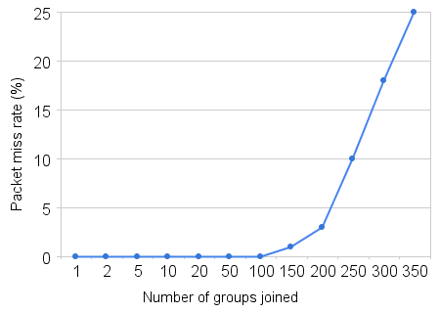
Managed IPMC abstraction
Traditional IPMC systems can
overload the router, melt down
Issue is that routers have a small
“space” for active IPMC addresses
In [Vigfusson, et al ‘09] we show how to use optimization to manage the IPMC space
In effect, merges similar groups while respecting limits on the routers and switches
Melts down at ~100 groups

Slide 23
Managed IPMC Abstraction
End user codes in C# or any of the other ~40 .NET languages, or uses Isis² as a library via remoting on Linux platforms from C++, Java, etc
Really fast pub/sub
Really fast replication
BFT,
DB xtns
DHTs, Overlays
Virtual Synchrony Multicast
(sender or total order, group views, …)
Safe (Paxos) Multicast
Gossip Objects
Basic Isis² Process Groups
Managed IPMC abstraction
(controls the actual IPMC addresses used, does flow control,
can map IPMC to UDP if it wishes to do so)

Slide 24
Channel Aggregation
Algorithm by Vigfusson, Tock [HotNets 09, LADIS 2008, Submission to Eurosys 10]
Uses a k-means clustering algorithm
  Generalized problem is NP complete
  But heuristic works well in practice

Slide 25

Optimization Questions
Dr. Multicast
    Assign IPMC and unicast addresses s.t.
      % receiver filtering (hard)
      Min. network traffic
      # IPMC addresses (hard)
(1)
Prefers sender load over receiver load
Intuitive control knobs as part of the policy

Slide 26









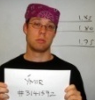


MCMD Heuristic
Dr. Multicast
Topics in `user-interest’ space
FGIF Beer Group
Free Food
(1,1,1,1,1,0,1,0,1,0,1,1)
(0,1,1,1,1,1,1,0,0,1,1,1)

Slide 27
MCMD Heuristic
Dr. Multicast
Topics in `user-interest’ space
224.1.2.4
224.1.2.3
224.1.2.5

Slide 28
MCMD Heuristic
Dr. Multicast
Topics in `user-interest’ space
Sending cost:
MAX
Filtering cost:

Slide 29
MCMD Heuristic
Dr. Multicast
Unicast
Topics in `user-interest’ space
Sending cost:
MAX
Filtering cost:

Slide 30
MCMD Heuristic
Dr. Multicast
Unicast
Unicast
Topics in `user-interest’ space
224.1.2.4
224.1.2.3
224.1.2.5

Slide 31
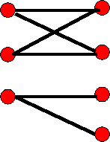
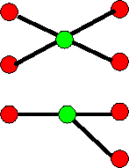
Using the Solution
Dr. Multicast
multicast
Heuristic
Procs L-IPMC
Procs L-IPMC
  Processes use “logical” IPMC addresses
  Dr. Multicast transparently maps these to true IPMC addresses or 1:1 UDP sends

Slide 32
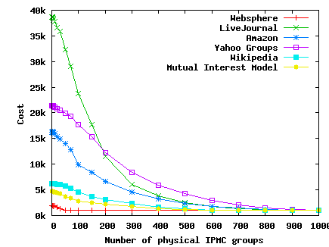
Effectiveness?
We looked at various group scenarios
Most of the traffic is
carried by <20% of groups
For IBM Websphere,
Dr. Multicast achieves
18x reduction in
physical IPMC addresses
[Dr. Multicast: Rx for Data Center Communication Scalability. Ymir Vigfusson, Hussam Abu-Libdeh, Mahesh Balakrishnan, Ken Birman, and Yoav Tock. LADIS 2008. November 2008. Full paper submitted to Eurosys 10.]

Slide 33
Hierachical acknowledgements
For small groups, reliable multicast
protocols directly ack/nack the sender
For large ones, use QSM technique:
tokens circulate within a tree of rings
  Acks travel around the rings and aggregate over
  members they visit (efficient token encodes data)
  This scales well even with many groups
  Isis² uses this mode for |groups| > 25 members, with each ring containing ~25 nodes
[Quicksilver Scalable Multicast (QSM). Krzys Ostrowski, Ken Birman, and Danny Dolev. Network Computing and Applications (NCA’08), July 08. Boston.]

Slide 34

Flow Control
We also need flow control to prevent bursts of multicast from overrunning receivers
AJIL protocol imposes limits on IPMC rate
  AJIL monitors aggregated multicast rate
  Uses optimization to apportion bandwidth
  If limit exceeded, user perceives a “slower” multicast channel
[Ajil: Distributed Rate-limiting for Multicast Networks. Hussam Abu-Libdeh, Ymir Vigfusson, Ken Birman, and Mahesh Balakrishnan (Microsoft Research, Silicon Valley). Cornell University TR. Dec 08.]

Slide 35
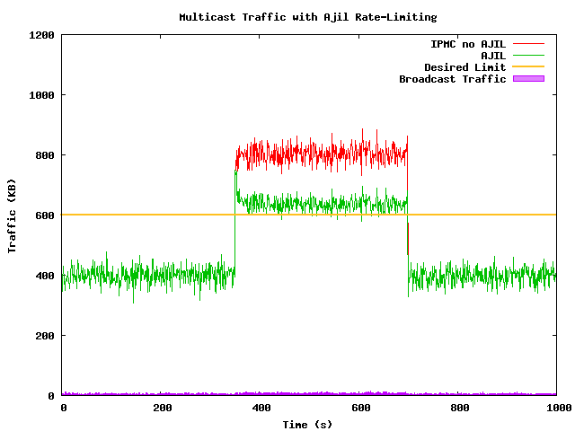
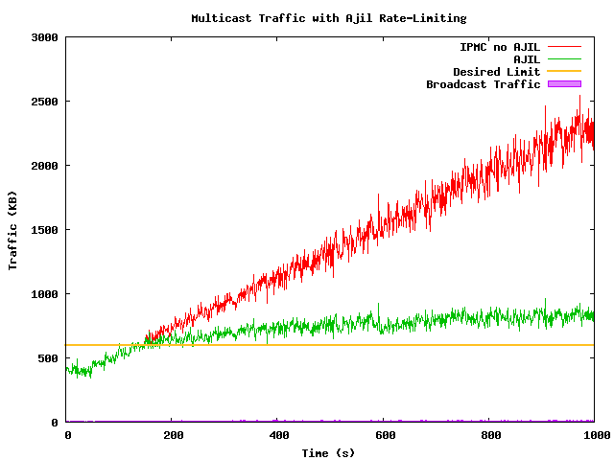
AJIL in action…
AJIL reacts rapidly to load surges, stays close to targets (and we’re improving it steadily)
Makes it possible to eliminate almost all IPMC message loss within the datacenter!

Slide 36
Summary of ideas
Dramatically more scalable yet always consistent, fault-tolerant, trustworthy group communication and data replication
Extremely high speed: updates map to IPMC
To make this work
  Manage IPMC address space, do flow control
  Aggregate acknowledgements
  Leverage gossip mechanisms

Slide 37

Multicast at the speed of light
We’re starting to believe that all IPMC loss may be avoidable (in data centers)
Imagine fixing IPMC so that the protocol was simply reliable. Never drops messages.
  Well, very rarely. Now and then, like once a month, some node drops an IPMC but this is so rare that it triggers a reboot!
I could toss out more than ten pages of
code related to multicast packet loss!

Slide 38
Conclusions
Isis² is under development… code is mostly written and I’m debugging it now
Goal is to run this system on 500 to 500,000 node systems, with millions of object groups
Success won’t be easy, but would give us a faster replication option that also has strong consistency and security guarantees!

