Slide 1
Data + Cloud

Slide 2
Movement

Slide 3
Internet == Slow

Slide 4
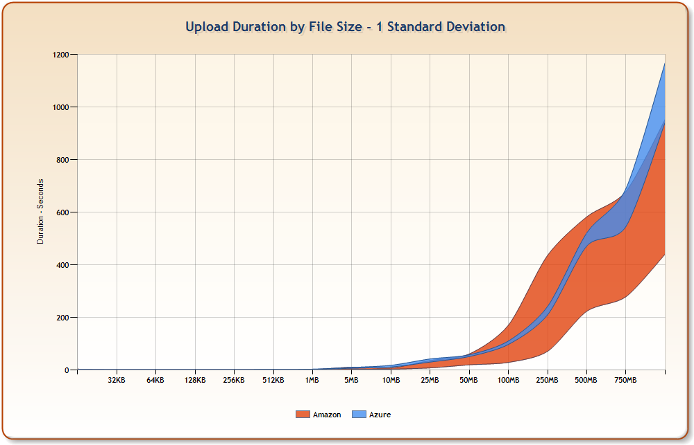
Network-Induced Variance

Slide 5
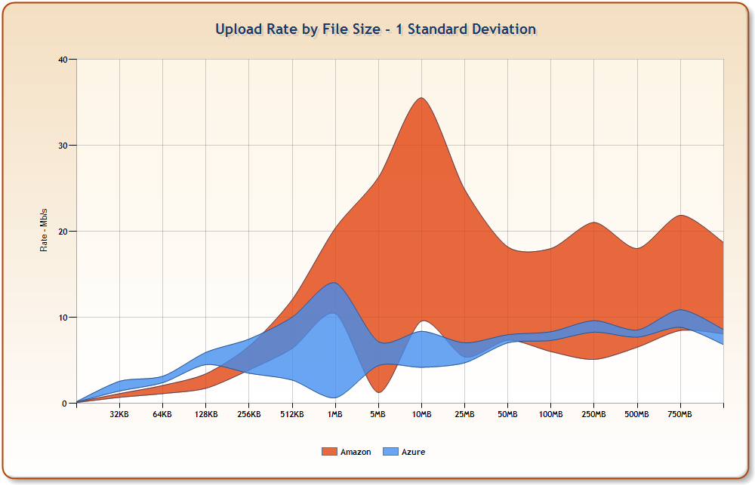
Network-Induced Variance

Slide 6
Multi-Threaded

Slide 7
% Improvement Due to Multi-Threaded Transfers

Slide 8
Services

Slide 9
Science Friendly !=
Internet Friendly?

Slide 10
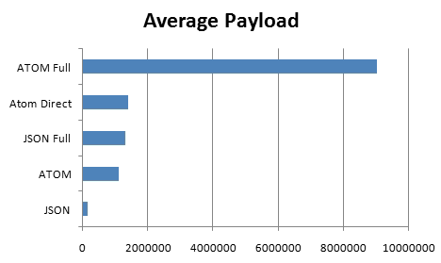
Average Payload (JSON v ATOM)

Slide 11
Future Work

Slide 12
We Can Do Better

