Slide 1
Shared Genomics :
Engaging clinical scientists with eScience infrastructure
David Hoyle, Mark Delderfield, Lee Kitching, Gareth Smith, Iain Buchan
North West Institute for BioHealth Informatics, University of Manchester

Slide 2
Outline
Genome-wide SNP data sets
Building an HPC platform accessible to clinical scientists
Aiding the interpretation of results

Slide 3
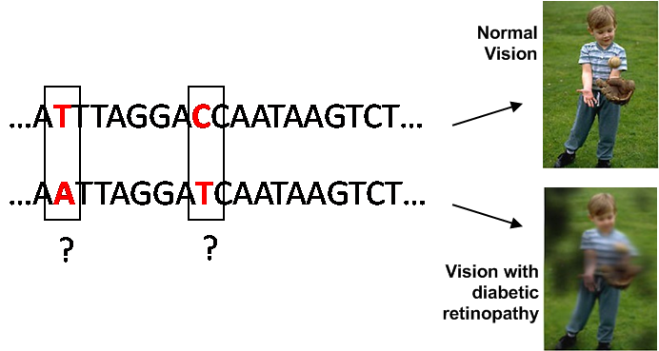
The scientific challenge
500,000 locii studied
Interactions ⇒ 10¹¹ SNP pairs
Gene-environment interactions

Slide 4
Scale of the task
for( i = 1 to #Random Data sets)
{
for( j = 1 to #SNPs)
{
for( k = 1 to #patients)
{
low complexity calc.
}
}
}
➲ Patients ⇒
S
N
P
s
Need to understand statistical results
Add relevant biological information

Slide 5
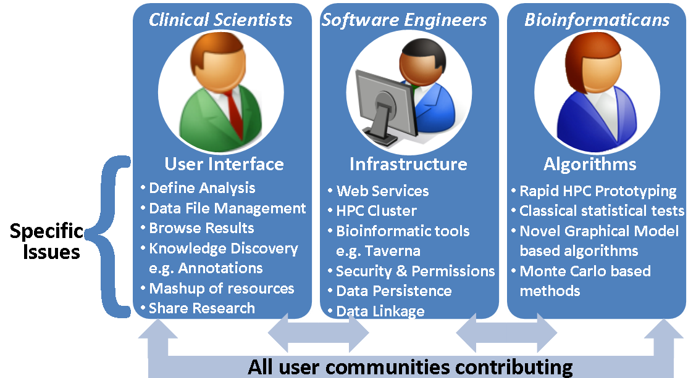
Contributing communities

Slide 6
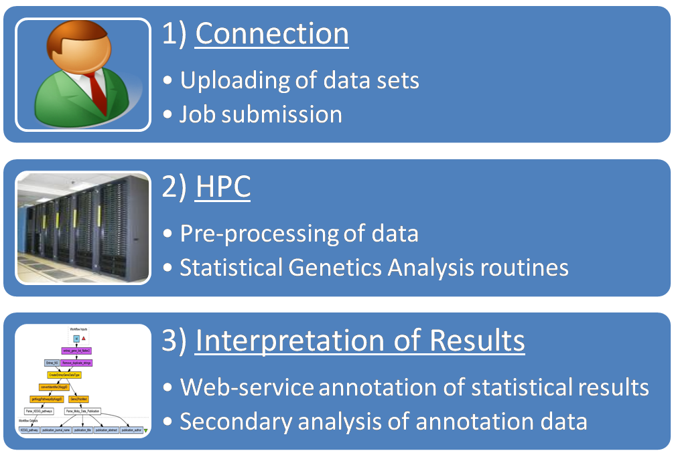
Tasks

Slide 7
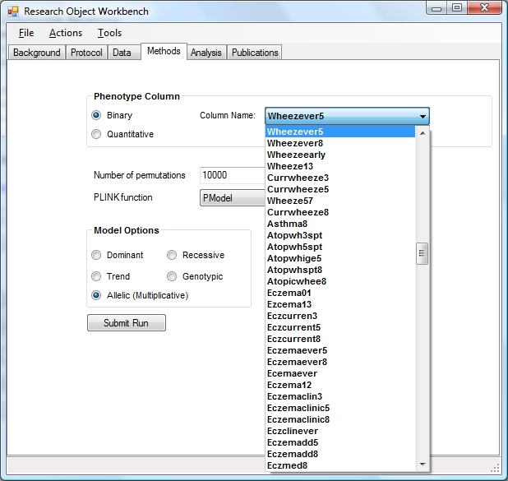
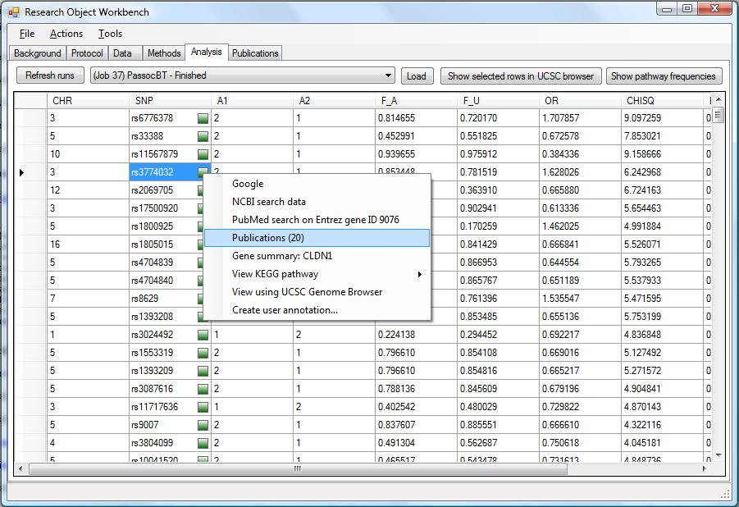
HPC for clinicians
Easy to drive
HPC infrastructure & bioinformatic tools need to be hidden
Similar in look-and-feel to apps our user are familiar with.

Slide 8
HPC Task
Start from established codebase
PLINK (http://pngu.mgh.harvard.edu/~purcell/plink/)
“Clean-up” into ANSI C
Parallelize - adding MPI calls
Deploy on cluster running Windows HPC Server 2008

Slide 9
Embarrassingly parallel
Adding cores yields benefits
Enables calculations on shorter timescales
Enables new calculations
Enables exploration of data

Slide 10
Automate annotation of results
Need to put statistical results in context
Annotate using web-services
avoids time consuming curation
allows re-use of services already collected into workflows
Annotation
Textual, e.g. publications, functional descriptions
Secondary computations, e.g. effects on protein structure.

Slide 11
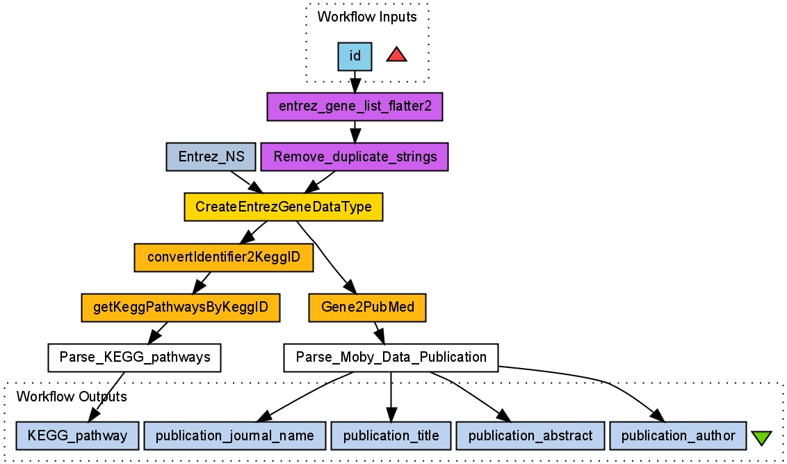
Example

Slide 12
Annotation as data
Mine annotation data for patterns
Standard practice in bioinformatics
e.g. Look for enrichment of GO terms, KEGG pathways, other functional descriptions
Do this automatically

Slide 13
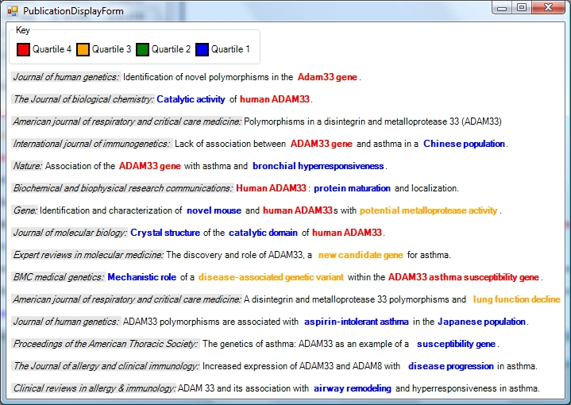
Termine

Slide 14
Thinking, Playing, Sharing,….
Thinking space as opposed to data space
Rapid exploration of ideas
Communicating ideas to others

Slide 15
Enhancing with RIAs

Slide 16
Future plans
Extend the analysis functionality
Re-use other codebases, e.g. Rgenetics
Extend annotations
Identify additional workflows from repositories
Visualization & HCI
RIAs may help
Close collaboration with local users

Slide 17
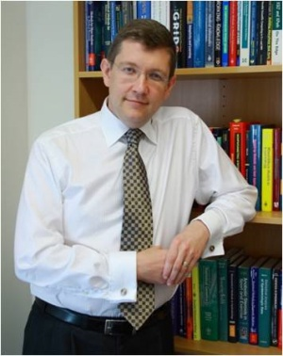
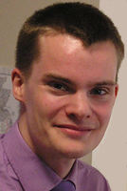
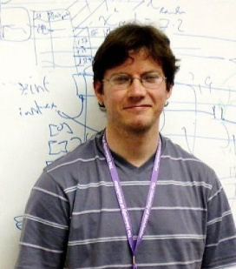
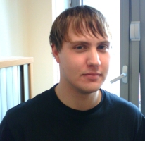
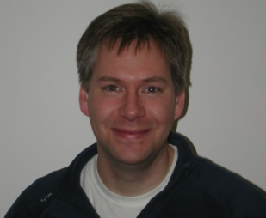
Thanks
Microsoft
Our local user-group
Prof. Adan Custovic, Dr. Angela Simpson - Wythenshawe Hospital
Dr. John New – Salford Hospital
Dr. Xiayi Ke, Dr. Janine Lamb – Medical School, UoM.
www.nibhi.org.uk

