Slide 1
Snowmelt runoff, eScience, and the end of stationarity
How do we build the knowledge and information base to provide clean, safe water for people and for ecosystems in the face of social and climate change?
Specifically for snowmelt runoff in the mountain West …
  How will we ensure reliable water supply while maintaining acceptable flood risks, improving water quality and creating sustainable habitat?

Slide 2
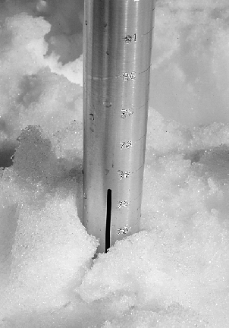
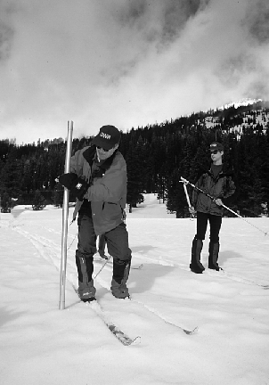
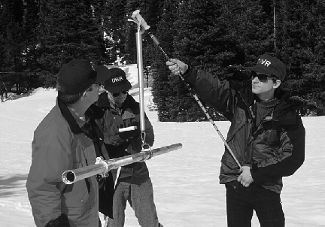
Manual measurement of SWE (snow water equivalent)

Slide 3
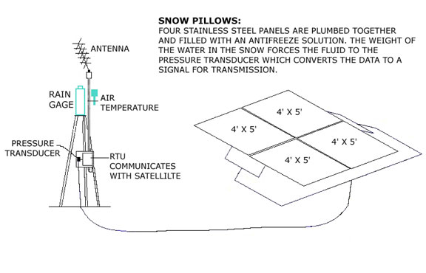
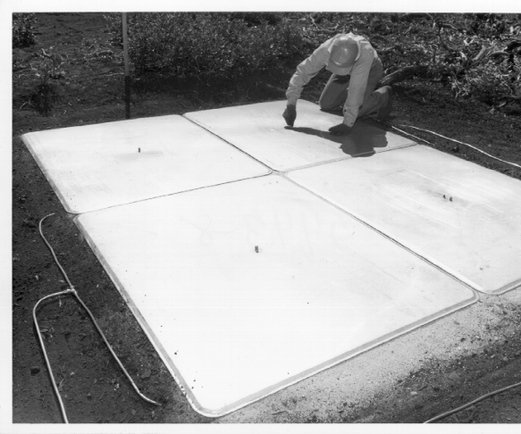
Automated measurement with snow pillow

Slide 4
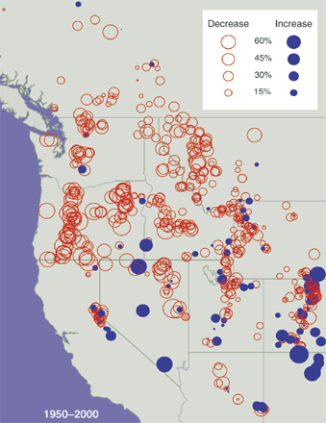
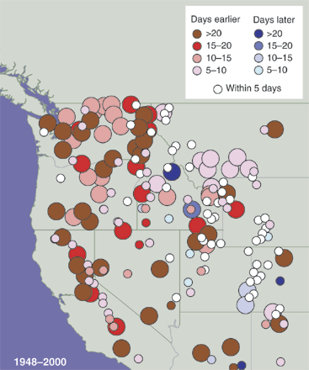
A changing western snowpack?
Less snow?
Earlier melt?
Service, R. F., As the West goes dry, Science, 20 Feb 2004

Slide 6
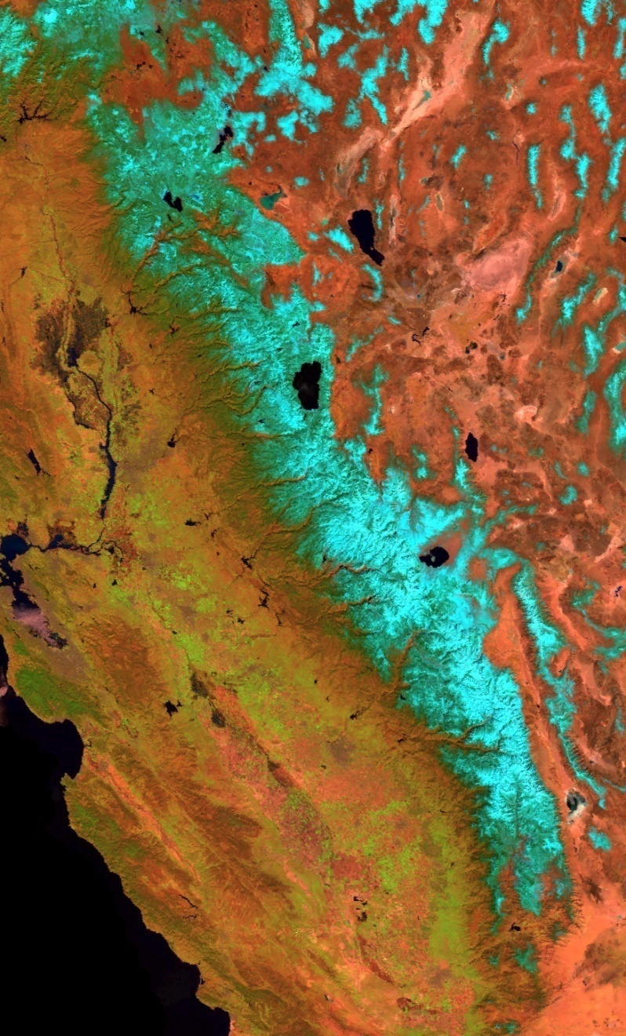
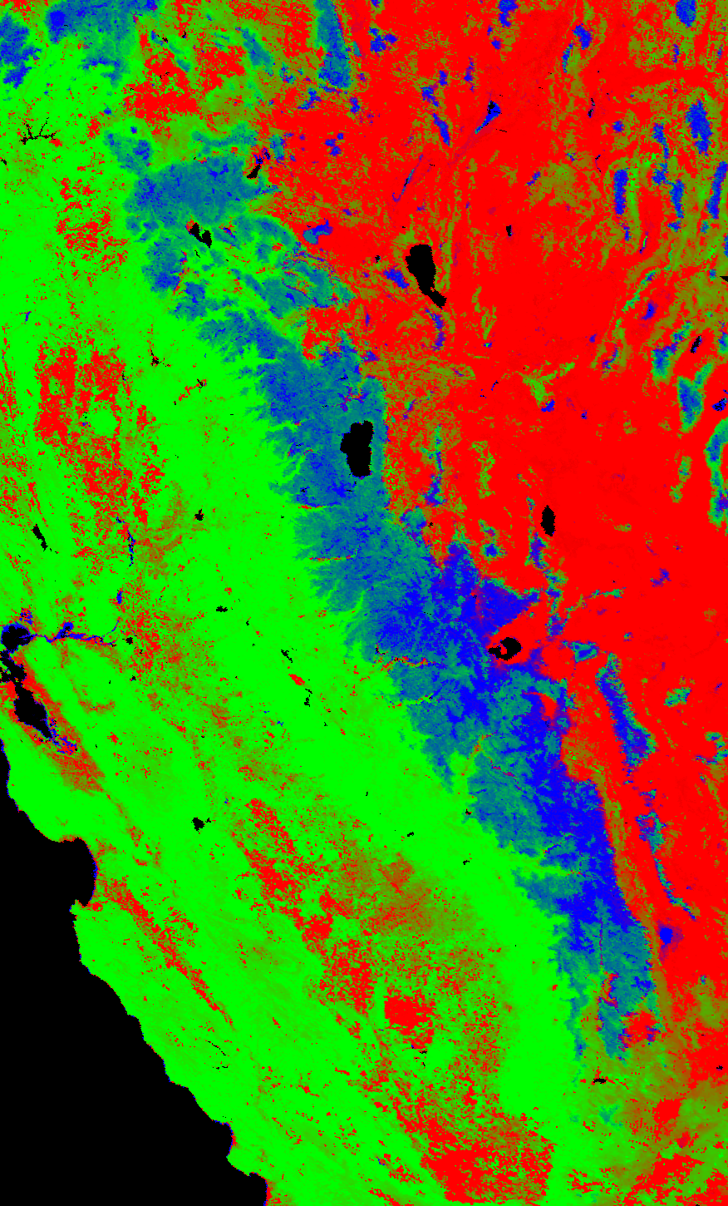
Pure endmembers,
01 Apr 2005
100% Snow
100% Vegetation
100% Rock/Soil
MODIS image

Slide 7
Model structure for MODIS snow-covered area and albedo (38 images/day × 300 days)

Slide 8
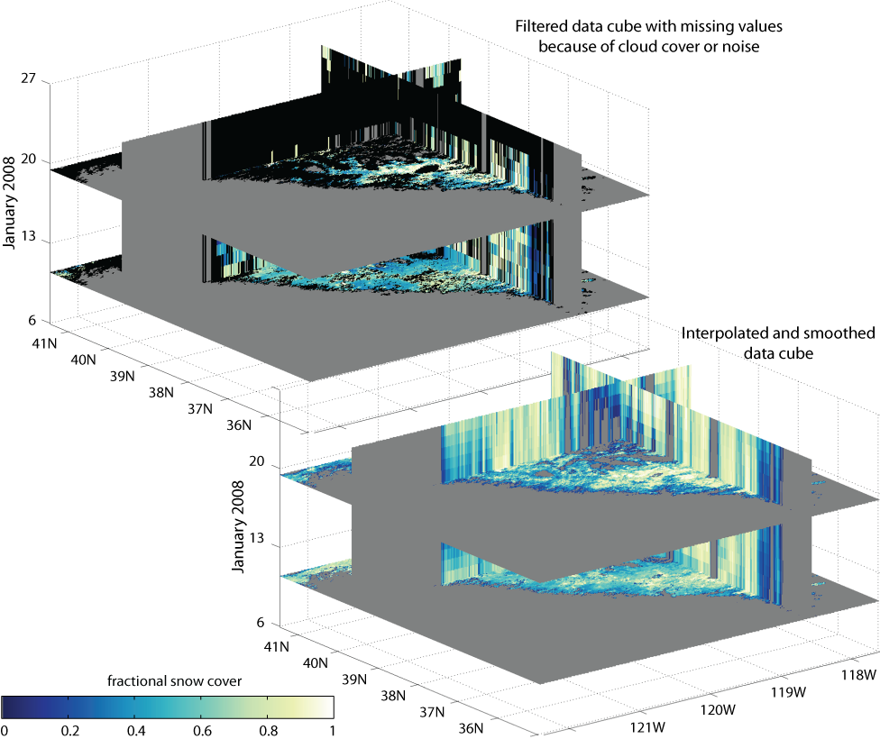

Slide 9
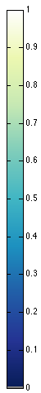
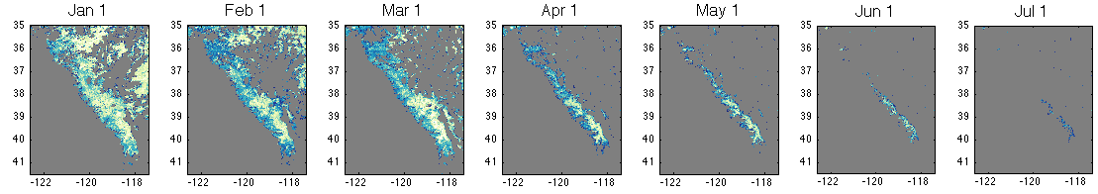
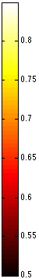
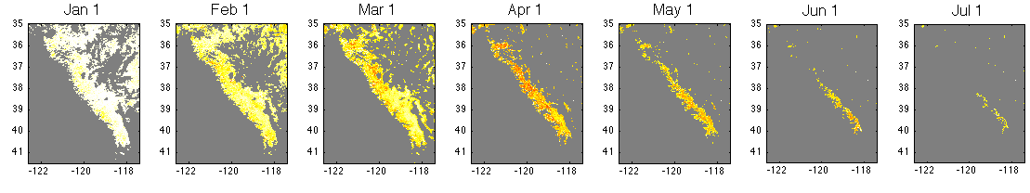
Snow-covered area and albedo, 2004
Snow Covered Area
Albedo

Slide 10
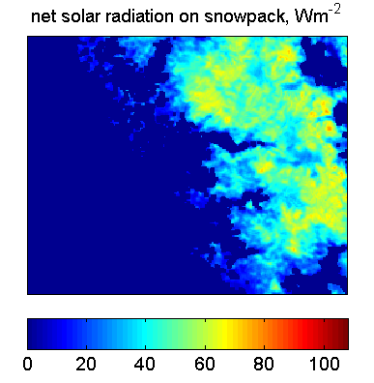
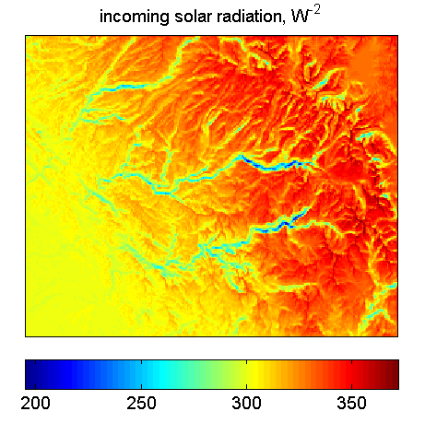
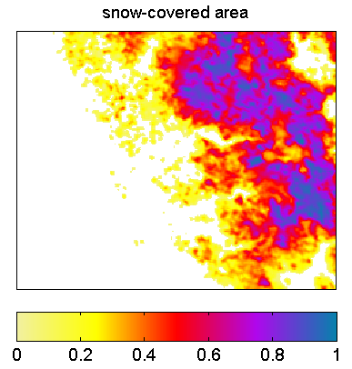
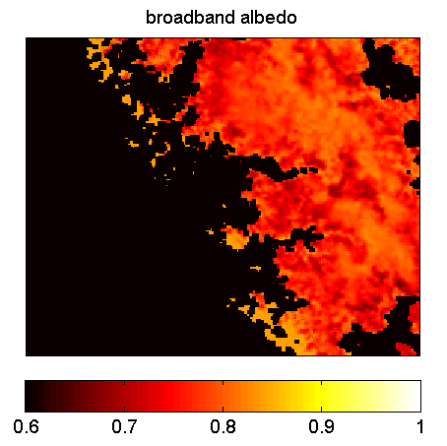
=
X
X [1–
]

Slide 11
The Data Author’s Perspective: from data creation to data curation
No “standard” environmental science computing environment
  commercial packages (ArcGIS, IDL, MATLAB, …)
  public packages/models (MM5, MODTRAN, …)
  locally-developed codes (C, Fortran)
How do we get these programs to
  communicate
  cooperate
  without rewriting?
And what about the Cloud?
  “graduated outsourcing”
Collect
Present
Store
Analyze
Search
Retrieve

Slide 12
So what do I want so I can do better?
Easy integration and data quality checks for a variety of datasets
  Surface measurements and remote sensing images
  which are stored at different places in different formats
Easy integration of tools
  SQL Server, MATLAB, IDL, my own low-level code, and even code for which I don’t have source
A Cloud that looks like my laptop/desktop
A good way to store/access/view multidimensional data (which are sometimes sparse)
A nice, geographic UI to get to the data
Ability to format output for a variety of analysis tools (e.g, GeoTIFF, OpenDAP)

