Slide 1
The New eScience Education at the University of Copenhagen
Professor Eric Jul
Director of eScience Studies eScience Center
DIKU – Department of Computer Science
University of Copenhagen

Slide 2
eScience
«The next 10 to 20 years will see
computational science firmly
embedded in the fabric of science
– the most profound development in the scientific method in over three centuries.»
US Department of Energy 2003.

Slide 3
So what is the problem?
Many scientists in many areas of the Natural Sciences are doing eScience
But most have a rather poor or ad hoc education within CS to do what they are doing
Lots of reinventing the wheel
Merely adding a programming course for xyz-logy students no longer suffices

Slide 4
A solution?
Introduce eScience thinking and courses into other departments
A hard solution: NIH – Not Invented Here

Slide 5
Our solution
Establish a separate eScience graduate program
Master’s and Ph.D. Degrees in eScience
Started August 2008
Separate program – just like Physics, CS, Chemistry, etc

Slide 6
The Program
PART II
PROGRAM DESCRIPTION

Slide 7
Entry Requirements
Entry Requirements
  Bachelor in own field
  Elite program – we just want the best ☺
  Masters program: 1/3 CS, 2/3 own field

Slide 8
eScience Graduate Program
eScience Masters program:
  2- year program – 120 ECTS (15/quarter):
  4 Compulsory Courses (½ year total)
  2-8 courses from list of eScience courses
  Individual projects – strong emphasis on projects – learning by doing
  Thesis ½, ¾ or 1 year – experimental

Slide 9
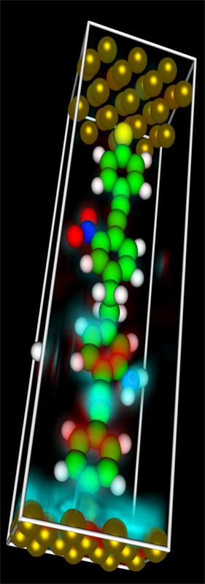
eScience Components
Modelling and simulation

Slide 10
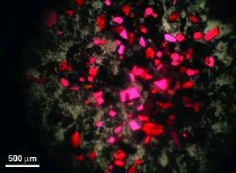
eScience Components
Modelling and simulation
Data acquisition and handling

Slide 11
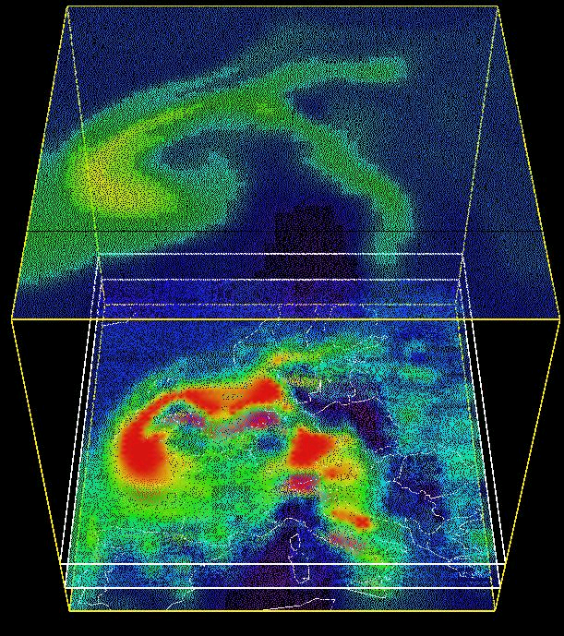
eScience Components
Modelling and simulation
Data acquisition and handling
Visualization

Slide 12
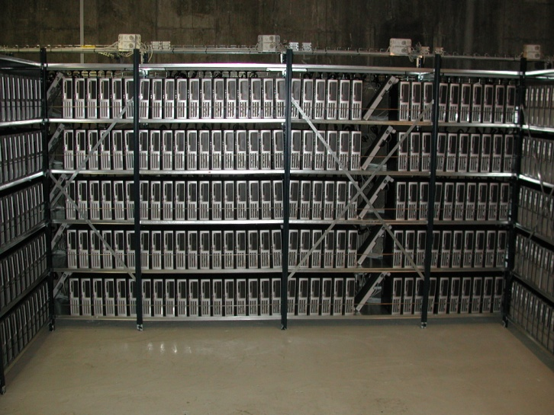
eScience Components
Modelling and simulation
Data acquisition and handling
Visualization
HPC and Grid

Slide 13
Four Compulsory Courses
Scientific Computing
Statistics
Data mining and databases
Scientific Visualization

Slide 14
Scientific Computing
Learn to do scientific calculations
Standard methods for computing and HPC
Experimentally oriented – learning by solving lots of smaller problems involving running programs on real data
Note: Taught by members of four different departments

Slide 15
Statistics
Important to have some understanding of stats
A very useful tool to extract relevant data – or verify it.

Slide 16
Data Mining and Databases
Handling large amounts of data:
  classic databases
  web access
  distributed data
  data storage
  data mining

Slide 17
Scientific Visualization
A newly designed course:
Visualization vital to many application.
  Visualization in both 2D and 3D
  More data mining
  More data analysis/compaction/extraction

Slide 18
Additional Courses from List
2-8 courses are to be chosen from a long list of eScience oriented courses across the College of Natural Sciences
Typically in the candidate’s own field, but also cross-disciplinary ☺
Total of 15-60 ECTS

Slide 19
Indiviual Projects
The program is project-oriented
15 - 45 ECTS Individual Projects (can be done in groups)
Learning by doing:
Typical project: tackle a given real-life problem, analyze it, write a program, run it, and evalute results
Written Report – Important!

Slide 20
Thesis
30, 45, or 60 ECTS Thesis:
As projects, just more.
Can be in any field of Natural Science, but must have substantial eScience components

Slide 21
Thoughts
PART III
THOUGHTS

Slide 22
Stovepipe Problem
By establishing a separate, cross disciplinary program, ownership is at the College level – NOT AT THE DEPARTEMENTAL LEVEL
As Director of eScience, I refer to the Dean
Good support from a few, good prime contact faculty members in almost every department
We are NOT trying to push “new computational science” into other departments – instead build it on the side – and let it spread

Slide 23
Student Mobility
Students are difficult to move:
We’re started with 8 students – slow trickle – expect 10 by end of 2008
Interest from outside Denmark:
one Norwegian
one Saudi Arabian/Lebanese
one Hongkong Chinese

Slide 24
Short-term Vision
Slowly build success
Get ”non-conservative” & interested faculty to introduce eScience thinking and courses in their own departments
Expand to Health Science, Economics, …

Slide 25
Long-term Vision
15-20 years from now:
no eScience program!
It will be an integral part of all science programs

Slide 26
Questions?
Thank you for listning ☺

