Slide 1
Data Storage Model
for Environmental Monitoring
Wireless Sensor Networks
Jayant Gupchup†, Răzvan Musăloiu-E† , Marcus Chang ^{ζ} ,
Alex Szalay±, Katalin Szlavecz* , Andreas Terzis†
Department of Computer Science, Johns Hopkins University†
Department of Physics and Astronomy, Johns Hopkins University±
Department of Earth and Planetary Sciences, Johns Hopkins University*
Department of Computer Science, University of Copenhagen ^{ζ}

Slide 2
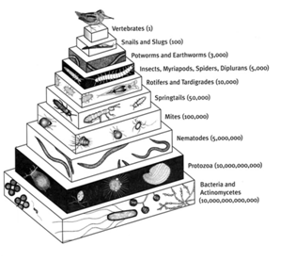
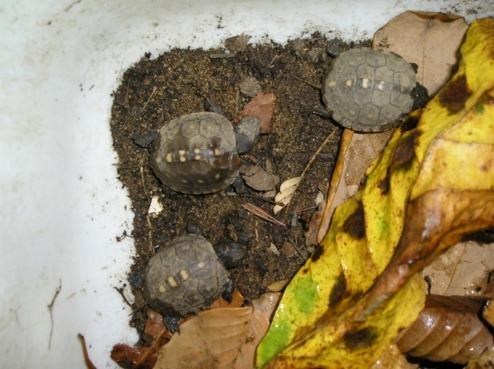
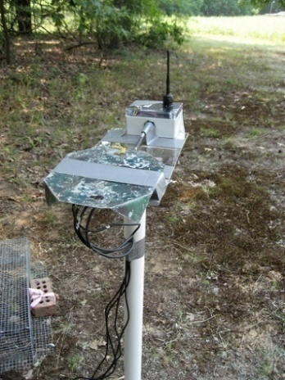
Life Under Your Feet
Understand spatial and temporal heterogeneity of soil ecosystems
Correlate ecological data with environmental variables (E.g. Soil Temperature)
Why Wireless Sensor Networks?
Non Intrusive
Continuous collection of data
Data collection at varying scales
Reduction in labor
Built-in Intelligence

Slide 3
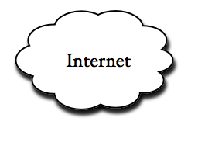
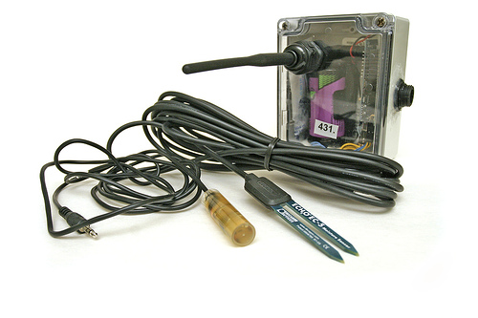
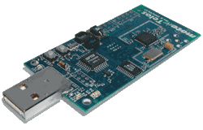
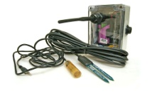
A Typical Sensor Network
Stable
Storage
Gateway/
Basestation
“MOTE”
“Box” + “Sensors”
…….
Notes:
Bring a box and explain the contents. Leave out optimization stuff. Operate for long periods of line.

Slide 4
Previous Deployments

Slide 5
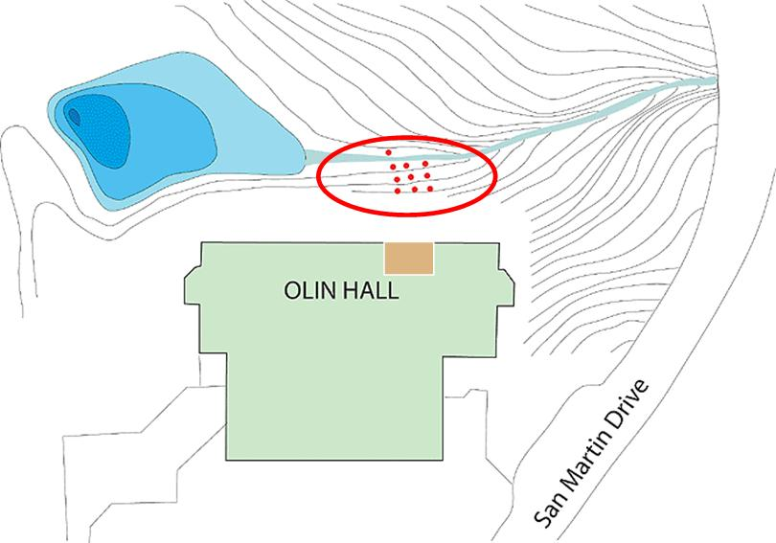
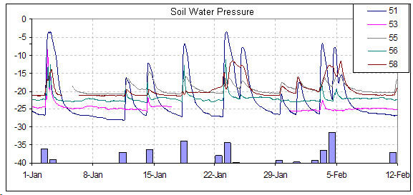
First Deployment - Olin
September 9, 2005 – July 21, 2006
Location: Olin Hall JHU Campus (Urban Forest)
Goal: Proof of Concept Deployment
10 Boxes
Soil Temperature
Soil Moisture
Box Temp
Light
Periodic Monitoring is crucial

Slide 6
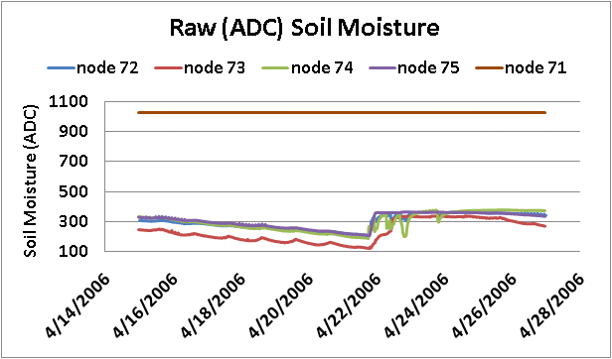
Data Monitoring Motivation
Notes:
Change Graph to Excel

Slide 7
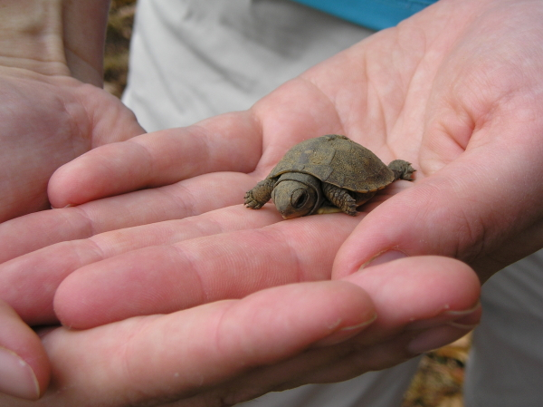
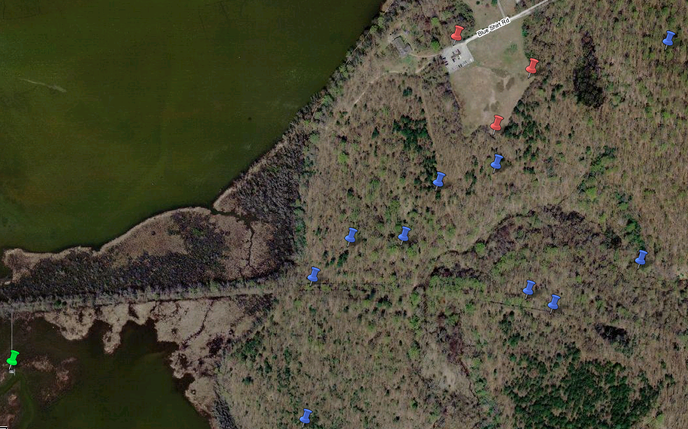
Deployment – Jug bay Turtle Monitoring
June 22, 2007– April 26, 2008
Location: Jug bay Wetlands, Arundel Co. Md
Goal - Monitor:
nesting conditions
over-wintering conditions
13 Boxes
Soil Temperature
Soil Moisture
Box Temp
Light

Slide 8
Lessons Learned

Slide 9
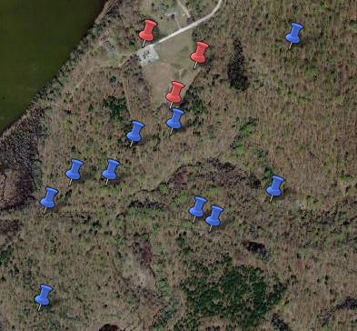
Schema Lessons
Hardware can fail!
Schema needs to handle hardware replacements from a science point of view
Sensor Heterogeneity
Inter Deployment
Intra Deployment
Seamless correlation of data
Across Deployments
Sensor Types
Notes:
Our viewpoint Vs the scientists viewpoint

Slide 10
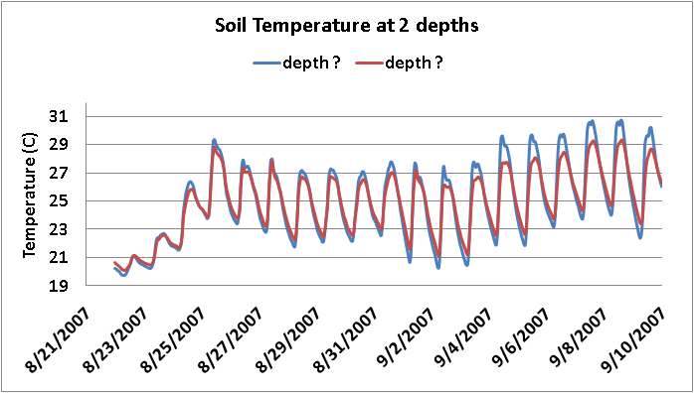
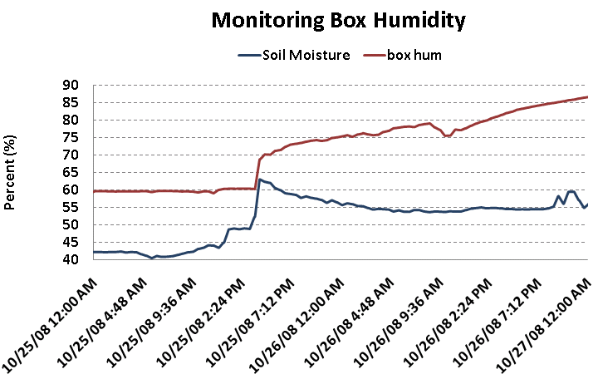
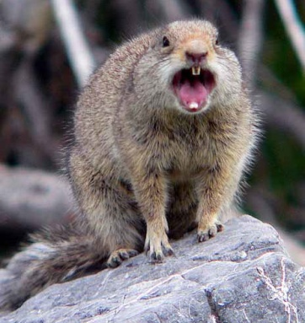
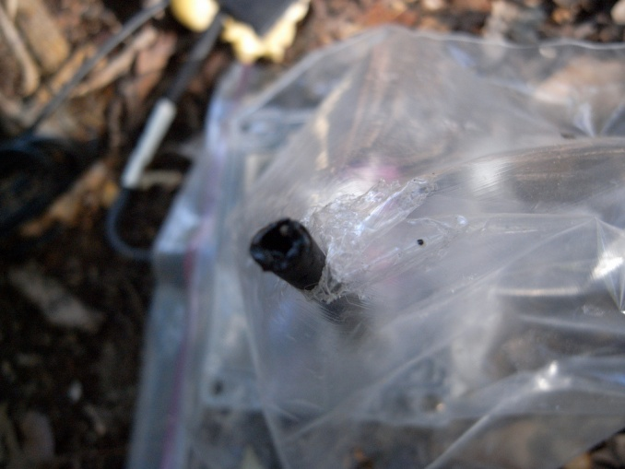
Data-Yield Lessons
Metadata is important
It can unlock many mysteries!
Save time, resources
Early Detection of Failure is crucial
Increase Data-Yield
Notes:
Show a flip of Soil Temperature. Show the effect of rain. Make the numbers bigger and bolder

Slide 11
Unified Architecture
Some details/tasks are deployment specific
Some details/tasks are deployment independent
2-phase Loading
Phase I : Staging
Meta Information
Deployment Specific
Computer Scientists care about deployments details
Phase II : Science
Hardware Agnostic
Deployment Agnostic
Scientists interested in data (not deployments details)
Notes:
Deployment : Computer Scientists. Scientists only want to know accuracy and location. CAPTURES all of this

Slide 12
Current Deployments
Notes:
That was the old. Evolution is the way forward.

Slide 13
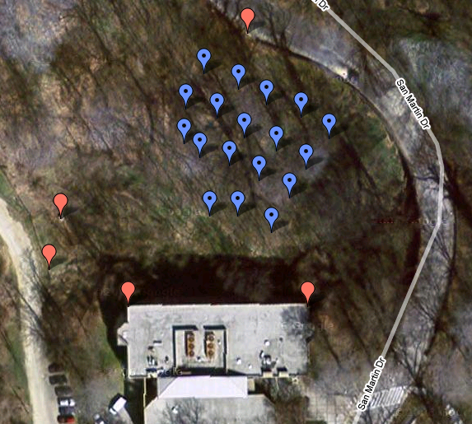
Olin Revisited
July 13, 2008 – n/a
Location: Olin Hall JHU Campus (Urban Forest)
Goal: Spatial & temporal variation of urban soil ecosystems
19 Boxes
Soil Temperature
Soil Moisture
Box Temp
Box Humidity
Light
Multiple hardware Replacement Dynamics
Boxes
Known
Locations
Notes:
Add the legend

Slide 14
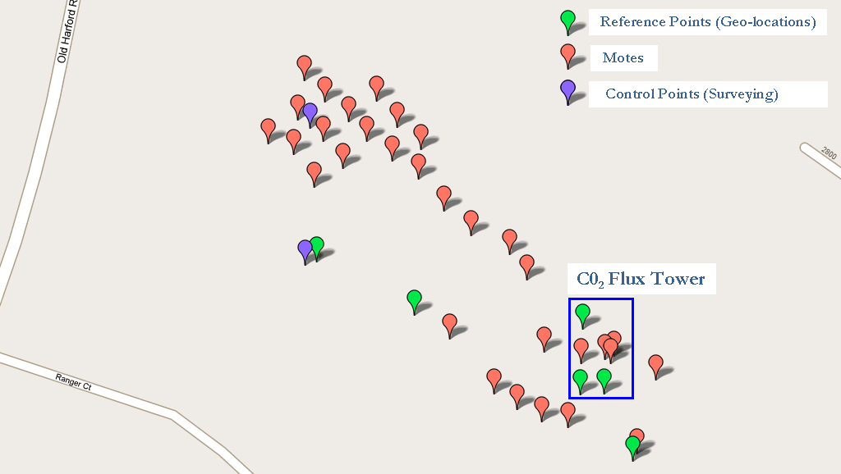
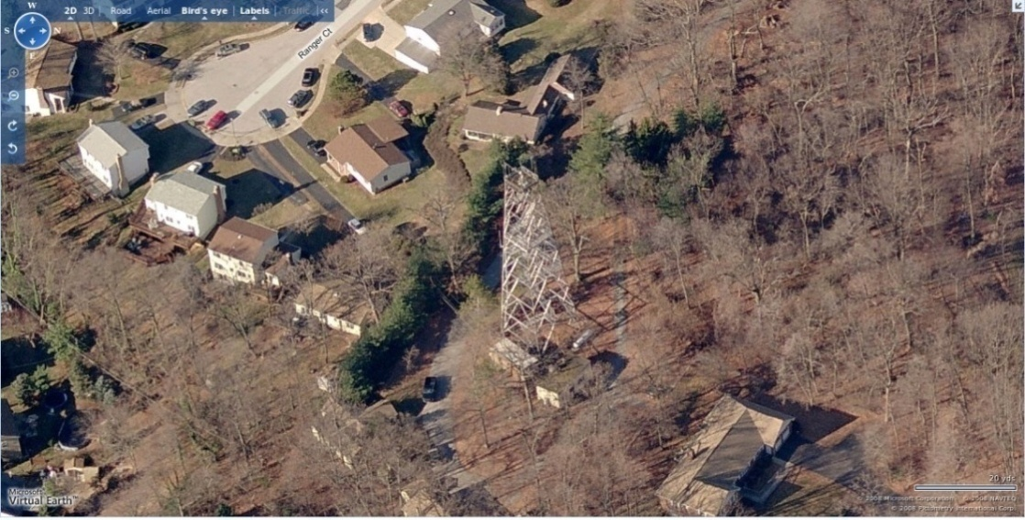
Cub Hill Deployment
July 29, 2008 – n/a
Location: Towson, MD
Co-located near a CO₂ Flux tower
Goal:
Exchange of ambient CO₂ , soil CO₂
Effect on Soil ecosystems
31 Boxes
Soil CO₂
Soil Temperature
Soil Moisture
Box Temp
Box Humidity
Light
New Sensor Type

Slide 15
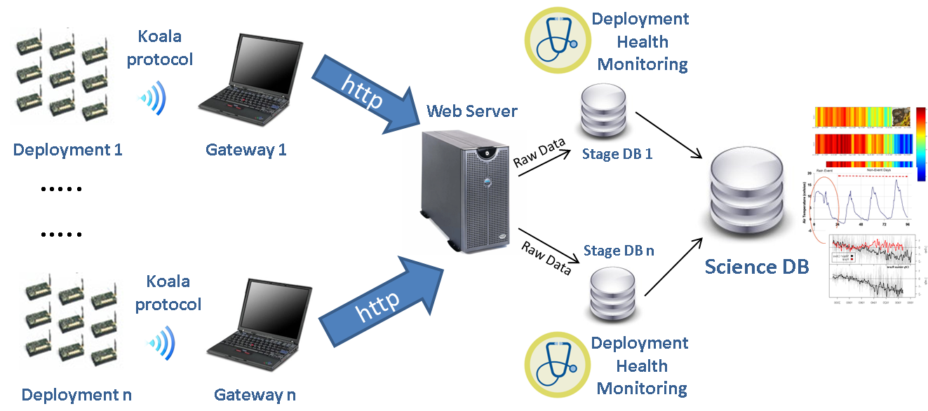
System Architecture
2 phase Loading
Every 6 hours
Journal of actions

Slide 16
2 phase Loading
&
Health Monitoring

Slide 17
Stage DB - I
Downloads ingested in stage DB
Raw Data in the form of packets
Journal of Actions taken by the mote.
Each download acts as a “version number”
Origins of the data can be traced using the version number
Routines to undo corrupted downloads using version number
Stage DB contains tracking information
When was hardware replaced?
What hardware is at what locations?
What is the health level of the components

Slide 18
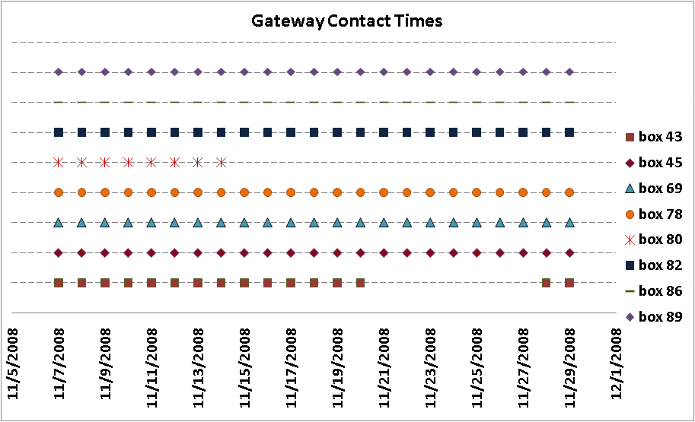
Stage DB - II
Journal
# of packet retransmissions
radio-on time
Last known contact time of each mote
Download Paths
# of reboots
# of beacons
Timestamp Reconstruction ….
Notes:
Drill down a little more. Replace with download paths

Slide 19
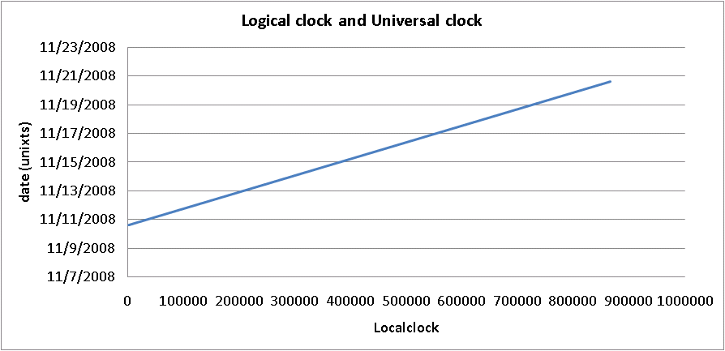
Stage DB III (Timestamp Reconstruction)
Clock-Synchronization is expensive
Each mote runs a logical clock
Measurements are marked using local timestamps (LTS)
GTS = α * LTS + β
GTS is the global timestamp (unixts)
α is the clock skew
β is the start time
Periodically collect (LTS,GTS) pairs. “Anchor Points”
Fit (α, β)
Slope (α ):
Clock Skew
β
Notes:
Expand Anchor points

Slide 20
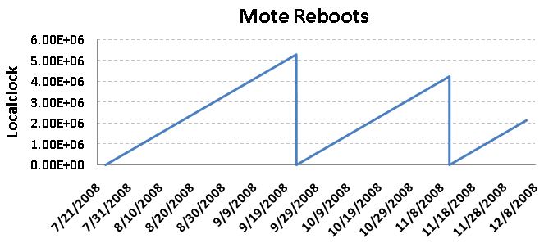
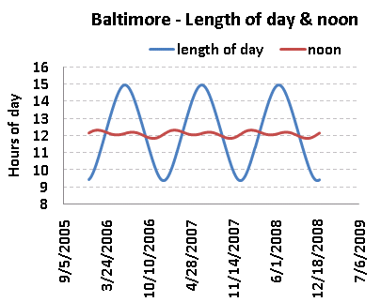
Stage DB IV (Timestamp Reconstruction)
Motes reboot
Start new segments
Fit no longer applicable
Detect “new segments”
Map “anchor points” to “segments”
Compute new fits for the new segment
When no anchor points available?
Sundial: using sunlight to reconstruct global timestamps, to appear in proceedings of European wireless sensor networks (EWSN 2009)
Segment

Slide 21
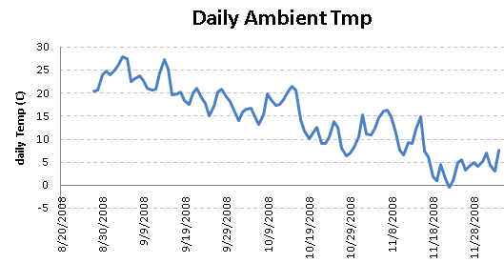
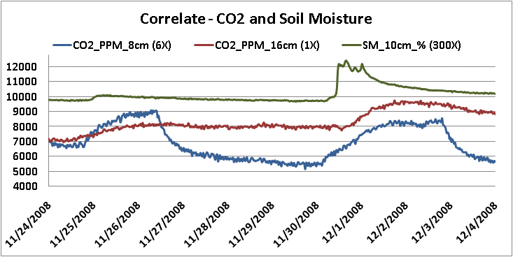
Science Database
Calibration, Cleaned, Time-Series …
Location centric
Data Series references using (Location, Type)
Hardware agnostic
Deployment agnostic
Unified Science Database
Correlate Heterogeneous data
Multiple deployments
Multiple Sensor Types
Multiple Scales
Box
Replacements
Notes:
Change the series types

Slide 22
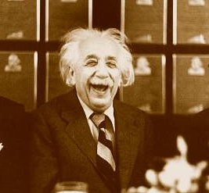
Summary
End-to-End Sensor Data
Deployment Specific : Stage
Deployment Independent : Science
Early detection of Failures
19 Boxes Replaced
7 Due to High Moisture
12 Due to Radio Failure & Misc.
16 Sensors Replaced
Detected Lethal code bugs (Sensor code)
Failure detection implies
Data continuity
Data Yield (fraction of usable data) is high
Scientists are happy
Notes:
Early detection of failure => high data yield.

Slide 23
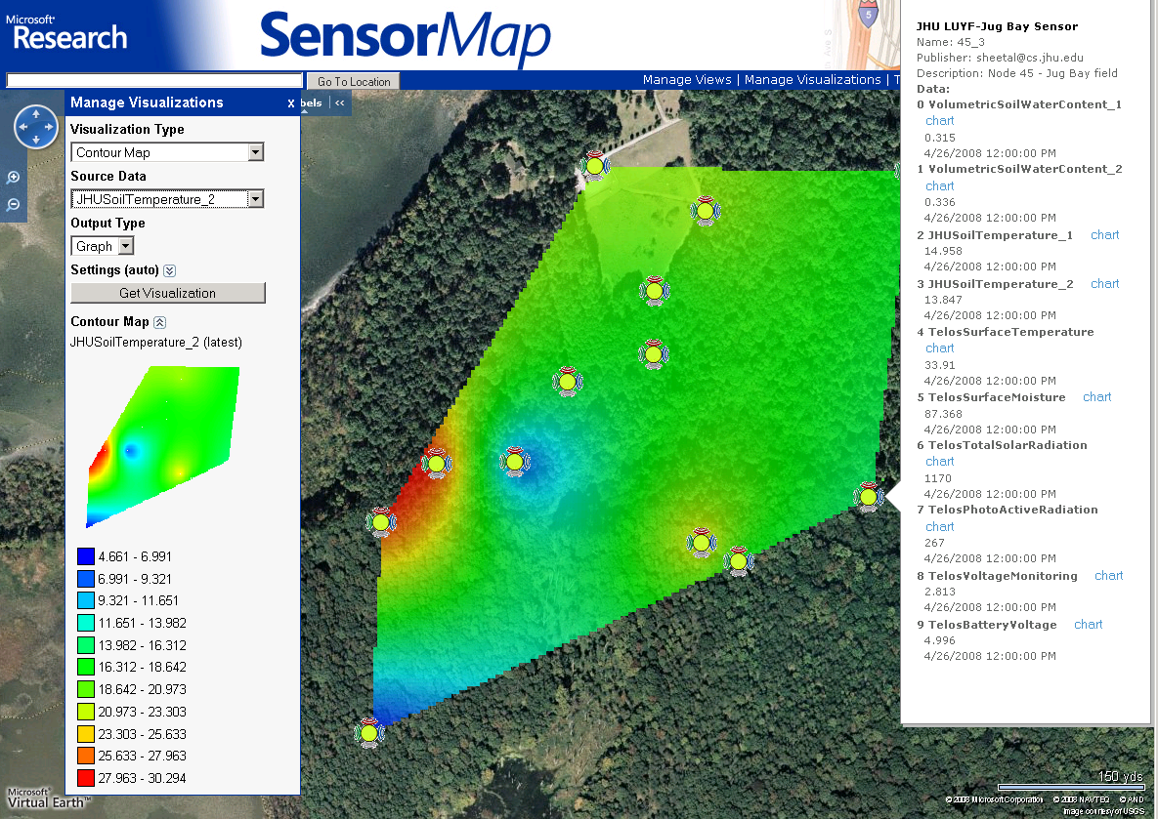
Visualize Data using SenseWeb
Senseweb
(http://atom.research.microsoft.com/sensewebv3/sensormap/)
Search “Mount Calvert”

Slide 24
Life Under Your Feet Team
Acknowledgements:
Liqian Luo (Microsoft Research)
Chris Swarth (Jug bay Wetland Sanctuary)
Maryland Dept. of Forest Service

