Slide 1

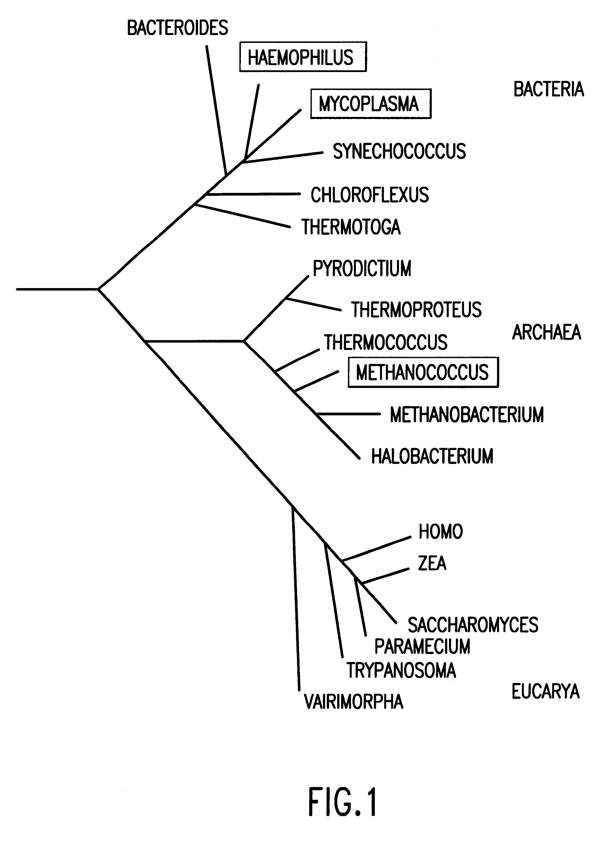
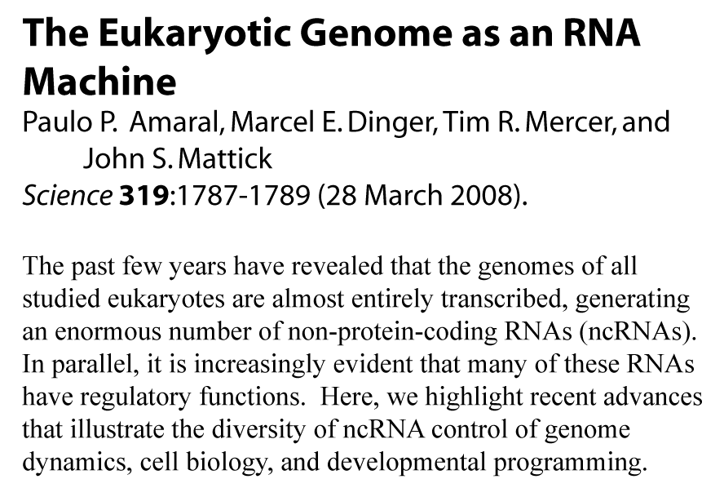
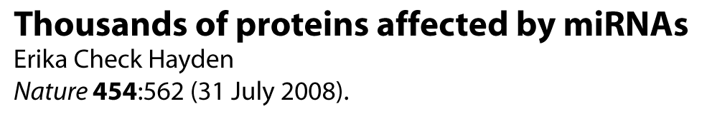
Utilizing Comparative Analysis to Determine and Characterize the Higher-Order Structure of RNA
The Gutell Lab @ The University of Texas at Austin

Slide 2
Major Topics
Importance of RNA in the Cell
  Major Changes in Paradigms
Grand Challenges in Biology
  Identification and Characterization of RNA Structure
  Predicting RNA Structure
      Traditional Energy-Based Method
      Comparative Analysis
Comparative Analysis
  Biological Rational and Computational Methodology
  Accuracy of the identification of structures that are common to a set of functionally equivalent sequences
Development of Novel Comparative Analysis Database
Applications to RNA Structure Prediction
  Identifying fundamental principles of RNA structure to improve the accuracy of the prediction of RNA secondary and tertiary structure

Slide 3
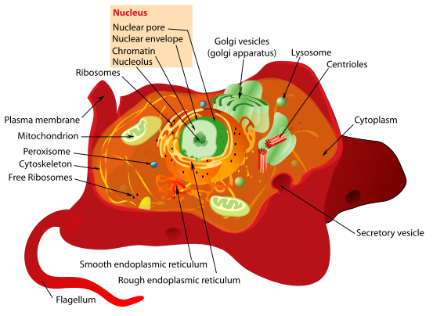
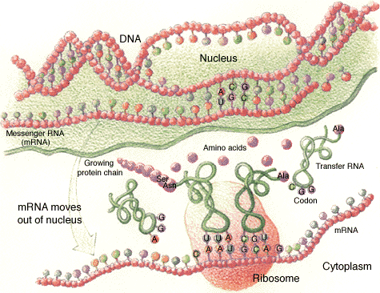
Cellular Complexity

Slide 4
1. RNA Science
Importance of RNA in Cells
  Structure, Function, and Regulation
Grand Challenges in Biology
  RNA Structure Prediction
  Determining Phylogenetic Relationships
Comparative Analysis
  Sequence Alignment
  Covariation Analysis
  Interrelations between Sequence, Structure, and Function
CRW Site

Slide 5
Importance of RNA: we are in the midst of a major paradigm shift in Biology
Past ~50 years:
  rRNA, tRNA, mRNA were thought to facilitate the basic function and regulation of cells, and primarily involved in the synthesis of proteins from DNA. The triplet code in mRNA was translated into the amino acids in proteins, and the tRNA and rRNA ‘helped’ cellular proteins produce more proteins.
This perspective is changing:
  While RNA can form simple A:U and G:C base pairings like DNA, RNA has the capacity to form unique three-dimensional structure that can form special chemical structures capable of performing different types of catalysis (like proteins)
  While it had been generally accepted that the complexity of an organism scales with the amount of protein in a cell, we are now beginning to appreciate that the complexity scales with the amount of RNA in the cell.

Slide 6
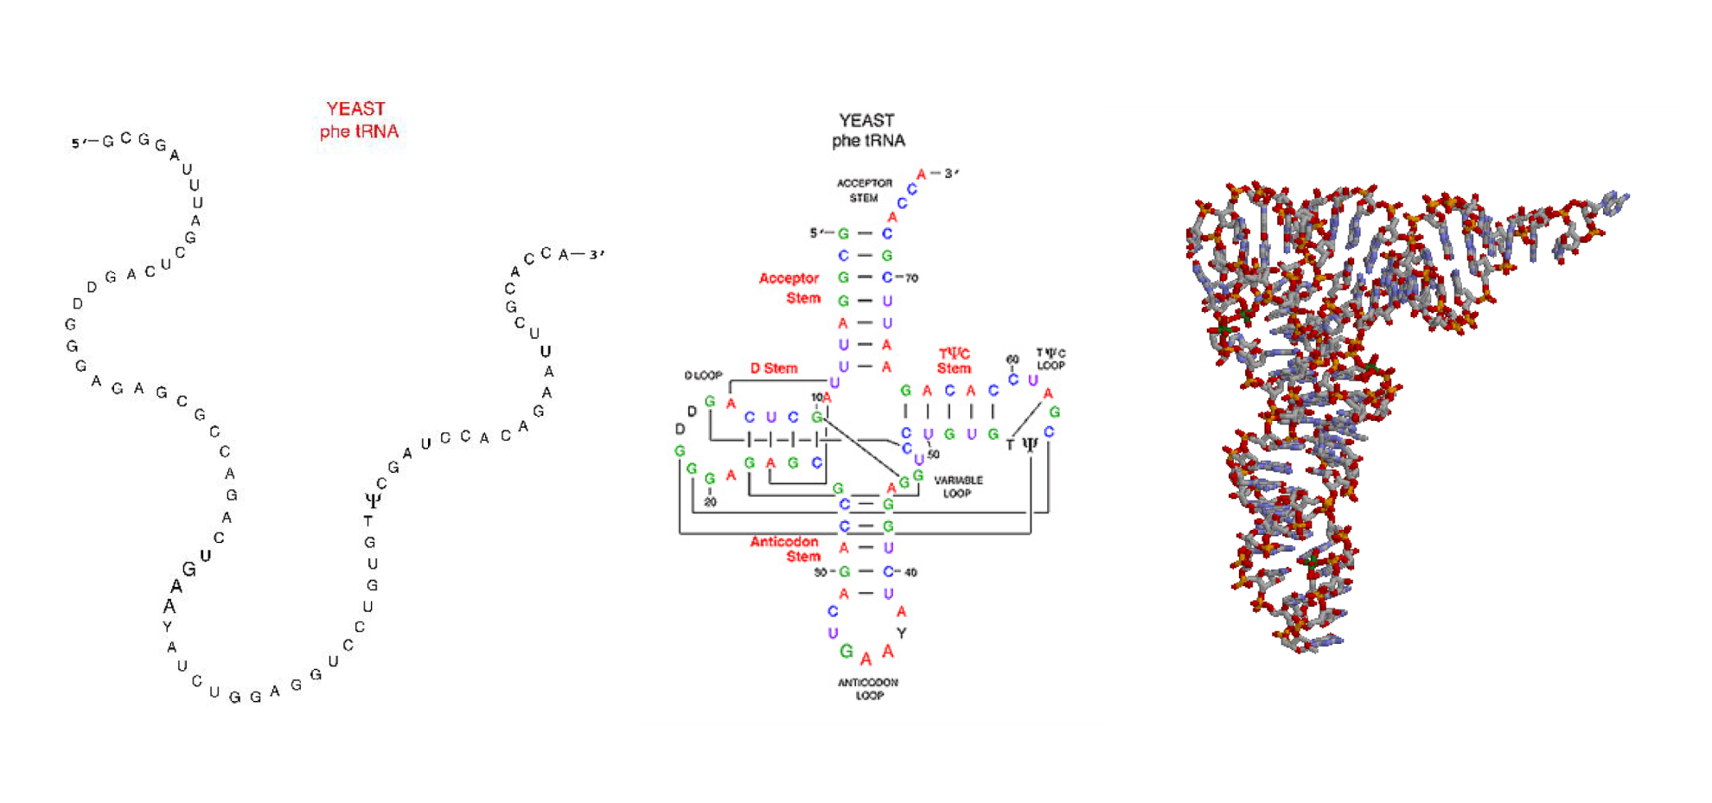
Grand Challenges in Biology I:
Predicting an RNA secondary and tertiary structure from nucleotide sequence.

Slide 7
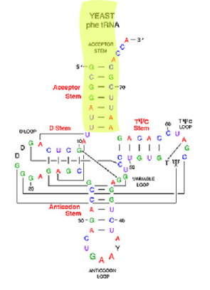
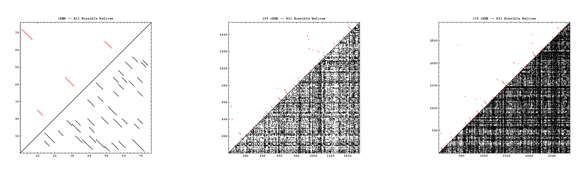
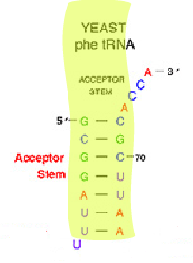
Complexity of RNA Folding
tRNA
16S rRNA
23S rRNA
Molecule | #nt | # potential helices | # possible structures | # actual helices
tRNA | 76 | 37 | 2.5 x 10¹⁹ | 4
16S rRNA | 1,542 | 14,684 | 4.3 x 10³⁹³ | 58
23S rRNA | 2,904 | 51,442 | 6.3 x 10⁷⁴⁰ | 105
Notes:
All possible helices (left to right): tRNA, 16S rRNA, 23S rRNA.

Slide 8
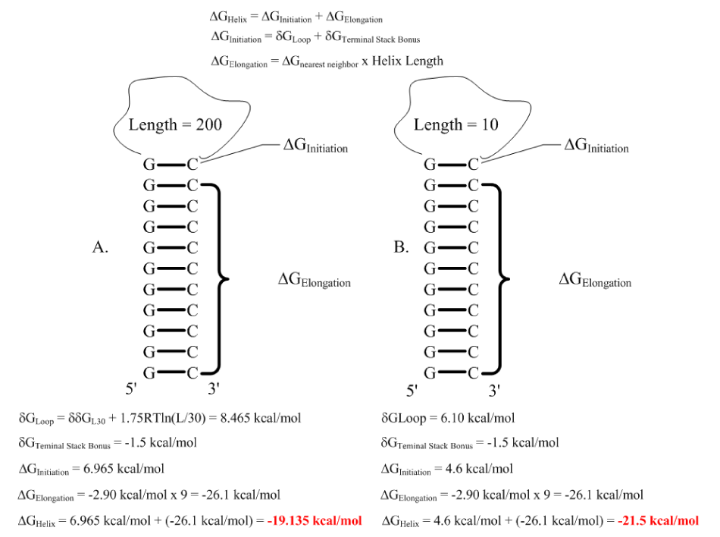
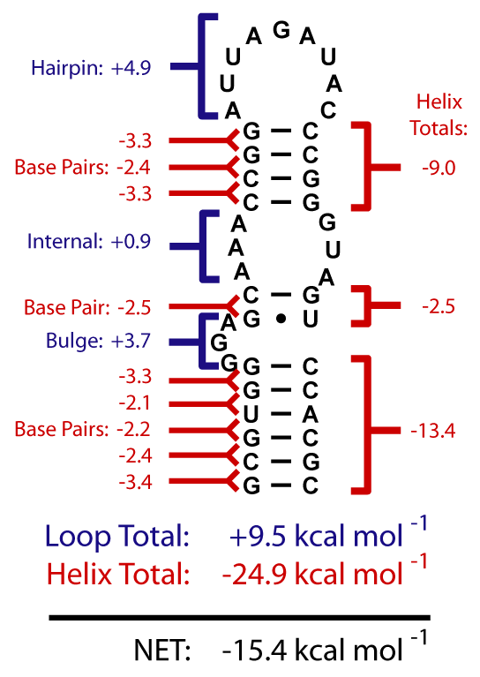
Turner-Based Energy Calculations
∆G_{Helix} = -19.135 kcal/mol
∆G_{Helix} = -21.5 kcal/mol

Slide 9
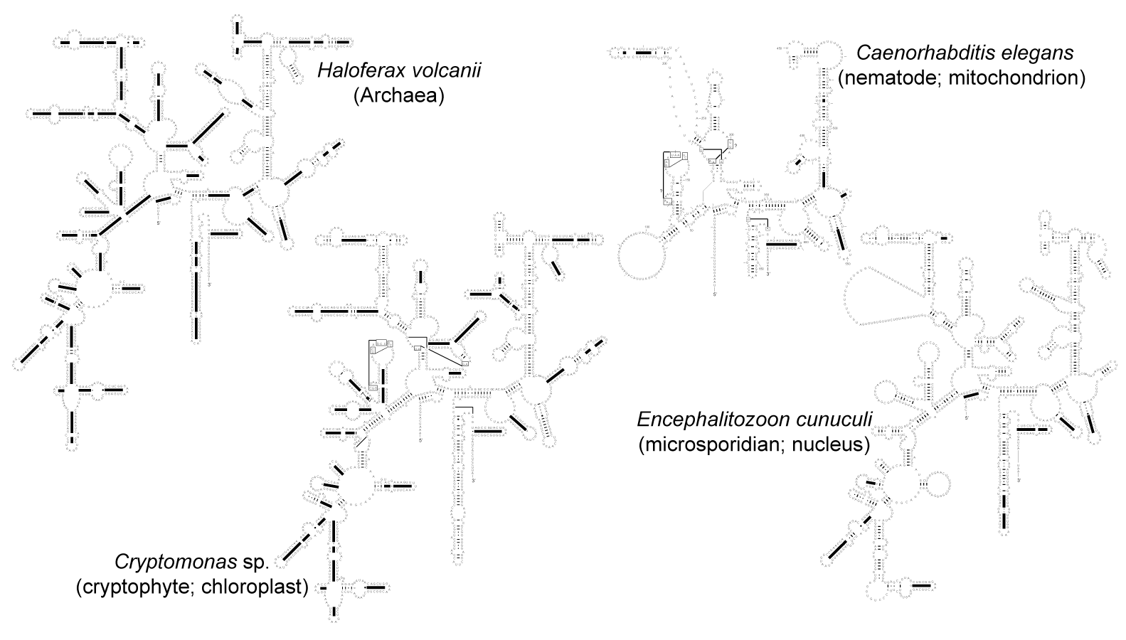
RNA Folding: 16S rRNA

Slide 10
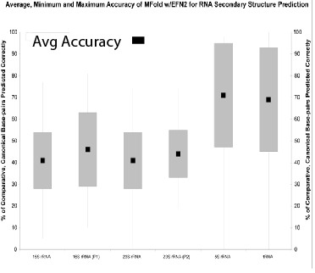
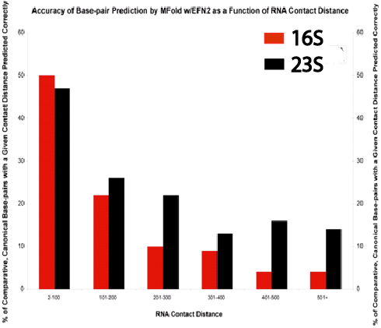
RNA Folding: Mfold Evaluation
16S
rRNA
16S
rRNA (P1)
23S
rRNA
23S
rRNA (P2)
5S
rRNA
tRNA
2-100
101-200
201-300
301-400
401-500
501+
Evaluation of the suitability of free-energy using nearest-neighbor energy parameters for RNA secondary structure prediction – Kishore J Doshi, Jamie J Cannone, Christian W Cobaugh and Robin R Gutell
BMC Bioinformatics 2004, 5:105

Slide 11
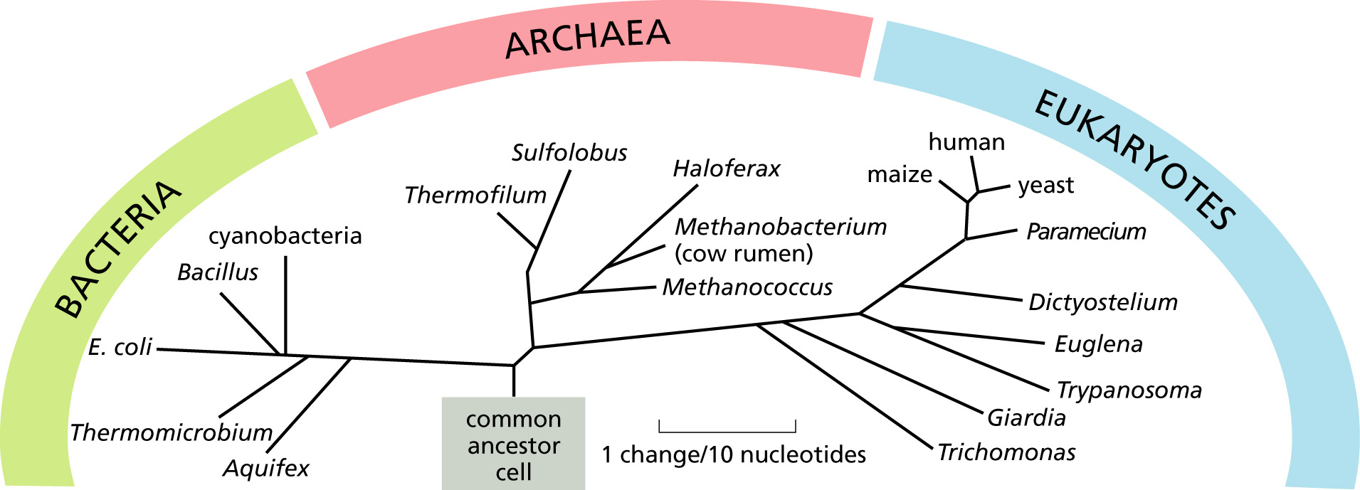
Grand Challenges in Biology II:
Determining the phylogenetic/taxonomic relationships for organisms that span the entire tree of life [rRNA – Carl Woese].

Slide 12
Nothing in Biology Makes Sense Except in the Light of Evolution.
--Theodosius Grygorovych Dobzhansky
from The American Biology Teacher, March 1973 (35:125-129)
Nothing makes sense in Evolution without a strong understanding of the Biological System. And in particular, a more complete understanding of the Structure and Function of a macromolecule is dependent on our knowledge of its Evolution.
--Robin Gutell

Slide 13
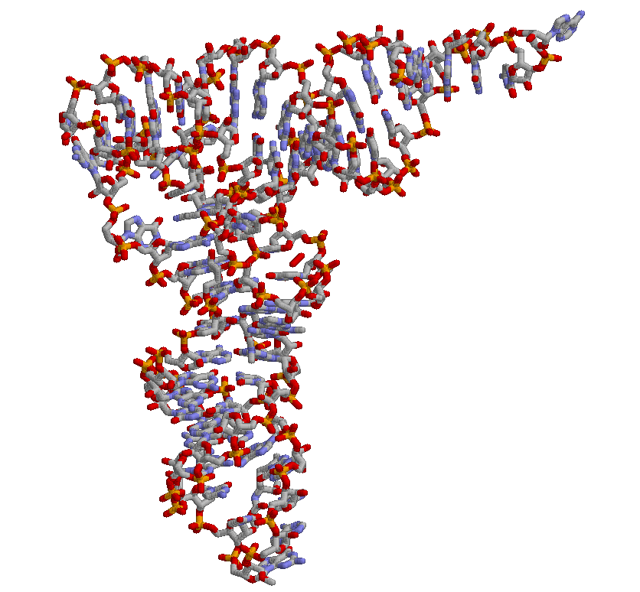
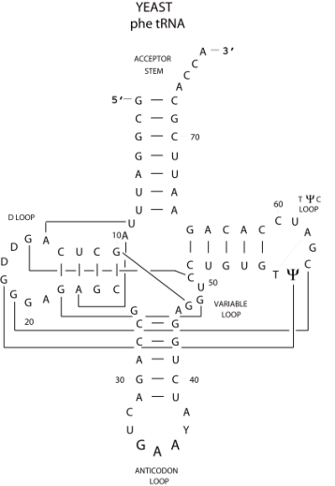
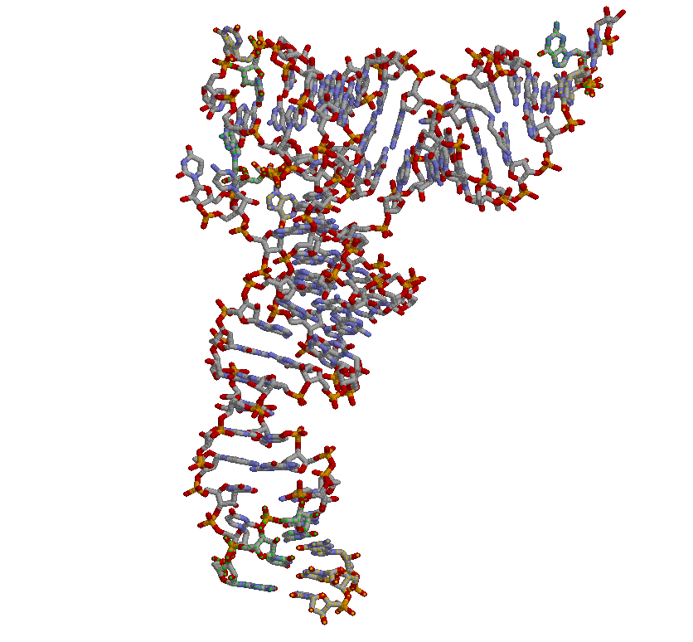
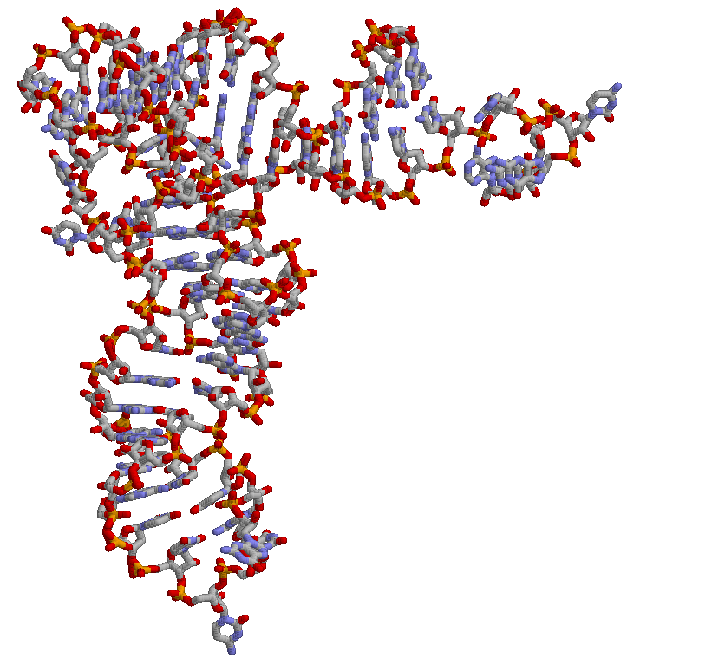
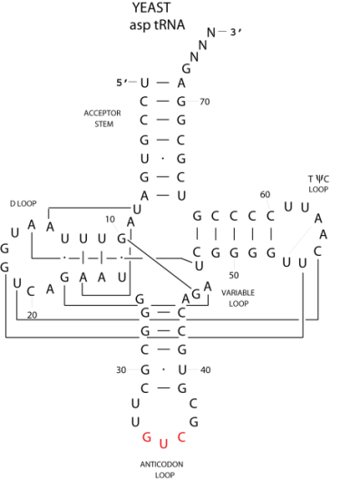
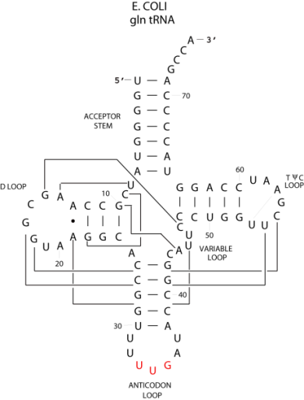
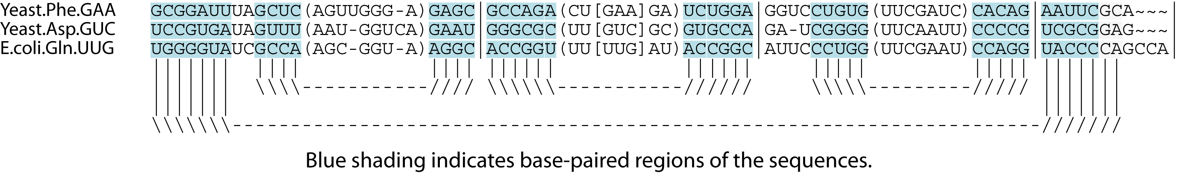
Comparative Analysis: Common Structure from Different Sequences
1
2
3
Sequence Pair | % Similarity
Yeast-Phe and Yeast-Asp (1 and 2) | 43.8 %
Yeast-Phe and E.coli-Gln (1 and 3) | 45.2 %
Yeast-Asp and E.coli-Gln (2 and 3) | 40.2 %
Notes:
Sequence similarities (pairwise): 1-2 (43.8%), 1-3 (45.2%), 2-3 (40.2%)

Slide 14
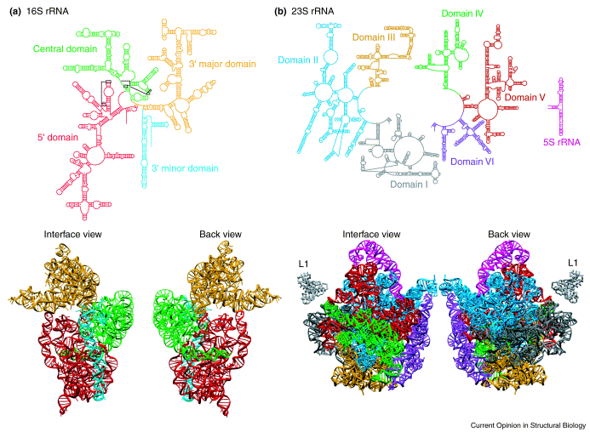
Accuracy of the Comparative Structure Models for rRNA
Model Base Pairs | Predictions
16S rRNA | 461/476 = 97%
23S rRNA | 779/797 = 98%
TOTAL | 1240/1273 = 97%

Slide 15
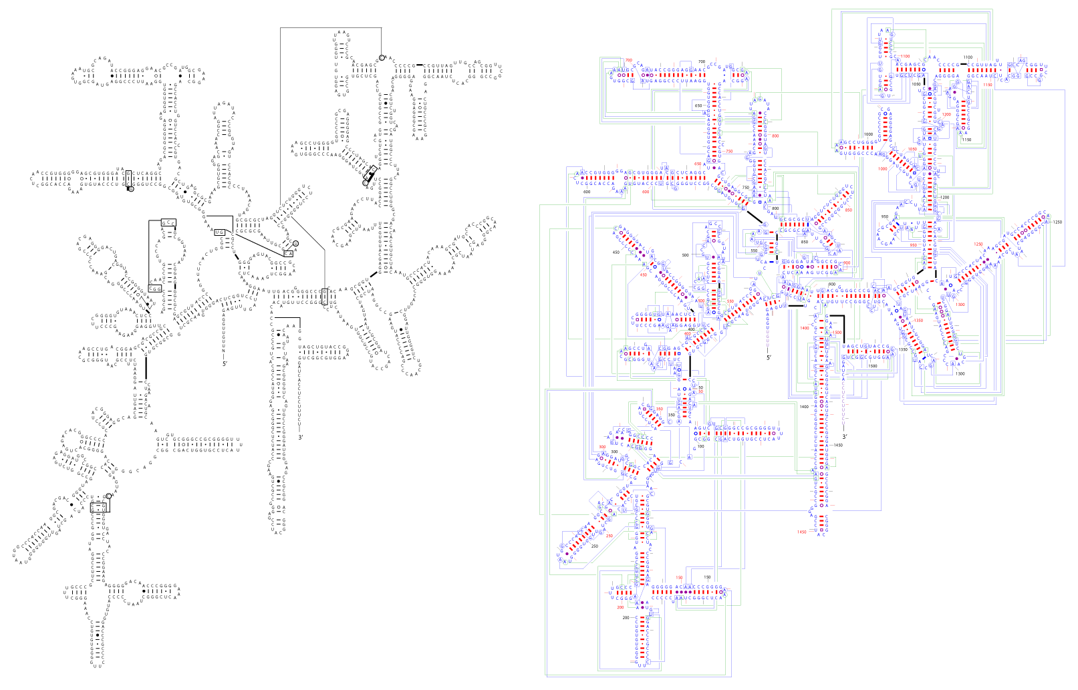
Comparative vs. Crystal Structures (Thermus thermophilus)

Slide 16
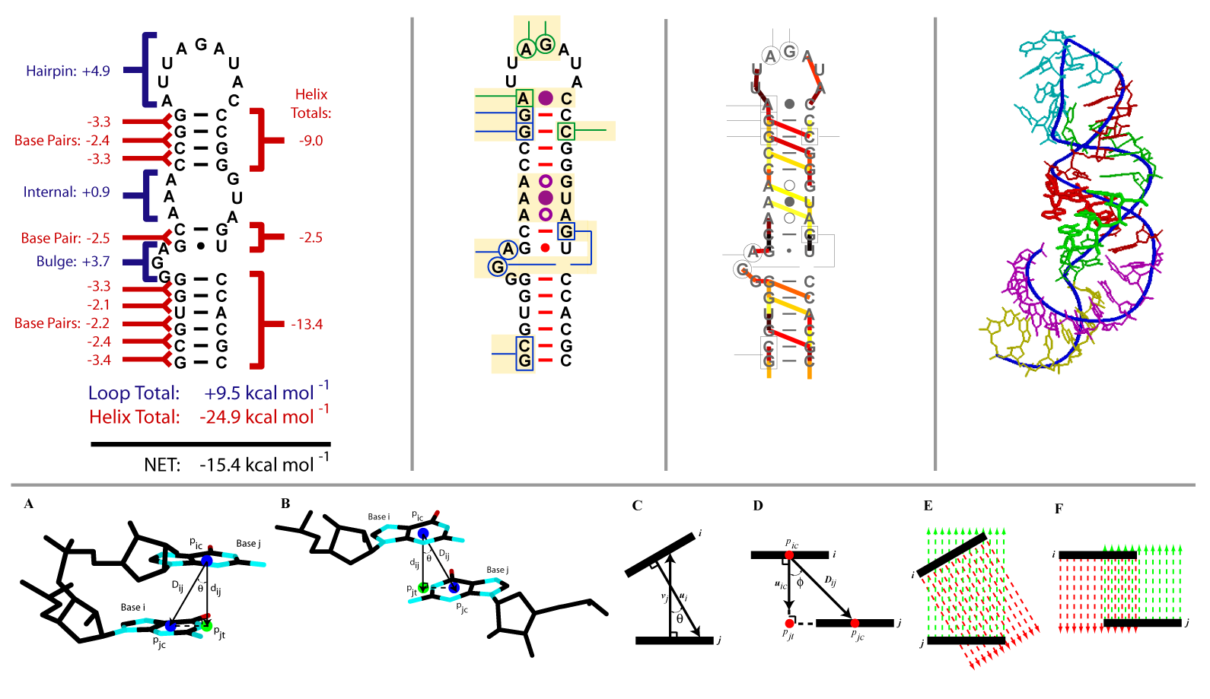
RNA Structure: Secondary Structure, Energetics, Base Stacking, and High-Resolution 3D Structure

Slide 17
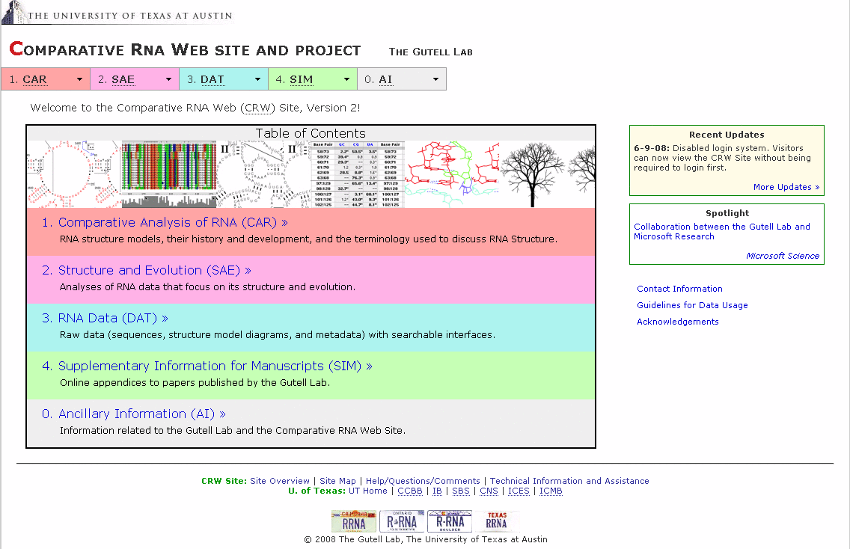
The Comparative RNA Web (CRW) Site http://www.rna.ccbb.utexas.edu/

Slide 18
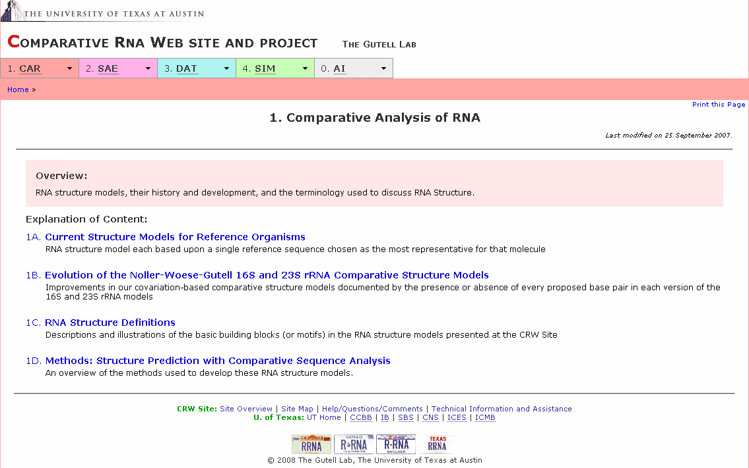
The Comparative RNA Web (CRW) Site

Slide 19
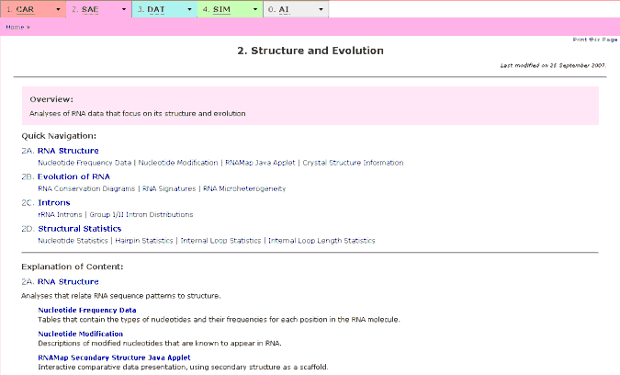
The Comparative RNA Web (CRW) Site

Slide 20
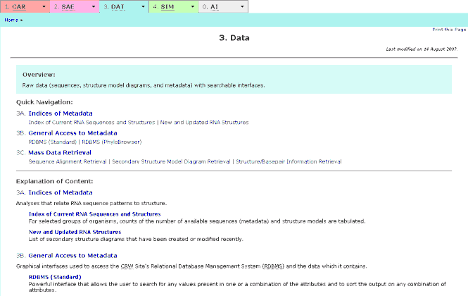
The Comparative RNA Web (CRW) Site

Slide 21
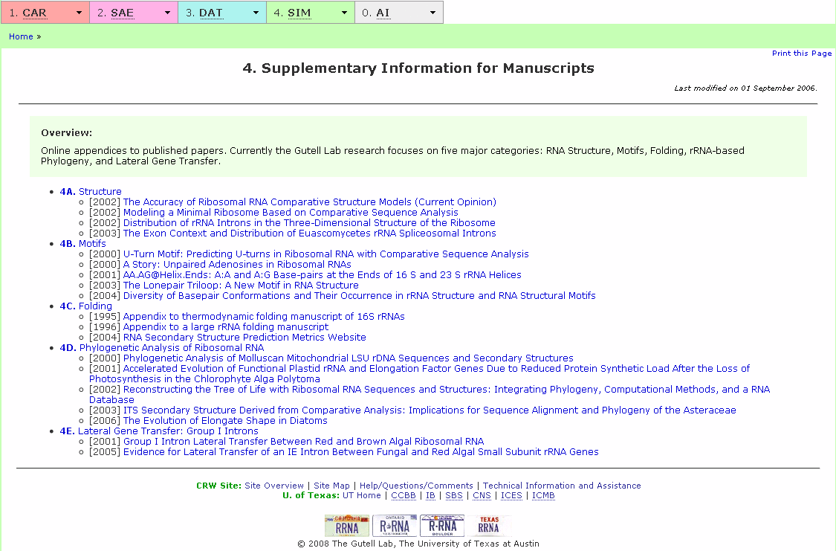
The Comparative RNA Web (CRW) Site

Slide 22
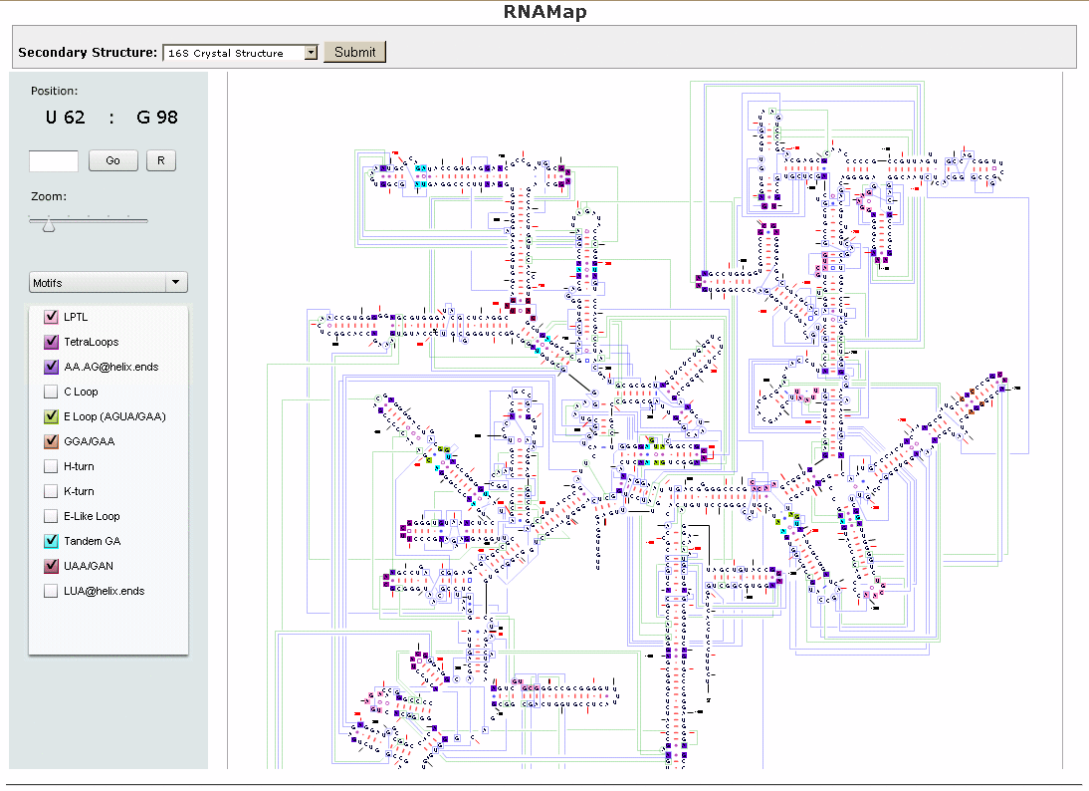
The Comparative RNA Web (CRW) Site

Slide 23
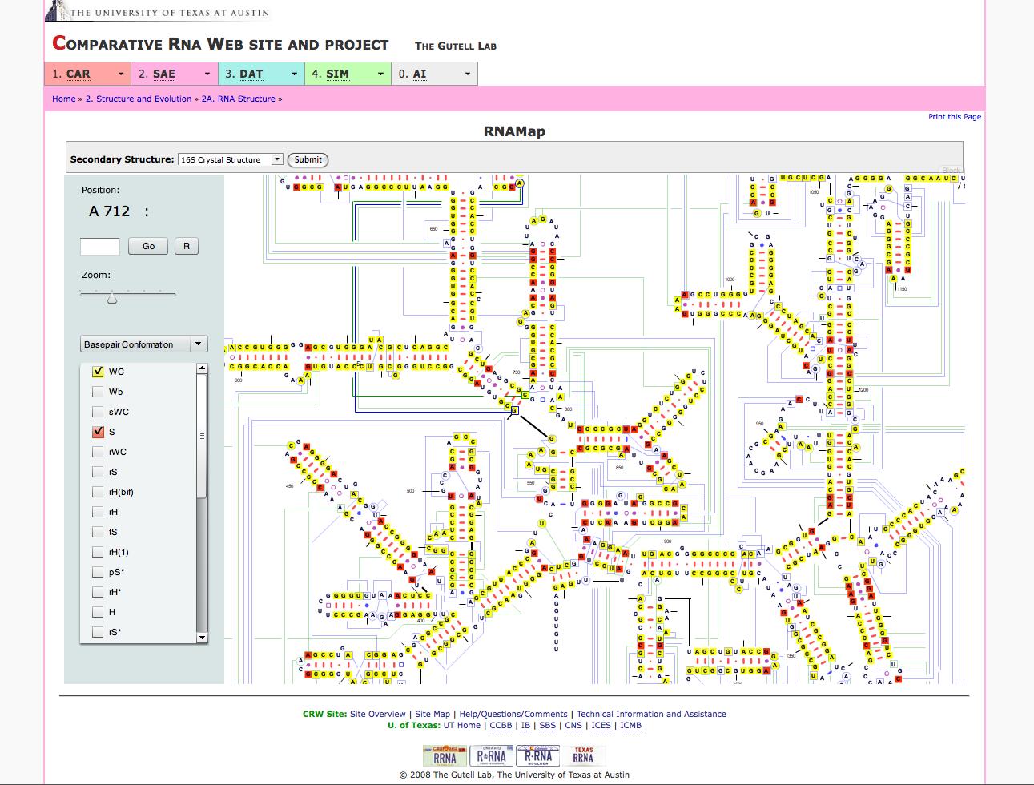
The Comparative RNA Web (CRW) Site

Slide 24
2. From Past to Future…
The Impact: Lessons from Evolving RNAs
The Problem: Effectively Using Large Volumes of Information Spanning Several Dimensions
The Project: Goals and Approaches

Slide 25
Carl R Woese - Insight
The comparative approach indicates far more than the mere existence of a secondary structural element; it ultimately provides the detailed rules for constructing the functional form of each helix. Such rules are a transformation of the detailed physical relationships of a helix and perhaps even reflection of its detailed energetics as well. (One might envision a future time when comparative sequencing provides energetic measurements too subtle for physical chemical measurements to determine.)
--Carl Woese (1983)

Slide 26
How Much Comparative Data?
Molecule | Raw Sequences | Aligned Sequences | Alignments | Structure Models | Structure Information
16S rRNA | 1,042,700 | 127,000 | 33 | 774 | 17,051
23S rRNA | 317,200 | 49,200 | 11 | 86 | 86
5S rRNA | 9,200 | 7,000 | 14 | 266 | 3,684
Group I Intron | 4,000 | 3,100 | 10 | 145 | 145
Group II Intron | 1,400 | 800 | 2 | 38 | 38
tRNA | 253,500 | 36,600 | 15 | 1 | 33,790
Total | 1,628,000 | 223,700 | 85 | 1,310 | 54,800
(Data from September 2008)

Slide 27
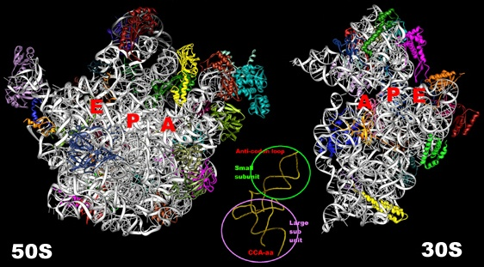
Three-Dimensional Structure
23S and 5S rRNAs (2904 + 120 nt) 34 ribosomal proteins molecular weight: 1,450,000 Da Resolution: ~3.0 Å | 16S rRNA (1542 nt) 21 ribosomal proteins molecular weight: 860,000 Da Resolution: ~3.0 Å
Notes:
Comparison molecular weights (in Daltons): water (18), aspirin (180), caffeine (194), ibuprofen (206), Xanax (309), insulin (5808), hemoglobin (monomer, 17,000; tetramer, 68,000)

Slide 28
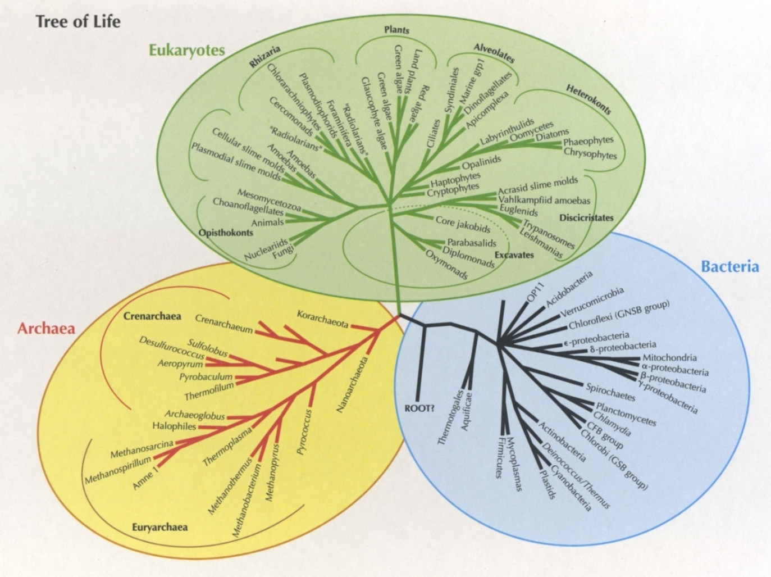
Phylogenetic Relationships (Taxonomy)
Group | # Nodes
Bacteria | 109,796
Archaea | 3,493
Eukaryota | 225,046
Other | 40,825
TOTAL | 379,160
(Data from September 2008)
Notes:
379,160 species nodes (109,796 Bacteria; 3,493 Archaea; 225,046 Eukaryota; 35,978 Viruses; 58 Viroids; 271 “unclassified sequences”; 4,516 “other sequences”; 2 UNRESOLVED NODES).

Slide 29
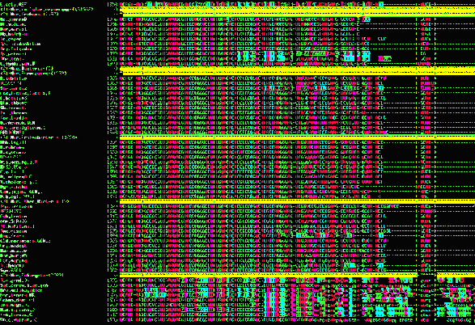
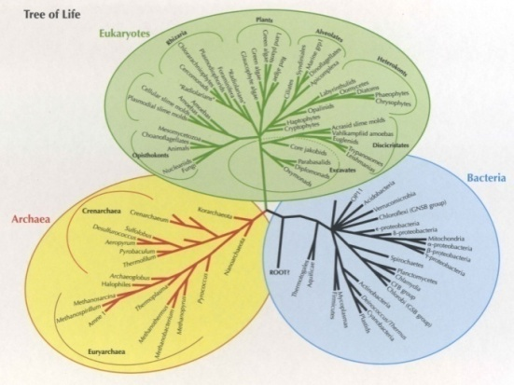

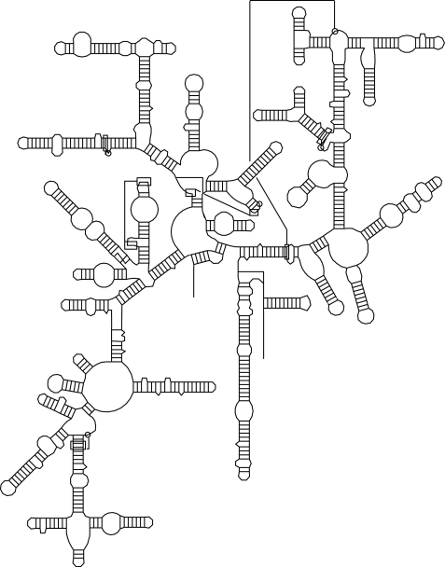
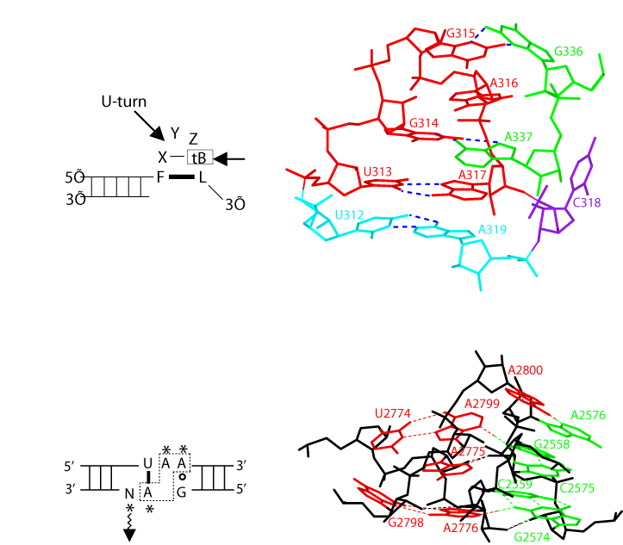
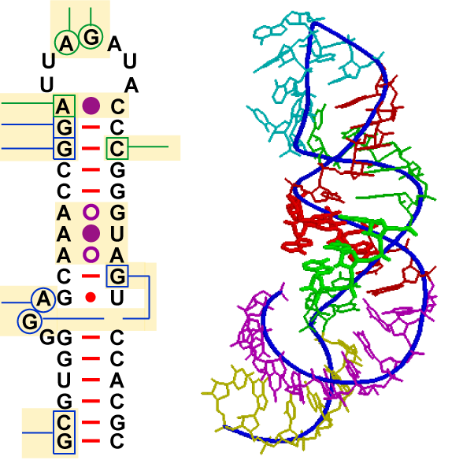
Goal: Integrate Multiple Dimensions of Comparative and Structural Information

Slide 30
3. Tool Development funded with MSR – TCI Grant– Integrated CAT
rCAD [RNA Comparative Analysis Database]
  Integration of multiple dimensions of information into MS-SQLServer
Visualization
  Graphical User Interface integrating multiple dimensions of sequence, phylogenetic, and structure information
CAT (Comparative Analysis Toolkit)
  Sophisticated tool to cross-index multiple dimensions of information
Notes:
For a CAT slide: use a drawing from Kishore’s Thesis? (showing GB, annotation, IISTR, motifs, 3D, phylo)

Slide 31
Current CRW Analysis Tools
AE2 (sequence alignment editor)
query (sequence alignment analysis program)
XRNA (secondary structure drawing program)
RDBMS (Relational Database management system; annotation of data inventory)
CAT (Comparative Analysis Toolkit)
CRW (Comparative RNA Web Site and Project)

Slide 32
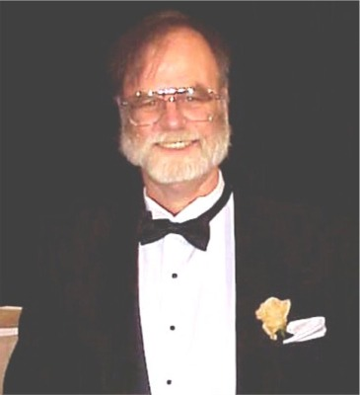


Stuart Ozer - Quote
Our collaboration began in February 2006 when you and your graduate student, Kishore Doshi, approached Microsoft with an extremely complex database problem: how to best represent large-scale […] metadata, sequence alignment, base pair and other structural annotations, and phylogenetic information into a single database system.
The challenge and complexity of this problem were music to our ears here at Microsoft. […] I had recently moved into Jim’s group after spending 5 years on the team that engineered the SQL Server database product, and was eager to tackle challenging computational problems in structural biology.
[…] I expect that our ongoing work together will continue to prove to be extremely fruitful for both your lab and Microsoft.
--Stuart Ozer (2007)

Slide 33
Data Management Re-architecture
CRW Web Site
External Data Source
Perl scripts and manual inspections.
CRW Web Site
Analysis Interface
Stored procedures
Triggers
Predefined queries
Sequence Alignment
External Analysis Software
External Data Source, i.e.
Sequence
Metadata
Phylogeny
Crystal Structure
MySQL Database
CAT
Alignment Editor
xRNA
Reporting Service
Alignment Editor
Structure Viewer
HTML
RNA XML
Integration Services
Packages
Data catalog
Data
sharing API
RNA Table
Organism
Genus
Cell_location
Type
Seq_nbr
Site_positions
Seq_size
NCBI Table
Taxonomy
Name
Flat Sequence Files
Microsoft SQL Server database
Alignment Files
Metadata
LocalGenbankRepository
SequenceMain
CellLocation
MoleculeType
Phylogenetic Information
Taxonomy
Name
AlternateName
Primary Sequence
Sequence
Alignment
Information
AlnSequence
Alignment Coulumn
Structure Diagram
Pair
Motifs
Crystal Structure
PDB files
RNA Join Table
Common name
Accession Number
Alignment name
Structure
Structure Diagram
Files
Before
After

Slide 34
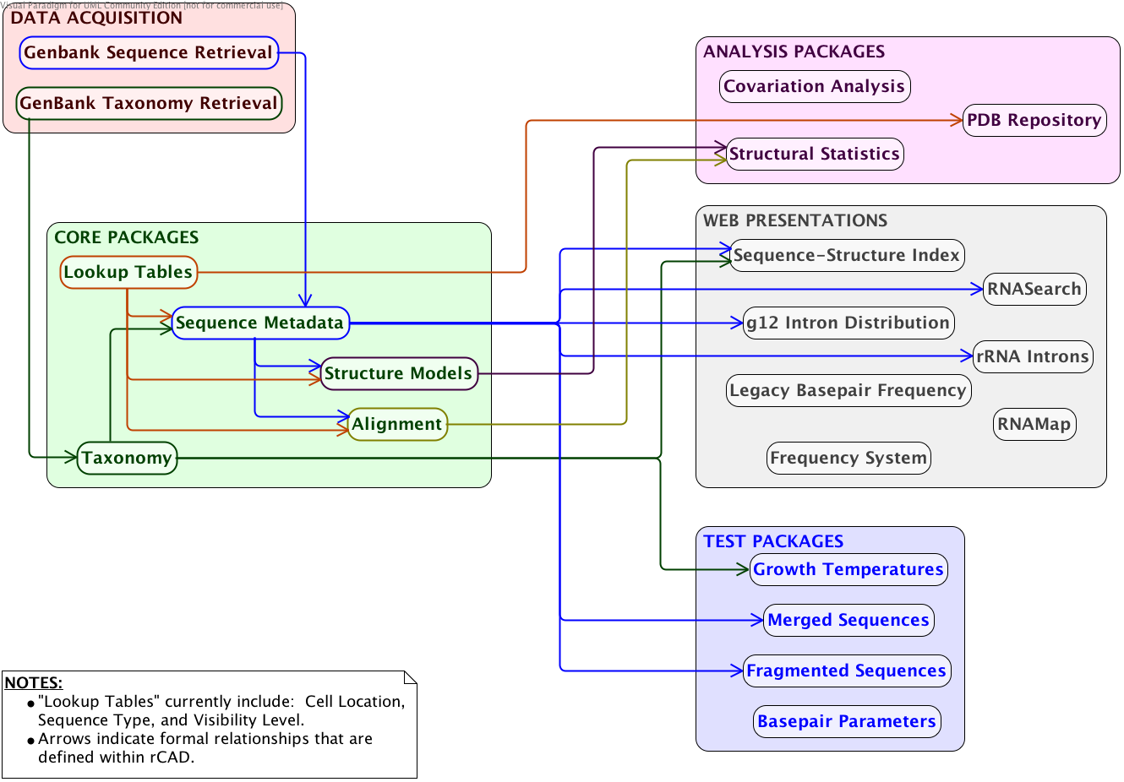
rCAD Schema

Slide 35
Redeveloped Tools
rCAD – RNA Comparative Analysis Database (and CRW Migration)
Curation/Redevelopment of CAT: Properly Cross-Index Dimensions of Information
Visualization Tools
High-performance, load-balancing system design (TACC)
CRW Services
Sophisticated Data Analysis (using the rCAD/SQL Server system)
Other HPC Applications

Slide 36
Process of Comparative Sequence Analysis
Cataloging sequence according to provided metadata information
Select a template alignment or a group of similar sequences based on meta data, i.e. taxonomy, location, sequence type
Correction for input metadata and re-cataloging sequence
Computing alignment
with algorithms utilizing various heuristics.
Alignment analysis
Co-variation analysis
Structural statistics
Deriving secondary motifs
…
Structure & Function
Sequences
New analysis results can cause revising heuristics model and/or preset parameter values

Slide 37
Multidisciplinary Strategy to Determine Fundamental RNA Structure
Principles of RNA Structure
Database-Knowledgebase (Computational)
RNA Structure (Biological)
Hardware/Software (Computational)
Phylogenetic (Biological)

Slide 38
rCAD: Managing RNA Sequences with SQL Server
Goals: Establish a computational foundation to improve comparative sequence analysis using multi-dimensional information and enable accurate prediction of structure and function.
Specific Challenges:
  Scalability: Thousands of new RNA sequences are added to GenBank every week.
  Diversity: Computing accurate sequence alignments requires us to consider different types of information, such as primary sequences, taxonomy group, secondary motifs, and tertiary structure.
  Flexibility: New questions are constantly raised during accumulation of new data and require ad-hoc solutions.
  Automation: Comparative analysis is a multi-step process that requires heavy involvement from domain scientists.

Slide 39
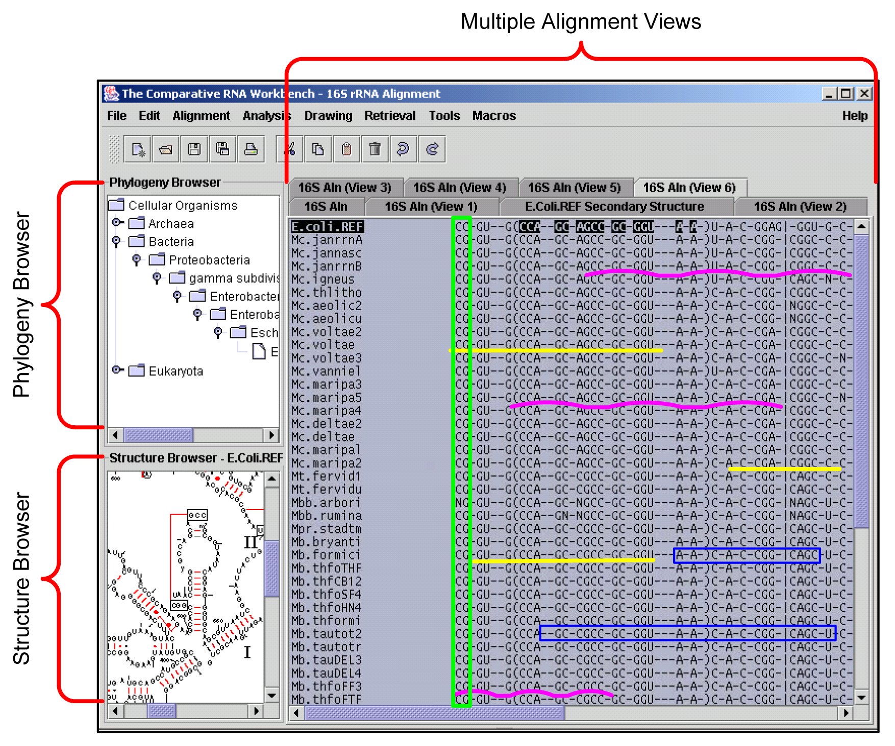
The Doshi Interface Proposal

Slide 40
4. Analysis and Applications
Nucleotide Frequency / Conservation
Covariation Analysis: Predicting Structure Common to a Set of Structurally Related Sequences
Structural Statistics / Machine Learning
  RNA Folding
  Generate Sequence Alignments
  Models of Evolution

Slide 41
RNA Structure
Notes:
Comparative analysis used to determine correct secondary structure. This was used as the baseline.
After a correct secondary structure prediction, the idea is to pass that structure over to a molecular modeling program which will then predict the tertiary structure.

Slide 42
Prediction using
Free-energy Minimization
Notes:
Each structural element is given a free-energy value. Many of these values have been experimentally determined.
For example, hairpin energy is determined through an algorithm that takes into account the length and the NTs at the intersection.
Basepair energies were talked about by Johnny. ILoops follow a similar approach as hairpins.
mFold uses the energy values and does an intelligent, but brute-force approach to look for the structure that gives the lowest estimate free-energy. It does this very well.

Slide 43
Comparative vs. Potential Energy
(16S rRNA; Bacteria; ~1542 Nucleotides)

Slide 44
Comparative vs. Potential Energy
(tRNA; ; ~76 Nucleotides)
Notes:
Further evidence.

Slide 45
mFold Prediction Accuracy
rRNA Molecule | Archaea | Bacteria | Eukaryote
16S | .59 | .49 | .34
23S | .57 | .51 | .43
5S | .72 | .73 | .71
Notes:
For smaller molecules, this brute-force approach has much better results.

Slide 46
RNA Folding Model
Distance
  Nucleotides in close proximity are more likely to interact
  Search only for helices with short simple/conditional distance
Energetics
  Needs improved energy parameters
    Basepair, hairpins, internal loops, …
  Statistical potentials generated from comparative analysis
Kinetics of the folding process
  Competition
  Direction to the folding pathway

Slide 47
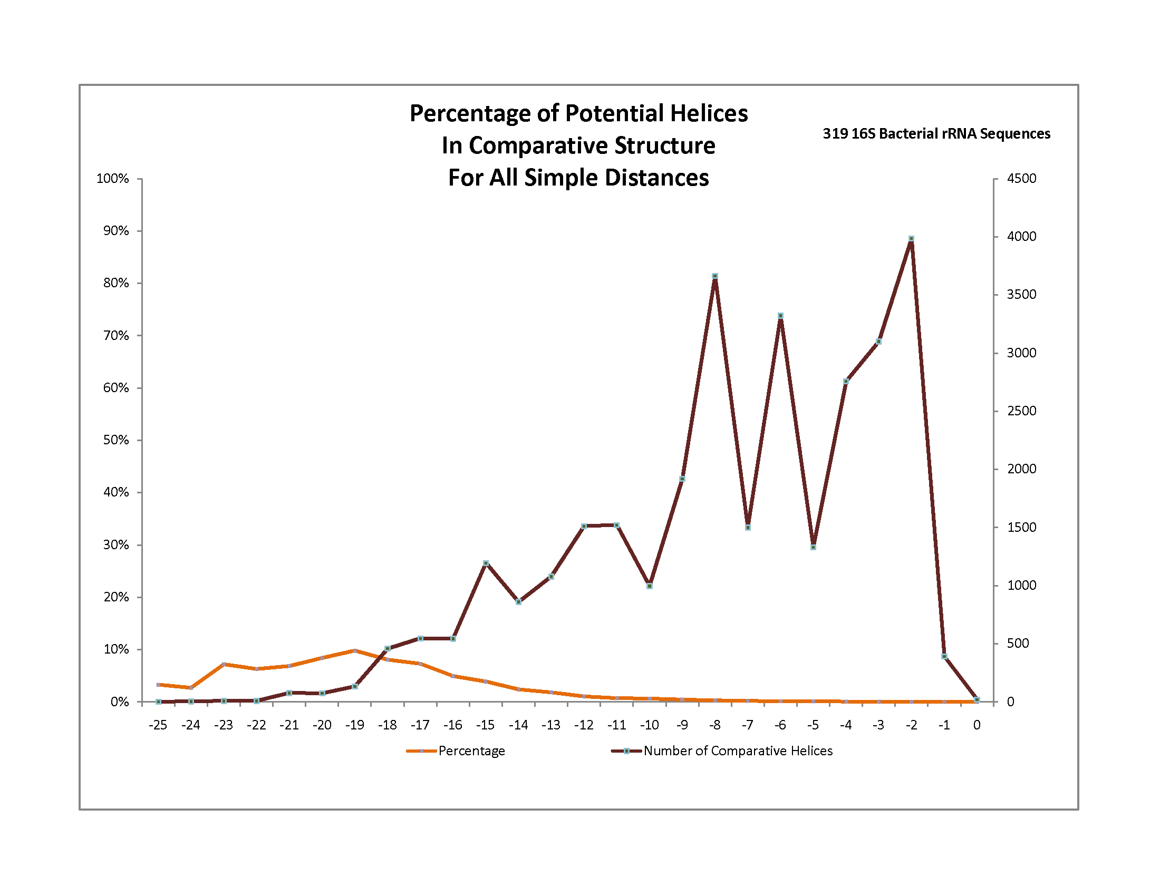
Energy Range | -25 -21 | -20 -16 | -15 -11 | -10 -6 | -5 -1
Comparative Helix Count | 123 | 1857 | 6599 | 11652 | 11183
Potential Helix Count | 1524 | 22723 | 268774 | 3378610 | 25410547
Percentage | 8.1 | 8.2 | 2.5 | 0.3 | 0.04

Slide 48
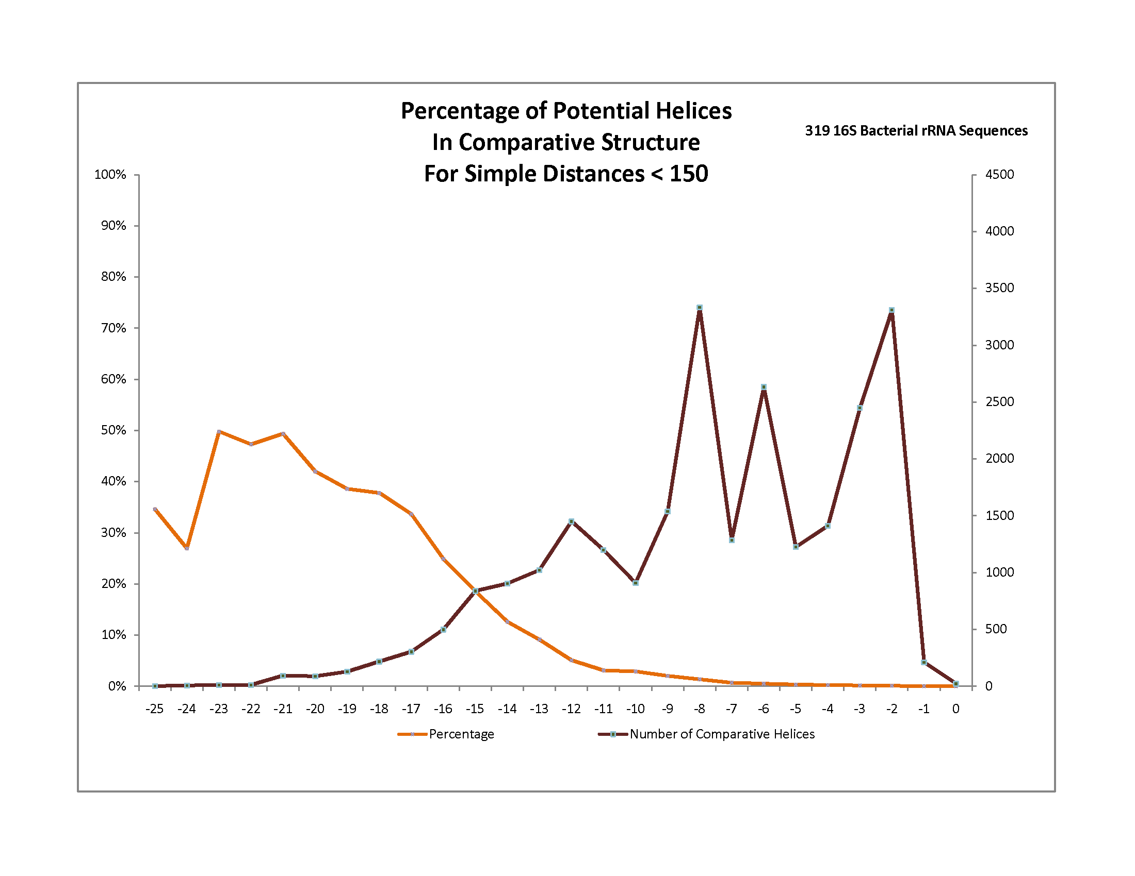
Energy Range | -25 -21 | -20 -16 | -15 -11 | -10 -6 | -5 -1
Comparative Count | 122 | 1233 | 5410 | 9696 | 8603
Potential Count | 256 | 3177 | 47959 | 638715 | 4773915
Percentage | 47.7 | 38.8 | 11.3 | 1.5 | 0.2

Slide 49
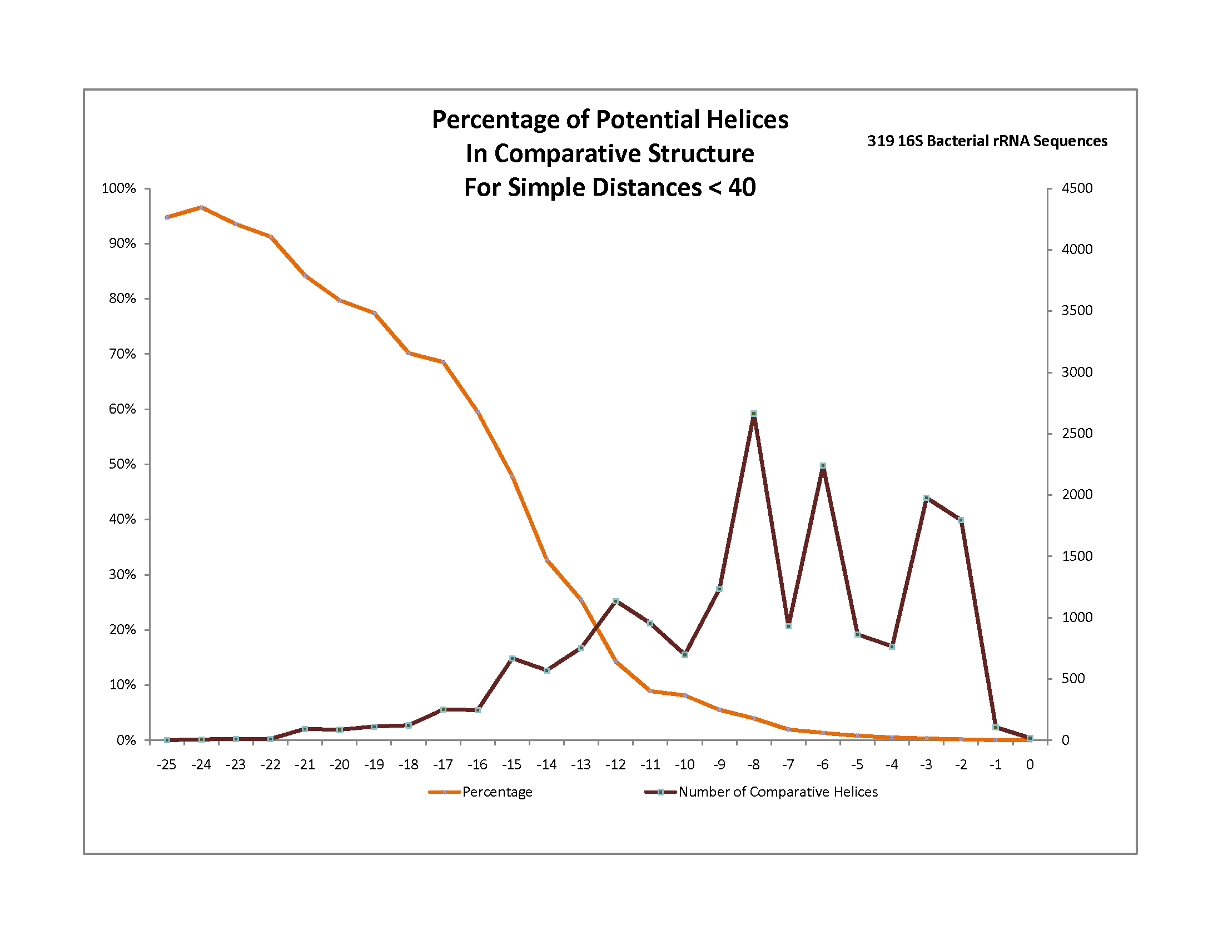
Energy Range | -25 -21 | -20 -16 | -15 -11 | -10 -6 | -5 -1
Comparative Count | 121 | 814 | 4078 | 7766 | 5504
Potential Count | 130 | 1124 | 13282 | 174200 | 1267031
Percentage | 93.1 | 72.4 | 30.7 | 4.5 | 0.4

Slide 50
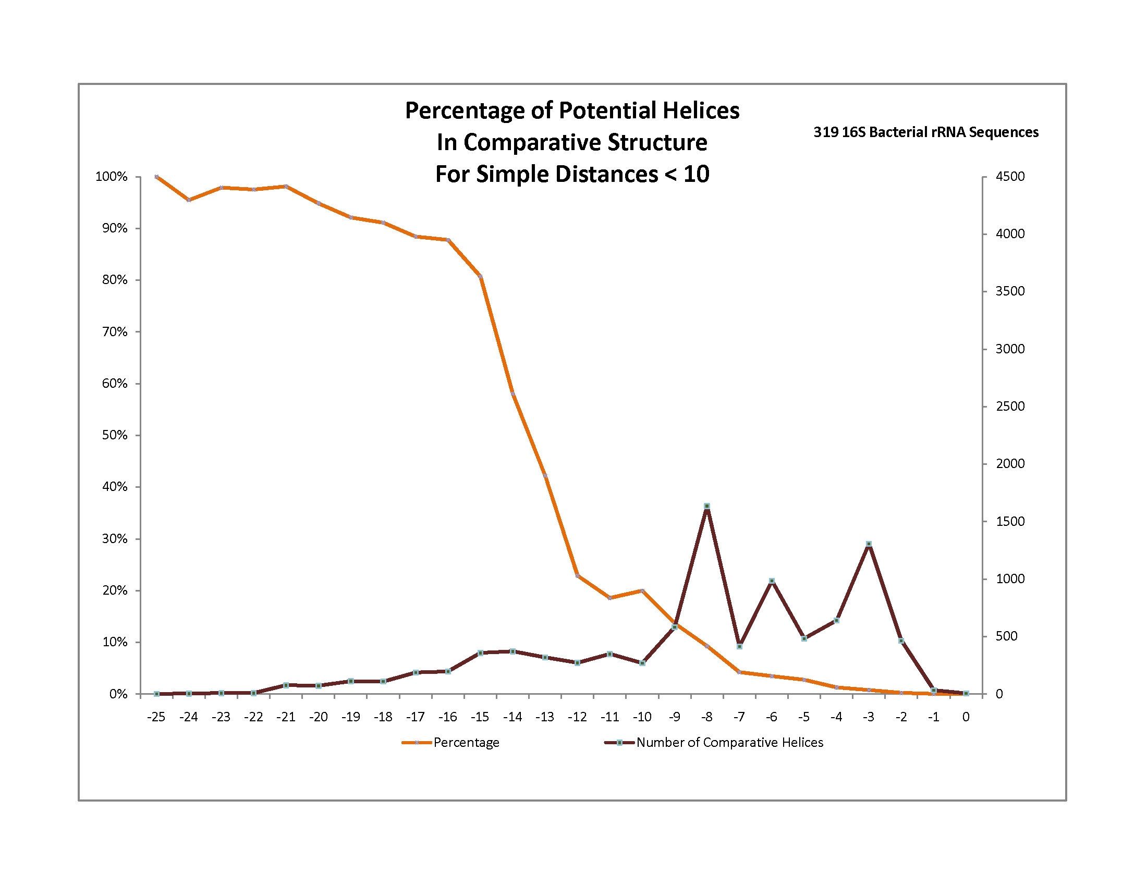
Energy Range | -25 -21 | -20 -16 | -15 -11 | -10 -6 | -5 -1
Comparative Count | 121 | 697 | 1657 | 3955 | 2909
Potential Count | 123 | 748 | 3059 | 38292 | 278994
Percentage | 98.4 | 93.2 | 54.2 | 10.3 | 1.0

Slide 51
Statistical Potentials
Distance
  Improves prediction accuracy
  Most comparative helices are not very stable.
    Even over short distances, prediction accuracy is low
Statistical Analysis
  Frequency is equivalent to stability
  Generate better energy parameters
    Bias in basepairing
    Hairpins can be stabilizing to RNA structure.

Slide 52
Improved Free-Energy Parameters
Notes:
We can look for specific motifs. While we can’t know what it will look like in 3-D, motifs that occur frequently should have a physical explanation.
Frequency

Slide 53
Frequency ≈ Stability
Base Pair Frequencies → Pseudoenergies
 | AU | CG | GC | GU | UA | UG
AU | .012 | .046 | .048 | .005 | .012 | .010
CG | .040 | .086 | .070 | .012 | .035 | .024
GC | .029 | .089 | .095 | .021 | .042 | .033
GU | .009 | .022 | .028 | .005 | .017 | .004
UA | .019 | .039 | .053 | .003 | .018 | .007
UG | .005 | .016 | .015 | .017 | .008 | .007
WHERE
Base Pair Frequencies
 | AU | CG | GC | GU | UA | UG
AU | -1.97 | -3.05 | -3.11 | -0.48 | -1.95 | -1.35
CG | -2.87 | -3.30 | -3.03 | -1.08 | -2.72 | -1.94
GC | -2.48 | -3.31 | -3.40 | -1.77 | -2.93 | -2.33
GU | -1.32 | -1.80 | -2.13 | -0.11 | -2.03 | 0.05
UA | -2.50 | -2.83 | -3.20 | -0.08 | -2.42 | -0.93
UG | -0.67 | -1.49 | -1.36 | -1.66 | -1.16 | -0.61
 | AU | CG | GC | GU | UA | UG
AU | -0.9 | -2.2 | -2.1 | -0.6 | -1.1 | -1.4
CG | -2.1 | -3.3 | -2.4 | -1.4 | -2.1 | -2.1
GC | -2.4 | -3.4 | -3.3 | -1.5 | -2.2 | -2.5
GU | -1.3 | -2.5 | -2.1 | -0.5 | -1.4 | 1.3
UA | -1.3 | -2.4 | -2.1 | -1.0 | -0.9 | -1.3
UG | -1.0 | -1.5 | -1.4 | 0.3 | -0.6 | -0.5
Statistical Potentials
Experimental Energies

Slide 54
Base Pair Stacking Energy: Experimental vs. Statistical

Slide 55
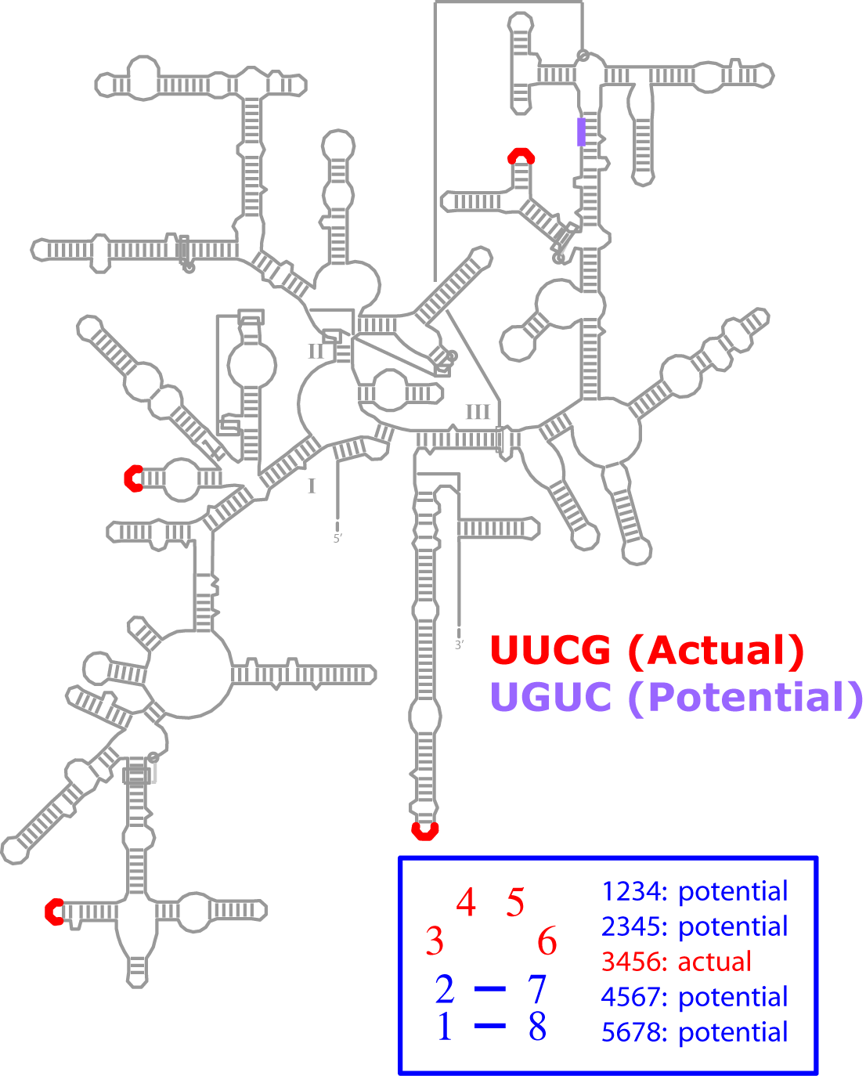
Structural Statistics: Tetraloops (Bacterial 16S rRNA)
Pattern | Actual | Potential |  |  | A / P
Total | 99064 | 1221206 |  |  | 0.08
UUCG | 12283 | 13258 |  |  | 0.93
AGCC | 6245 | 7551 |  |  | 0.83
GCAU | 4465 | 5531 |  |  | 0.81
GCAA | 9548 | 12599 |  |  | 0.76
GAAG | 5906 | 8545 |  |  | 0.69
246 others […]
UGCU | 0 |  | 722 | 0
UGGA | 0 |  | 1539 | 0
UGUA | 0 |  | 878 | 0
UGUC | 0 |  | 5695 | 0
UGUU | 0 |  | 2454 | 0
From ~36,000 sequences.

Slide 56
Hairpin Nucleation
Hairpin statistical potentials
  Helices with short simple distances have a higher rate of prediction.
Conditional Distance
  With proper prediction of nucleation points, folding problem should become simpler.
  Does the distance hypothesis still hold after nucleation has occurred?
    After one helix forms, two nucleotides with a larger simple distance can have a smaller conditional distance.

Slide 57
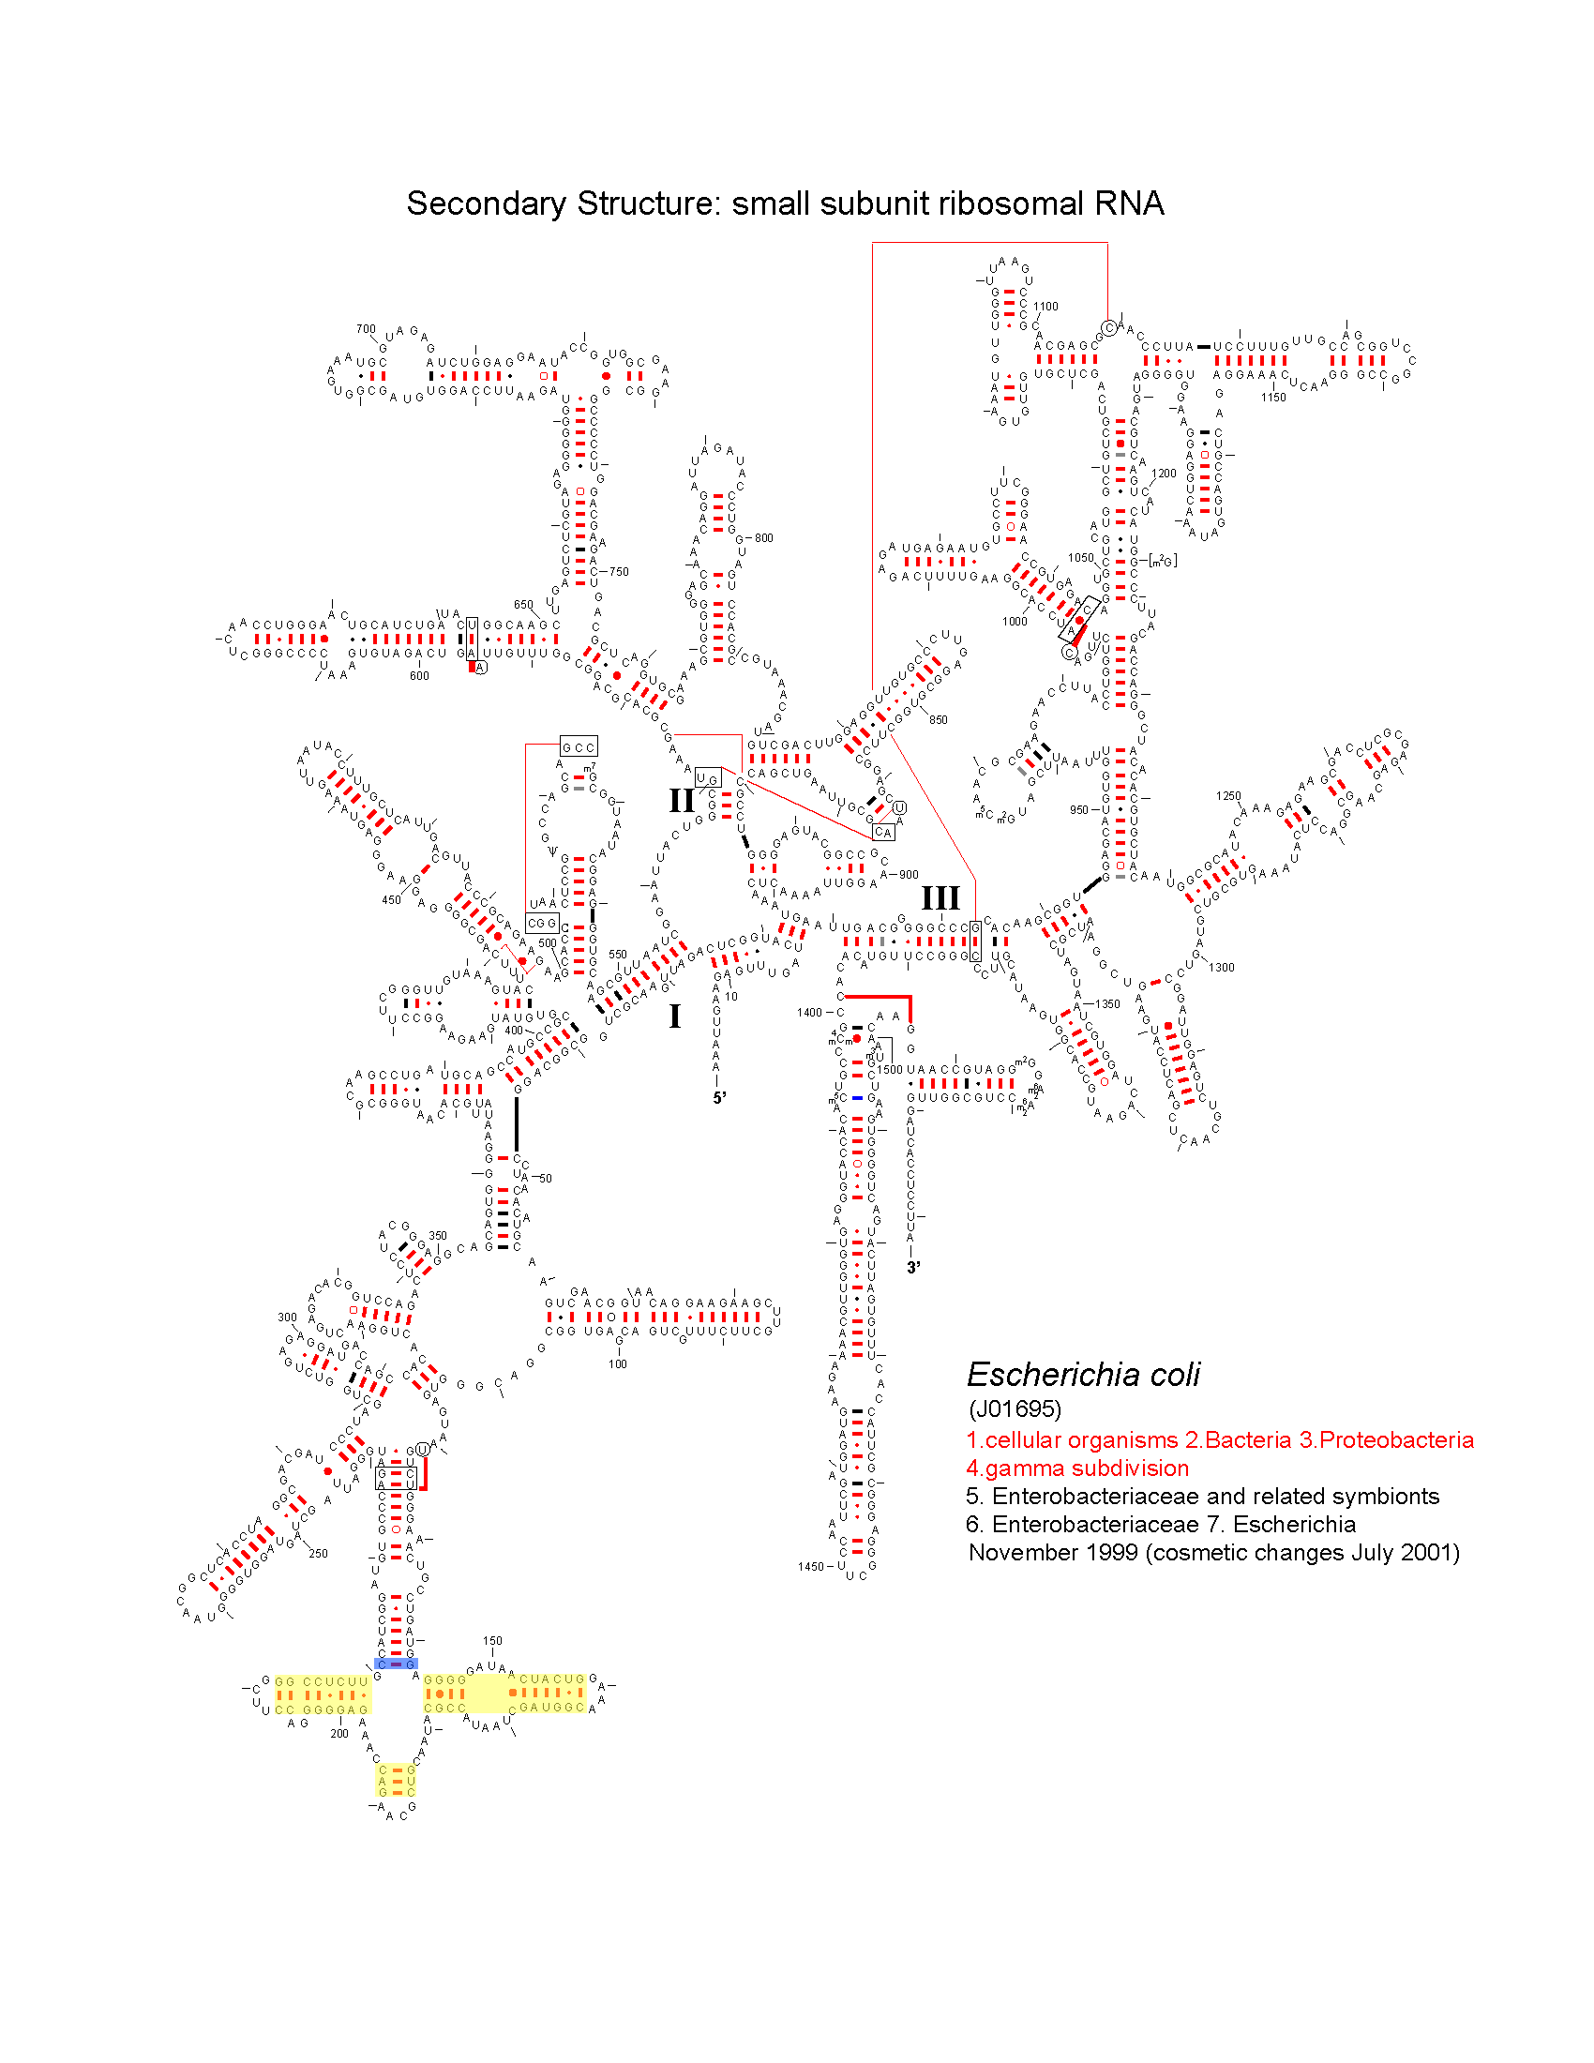
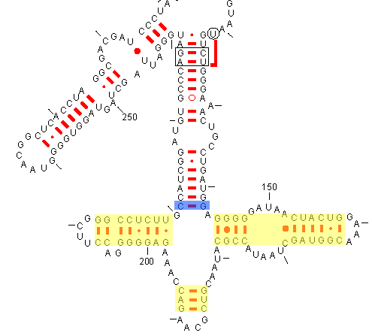
Conditional Distance
Simple Distance = 79
Conditional Distance = 15

Slide 58
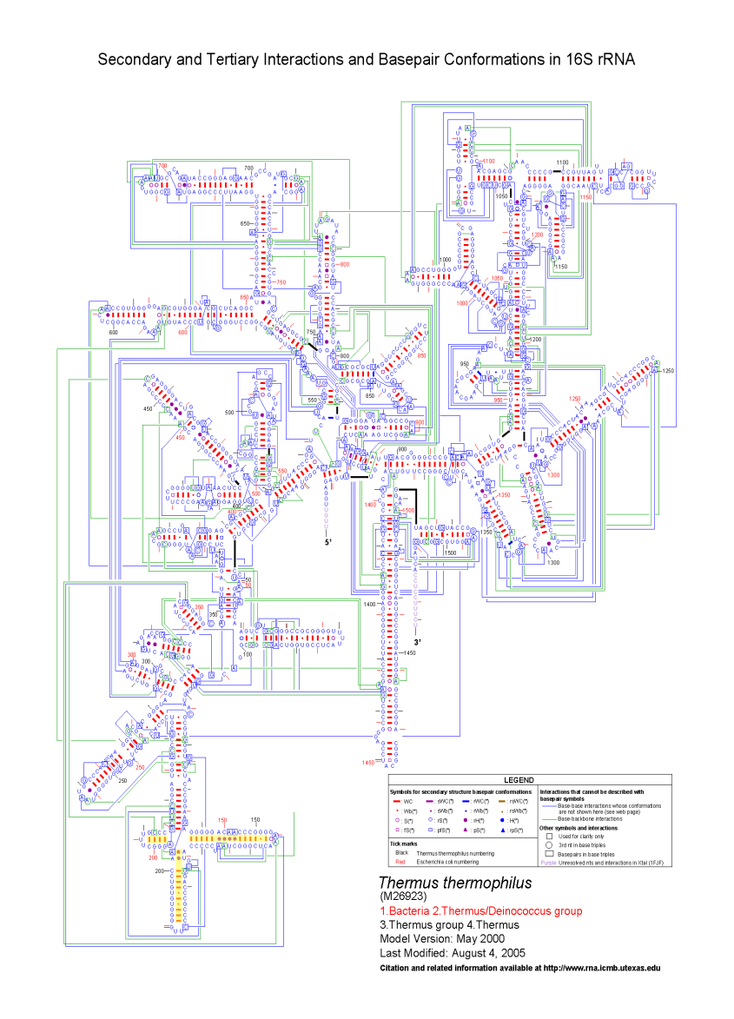

Conditional Distance
Simple Distance = 79
Conditional Distance = 5

Slide 59

Energy Range | -25 -21 | -20 -16 | -15 -11 | -10 -6 | -5 -1
Comparative Count | 2 | 1173 | 4483 | 7804 | 8267
Potential Count | 261 | 8277 | 95697 | 1356079 | 11996467
Percentage | 0.8 | 14.2 | 4.7 | 0.6 | 0.07

Slide 60

Energy Range | -25 -21 | -20 -16 | -15 -11 | -10 -6 | -5 -1
Comparative Count | 1 | 563 | 3559 | 6737 | 6371
Potential Count | 45 | 1538 | 24959 | 361470 | 3193537
Percentage | 2.2 | 36.6 | 14.3 | 1.9 | 0.2

Slide 61

Energy Range | -25 -21 | -20 -16 | -15 -11 | -10 -6 | -5 -1
Comparative Count | 1 | 371 | 2685 | 4667 | 3340
Potential Count | 2 | 482 | 7651 | 105548 | 895690
Percentage | 50.0 | 77.0 | 35.0 | 4.4 | 0.4

Slide 62

Energy Range | -25 -21 | -20 -16 | -15 -11 | -10 -6 | -5 -1
Comparative Count | 0 | 138 | 1311 | 1989 | 1692
Potential Count | 0 | 168 | 2444 | 27367 | 223267
Percentage | 0 | 82.1 | 53.6 | 7.3 | 0.8

Slide 63
Summary and Future Work
rCAD
  Cross-index multiple dimensions of information
  Find new relationships between structure and sequence
    Determine fundamental principles of RNA structure
    Increase the accuracy of prediction of RNA secondary and tertiary structure
Future
  Structural statistics on additional motifs will improve energy parameters
    Internal loops, multi-stem loops, e.g. E-Loop, UAA/GAN
  Folding algorithm
    Incorporating distance constraints, improved energetics and kinetics

Slide 64
Research Team and Support
Team:
  Robin Gutell (Principal/Principle Investigator)
  Jamie Cannone (CRW Site/Project curator; rCAD development)
  Kishore Doshi (rCAD/CAT development; RNA folding)
  David Gardner (structural statistics; RNA folding)
  Jung Lee (RNA structure analysis)
  Weijia Xu (Texas Advanced Computing Center; rCAD development)
  Stuart Ozer (Microsoft; rCAD development)
  Pengyu Ren/Johnny Wu (Statistical potentials, BME)
  Ame Wongsa (RNAMap development)
Funding:
  Microsoft Research (TCI)
  National Institutes of Health
  Welch Foundation
Notes:
Add roles for each person to this slide – let people read while you talk.

Slide 65

Have rRNA, Will Travel

