Slide 1



A Data Model for Environmental Observations
David Valentine - valentin@sdsc.edu
Bora Beran - borabe@microsoft.com
Oleg Kapeljushnik - oleg@renci.org

Slide 2
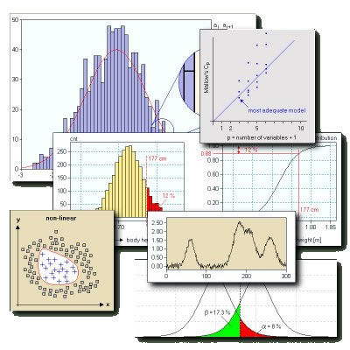
Challenges of Environmental Data Storage
Maintain data integrity, interoperability and completeness even for non-database professionals
Easily organize and navigate disparate data sets
Interact with data at higher level than SQL queries
Discussion Outline
Observations Data Model (ODM) Database Model
Entity Data Model (EDM)
Usage scenarios and examples

Slide 3















FLUXNET
A network of networks
To better understand the net ecosystem productivity and carbon sequestration of the terrestrial biosphere
250+ towers, 950+ site years of data
Micrometeorology: e.g. CO₂, H₂O and energy fluxes
http://www.fluxdata.org

Slide 4

CUAHSI
An organization of hydrologists with 115 member institutions
Involved in cyberinfrastructure efforts since 2004
11 test-bed sites funded through NSF’s Environmental Observatory Program
Developers of ODM v1.0 (and v1.1)
http://his.cuahsi.org/odmdatabases.html
WaterML (WaterOneFlow) Web Services
http://his.cuahsi.org/wofws.html
http://www.cuahsi.org

Slide 5
Renaissance Computing Institute (RENCI)
Disaster Studies Initiative
Brunswick County Flood Sensor (BCFS) network
Real-time data for county officials and the NWS to assess flooding hot spots in the county
https://www.sensordatabus.org/bcfs
UNC Charlotte weather stations
Real-time weather data collection in Brunswick County throughout hurricane season
BCFS Project Motto: “When you are up to your eyeballs in alligators, it is hard to remember that you are there to monitor the swamp…”
--Ilia Baldine, Renci
http://www.renci.org

Slide 6
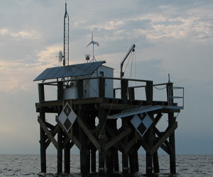
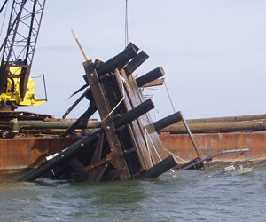

Renaissance Computing Institute (RENCI)
North Carolina Environmental Observation Network System (NC-EONS) – Pamlico Sound
Understanding marine ecosystems and possible effects of climate change
5.8 gigahertz high-speed wireless communications link at the ferry terminal, VHF 9600 baud packet switched network and a 902 megahertz wireless network
Sept 30th, 71-foot steel trawler accidentally strikes the platform
To be rebuilt in Spring 2009
https://www.nceons.org/

Slide 7

Renaissance Computing Institute (RENCI)
Sensor Data Bus (SDB)
Hosting platform for the aforementioned science projects, among others
Repository/data warehouse for all of our sensor data
Tools, technologies and services centered around interacting with disparate forms of sensor data and corresponding metadata
All code and tooling developed on top of ODM (v2.0), the Entity Data Model, and the Microsoft platform will be released under FreeBSD style open source license
https://www.sensordatabus.org

Slide 8


Data Model for Environmental Observations
FLUXNET
Spatial support
Extensibility
Ancillary data support
Ease of use
Provenance tracking
Versions
Namespace translation
Entity Framework
STORED PROCS
Database Schema
CUAHSI
RENCI
User Defined Types
Others…

Slide 9
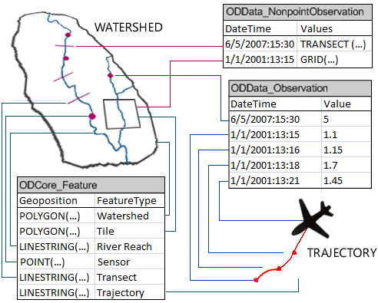
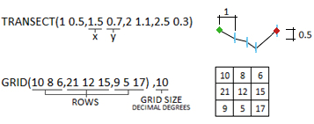
Data Model for Environmental Observations
NEW DATA TYPES
STREAMLINED DESIGN
SPATIAL SUPPORT
ftp://ftp.research.microsoft.com/pub/tr/TR-2008-92.pdf

Slide 10
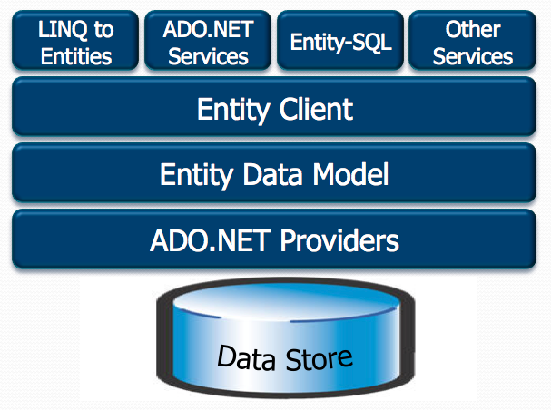
Entity Framework – Key Features
Separates application from database schema
Object oriented
Interact with data as objects
Entity types can inherit from other entity types
Acts as DAO layer of an application
Various technologies which work with EDM
Entity-SQL
LINQ to Entities
ADO.NET Data Services
And more…

Slide 11
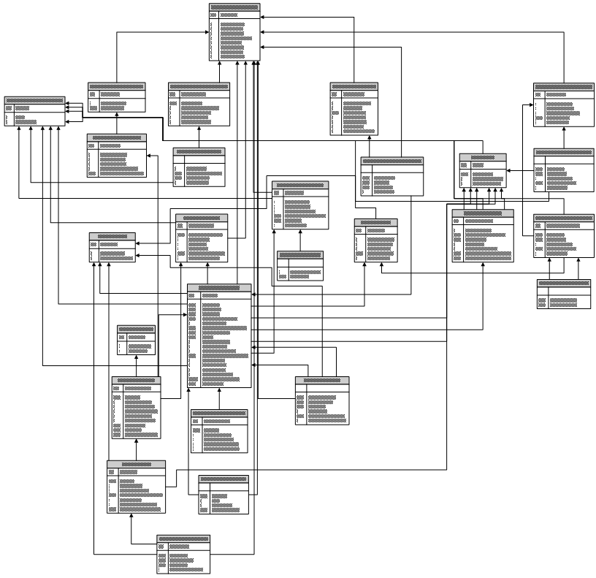
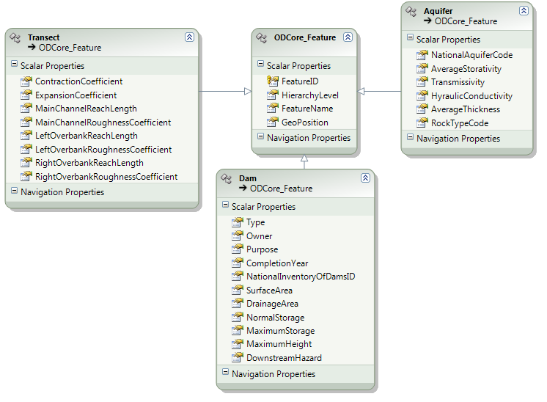
A Data Model for Environmental Observations
SELECT P.FeatureID, MAX(CASE WHEN PropertyName = 'Dam Type' THEN [PropertyValue] ELSE NULL END) AS [Dam Type], MAX(CASE WHEN PropertyName = 'Dam, Purpose' THEN [PropertyValue] ELSE NULL END) AS [Dam Purpose] FROM SciScope.dbo.ODCore_Feature AS F INNER JOIN dbo.ODExtensibility_FeatureProperty AS P ON F.FeatureID = P.FeatureID INNER JOIN dbo.ODExtensibility_GenericProperty AS G ON G.PropertyID = P.PropertyID WHERE (F.FeatureType = 'Dam') GROUP BY P.FeatureID
Entity SQL
Query<Dam> DamsQuery = db.GetQuery<Dam>( "SELECT * FROM Dams");
LINQ to Entities
IQueryable<Dam>DamsQuery = from d in Dams
select d;
Why an Entity Data Model?
Simplifies code development
User to deals with conceptual model rather than database schema
DB schema changes don’t affect software built on top of the entity model
Entity Data Model

Slide 12
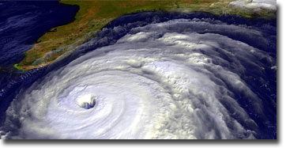
Features and Events
Watershed (feature)
Hurricane (event)
Dam (feature)
Drought (event)
Aquifer (feature)
Hurricane Floyd (1999)
Usage Scenarios
How does this hurricane compare with others?
What is the average precipitation and its departure from normal for the watershed above some reservoir?

Slide 13


Usage examples
.NET code
Web Services
ADO.NET Data Services

Slide 14
Summary
ODM2 and associated tooling can have a significant impact in data interoperability and availability
Common interfaces lead to a rich ecosystem of tooling - ODM Tools and WaterOneFlow Services are just the beginning
The Entity Framework and .Net platform features such as LINQ to SQL will enable more rapid and intuitive software development

Slide 15
Resources
www.renci.org
www.sensordatabus.org
ftp://ftp.research.microsoft.com/pub/tr/TR-2008-92.pdf

