Slide 1

Management and contextualization of scientific virtual appliances
Germán Moltó
Associate Professor at the Universidad Politécnica de Valencia (Spain)
gmolto@dsic.upv.es
For the Cloud!

Slide 2

OUTLINE of the talk
Outline
  Introduction and Overview of the GRyCAP
  Scientific Cloud Computing
  Contextualization: Scientific Virtual Appliances
  Virtual Appliances Repositories and Catalogs
  Scientific Applications
  Conclusions and Future Challenges

Slide 3
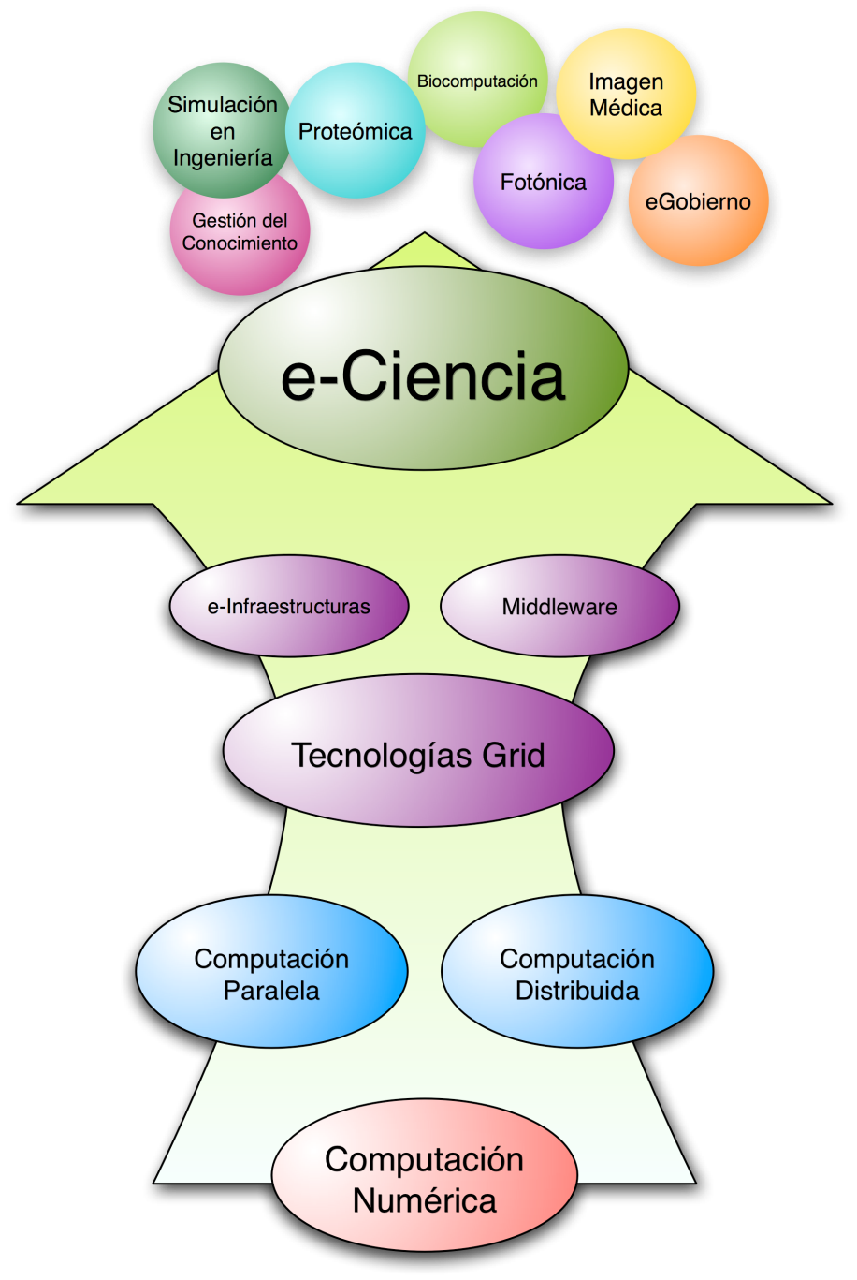
The grycap in a slide
Grid and High Performance Computing Group
Group of the Area of Information Technologies and Computational Science Created on 1986 by Vicente Hernández and Composed by 28 Researchers (http://www.grycap.upv.es).
Adoption of Parallel and Distributed Computing Technologies for Improving the Performance of Scientific Applications.
Evolution to Grid and Cloud Technologies
E-Science: Support for Science Research through the Collaborative Use of Distributed Resources.
e-Government
Engineering Simulation
Proteomics
Medical Imaging
Biomedical Computation
Photonics
e-Science
e-Infrastructure
Middleware
Grid Technologies
Cloud Technologies
Parallel Computing
Distributed Computing
Numerical Computation

Slide 4
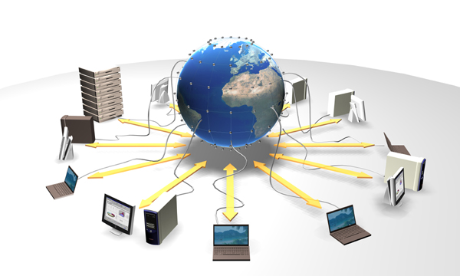
Scientific applications
Scientific Applications typically require:
  Large computational power.
    Its requirements might exceed the resources of a single machine
  Processing large amount of data.
Combination of Several Techniques
  High Performance Computing
    Using multiple processors to solve a problem.
  Grid Computing
    Enable the collaborative usage of resources from multiple organizations to face the efficient execution of large-dimension problems.
Notes:
It’s requirements might exceed the capacities of single computers.
Specific Execution Environment:
Operating System, Numerical Libraries, Middlewares, Databases, …
.
Either Shared Memory (OpenMP) or Distributed Memory (MPI).

Slide 5
Grid computing
Pros and Cons
Grid Computing has been successfully employed in many scientific areas, although same caveats exist.

Slide 6
Cloud computing
For Scientific Computing
Cloud Computing advantages over Grid Computing:
  It allows the resource consumers to configure their specific Execution Environments.
    A controlled enviroment is critical to guarantee the successful execution of scientific applications.
  Dynamic scaling of infrastructures for resource providers.
    Virtual Machines can be deployed using workload-aware strategies.
  Fast and easy access to a large amount of resources.
    No need for scientific comission’s approval, just use your Credit Card.
  Reduced energy consumption (Green Computing)
    Machines are only provisioned when they are requested.
    Virtualization leverages server consolidation.

Slide 7
The point of view of the scientist/Engineer
Scientists and Engineers should not be concerned with implementation details of technology.
I don’t care about technology, I just want my apps to run the fastest possible
X.509
Proxies
CAs
Grid
VOs
SE
gLite
Globus
LFN
SURL
…
Hypervisor
Configuration
Focus on abstracting the details of application porting to the Cloud.
Cloud
Deployment
Monitoring
APIs
…

Slide 8
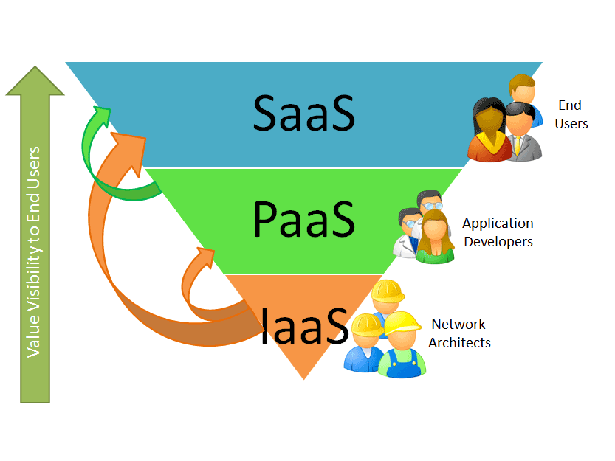
SCIENTIFIC Cloud computing
Scientific Cloud Computing focuses on the execution of scientific applications on a (typically) IaaS cloud.
Google
Docs
Office
Live
…
Google App Engine
MS Azure
…
Eucalyptus
OpenNebula
…
Amazon EC2
Source: www.saasblogs.com
It requires the management and provision of Scientific Virtual Appliances from a Virtual Machine Manager.

Slide 9
Virtual machine managers
VMMs provide the basic tools to build an IaaS Cloud
  Different tools in the cloud arena for VM management.

Slide 10
Current limitation of cloud computing tools
Virtual Machine Managers focus on supporting the life cycle of VMs.
Scientific Cloud Computing also requires:
  (semi-)Automated contextualization of Virtual Machines for scientific applications → Scientific Virtual Appliances (SVA).
  Reusing SVAs from one experiment to another, also to enhance SVAs sharing among different researchers.
We focus on:
  Application contextualization (From a VM to a SVA).
  Repositories and catalogs of SVAs.

Slide 11
Virtual appliances
A Virtual Appliance (VA) consists of a Virtual Machine specially configured for an Application.
Application
App Data
Application
Computational Libraries
Application Requirements
Middlewares
Operating System
Persistence Layer
Virtual Appliance
Services
Operating System
Scientific Virtual Appliance

Slide 12
Contextualizing scientific virtual appliances
From VMs to production SVAs …
Contextualization means creating the appropriate SW/HW environment for the successful execution of an application.
  Virtual Machines need to be contextualized (IP, DNS, etc.).
    Support typically provided by the VMMs.
  Applications need to be contextualized.
    Deployed, configured, built, executed.
Virtual Machine
Scientific
Virtual Appliance
Contextualization
Plain OS
Scientific Application running

Slide 13
Software configuration tools
Many machine configuration tools.
Focus on automating the:
  Machine configuration
    DNS, Config files, etc.
  Installation of commonly used packages:
    Web Servers, Application Servers, etc.
Client-Service tools.

Slide 14
Deploying scientific applications
Many scientific applications follow the same patterns …

Slide 15

Automating application contextualization (I)
For Scientific Applications
We are working on software for (scientific) application contextualization.
  Goal: Software inoculation and configuration into the VM with minimum user intervention.
  Automation vs SSH-based Manual Installation
App
Install Packages
App Description (XML)
CNTXTLZR
Configure
Software Dependences
Contextualization Plan
Build
Deploy / Run

Slide 16
Automating application contextualization (II)
Developed a proof-of-concept tool for scientific application contextualization.
  Python-based to ensure good portability.
  Plugin-based to describe the deployment of software packages.
    XML language
The tool, application and requirements are staged into the VM at boot time via the VMM capabilities (OpenNebula).
  VM is turned into a SVA by application contextualization at boot time.

Slide 17
Toward virtual machine cataloguing
There exist VM catalogs out there:
  VMWare Marketplace
  Science Clouds Marketplace
BUT…
  For human consumption, no APIs, unstructured metadata, etc.
The VM Catalog includes:
  VM Metadata (OS, Software Environment, etc.)
    OVF (Open Virtualization Format), XML-based.
  Links to VM repositories (either local or remote).
  Matchmaking algorithms to retrieve the most appropriate VMs according to user requirements (hard vs soft).

Slide 18
Management of scientific virtual appliances
The user/admin provides a description of the VM in OVF format.
FTP server instances are created on demand with dynamic and temporary credentials for VM upload.
Client-Side Libraries to ease the interaction with the catalog.

Slide 19
Virtual Machine Repository
The VM Repository includes:
  Storage of VMs
  Data Access Mechanisms
    HTTP and FTP.
    GridFTP would provide enhanced X.509-based security.
Virtual Machines considered:
  Golden VMs
    Example: JeOS-based, Low footprint (Ubuntu JeOS , 380 Mbytes HD)
  Pre-Contextualized VMs
    Reuse the work done. No need to re-deploy software forever.
    Example: A Globus Tookit 4-based VM that can be reused for the deployment of different Grid Services.

Slide 20
The big picture
Catalogs, Repositories and Contextualization

Slide 21
Remote controlling an application
How to control the App and access the output files inside the VA?
  We rely on the Opal 2 Toolkit
Opal 2 Toolkit provides a WS Wrapper for Applications
  Operations for starting, monitoring and terminating the application.
  Support for local, MPI and Globus-based executions.
  Output files accessible through Tomcat (computational steering).
Generic Opal 2 WSDL
App
App
App
Opal 2 Toolkit
Application Server (Apache Tomcat)
Virtual Appliance
Opal 2 Toolkit developed @ NBCR

Slide 22
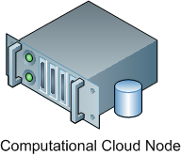
Web services wrapper to computational applications
WS-Wrapped Applications can now be orchestrated by the Cloud Enactor (acting as a Task Manager).
  Applications can now be controlled (started and monitored) inside the Scientific Virtual Appliance.
  Many instances of the application can be concurrently managed.
Virtual Appliance
Cloud Enactor
(Task Manager)
WS Wrapper (OPAL)
Control, Monitor,
Access files
App
API
Client-Side OPAL API
Hypervisor

Slide 23
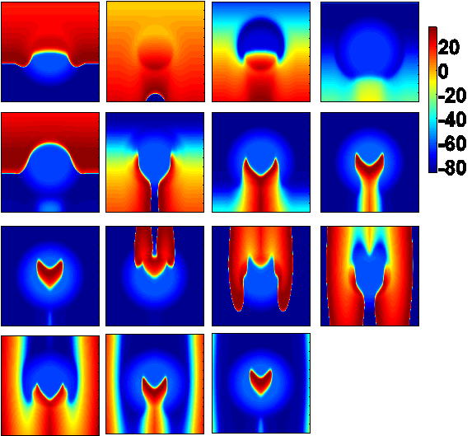
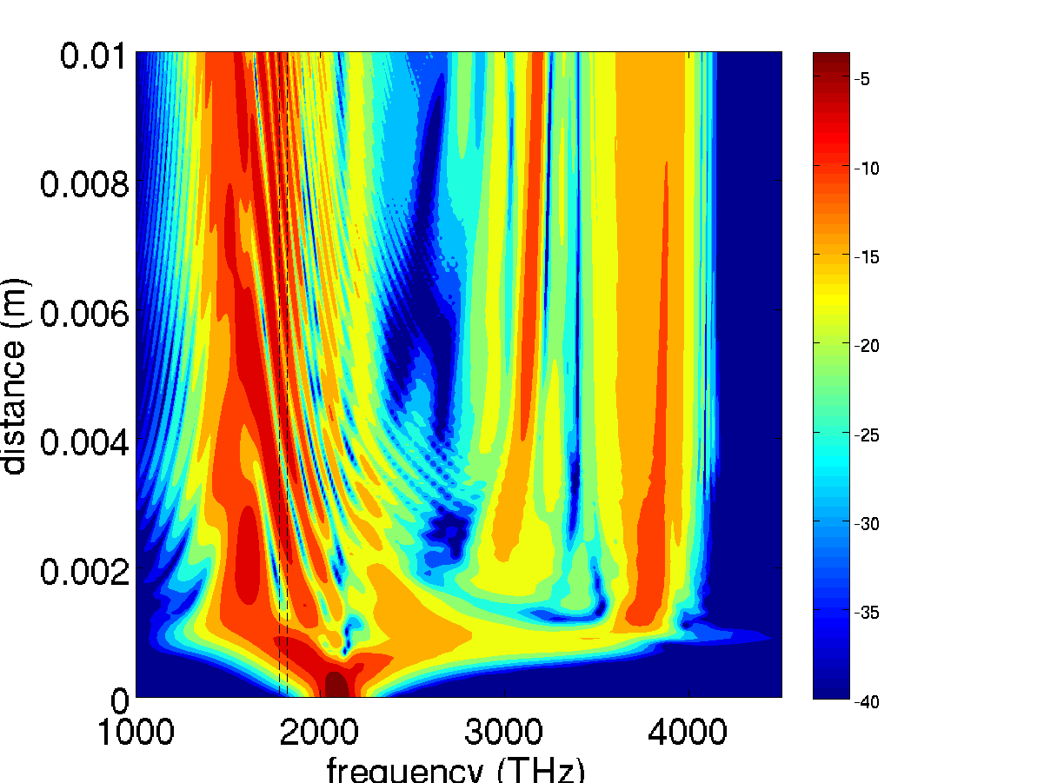
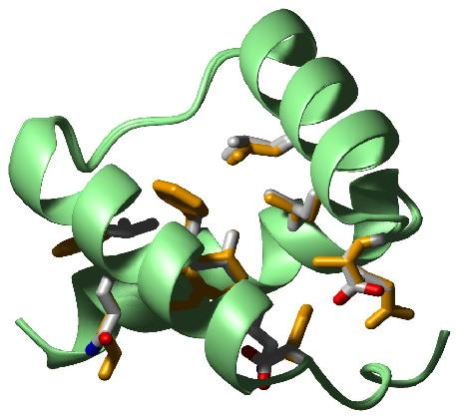
Scientific applications
Simulation of Cardiac Electrical Activity
  Action Potential Propagation on Cardiac Tissues.
Simulation of Guided Light in Photonic Crystal Fibers
  Optimization of Supercontinuum Spectrum using Genetic Algorithms.
Optimization of Protein Design with Target Properties
  Computationally Intensive, Simulated Annealing, Monte Carlo.

Slide 24
conclusions
Scientific Cloud Computing requires tools to abstract the interaction with Cloud infrastructures.
  From Applications to Scientific Virtual Appliances
At the GRyCAP we are working on:
  Application Contextualization
  Virtual Appliances Management
The Cloud looks like an alternative approach for the execution of scientific applications.
  Definition of Specific Execution Environments

Slide 25
Challenges in the near future
Interoperability among Clouds
  Avoid vendor lock-in
  Software Gateways among Infrastructure Providers
Large Ecosystem of Virtual Machine Managers
  They share some functionalities and goals
  Developers like to code for the winning horse
Common APIs for Cloud Computing
  Apache LibCloud, Deltacloud, jclouds, Dasein Cloud API, Fog, etc.
Clouds and Grids must provide Computational Support to Scientific Applications

