Slide 1
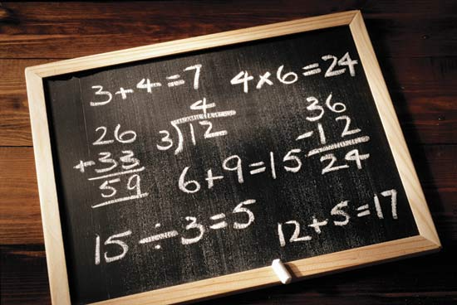
Web 2.0 + Web 3.0
= Web 5.0?
The HSFBCY + CIHR + Microsoft Research
SADI and CardioSHARE Projects
Mark Wilkinson & Bruce McManus
Heart + Lung Institute
iCAPTURE Centre, St. Paul’s Hospital, UBC

Slide 2
Non-logical reasoning and querying over distributed data that doesn’t exist

Slide 3

How do we make data and tools easily available to biologists

Slide 4
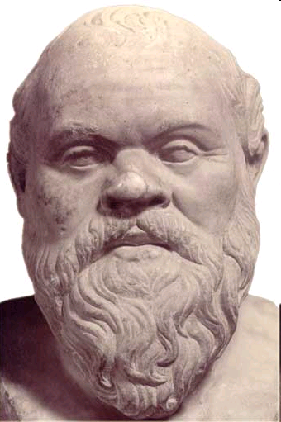
Ontologies!

Slide 5
Problem…

Slide 6
Ontology Spectrum
Because it fulfils XXX
WHY?
Thesauri
“narrower
term”
relation
Frames
(Properties)
Selected
Logical
Constraints
(disjointness,
inverse, …)
Catalog/
ID
Formal
is-a
Informal
is-a
Formal
instance
General
Logical
constraints
Terms/
glossary
Value Restrs.
Because I say so!
Originally from AAAI 1999- Ontologies Panel by Gruninger, Lehmann, McGuinness, Uschold, Welty;
– updated by McGuinness.
Description in: www.ksl.stanford.edu/people/dlm/papers/ontologies-come-of-age-abstract.html

Slide 7
My Definition of Ontology
(for this talk)
Ontologies explicitly define the things that exist in “the world” based on what properties each kind of thing must have

Slide 8
Ontology Spectrum
Thesauri
“narrower
term”
relation
Frames
(Properties)
Selected
Logical
Constraints
(disjointness,
inverse, …)
Catalog/
ID
Formal
is-a
Informal
is-a
Formal
instance
General
Logical
constraints
Terms/
glossary
Value Restrs.

Slide 9
My goal with this talk: the “sweet spot”

Slide 10
COST
Thesauri
“narrower
term”
relation
Frames
(Properties)
Selected
Logical
Constraints
(disjointness,
inverse, …)
Catalog/
ID
Formal
is-a
Informal
is-a
Formal
instance
General
Logical
constraints
Terms/
glossary
Value Restrs.

Slide 11
COMPREHENSIBILITY
Thesauri
“narrower
term”
relation
Frames
(Properties)
Selected
Logical
Constraints
(disjointness,
inverse, …)
Catalog/
ID
Formal
is-a
Informal
is-a
Formal
instance
General
Logical
constraints
Terms/
glossary
Value Restrs.

Slide 12
Likelihood of being “right”
Thesauri
“narrower
term”
relation
Frames
(Properties)
Selected
Logical
Constraints
(disjointness,
inverse, …)
Catalog/
ID
Formal
is-a
Informal
is-a
Formal
instance
General
Logical
constraints
Terms/
glossary
Value Restrs.

Slide 13
Here’s my argument…

Slide 14
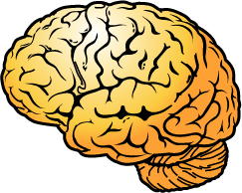
Semantic Web?
An information system where machines can receive information from one source, re-interpret it, and correctly use it for a purpose that the source had not anticipated.

Slide 15
Semantic Web?
If we cannot achieve those two things, then IMO we don’t have a “semantic web”, we only have a distributed (??), linked database… and that isn’t particularly exciting or interesting…

Slide 16


Where is the semantic web?
Thesauri
“narrower
term”
relation
Frames
(Properties)
Selected
Logical
Constraints
(disjointness,
inverse, …)
Catalog/
ID
Formal
is-a
Informal
is-a
Formal
instance
General
Logical
constraints
Terms/
glossary
Value Restrs.
REASON: “Because I say so” is not open to re-interpretation

Slide 17

SADI
Find. Integrate. Analyse.
Founding partner

Slide 18
CardioSHARE
Data + Knowledge for Cardiologists
Founding partner

Slide 19
SADI exposes Web Services as “bog-standard”
Semantic Web data endpoints

Slide 20
DEMO

Slide 21
Recap
what we just saw
A SPARQL database query was entered into
the SHARE environment
The query was passed to SADI and was interpreted based on the properties being asked-about
SADI searched-for, found, and accessed the databases and/or analytical tools required to generate those properties
“The play was performed”

Slide 22
Recap
what we just saw
We asked, and answered a complex
“database query”
WITHOUT A DATABASE!!

Slide 23
CardioSHARE
We construct small, independent OWL classes representing cardiovascular clinical concepts
These classes simplify the construction of complex queries by “encapsulating” data discovery, retrieval, and analysis pipelines into simple, easy-to-understand words and phrases.

Slide 24
CardioSHARE
These Classes are shared on the Web such that third-parties, potentially with different expertise, can utilize the expertise of the person who designed the Class.
Easily share your expertise with others!
Easily utilize the expertise of others!

Slide 25
CardioSHARE
We are not building massive ontologies!
Publish small, independent single-Class definitions
Cheap
Scalable
Flexible
Don’t try to describe all of biology!

Slide 26
DEMO #2

Slide 27
Recap
SADI interprets queries
(SPARQL + OWL Class Definitions)
Determine which properties are available, and which need to be discovered/generated
Discovery of services via on-the-fly “classification” of local data with small OWL Classes representing service interfaces

Slide 28
Recap
CardioSHARE encapsulates workflows as
OWL Classes (an ontology is a query)
Ontologies consist of one class
Low-cost, high accuracy

Slide 29
What we achieve
Re-interpretation :
The SADI data-store simply collects properties, and matches them up with OWL Classes in a SPARWL query and/or from individual service provider’s
WS interface

Slide 30
What we achieve
Novel re-use:
Because we don’t pre-classify, there is no way for the provider to dictate how their data should be used. They simply add their properties into the “cloud” and those properties are used in whatever way is appropriate for me.

Slide 31
What we achieve
Data remains distributed – no warehouse!
Data is not “exposed” as a SPARQL endpoint → greater provider-control over computational resources
Yet data appears to be a SPARQL endpoint… no modification of SPARQL or reasoner required.

Slide 32











Fin
Credits
Edward Kawas and ~40 others (Moby)
Benjamin VanderValk (SADI & SHARE)
Luke McCarthy (SADI & SHARE)
Soroush Samadian (CardioSHARE)
Maria Markov & Veronika Grandl
(CardioSHARE “dumb” data model)
Microsoft Research
O | B | F

