Slide 1
“How to build a better Wikipedia”:
Ubiquitous Infrastructure for Deep Accountability
Robert E. McGrath
December 8, 2008

Slide 2
Origin
An earlier paper discussing NCSA’s cyberenvironments for collaboration was rejected
Criticized by reviewers
  Wikipedia is “nearly perfect” (!?), why do we need all this cyberinfrastructure?
  Whatever you do, it must be “simple” like a wiki
  “Come back when you have implemented something”
This led me to take Wikipedia as a thought experiment: how would I build a better Wikipedia?
  ...and how might NCSA technology and cyberinfrastructure might be deployed

Slide 3
Main Points
NCSA and others are developing important new technology
  See other presentations and colleagues from NCSA for more details
  There is a gap between de facto practice (wikis, blogs, rss) and “formal” Cyberinfrastructure (Grid, etc.)
    Cyberinfastructure is necessary but not sufficient
    Web 2.0 has significant missing features, in particular around “accountability”—who says so, what is the support, etc.
Wikipedia as an instructive case: what could be improved, and how?
  Especially, for science or other ‘serious’ collaborations

Slide 4
“A Better Wikipedia?”
Critiques of wikipedia
  A single snapshot can only be a shallow treatment
  Discussion, knowledge, data, etc. “outside” wikipedia is not easily visible, closely associated, nor part of the provenance
  A single snapshot can be only one view, ideal for only some uses—alternative “skins” are needed
Key Improvements
  Broader and deeper account of the knowledge
  Drilling down in the article leads to representations of the history, sources, and processes underlying the claims, including data and software used, citations, and accounts of who did what

Slide 5
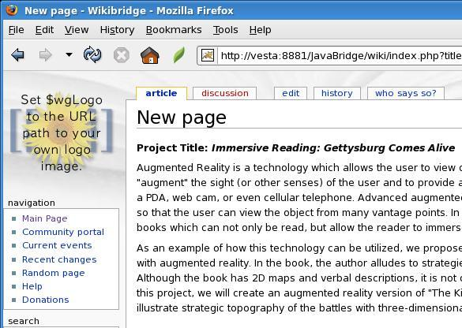
Basic Vision: a “Who says so?” button

Slide 6
Where We Stand
(+) We can collect data to solve these problems
  Can collect provenance, annotations, serialized workflows, etc. in RDF
  Can query and reason across many sources
    This enables combining information about wiki discussions, computations, datasets, off-line resources, etc.
  See NCSA Tupelo, Tupelo Provenance API, etc.
(-) Not easy to retrieve and understand
  E.g., thumbnail display to show ‘who says so’, or ‘what is the supporting evidence’
More than just thought but less than a demo: a partial instrumentation of Mediawiki— “a better wikipedia?”

Slide 7
Thanks
This material is based upon work supported by the National Science Foundation (NSF) under Award No. BES-0414259, BES-0533513, and SCI-0525308 and the Office of Naval Research (ONR) under award No. N00014-04-1-0437. Any opinions, findings, and conclusions or recommendations expressed in this publication are those of the author(s) and do not necessarily reflect the views of NSF and ONR.
Also, thanks to the Institute for Advanced Computing Applications and Technologies (IACAT) and the National Center for Supercomputing Applications (NCSA) for supporting related work.

Slide 8
NCSA Cyberenvironment and Technologies
Main Web Site: http://cet.ncsa.uiuc.edu/cet/
Publications and Presentations: http://cet.ncsa.uiuc.edu/cet/publications.html

