Slide 1

Information as a Service
Christian Liensberger
Program Manager
cliens@microsoft.com

Slide 2




What is “Dallas”?
I need Data!
Different formats
Flat file / Relational / Hierarchical
Different billing
Credit card / Invoice / Free
Different access methods
FTP / DVD / Database / Web service
Semantics
Discovery

Slide 3

What is “Dallas”?
I need Data!
Marketplace
SharePoint
Excel
SQL Server
Dynamics
Custom Apps
Standard Data Access (OData)
Services for
Content Providers
Billing
Account Management

Slide 4
What is “Dallas”?
  Discover, acquire, and consume structured and blob datasets
  to power any application – on any platform and any screen size.
  Easy to consume secure APIs for content. Integrations with Office, SQL, Dynamics planned for instant discovery and mash-up of data for the information worker.
  Information Discovery
  Partner driven ecosystem and global reach to deliver data
  and functionality to developers and information workers.
  Set your price, terms, and use our cloud to deliver web services and data to the world!
  Brokerage
  Business
  Single click analysis to augment private data with premium commercial and public domain data - on premises or in the cloud.
  Discover, create, buy and sell analytics and reports on top of Dallas content…
  Analytics and Reporting
  Built completely on the Windows Azure platform

Slide 5
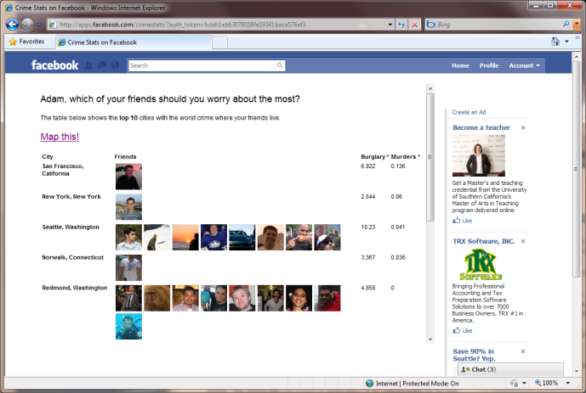
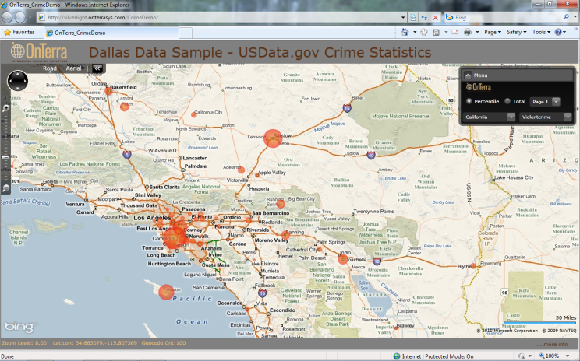
Crime from two perspectives - Demo
http://apps.facebook.com/crimestats

Slide 6
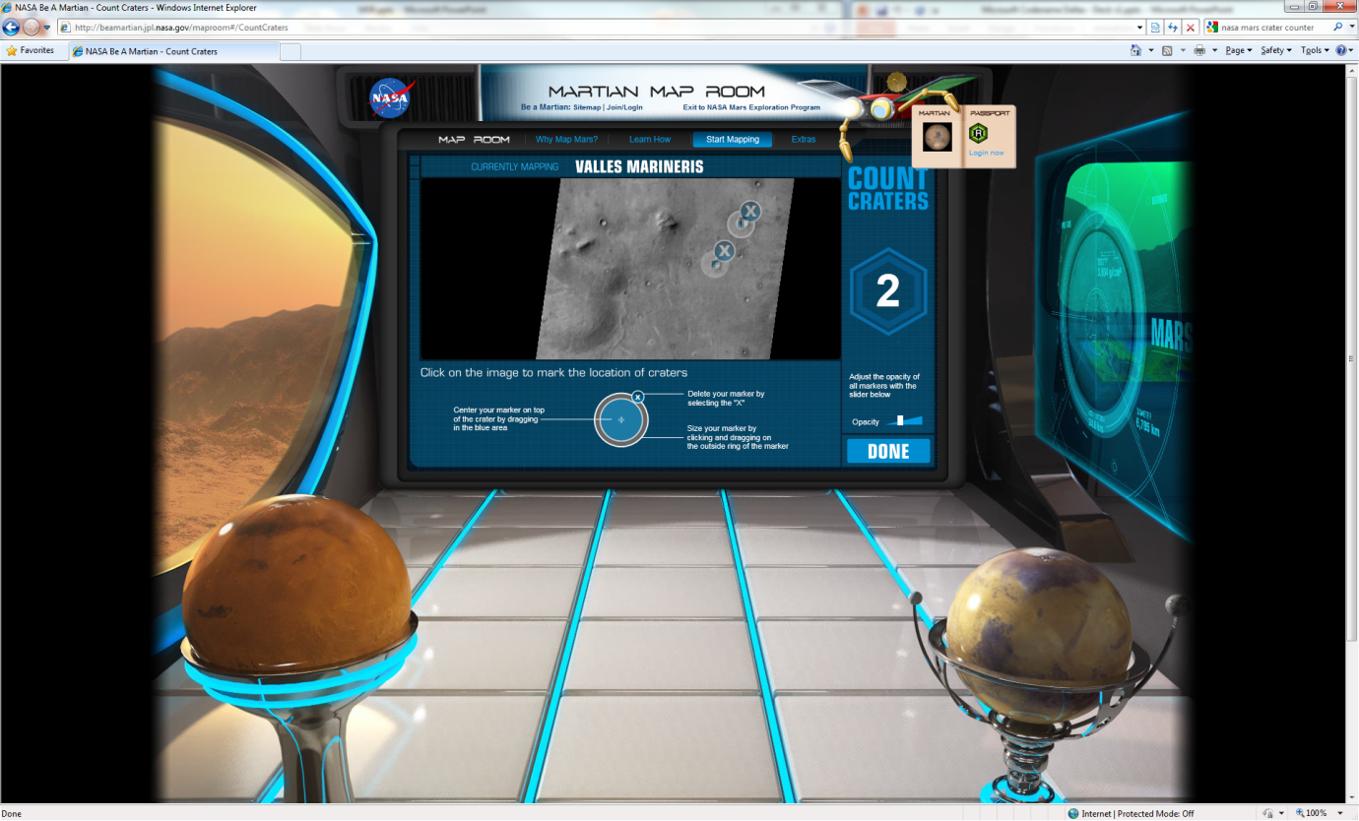
NASA crater counter - Demo
http://beamartian.jpl.nasa.gov/

Slide 7
How can “Dallas” help me?
Developers
Trial subscriptions allow you to investigate content and develop applications without paying data royalties
Simple transaction and subscription models allow pay as you grow access to multi-million dollar datasets
Consistent REST based APIs across all datasets facilitate development on any platform
Visually build and explore APIs, preview results
C# proxy classes
Information Workers
Integration with PowerPivot to easily work with the data in Microsoft Excel
Simple, predictable licensing models for acquiring content
Coming soon: ability to consume data from SQL Server, SQL Azure Database, and other Microsoft Office assets

Slide 8
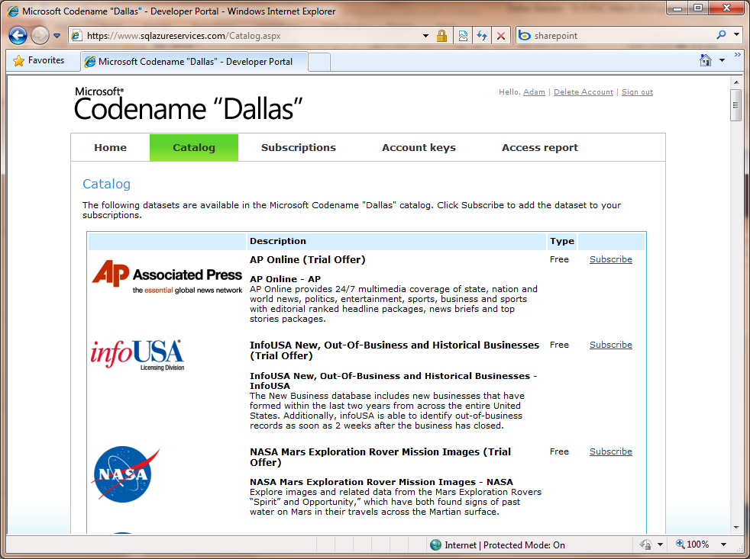
Marketplace
Featured datasets
Sample data visualizations
Public domain data

Slide 9
Marketplace Pricing
Subscriptions
Monthly term
Unlimited usage for the dataset for one user
Transaction Bundles
$X for Y transactions
Auto-refill option
Auto-renewing
Allows caching of data and offline access
Transactions expire after 1 month
Free
Trial

Slide 10
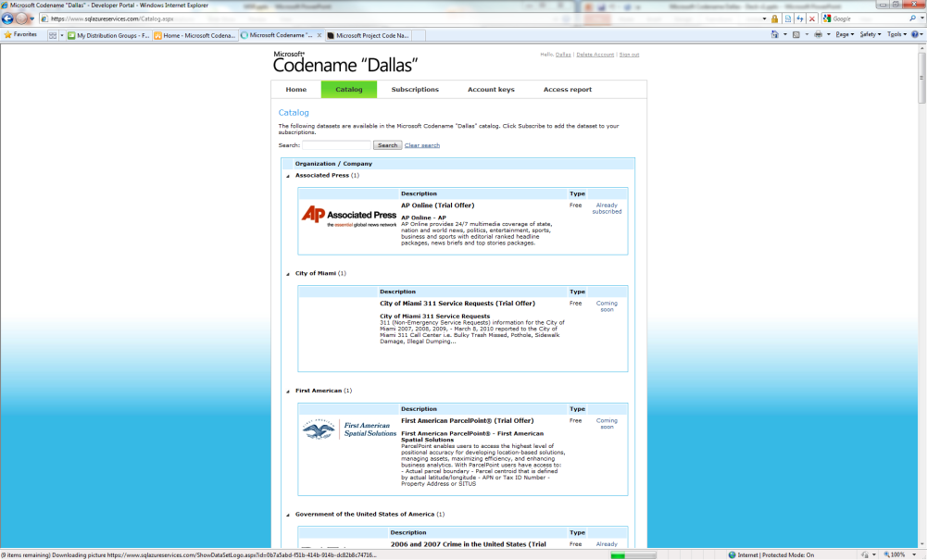
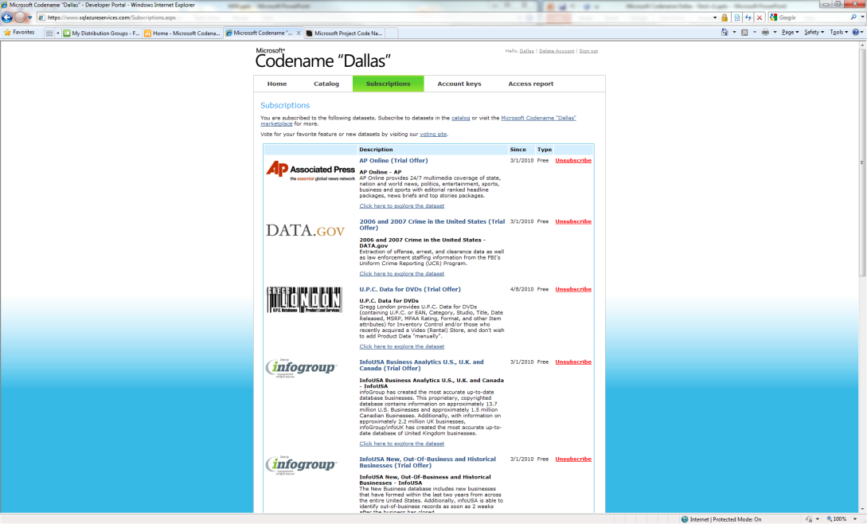
User portal - Demo

Slide 11
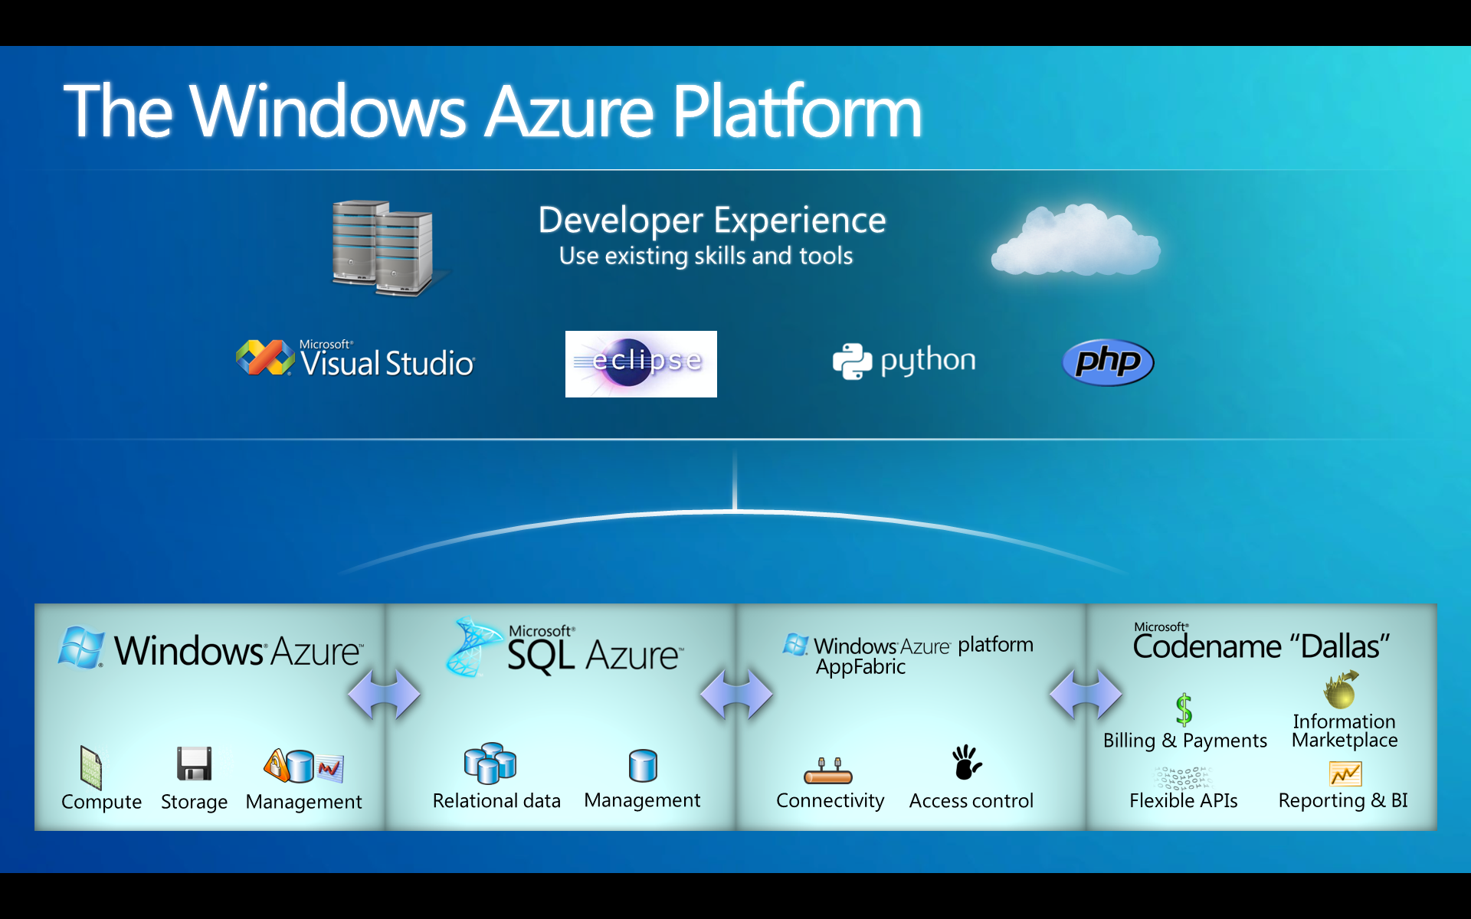
The Windows Azure platform

Slide 12
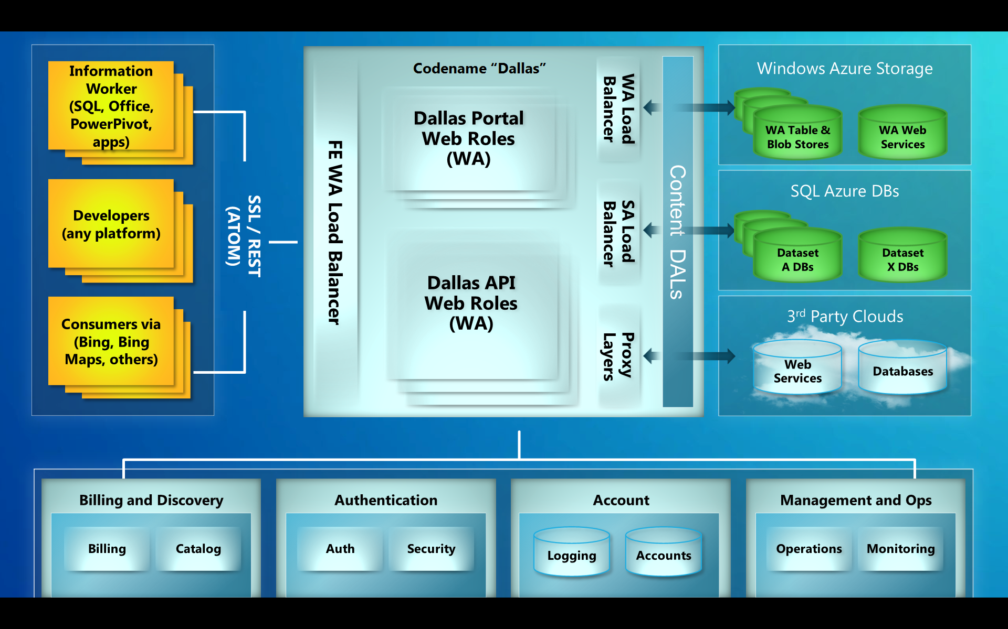
“Dallas” Architecture

Slide 13
“Dallas” and OData
Open Data Protocol (www.odata.org)
  Expose data source to the web
  Released under the Microsoft Open Specification Promise (OSP)
REST based query language
  Functionality like SQL
Results are returned as Atom Pub
Client libraries for .NET, PHP, JAVA, Objective C (iPhone)
  Build-in support in Visual Studio (Add service reference)
  LINQ support

Slide 14
“Dallas” and OData
Payload is OData
Queries are executed as fixed functions
  Simple REST head
  C# classes that allow queries with 2 lines of code
  Flexible queries coming soon…

Slide 15
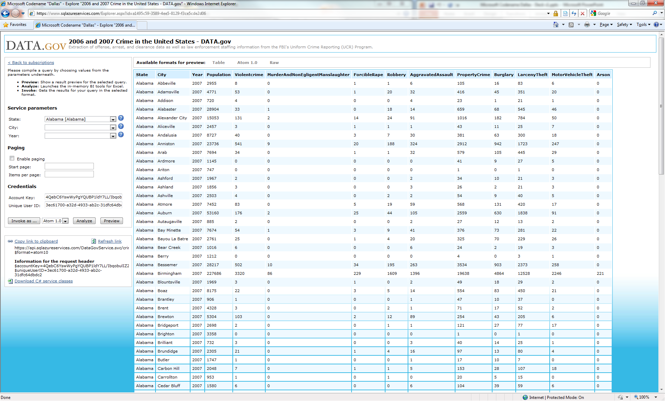
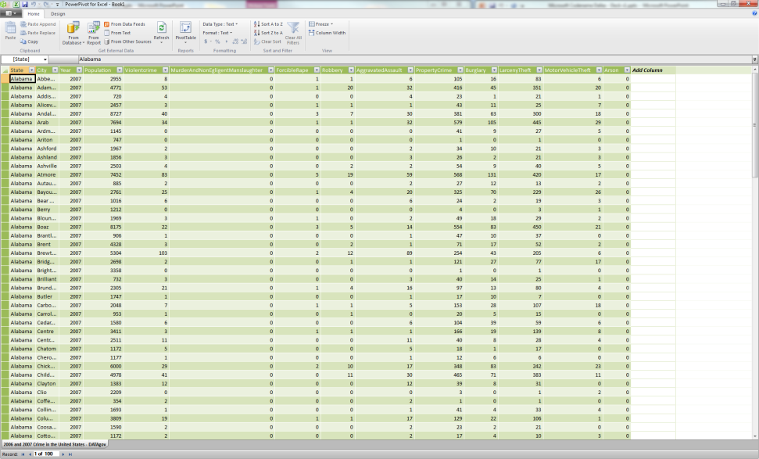
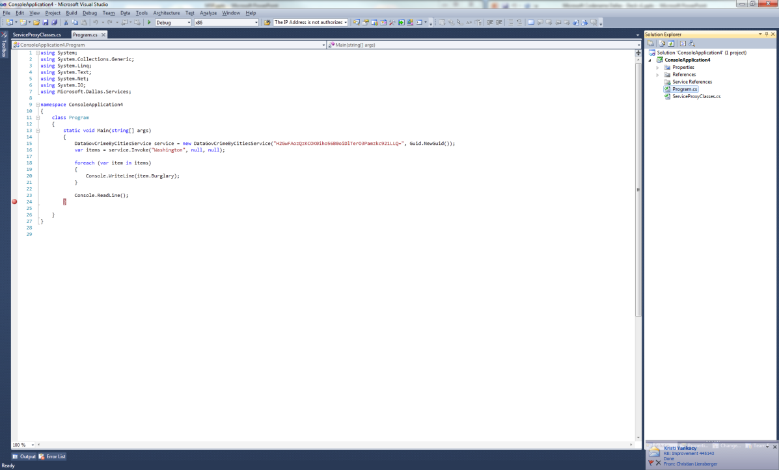
Consuming “Dallas”- Demo

Slide 16
“Dallas” consumption scenarios
Dataset agnostic vs. specific datasets
Semantic tagging allows easy association hints without solving world hunger (aka schema unification)
  e.g. Latitude, Longitude, Age, Year, etc.
Whose “Dallas” account?
  App developer or user

Slide 17
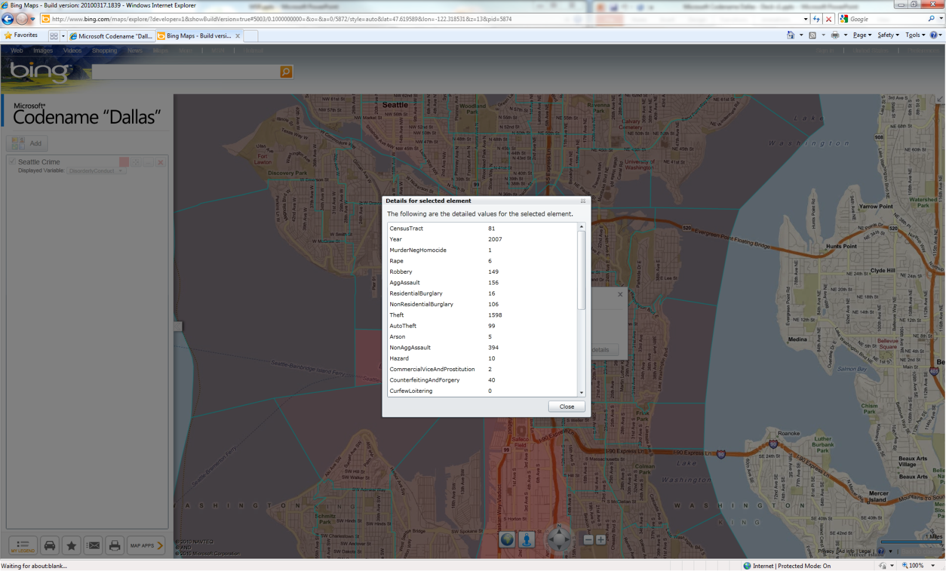
Bing Maps - Demo

Slide 18
Content Providers
Content Partner Value
  Easy publication and on-boarding process regardless of blob data, structured data, or dynamic web services
  Expose your content to Microsoft’s global developer and information worker community
  Scalable Microsoft cloud computing platform handles storage, delivery, billing, and reporting
  Content discovery and integration inside Microsoft Office and SQL Server
  Developer tooling on the Microsoft platform to ease Visual Studio and .NET development
  Finally, tap into Microsoft sales machine!

Slide 19
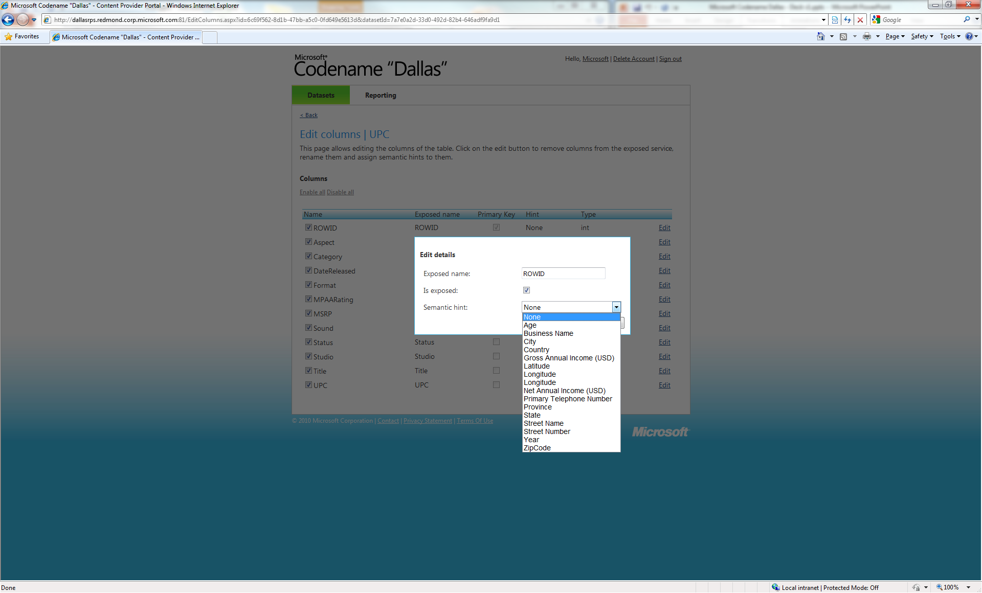
Publishing experience - Demo

Slide 20
Requirements
All Content:
  Must have distribution and resell rights
  Must make data available for 12 months to not break ISVs and IWs
  Must be able to handle query load
    Windows Azure platform a significant value –add for auto scale!
  Must sign contract for uptime, load balancing, non-breaking changes, payload format
Commercial Content
  Must be in top 5 of industry by revenue or requested by ISV / IW community or requested by Dallas customers / partners
Public Domain Content
  Must have rights to distribute openly for commercial and public domain use
  Must be the source of authoritative, curated content

Slide 21
Business Model Overview
Content Providers – own your business!
  Define free trials
  Control data consumption
  Name your price for transactions and subscriptions
  Name your terms (our EULA or yours?)
Microsoft acts as the merchant of record and broker to millions of IWs and developers
  Microsoft will apply a small % to cover BW and billing surcharges

Slide 22
Revenue and Usage Reporting
Revenue Dashboard
  Track content consumption and volume to determine what offers are working
  Regular payments from Microsoft as your reports, data, and web services are consumed
  Ability to report abuse on data and terms of use
Create new offers based on market demand to grow and extend your reach
  Example: Create offers to attract “the long tail” if you need a new channel

Slide 23
Q&A
Call To Action!
  Developers: CTP2 is now available – use it and provide feedback!
    Portal located at: www.sqlazureservices.com
  NASA developer contest running
  Content Providers: DallasBD@Microsoft.com
Questions?
  http://www.Microsoft.com/Dallas
  http://blogs.msdn.com/Dallas

