Slide 1
Pan-STARRS: Learning to Ride the Data Tsunami
María A. Nieto-Santisteban¹,
Yogesh Simmhan³, Roger Barga³, Tamas Budávari¹, László Dobos¹, Nolan Li¹, Jim Heasley², Conrad Holmberg², Michael Shipway¹, Alexander Szalay¹, Ani Thakar¹, Michael Thomassy⁴, Jan vandenBerg¹, Catharine van Ingen³ , Suzanne Werner¹, Richard Wilton¹, Alainna Wonders¹
1. Johns Hopkins University
2. University of Hawaii
3. Microsoft Research
4. Microsoft SQL Server CAT
Microsoft eScience Workshop,
December 8th 2008, Indianapolis, IN, U.S.A.

Slide 2
Agenda
GrayWulf
Software Architecture
Pan-STARRS
Riding the Data Tsunami

Slide 3
Motivation
Nature of Scientific Computing is changing
CPU cycles/s ➔ IO/s
Data storage and datasets grow faster than Moore’s Law
Computation must be moved to the data, as the data cannot be moved to the computation
Scientific community is in need of scalable solutions for data intensive computing
Notes:
Large data sets are here, solutions are not
Exponential data growth
> data will be never co-located
Sociological trends:
Data collection in ever larger collaborations (VO)
Analysis decoupled, off archived data by smaller groups
Even HPC projects choking on IO
Comprehensive array support is needed

Slide 4
Requirements
CHEAP!
Notes:
Scientists are “cheap”
They will not pay for license, rather write it themselves
Giving them SW is not enough, need recipe for solutions

Slide 5
Requirements
CHEAP!
Scalability
Ability to grow & evolve over time
Performance
Fault tolerance and recovery
Easy to operate
Easy to use
Easy to share
Notes:
Scientists are “cheap”
They will not pay for license, rather write it themselves
Giving them SW is not enough, need recipe for solutions

Slide 6
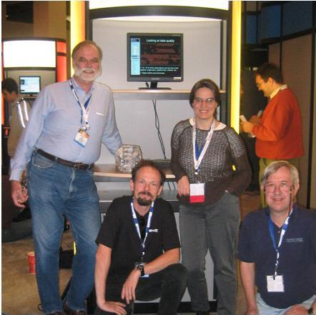
GrayWulf
(Gray) Database & HPC technologies (Wulf) on commodity hardware
SDSS DR1
1TB!
Jim, Peter, Alex, and Maria
Super Computing 2003

Slide 7
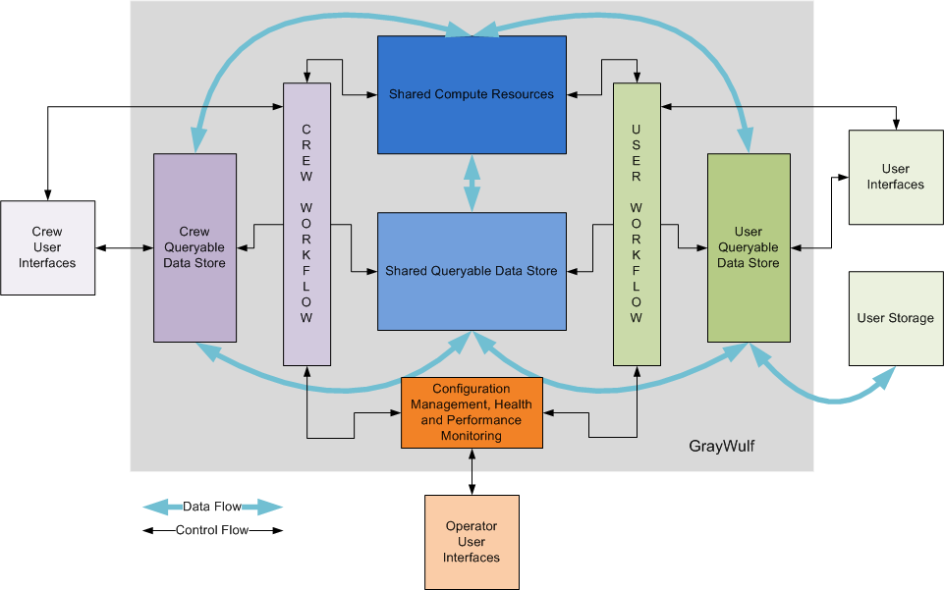
Architecture

Slide 8
Pan-STARRS Panoramic Survey Telescope and Rapid Response System
Primary goal:
Discover and characterize Earth-approaching objects, both steroids and comets that might pose a danger to our planet
Collected data is rich in scientific value and will be used for Solar System and Cosmology studies
M51, The Whirlpool Galaxy, as imaged by the central 4 OTAs in the PS1 camera
Comet Holmes, GPC1 camera in the PS1 telescope
PS1 telescope Haleakala (Maui)
Notes:
Pan-STARRS
4 telescopes placed in Mauna Kea observing the same region of the sky simultaneously
PS1: Prototype composed of a single telescope placed in Haleakala (Maui)

Slide 9
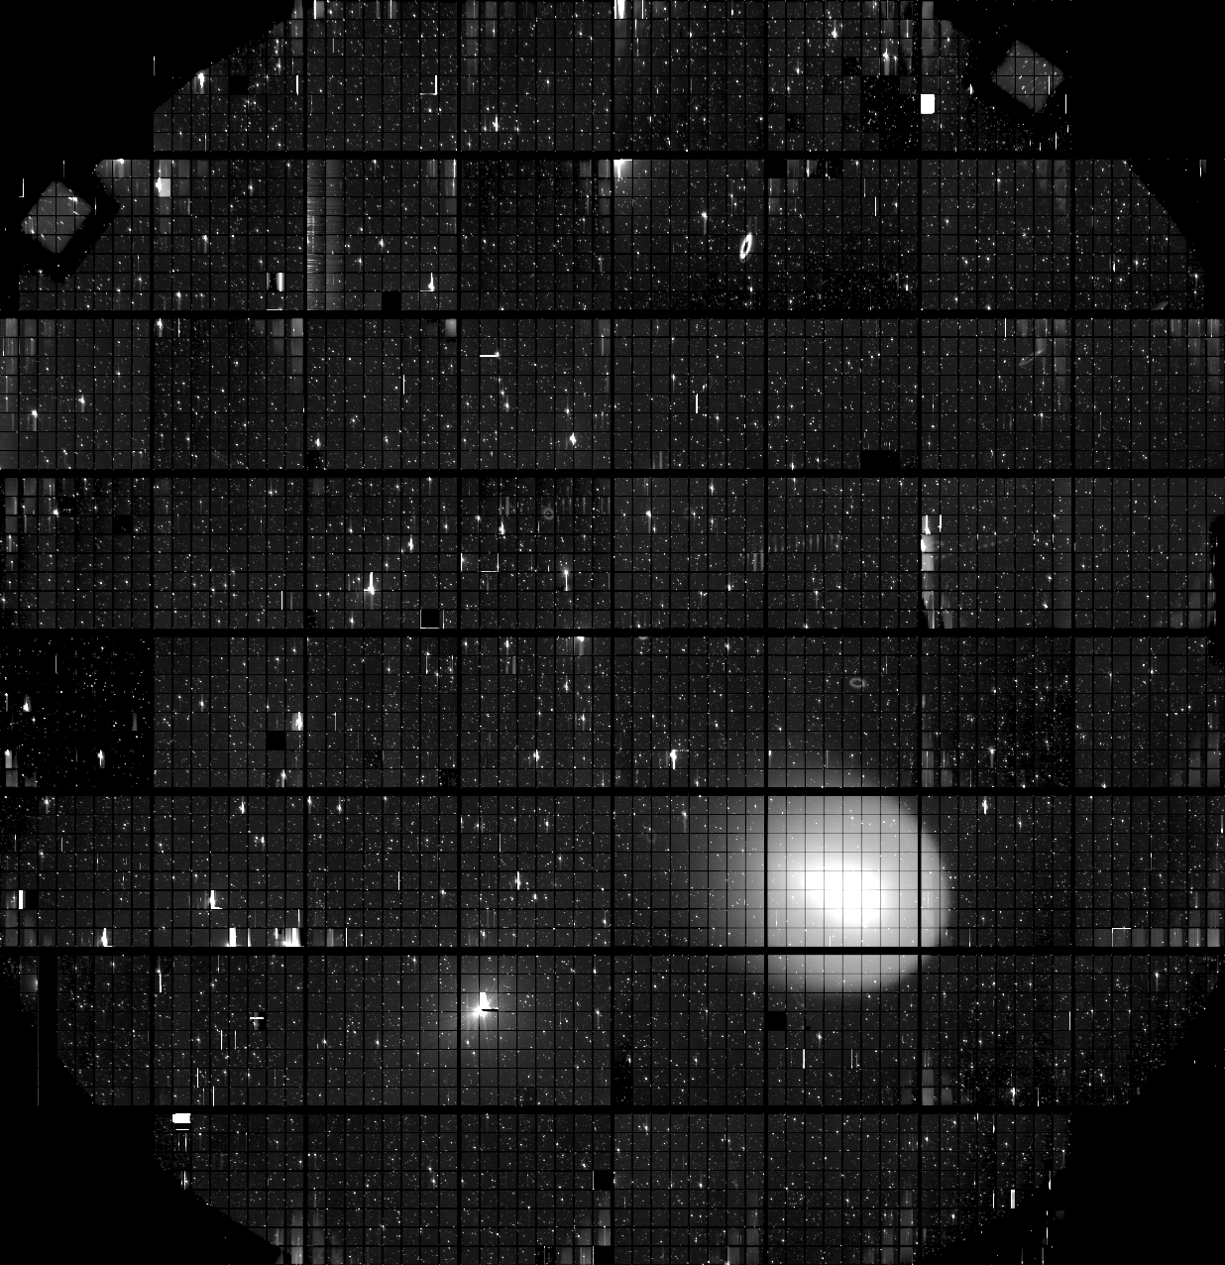
Pan-STARRS PS1
Digital map of the sky in 5 colors
CCD mosaic = 1.4 gigapixels
2/3 of the sky, 3 times per month
Starts at end of 2008, and will run for 3.5 yrs
Data Volume
>1 PB / year of raw image data (2.5 TB/night)
5.5 e9 celestial objects
350 e9 detections
~100 TB SQL Server database built at JHU (PSPS-ODM)
3 copies for performance, fault tolerance, and recovery
300 TB, the largest astronomy db in the world!
Operated by the Pan-STARRS Science Consortium (PS1SC)
Hawaii + JHU + Harvard/CfA + Edinburgh/Durham/Belfast +
Max Planck Society
Raw image of Comet Holmes taken with the GPC1 camera early in the commissioning of the PS1 telescope
Notes:
Next Generation Sky Survey (3/4 of sky)
CCD – Charge Coupled Devices
Captured 50%-90% of photons
Issue is resolution & size
2K X 4K today, bigger size is an issue
Created mosaic of many smaller CCDs in contiguous layour
Biggest = Sloan
Pan-STARRS is 4X time faster and 4 filters
Mosaic of many CCDs to make 1.4gigapixel camera, 2 bytes/pixel
-- (PSPS-ODM) Published Science Product Subsystem – Object Data Manager

Slide 10
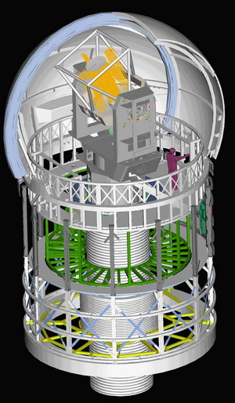
Pan-STARRS PS4
PS1 is phase 1
PS4: 4 identical telescopes in year 2012
4 PB / year in image data
400 TB / year into a database
PS4 Enclosure concept
Notes:
PS1 is step 1 to validate approach before PS4
The PS4 enclosure concept

Slide 11
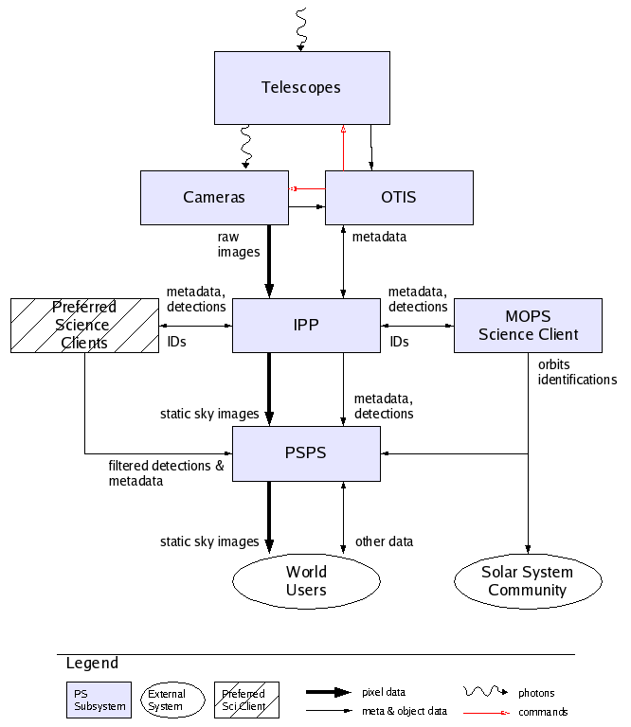
Pan-STARRS System Architecture
Human
WBI
Other SW Clients
DRL
ODM
SSDM
Other DM
IPP
MOPS
Notes:
We are the Object Data Manager within the Published Science Product Subsystem
Pan-STARRS saves the world, ODM answers to The Ultimate Question ☺
Part of the PS1 PSPS mission is to better understand how the full set of requirements might be achieved in the future from hardware design to responding to user queries.
PS1 PSPS will provide access to the PS1 data to members of the PS1 Science Consortium

Slide 12
SDSS/SkyServer
Pioneer in very large data publishing
470 million web hits in 6 years
930,000 distinct users vs 15,000 astronomers
Delivered 50,000 hours of lectures to high schools
Delivered >100B rows of data
Everything is a power law
Over 2,000 ‘power users’, more than 2000 refereed papers
Notes:
SDSS predecessor of Pan-STARRS.

Slide 13
Similarities with SDSS
Strong requirements on Spatial queries
HTM, Zones, Algebra on regions in SQL Server
The “20 queries” design methodology
Queries from PAN-STARSS scientists – the 20 queries sample queries
Two objectives
Find potential holes/issues in schema
Serve as test queries for integrity and performance
Query Manager, PS1 Data Retrieval Layer of the database, MyDB
Astronomers and Scientists get their own Sandbox
Data is available over the internet
Provides a place to share

Slide 14
Differences with SDSS
Time dimension
Most regions will be observed multiple times (~60)
Must store and provide access to temporal history for variability studies
Goes deeper and fainter: contains information from co-added images
Loading process
Demanding and sophisticated
Higher data volume to ingest
Must add ~120 million new detections per day
Must provide updated object information monthly (we plan on weekly)
Database size = 100 TB

Slide 15
Pan-STARRS PS1 - monolothic
Table | Year 1 | Year 2 | Year 3 | Year 3.5
Objects | 2.03 | 2.03 | 2.03 | 2.03
StackDetection | 6.78 | 13.56 | 20.34 | 23.73
StackApFlx | 0.62 | 1.24 | 1.86 | 2.17
StackModelFits | 1.22 | 2.44 | 3.66 | 4.27
P2Detection | 8.02 | 16.03 | 24.05 | 28.06
StackHighSigDelta | 1.76 | 3.51 | 5.27 | 6.15
Other Tables | 1.78 | 2.07 | 2.37 | 2.52
Indexes (+20%) | 4.44 | 8.18 | 11.20 | 13.78
Total | 26.65 | 49.07 | 71.50 | 82.71
Sizes are in TB

Slide 16
Distributed Architecture
The bigger tables are spatially distributed across servers called Slices
Using slices improves system scalability
Spatial information is embedded in ObjectID
Tables are sliced into ranges of ObjectID, which correspond to broad declination ranges
ObjectID boundaries are selected so that each slice has a similar number of objects
Distributed Partitioned Views “glue” the data together

Slide 17
Design decisions
Objects are distributed across slices
Objects, and metadata tables are duplicated in the slices to provide parallelization of queries, and facilitate recovery
Detections belong into their object’s slice
Orphans belong to the slice where their position would allocate them
Orphans near slices’ boundaries will need special treatment
Objects keep their original object identifier
Even though positional refinement might change their objectID

Slide 18
Pan-STARRS
Workflow Manager (WFM)
Cluster Manager (CSM)
Linked Servers
Perf. Monitor
[Objects_s1]
[Detections_s1]
Meta
P_S1
P_sm
[Objects_sm]
[Detections_sm]
Meta
Objects Detections Meta
PS1
PS1 database
Query Manager (QM)
Legend
Database
Full table [Sliced_table]
Partitioned View
DRL
Web Based Interface (WBI)

Slide 19
Partitioning
Objects and Detections are partitioned by ObjectID
Object partitions in main server correspond to whole slices
S₁
Linked servers
S_{m}
PS1
PS1 database
Query Manager (QM)
Web Based Interface (WBI)

Slide 20
Layered Architecture
Layer 0
Staging servers
Data transformation
Layer 1
Loading/Merger servers
Scrubbing, loading, merging, …
Layer 2
Slice and Head servers
User queries
Layer 3
Admin, Query Manager, and MyDBs servers
Workflows, Cluster management, user databases, …

Slide 21
The Cold, the Hot, and the Warm
IPP
Fits
Staging 1
Fits
Staging 2
Fits
Fits
Fits₁
Fits_{n}
DX
csv
csv
csv
csv
csv
csv
csv
csv
csv
csv
csv
csv
L0
csv
csv
csv
csv
csv
csv
ODM
LM₁
LM₂
LM₃
LM₄
LM₅
LM₆
s
1
s
2
s
3
s
4
s
5
s
6
s
7
s
8
s
9
s
10
s
11
s
12
s
13
s
14
s
15
s
16
L1
S₁
S₂
S₃
S₄
S₅
S₆
S₇
S₈
s
1
s
2
s
3
s
4
s
5
s
6
s
7
s
8
s
9
s
10
s
11
s
12
s
13
s
14
s
15
s
16
s
16
s
3
s
2
s
5
s
4
s
7
s
6
s
9
s
8
s
11
s
10
s
13
s
12
s
15
s
14
s
1
L2

Slide 22
Pan-STARRS Layer 2
H₁
PS1
H₂
PS1
S₁
S₂
S₃
S₄
S₅
S₆
S₇
S₈
s
1
s
2
s
3
s
4
s
5
s
6
s
7
s
8
s
9
s
10
s
11
s
12
s
13
s
14
s
15
s
16
s
16
s
3
s
2
s
5
s
4
s
7
s
6
s
9
s
8
s
11
s
10
s
13
s
12
s
15
s
14
s
1
María Nieto Santisteban, 2008 Microsoft eScience Workshop
22

Slide 23
Pan-STARRS
Object Data Manager Subsystem
System Operation UI
System Health Monitor UI
Query Performance UI
Data Flow
Control Flow
System & Administration Workflows
Orchestrates all cluster changes, such as, data loading, or fault tolerance
Configuration, Health & Performance Monitoring
Cluster deployment and operations
Pan-STARRS Cloud Services for Astronomers
MSR Trident Scientific Workbench
Tools for supporting workflow authoring and execution
Loaded Astronomy Databases
~70TB Transfer/Week
Deployed Astronomy Databases
~70TB Storage/Year
Query Manager
Science queries and MyDB for results
Pan-STARRS
Telescope
Image Processing Pipeline
Extracts objects like stars and galaxies from telescope images
~1TB Input/Week
María Nieto Santisteban, 2008 Microsoft eScience Workshop
23

Slide 24
Conclusion
Pan-STARRS PS1 database will be ~20 times bigger than Sloan Sky Server (SDSS); 10 year project in 10 days
Distributed solution required - the monolithic solution will not work
Highly scalable distributed database system has been designed to take advantage of current SQL Server 2008 capabilities, Windows Workflow Foundation , Windows HPC, and Trident
Moore’s Law & exponential data growth - Petabytes/year by 2010
Need scalable solutions, Move analysis to the data, Spatial and temporal features essential
Same thing happening in all sciences
High energy physics, genomics, cancer research, medical imaging, oceanography, remote sensing, …
Application of Pan-STARRS Pattern – 100+TB common
María Nieto Santisteban, 2008 Microsoft eScience Workshop

